Slide 1
Support Vectors Learning for Vector Field Reconstruction
Marcos Lage, Rener Castro, Fabiano Petronetto, Alex Laier, Geovan Tavares, Thomas Lewiner and Hélio Lopes
Matmidia Labs - PUC-Rio - Brazil

Slide 2
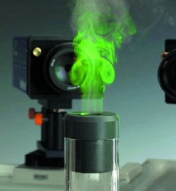

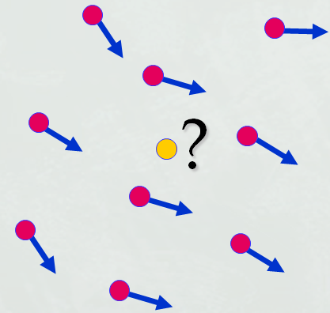
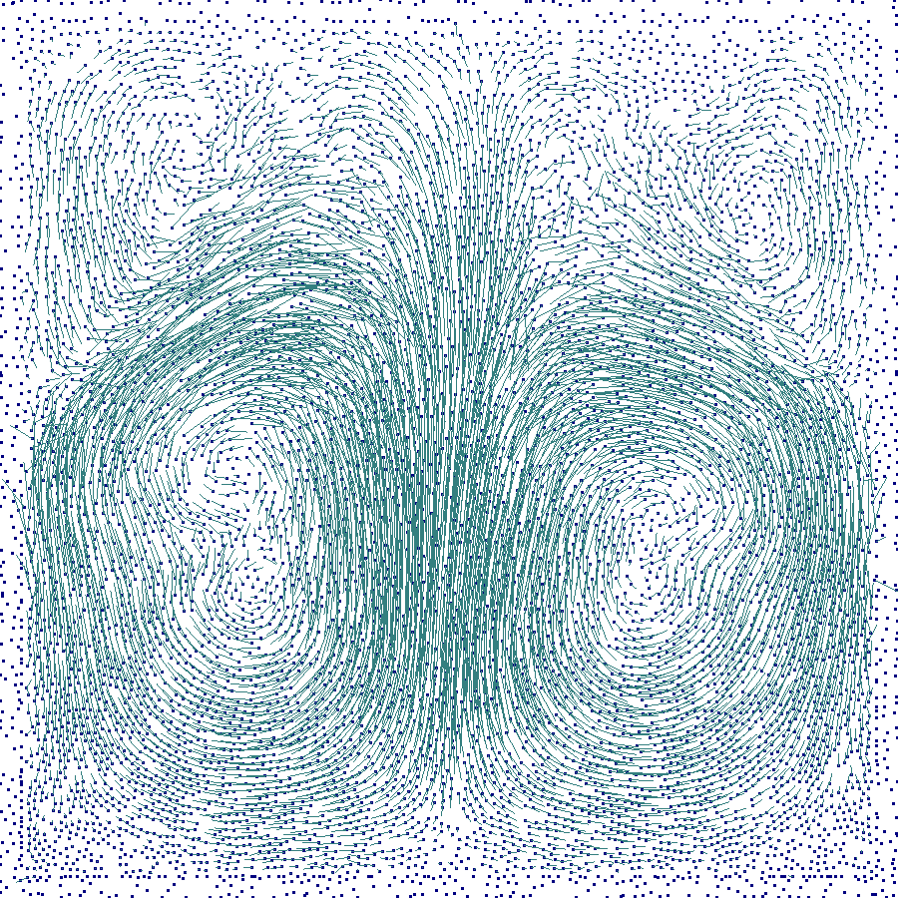
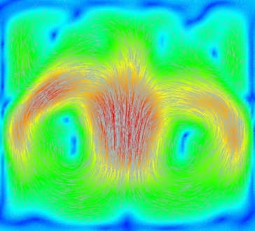
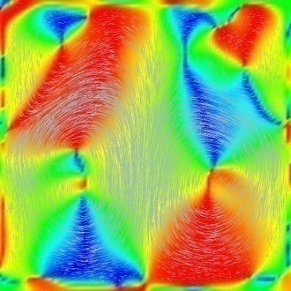
Outline
Motivation
Problem description
Support Vector Regression based approximation
Future Works

Slide 3
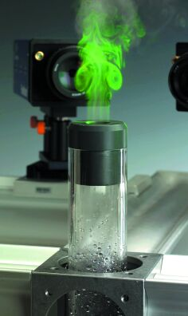
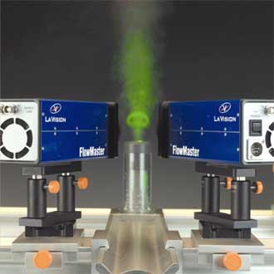
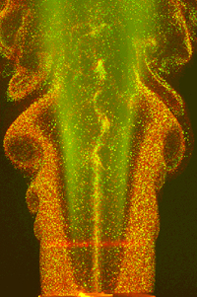
Motivation
Particle Image Velocimetry
(Luiz Fernando A. Azevedo, PUC-Rio)

Slide 4
PIV Examples
3D shear jet flow/ A Few Particles
Image Size: 256 x 256 pixel
Area: 4 x 4 cm
Laser thickness: 2 mm
Number of Particles: 1000
Interval: 0.005 sec
Max. Velocity: 10 pixel/interval
  Okamoto K., Nishio S., Kobayashi T., Saga T., Takehara K., 2000,
  "Evaluation of the 3D-PIV Standard Images (PIV-STD Project)", J. Visualization, 3-2, 115-124.

Slide 5
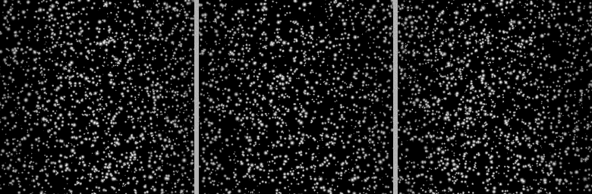
PIV Examples
Transient 3D shear jet flow field from 3 angles with wall refrection
Image Size: 256 x 256 pixel
Area: 4 x 4 cm
Laser thickness: 2 mm
Number of Particles: 1000
Interval: 0.005 sec
Max. Velocity: 10 pixel/interval
  Okamoto K., Nishio S., Kobayashi T., Saga T., Takehara K., 2000,
  "Evaluation of the 3D-PIV Standard Images (PIV-STD Project)", J. Visualization, 3-2, 115-124.

Slide 6
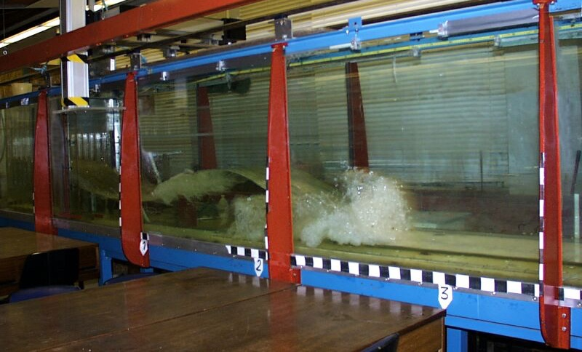
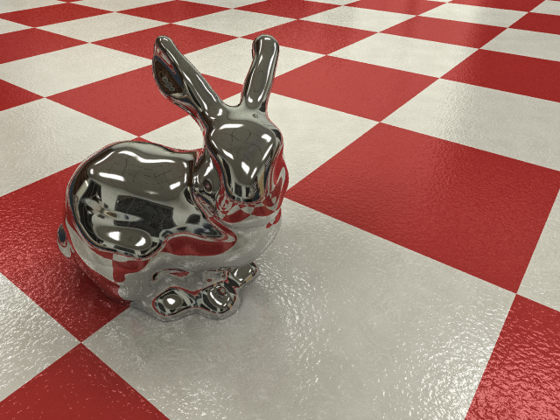
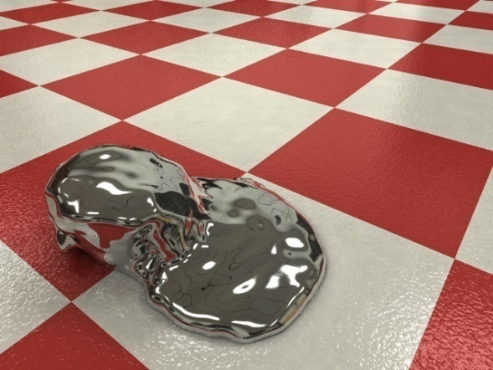
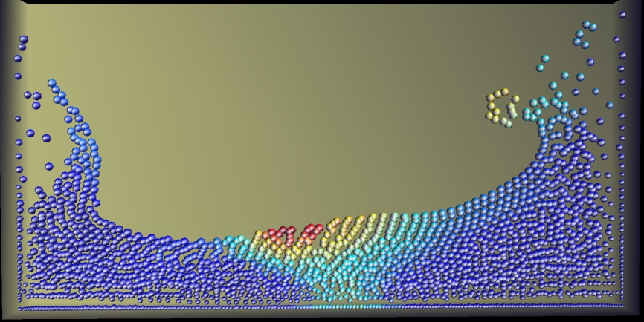
Motivation
Smoothed Particle Hydrodynamics (SPH)
(F. Petronetto, A. Paiva, T. Lewiner, G. Tavares – PUC-Rio – Sibgrapi 2006)

Slide 7
Problem description

Slide 8

Problem description
?

Slide 9
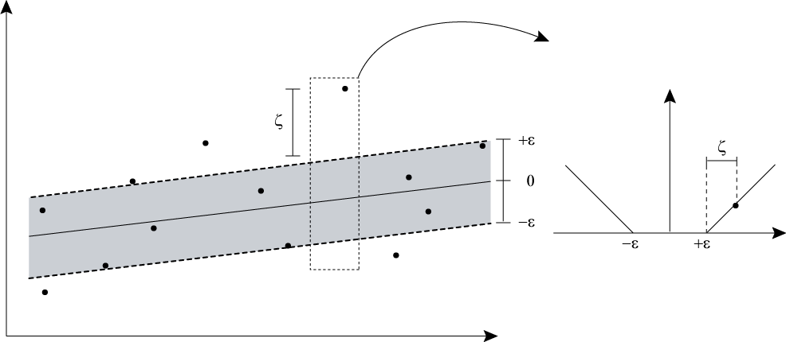
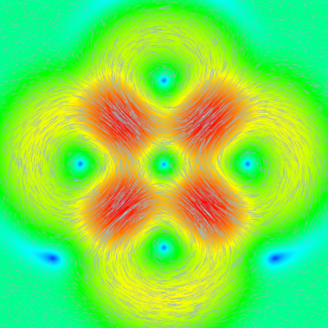
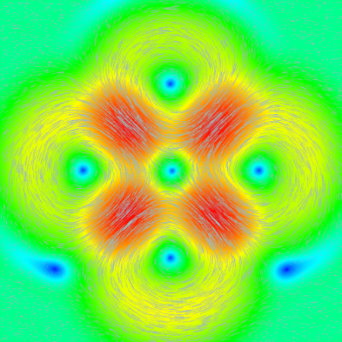
SVR based method
Support Vector Regression brief review
SVR based methods
Results

Slide 10
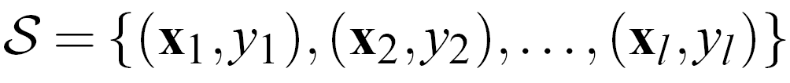



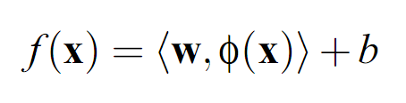

Support Vector Regression (ε-SVR)
Smola A. J., Schölkopf B., A tutorial on support vector regression, 2004, Statistics and Computing 14, 199–222.
Trainning set:
where
and
Mapping to the feature space:
Approximation on the feature space:

Slide 11
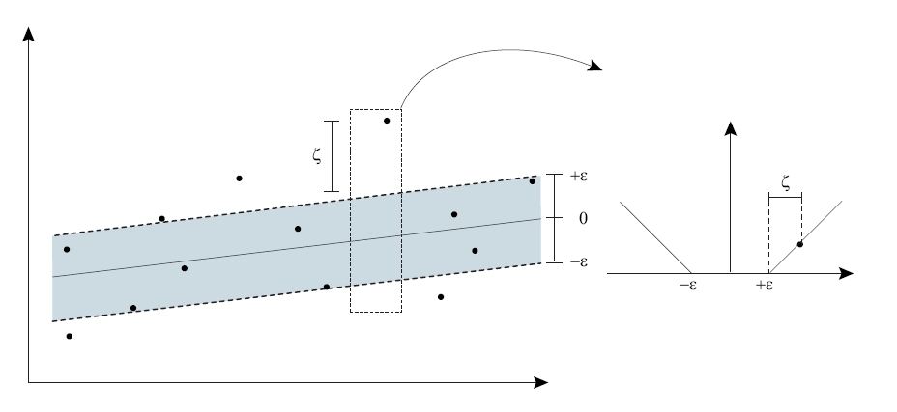
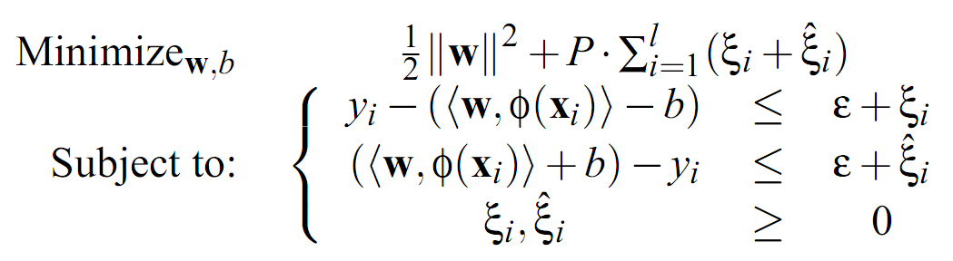
Support Vector Regression (ε-SVR)
Optimization problem:

Slide 12
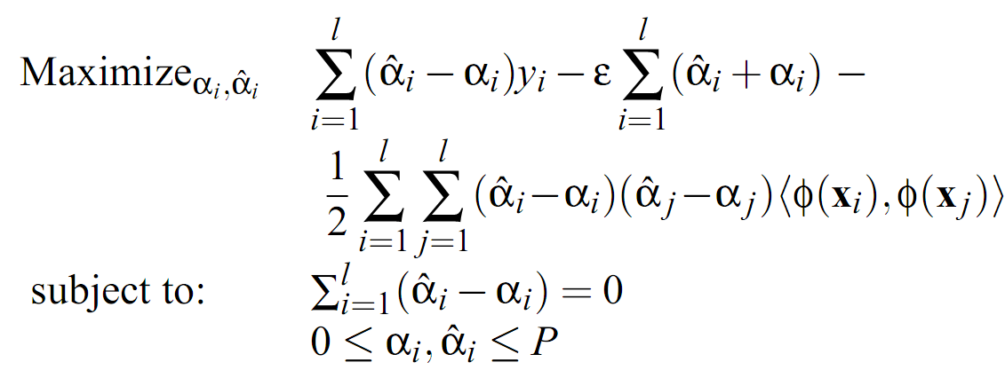
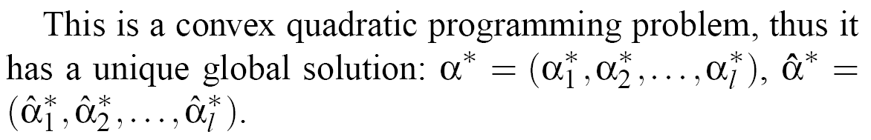
Support Vector Regression (ε-SVR)
Optimization problem on its dual form:

Slide 13
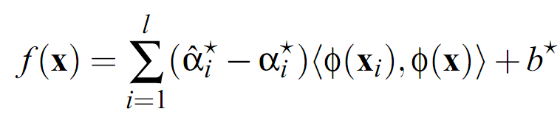
Support Vector Regression (ε-SVR)
Support vectors:
Approximated function:

Slide 14
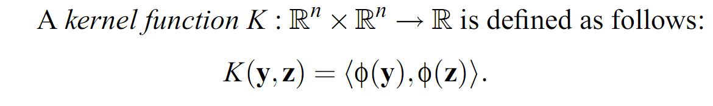


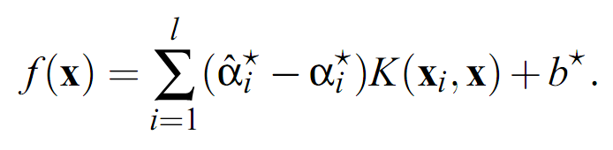
Support Vector Regression (ε-SVR)

Slide 15
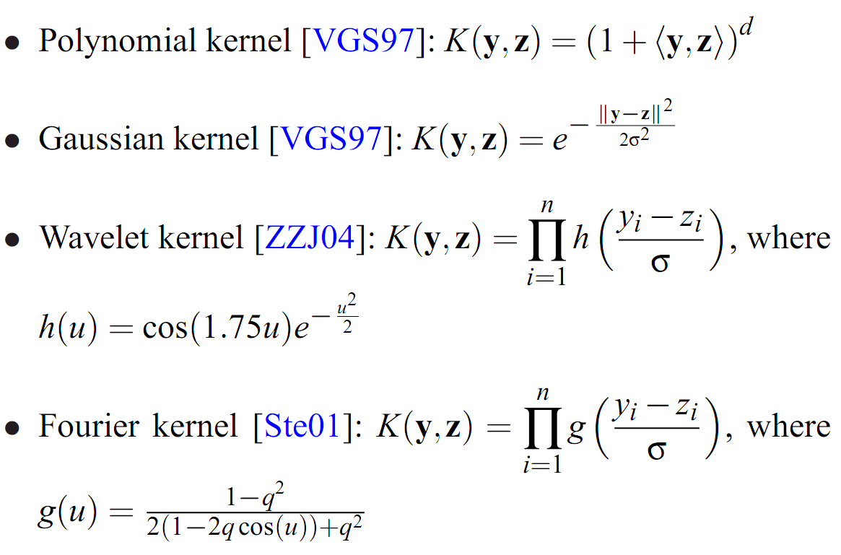
Kernel Functions

Slide 16
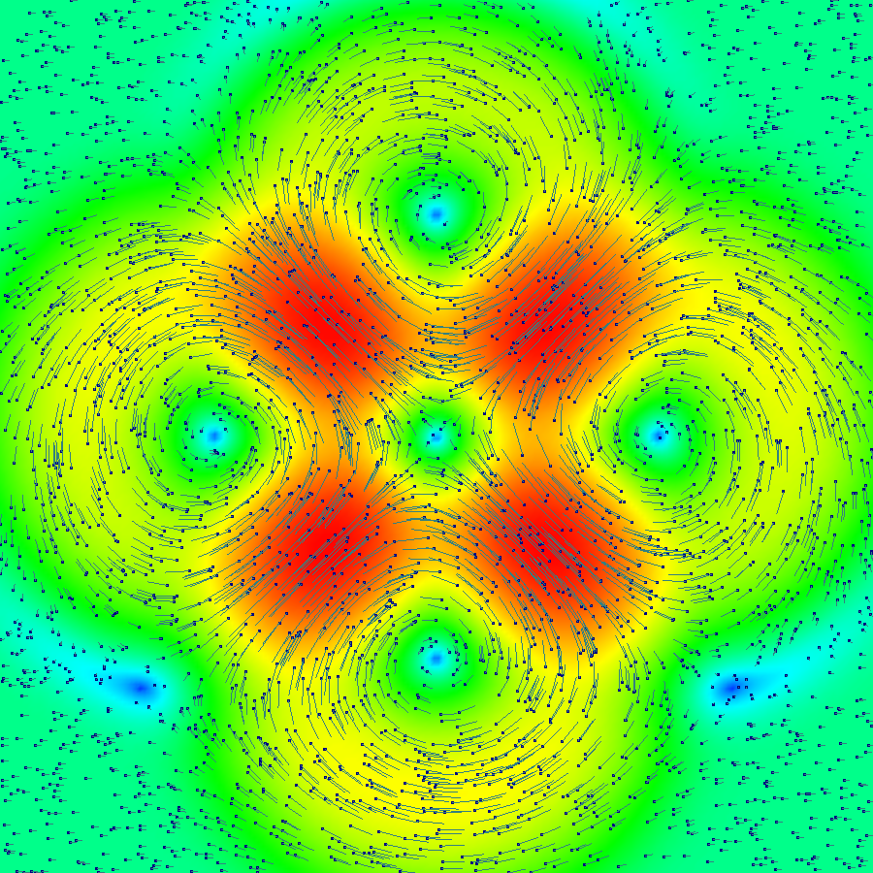
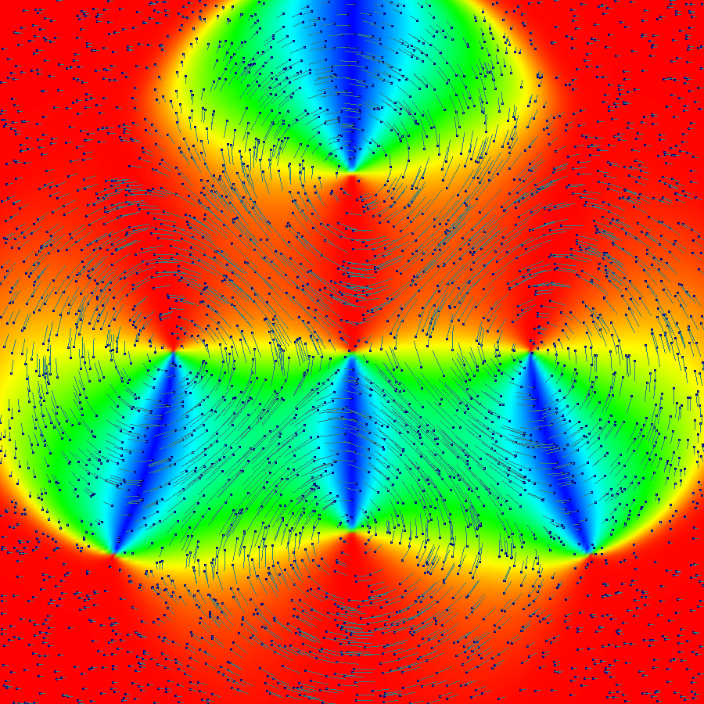
SVR based method
3600 vectors of an synthetic 2D vector field sampled
randomly in the square.

Slide 17
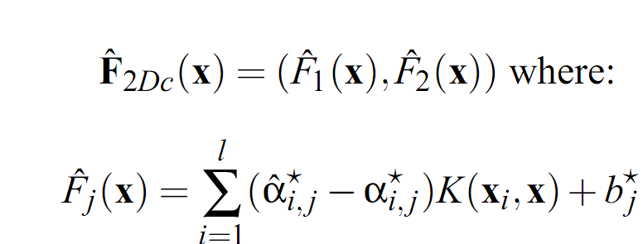
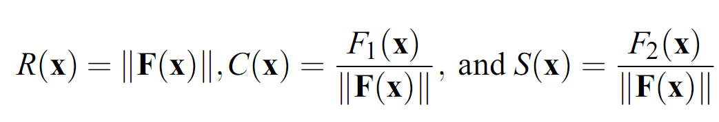
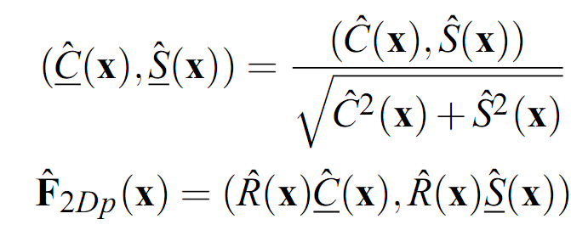
2D SVR based methods
Cartesian
Polar

Slide 18
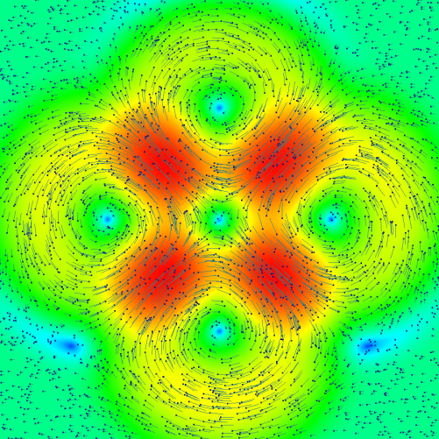


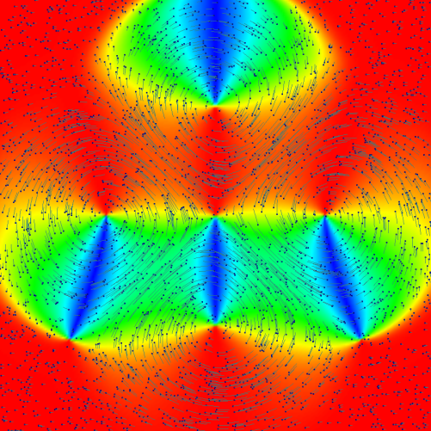
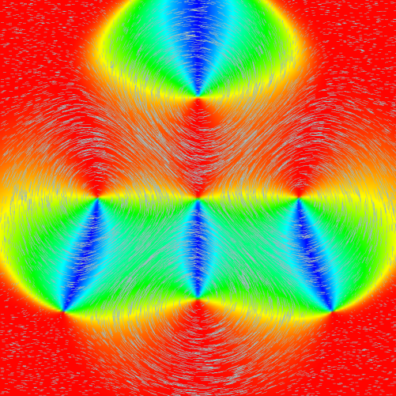
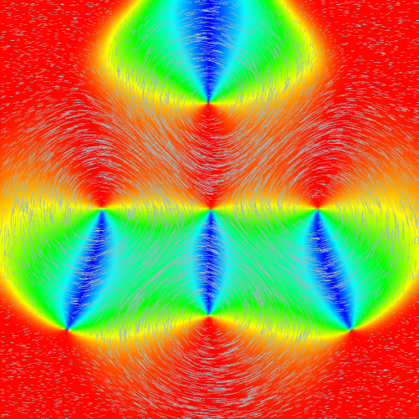
2D SVR based methods
Original
Cartesian
Polar

Slide 19
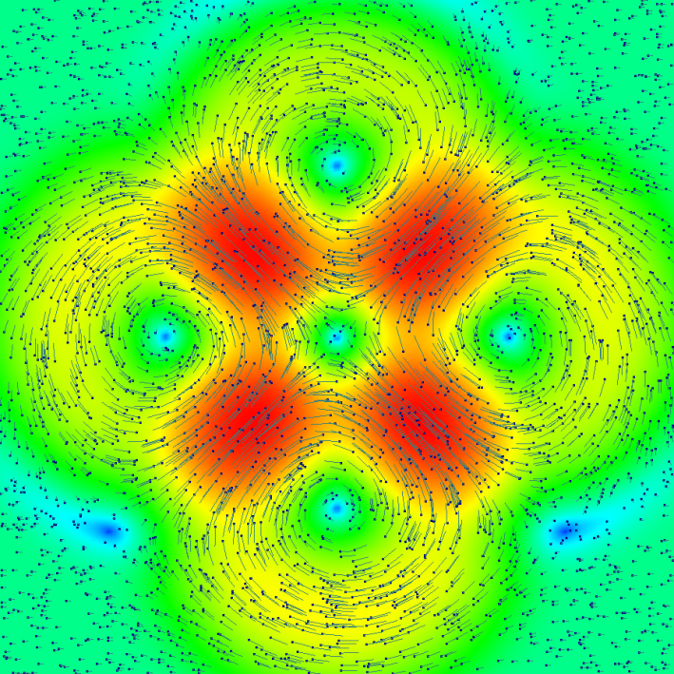
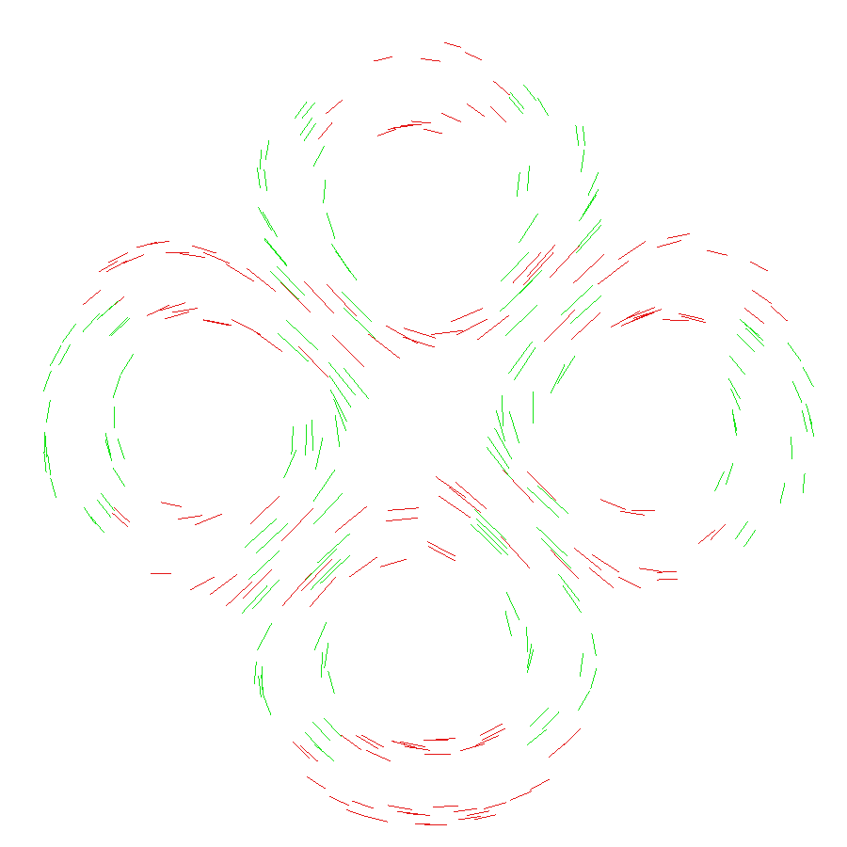

2D SVR based methods
Cartesian support vectors (x in red,y in green)

Slide 20
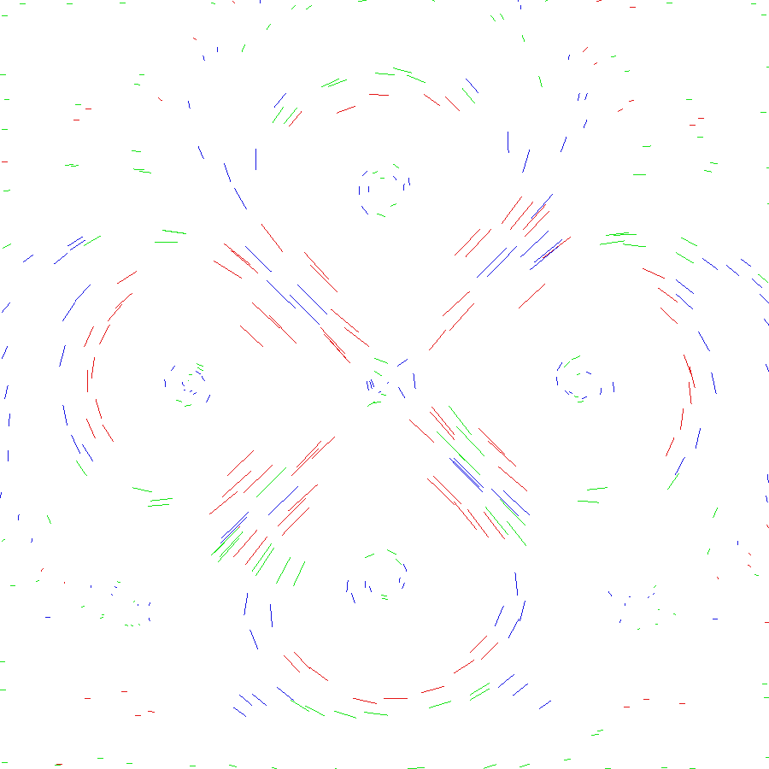
2D SVR based methods
Polar support vectors (R in red, C in green and S in blue)

Slide 21
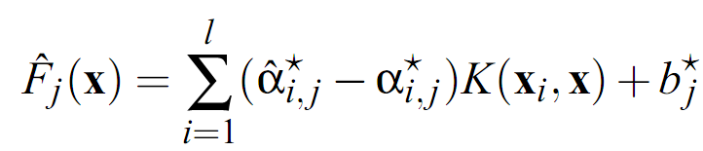

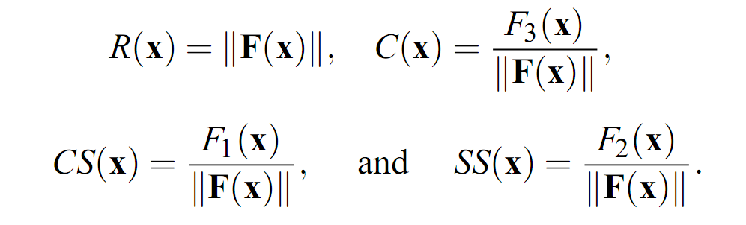
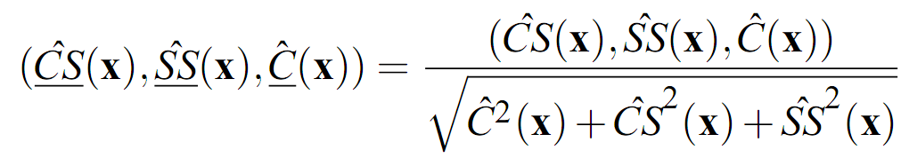

3D SVR based methods
Cartesian
Spherical

Slide 22
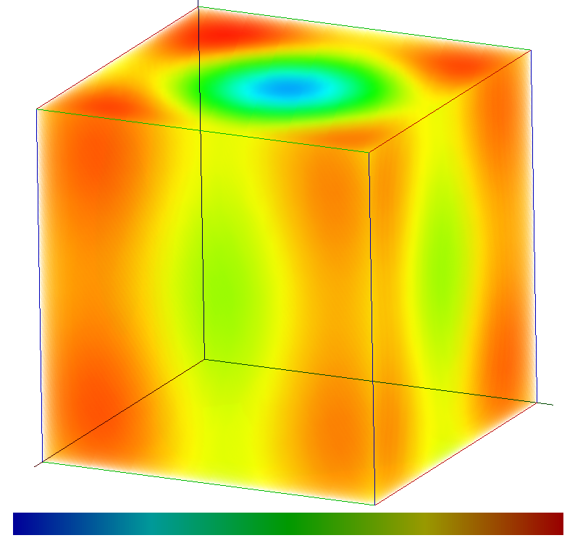
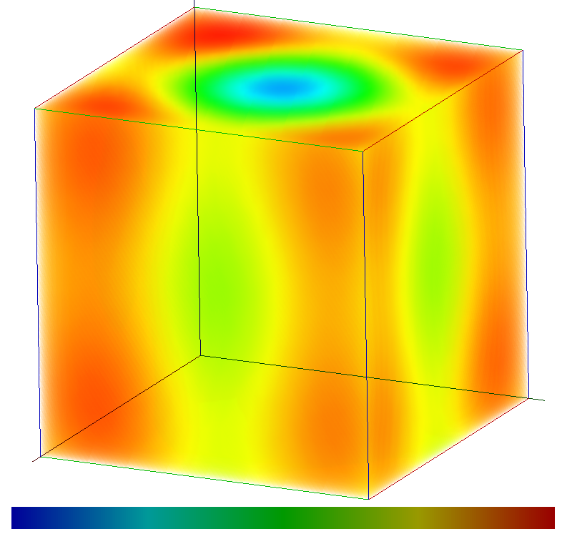
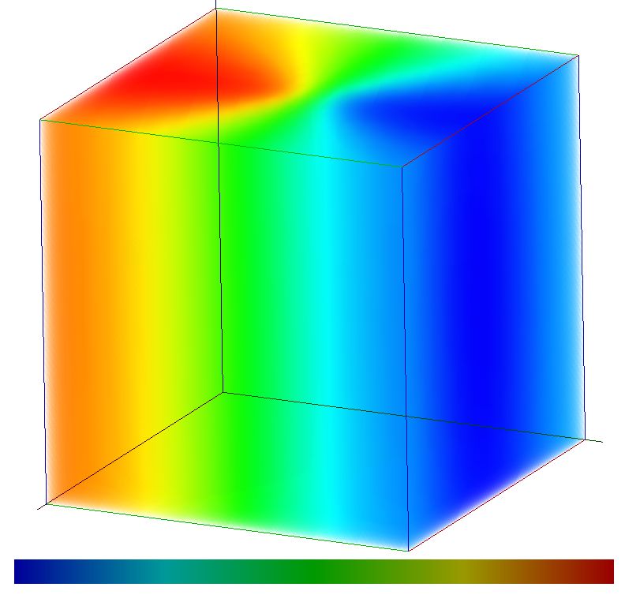
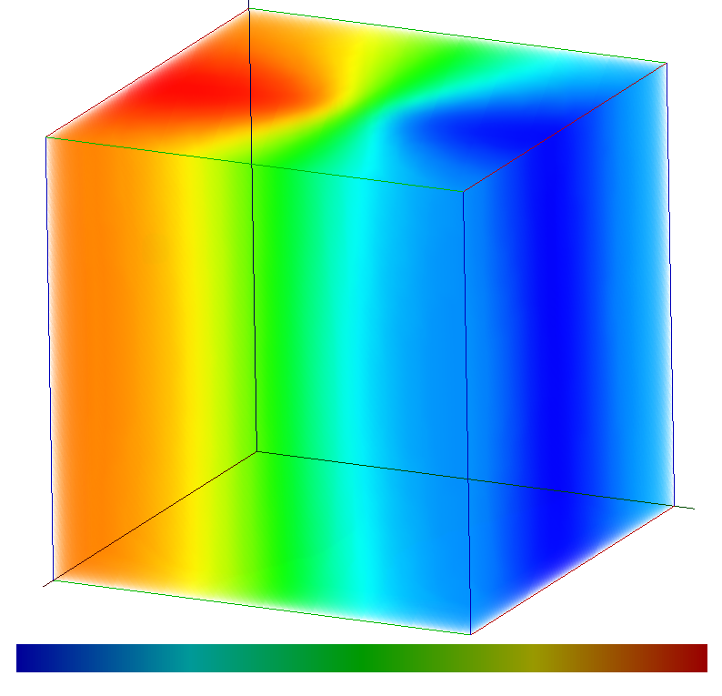
3D SVR based methods
Cartesian
Polar

Slide 23
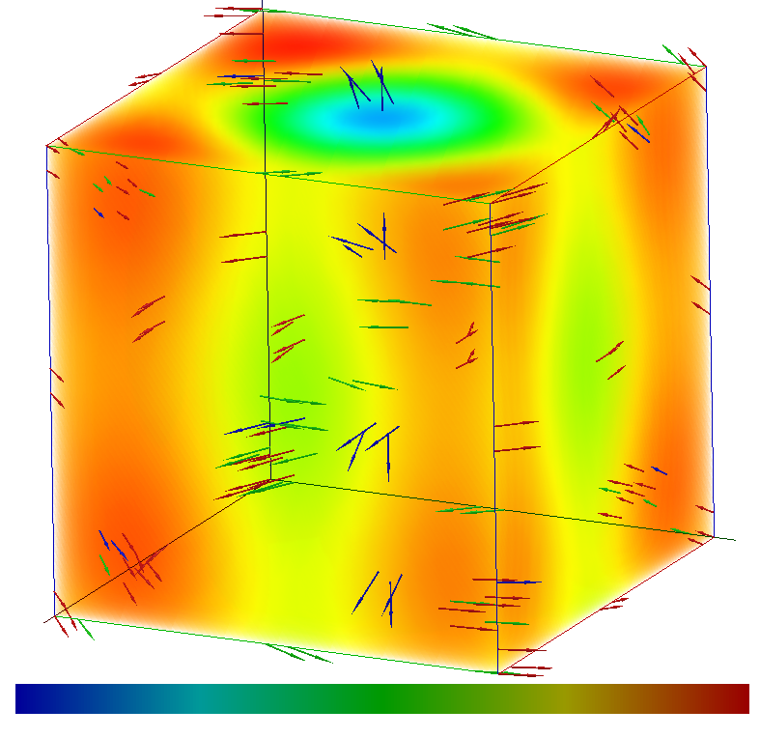
3D SVR based methods
Cartesian support vectors (x in red,y in green, z in blue)

Slide 24
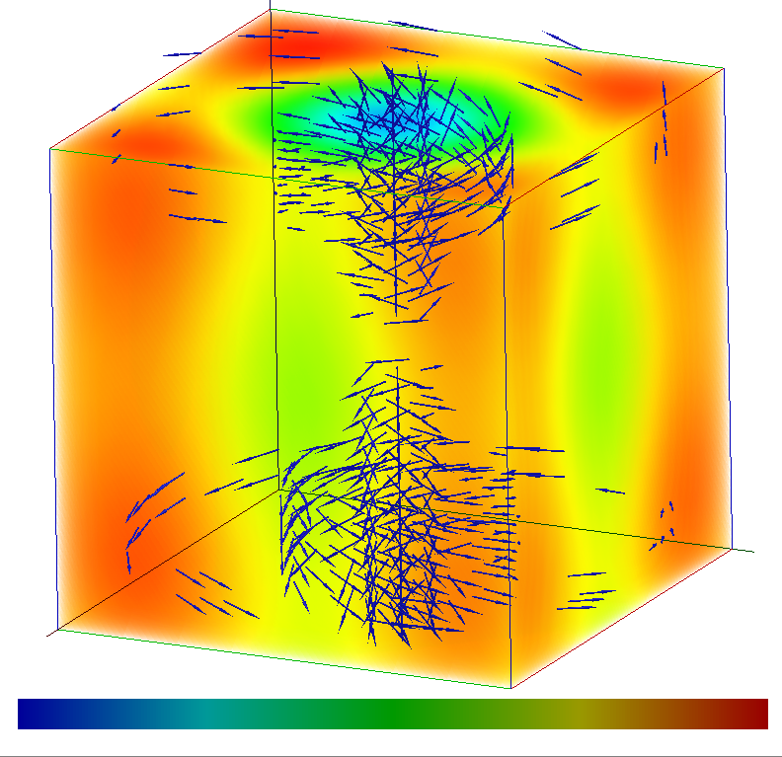
3D SVR based methods
Polar support vectors (C coordinate)

Slide 25
SVR based methods
Global
approach
Support vectors
interpretation
Hard to
implement
Slow

Slide 26
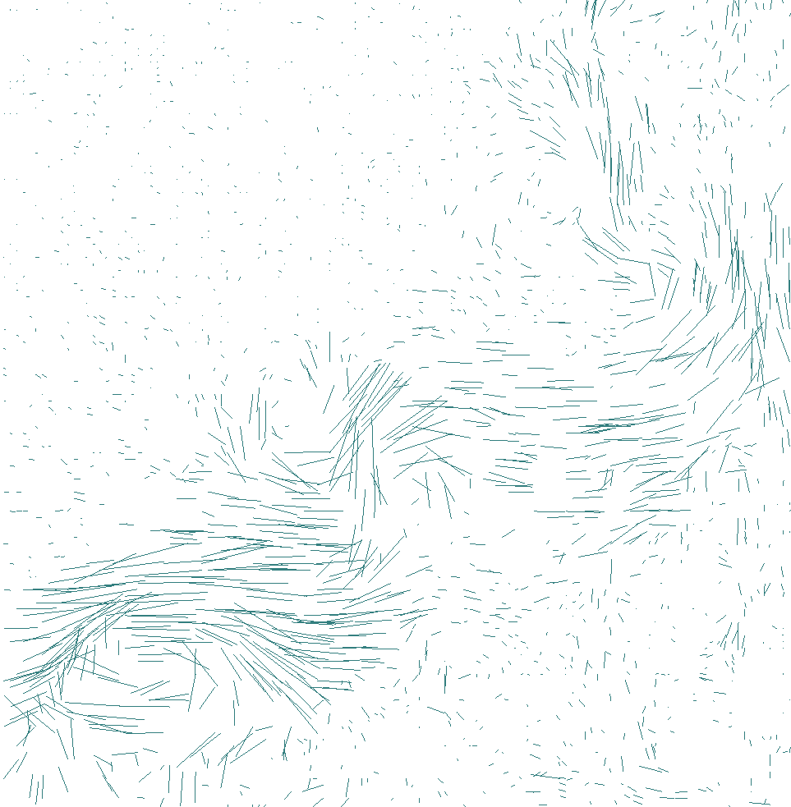
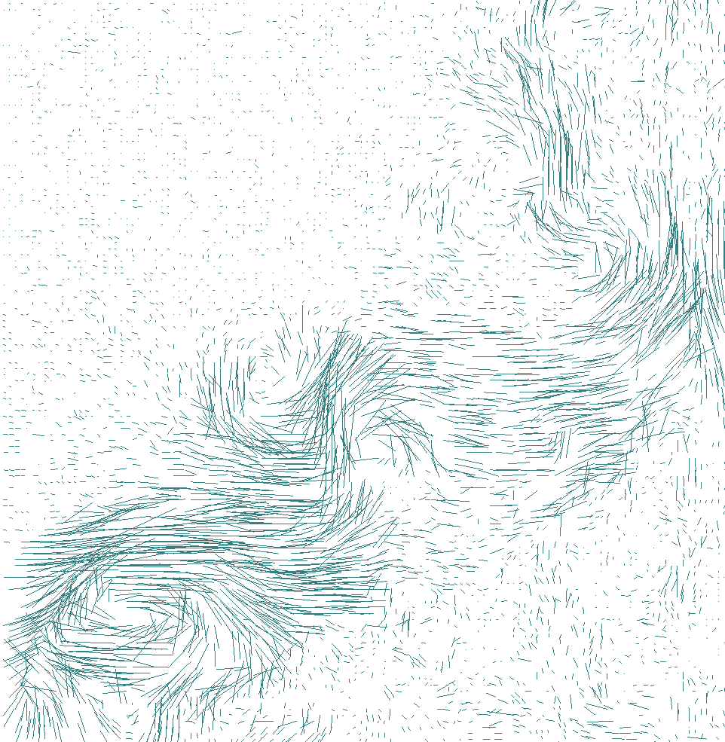

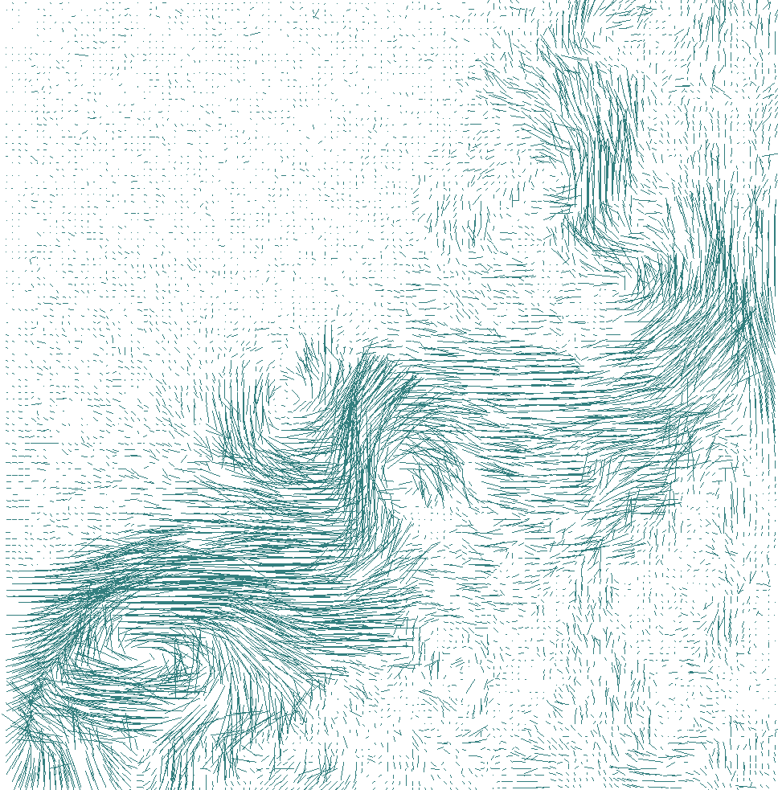








PU vs SVR based methods
2000 points
6000 points
11000 points
16000 points
PU: 0.00036
PU: 0.00046
PU:0.00047
PU:0.00046
SVR: 0.00042
SVR: 0.00046
SVR:0.00069
SVR:0.00051

Slide 27
Conclusion & Future Work
Reconstructions methods with error control
  → Extend to time dependent 2D/3D vector fields
Global approximation methods
  → More constraints:
  divergent-free, rotational-free vector fields reconstructions

Slide 28



Conclusion & Future Work
Topological analysis
  → Mesh-free vector field Hodge decomposition
Conservative Field
Div-free
Curl-free

