Slide 1

Vector field reconstruction from sparse samples with applications
Marcos Lage, Fabiano Petronetto, Afonso Paiva, Hélio Lopes,
Thomas Lewiner and Geovan Tavares
Laboratório Matmidia - Departamento de Matemática - PUC-Rio - Rio de Janeiro - Brasil

Slide 2

Vector fields

Slide 3






Problem description

Slide 4


Problem description
?
on the whole region

Slide 5
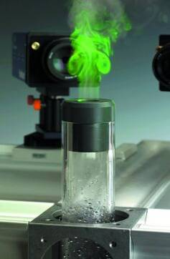
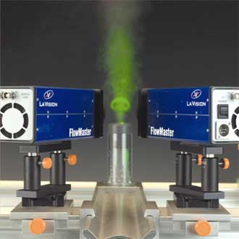
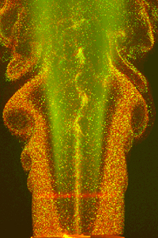
Motivation
Particle Image Velocimetry
(Luiz Fernando A. Azevedo, PUC-Rio)

Slide 6
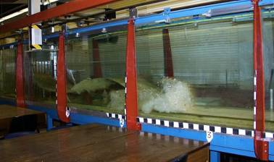
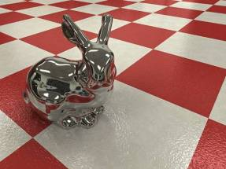
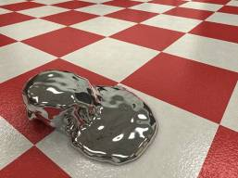
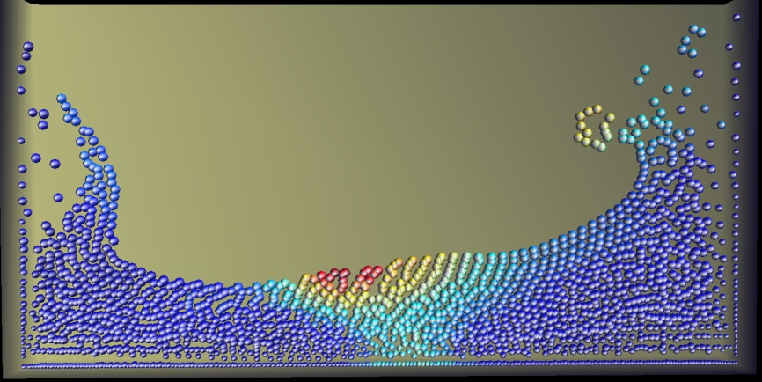
Motivation
Smoothed Particle Hydrodynamics (SPH)
(F. Petronetto, A. Paiva, T. Lewiner, G. Tavares – PUC-Rio – Sibgrapi 2006)

Slide 7
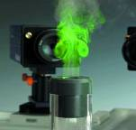
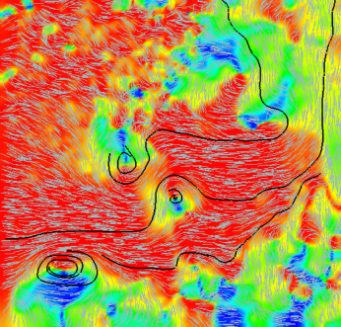
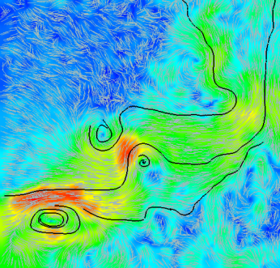
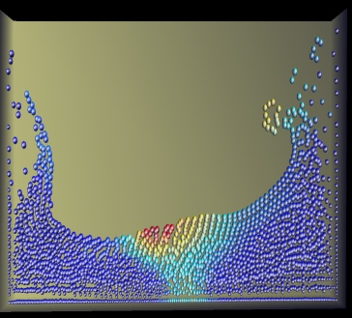
Outline
Problem description
Motivation
Local approximation
From local to global approximation
Results
Future Works

Slide 8


Local approximations
?
on the whole region

Slide 9
Local approximations
Classical least squares method:
Ax = B

Slide 10


Acceleration fitting
We can improve the vector field approximation …

Slide 11
Acceleration fitting
... changing the minimization problem:
µ user parameter

Slide 12
Robustness
Least squares numerical instability
Ridge regression: get around zero eigenvalues
(A + βI_{d})x = B
β user parameter

Slide 13
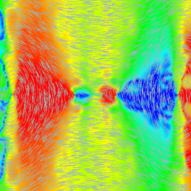
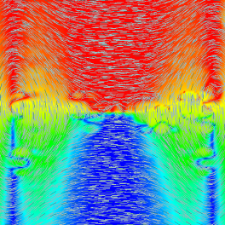
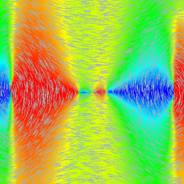
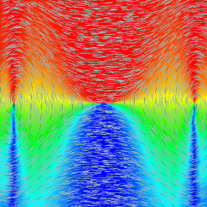
Effects of Ridge Regression
Without Ridge Regression
With Ridge Regression

Slide 14
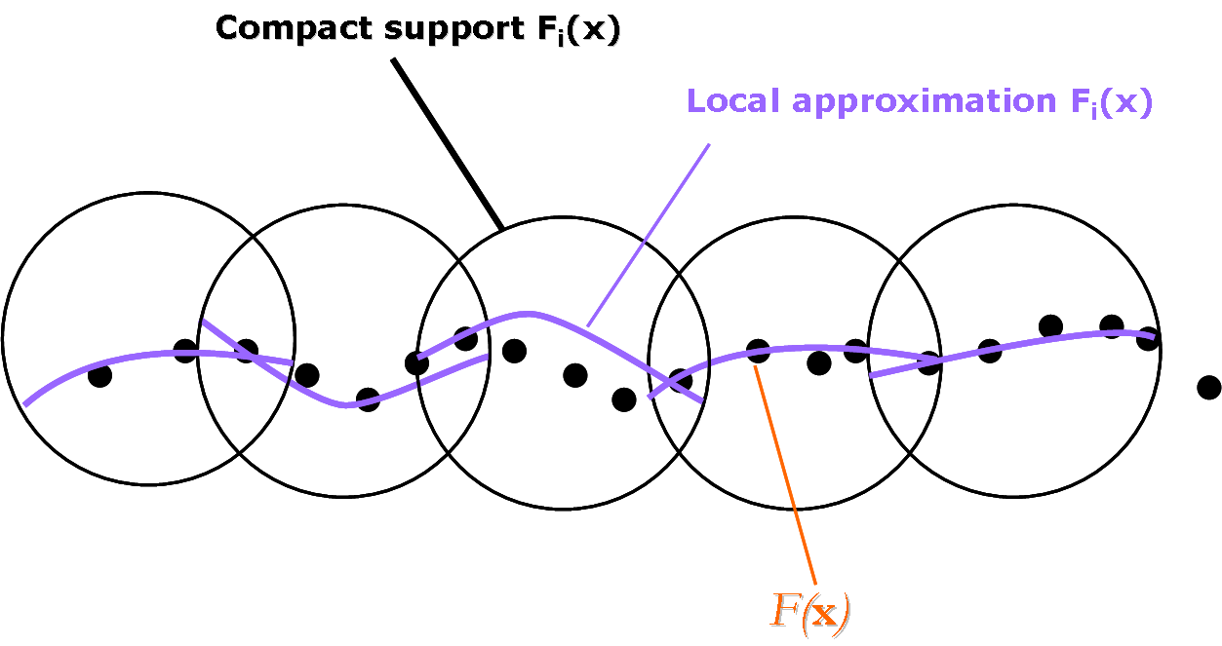
From local to global approximation

Slide 15
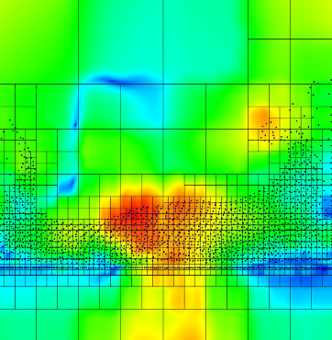
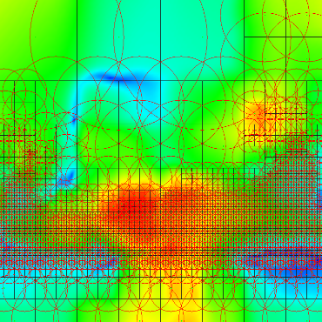
From local to global approximation
Domain subdivision
Compact supports

Slide 16
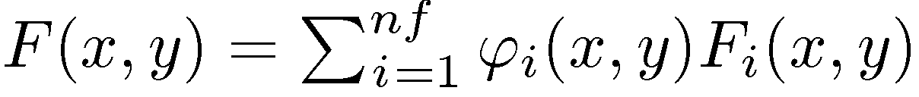
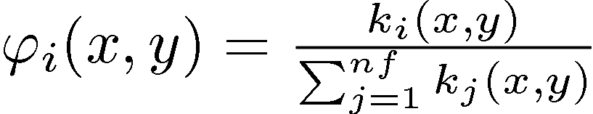
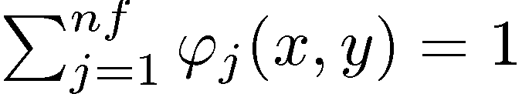
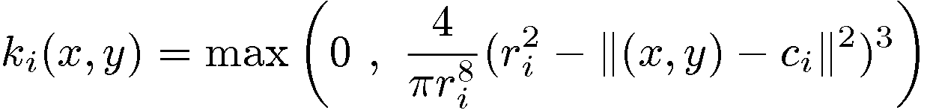
From local to global approximation
Partition of Unity:
and
Kernel functions:

Slide 17
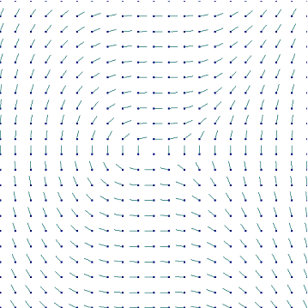
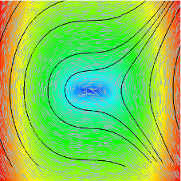
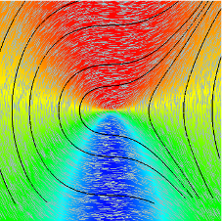
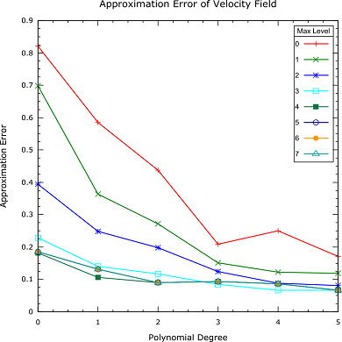

Results
Synthetic field:

Slide 18
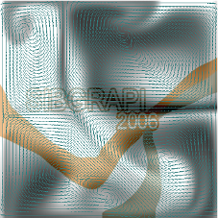
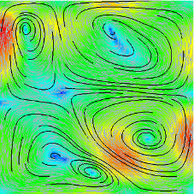
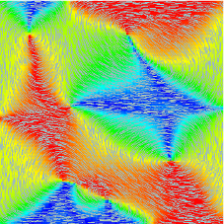
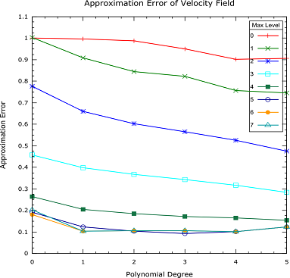
Results
Stable Fluids: (Stam, J. 1999. Stable fluids)

Slide 19
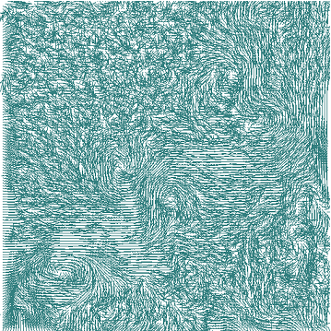


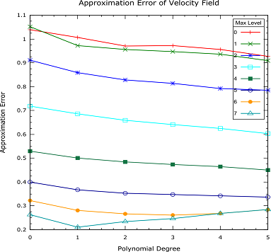
Results
Particle Image Velocimetry: (Luiz Fernando A. Azevedo, PUC-Rio)

Slide 20
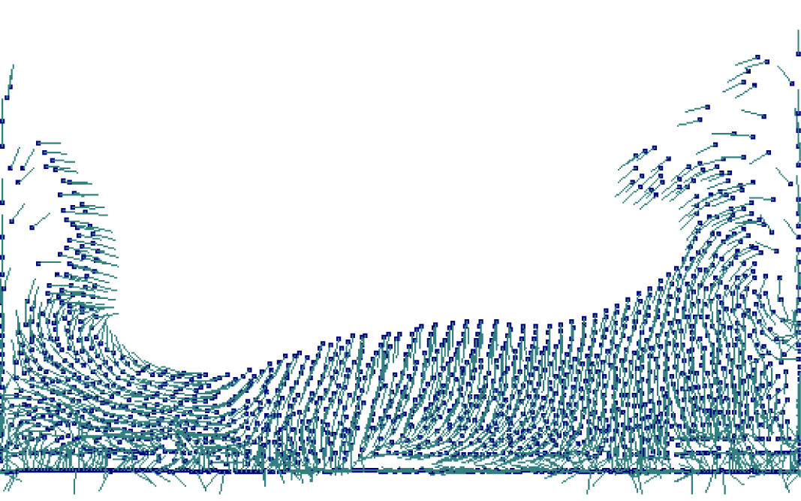
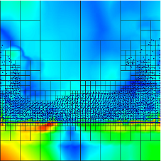
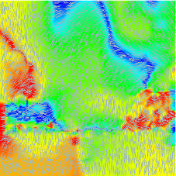
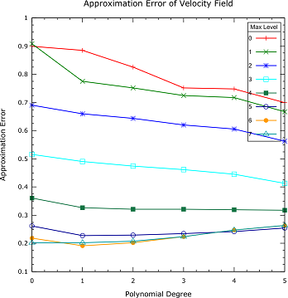
Results
Smoothed Particle Hydrodynamics (SPH):
(F. Petronetto, A. Paiva, T. Lewiner, G. Tavares – PUC-Rio)

Slide 21
Conclusion & Future Work
Fast and accurate reconstruction
  → Extend to time dependent 2D vector fields
Applicable to visualization
  → Extend to time dependent 3D vector fields
Minimize quadratic error
  → More constraints:
  conservative, divergent-free vector fields reconstructions.

Slide 22
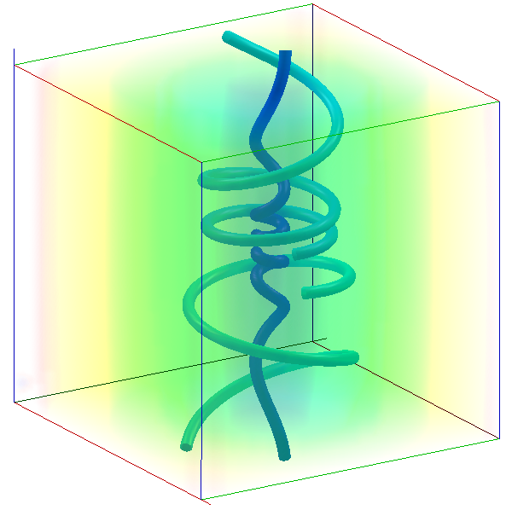
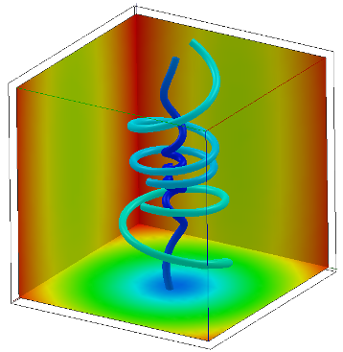
More results …
The Method has already been extended to
3D vector fields

Slide 23
Thanks !!!

