Slide 1


Slide 2

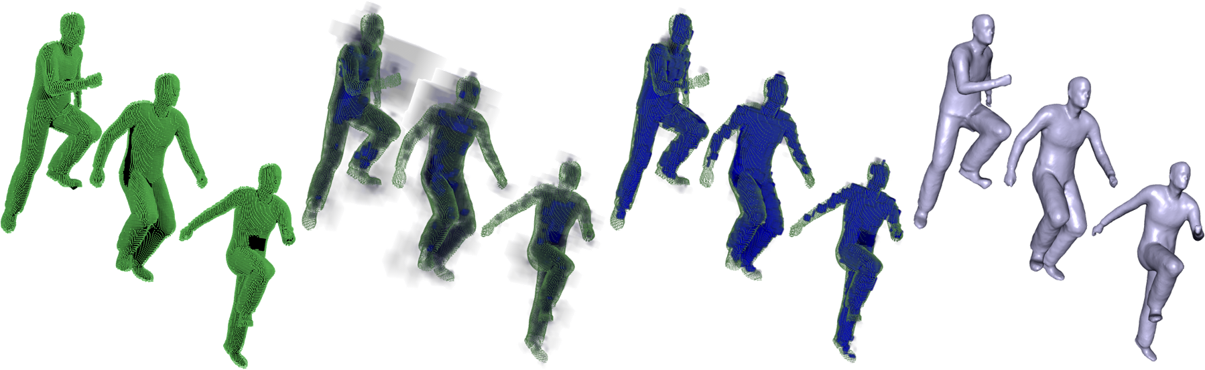
Space-time Surface Reconstruction
using Incompressible Flow
Andrei Sharf Dan A. Alcantara Thomas Lewiner Chen Greif
Alla Sheffer Nina Amenta Daniel Cohen-Or

Slide 3

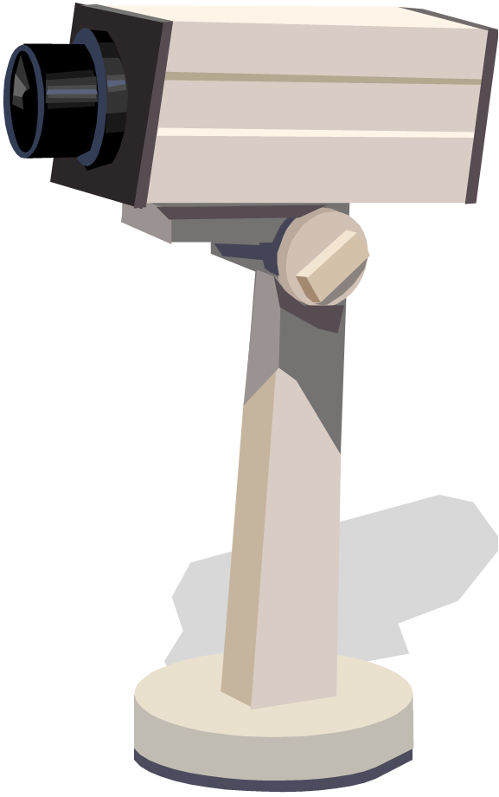
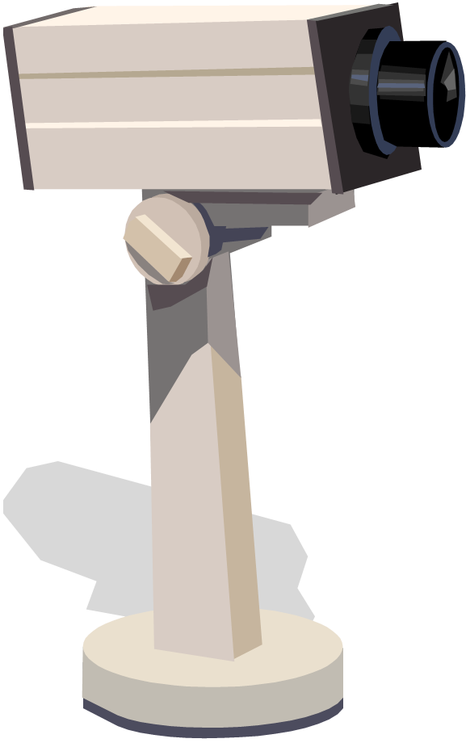
4D Data acquisition - setting
Synchronized static cameras
2-16 views
Capture rates 10-30 fps
Notes:
Recent advances scanning technologies together with increasing computational power allow the space-time capture of 3D objects as they move and deform.
Systems produce dense point samples over large parts of the surface of a moving object, at rates from ten to thirty frames per second.
Reconstructing the data into a coherent model of a deforming object is a challenging computational problem that is just beginning to be addressed

Slide 4
4D Data acquisition - limitations
Persistent self occlusions
Low frame rate and resolution
Noise
Notes:
The input scans are typically collected by a small set of fixed synchronized cameras. Because of the small number of fixed views, large parts of the surface are occluded in each frame, leading to gaping holes that often persist across many frames.
Current real-time systems also suffer from low resolution, insufficient frame rate and noise. While it is reasonable to assume advances in real time scanning technology will improve the data quality, persistent occlusions will always be an issue since it is an inherent problem to scanning process.
To generate the synthetic inputs in our experiments, we use a virtual multi-camera that simulates a real-time laser scanner. For each camera it shoots rays, registering the closest visible surface points from the virtual camera position. We record only position information for each scan point and not surface orientation.

Slide 5
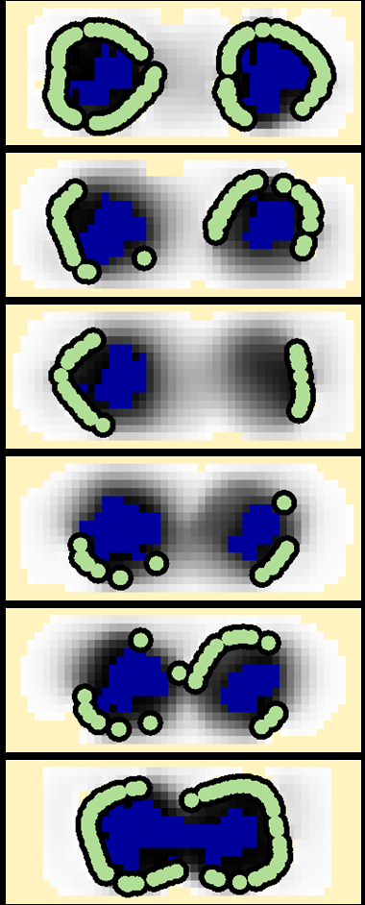
Motivation
Volume is incompressible across time
Explicitly modeling of mass field:
  Compute inside/outside volume
  Include physical assumptions
  Object is watertight manifold
time
mass field
2D
Notes:
Our motivation is that the motion of the object can be described as an incompressible flow of material through time.
Volume incompressibility assumption prevents mass concentration or dispersion: We constrain all of the material in one time-frame to move to some nearby position in the next, ensuring mass conservation, while preventing mass from concentrating or dispersing, producing what we call an incompressible flow.
This incompressible prior puts a very strong constraint on the shape of our solid and its flow.
We use this flow terminology somewhat loosely; as will be seen, our method does not produce a physically accurate fluid flow; nor does it need to.
By using a volumetric reconstruction approach which explicitly models object’s mass we compute a watertight manifold reconstruction

Slide 6
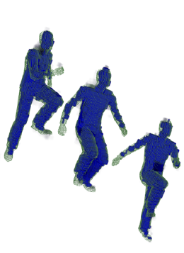
Contribution
Incompressible mass flow 4D reconstruction
  Global system considers all frames simultaneously
  Simple formulation on a grid
General un-constrained deformations
time
Notes:
Our contribution is a flow simulation for 4D reconstruction…
We take advantage of space-time coherence and adopt a global approach, which considers all frames simultaneously.
The estimation of both distribution of material in space and its flow is computed by iteratively updating and solving a linear system
Our formulation requires the fairly mild assumptions that the object moves smoothly through time and that the speed of movement between consecutive time frames is bounded. We do not need to assume that the motion is globally or locally rigid, nor do we have any assumptions on the topology or geometry of the object.

Slide 7
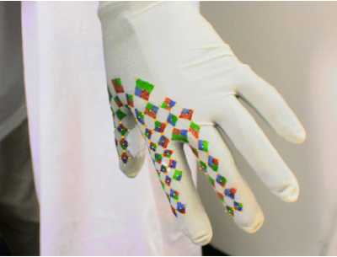
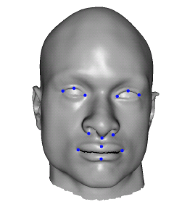
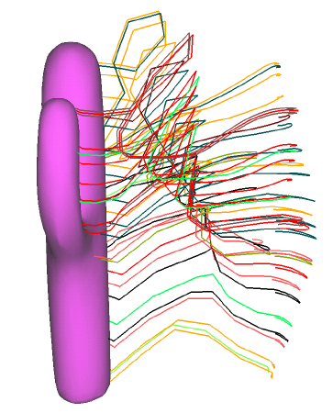
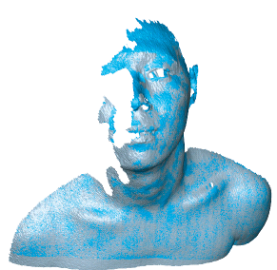
Related work
Guskov et al. 2003
Marker based
[Marschner et al. 2000; Guskov et al. 2003; White et al. 2007]
Template based
[Allen et al. 2002; Anguelov et al. 2004; Zhang et al. 2004; Anguelov et al. 2005, Aguiar et al. 2008; Bradley et al. 2008]
Point correspondence and registration
[Shinya 2004; Wang et al. 2005, Anuar and Guskov 2004, Pekelny and Gotsman 2008, Chang and Zwicker 2008; Li et al. 2008]
Surface based space-time
[Wand et al. 2007; Mitra et al. 2007; Suessmuth et al. 2008]
Zhang et al. 2004
Anuar et al. 2004
Li et al. 2008
Mitra et al. 2007
Notes:
While numerous methods exist for reconstructing static 3D models, none of them is directly applicable to the dynamic setting, approaching the specific challenges and characteristics.
The main challenge faced by dynamic reconstruction is to properly define the relationship between the temporal and spatial dimensions in order to accumulate information over time to correctly complete locally missing data.
Much of the attention in 4D reconstruction has been paid to processing specific shapes such as humans or garments where additional information is available to guide the reconstruction, e.g., marker correspondences or templates. Unmarked data is much simpler to acquire making a markerless approach like ours more general.
Arbitrary shape reconstruction from point cloud sequences is usually treated as a surface deformation over time. They generally assume spatial smoothness and rigid motion priors. Surface based methods, focus on inter-frame registration and correspondence.
We approach the problem by operating on a volume, rather than a surface. In particular, we generate a sequence of watertight manifolds as output, and we model the flow of mass in order to compensate for missing data. Unlike these techniques our method does not require dense spatial sampling to complete missing data. Furthermore we observed it is much faster.

Slide 8
FLOW reconstruction
In: 3D point cloud frames
Out: watertight surface
Explicit volume modeling
  4D solid on a grid
  Characteristic function
Notes:
We consider the problem of reconstructing a moving and possibly deforming object of arbitrary topology given a sequence of 3D frames and no correspondence. Each frame consists of a cloud of points in 3D sampled over the object’s surface.
Our goal is to reconstruct a watertight surface in space-time, that is, a 3D surface embedded in 4D.
We represent this 4D solid using its characteristic function on a 4D grid, from which we extract the actual object surface at a final step
By using a volumetric reconstruction approach which explicitly models object’s mass we compute a watertight manifold reconstruction

Slide 9
3D reconstruction techniques fail
Surface reconstruction of individual frames fails

Slide 10
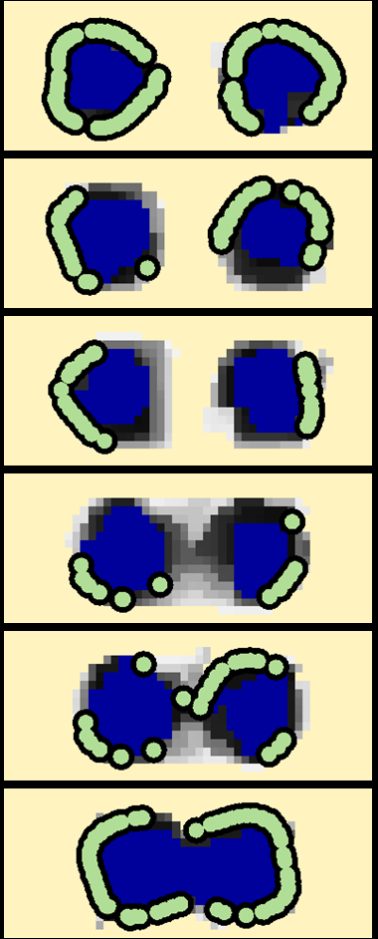
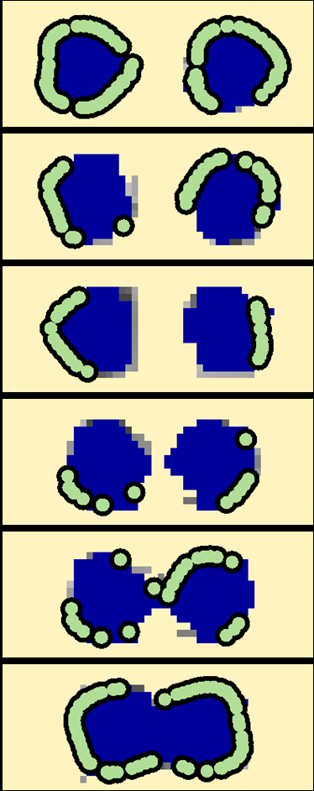
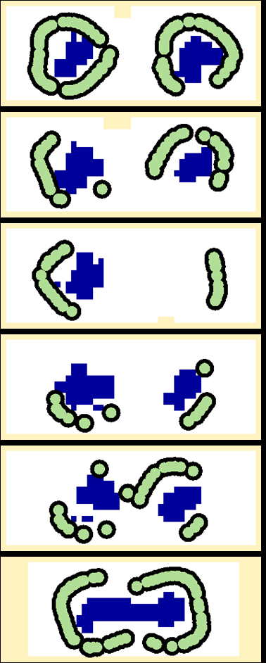
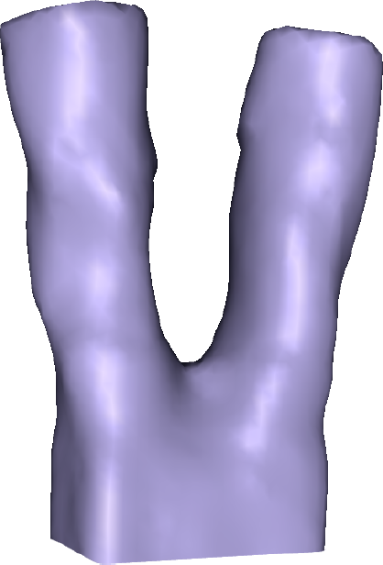
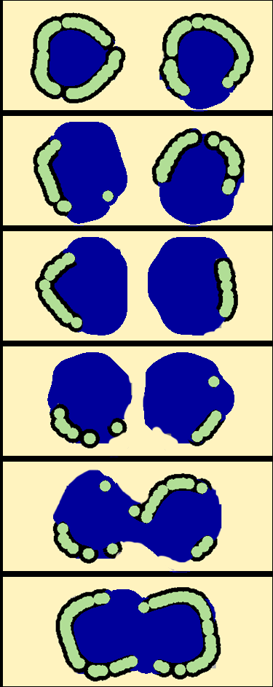
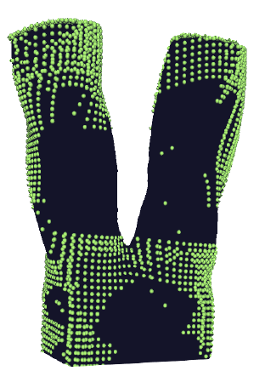
2D example
known outside 0
known inside 1
unknown [0-1]
Notes:
The 2D space-time surface of a single rounded box splitting from one connected component into two.
Despite the poor sampling of the round areas and the changing topology, the estimation of the mass is able to separate and accumulate where the round objects are expected to be for each time step

Slide 11
1D representation
Domain: space time grid
Material: characteristic function x^{t}_{i} values mass amount at each cell
Flow: amount of material v^{t}_{i,j} moving from cell x^{t}_{i} to cell x^{t+1}_{j}
x^{t+1}_{i-1}
x^{t+1}_{i}
x^{t+1}_{i+1}
t+1
time
v^{t}_{i,i-1}
v^{t}_{i,i}
v^{t}_{i,i+1}
t
x^{t}_{i}
Notes:
For the sake of simplicity we describe our formulation for an object in one-dimensional space deforming through time.
The domain is then an nx1 mx1 space-time grid, and we use i j for space indices and t for time ones.
The characteristic function values xt i at each cell can be seen as representing the amount of material in the cell.
Using this representation we describe the motion and deformation of the object over time as flow of material through space-time.
The flow is represented by variables vtij representing the amount of material moving from cell xt i at time t to another cell xt1
j at time t 􀀀1. Note that, in contrast to the the simulation of fluid flows, material in our model moves through time at a constant rate, so that higher flow values on an edge mean more material moving through the edge.

Slide 12
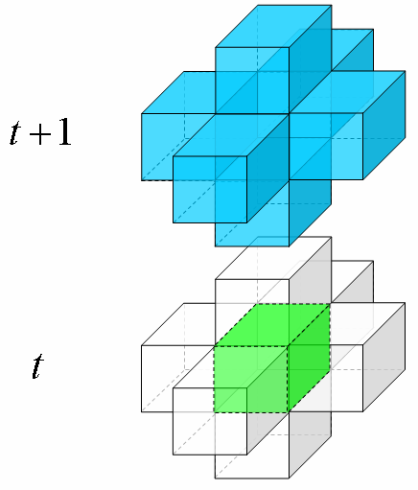
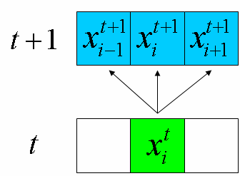
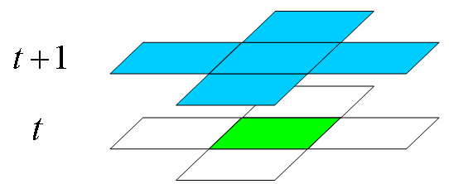
Higher dimensions generalization
Regular 4D grid on top of 3D scan frames
Space-time adjacency relationships:
1D
2D
3D
Notes:
The three- and four-dimensional formulations we use later are straightforward generalizations obtained by replacing the spatial adjacency relationships used in one dimension with those for higher dimensions

Slide 13
FLOW physical constraints
Mass preservation: material in cell equals to material flowing into and out of the cell
time
Notes:
We formulate the reconstruction as a solution to a constrained minimization problem, based on the following set of assumptions.
We interpret flow incompressibility as constraining the amount of material in any cell to be equal to the amount of material flowing into the cell from the previous time frame, and also to the amount of material flowing out of the cell into the next time frame.

Slide 14
FLOW physical constraints
Spatial continuity: values spatially adjacent to be identical everywhere, except across boundaries
space
Notes:
In the characteristic function, we expect values xt i in spatially adjacent cells to be identical everywhere, except across the object boundaries.
Because the scans give an incomplete representation of the surface, however, we do not know where some of the boundaries are and in addition we cannot be sure of the in/out orientation at all known boundaries.

Slide 15
FLOW Physical Constraints
Flow momentum: flow direction should be smooth across time
Notes:
We expect the object deformation, and hence the flow, to be smooth in time. This smoothness is captured by a momentum term that penalizes the flow for changing direction from one time frame to the next:

Slide 16
Constrained Minimization Problem
Optimization:
Constraints:
  Incompressibility constraints
  Boundary values

Slide 17
Challenges
Sublinear exponent
iterative reweighted least squares
Huge matrices
fine-tuned iterative solver
Mass stability
boundary constraints,
clamping

Slide 18
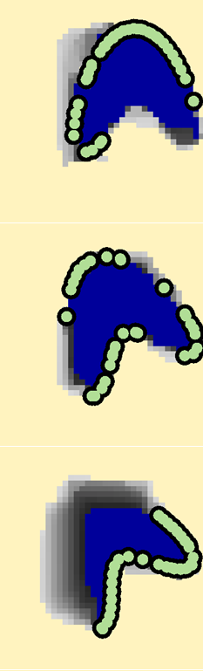
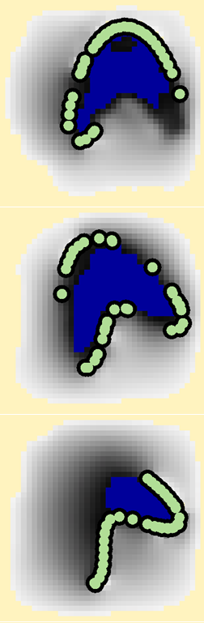
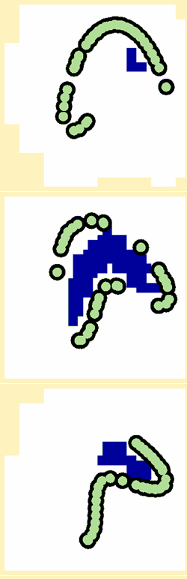
Sublinear exponent
Iteratively Reweighted Least Squares:
from previous iteration
small close to discontinuities
converges with good init and few outliers
time
iteration

Slide 19
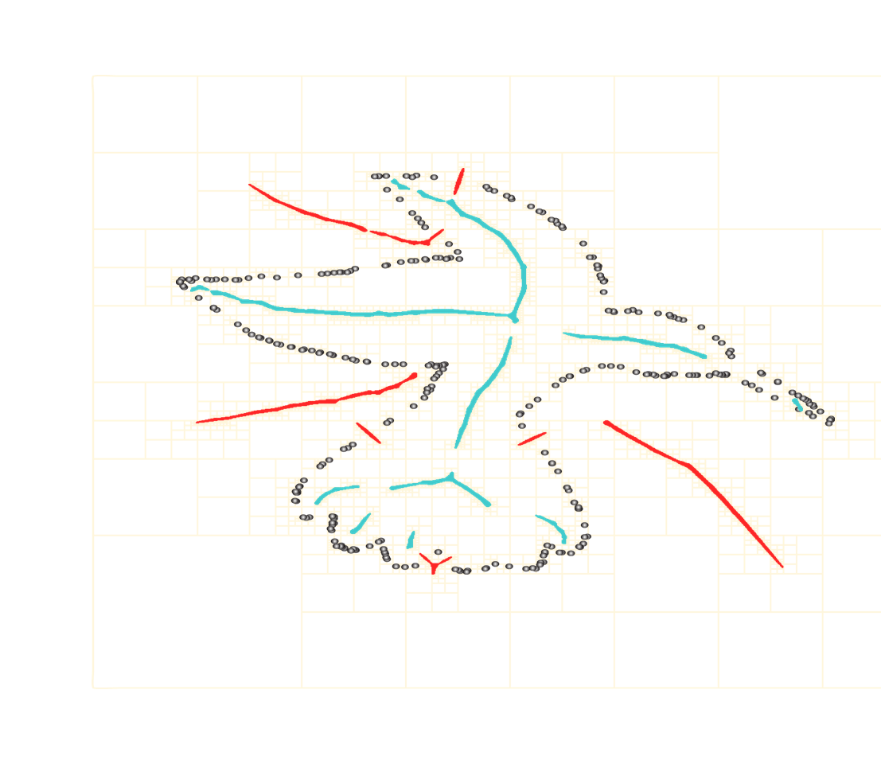
Huge data problem
Problem size
20-200 frames x (2⁸)³ grid resolution x 8 variables per cell in time
Reduce initial number of unknowns
Pre-assignment from visibility hull : inside/outside labels
High resolution per-frame surface reconstruction
Sharf et al. 07

Slide 20
Minimization problem
Lagrange multipliers:

Slide 21
Matrix engineering
Iterative, preconditioned with
many eigenvalues 1
fast convergence
Augmenting approach:
solve with CG
MINRES solver with decreasing tolerance

Slide 22
Mass stability: clamping/back substitution
time
iteration
: amount of mass at cell (i,t)
: inside, outside
clamp
if then adjacent
back-substitution reduces the system size

Slide 23

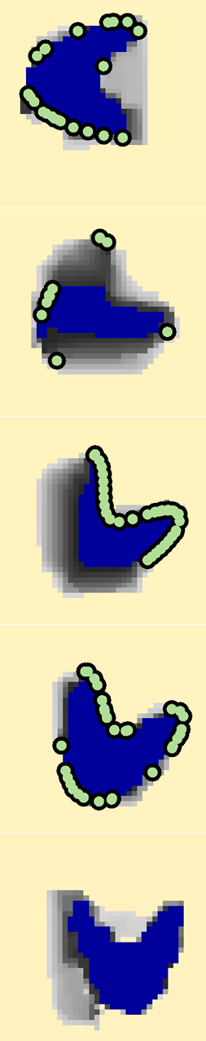
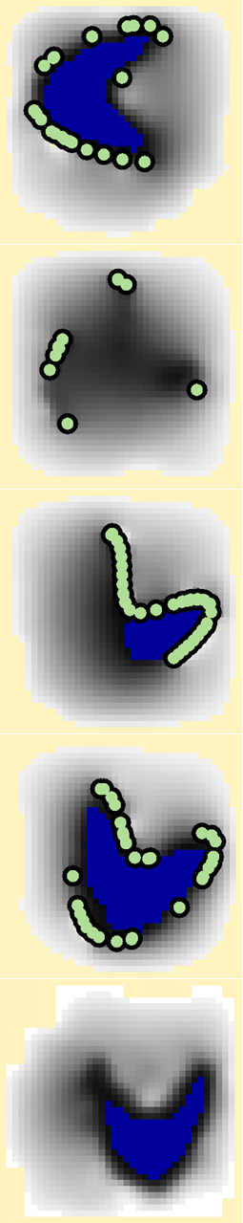
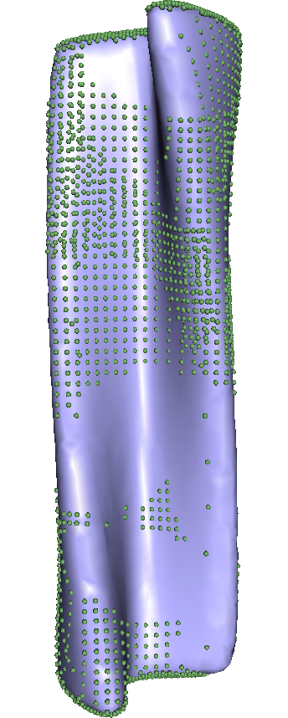
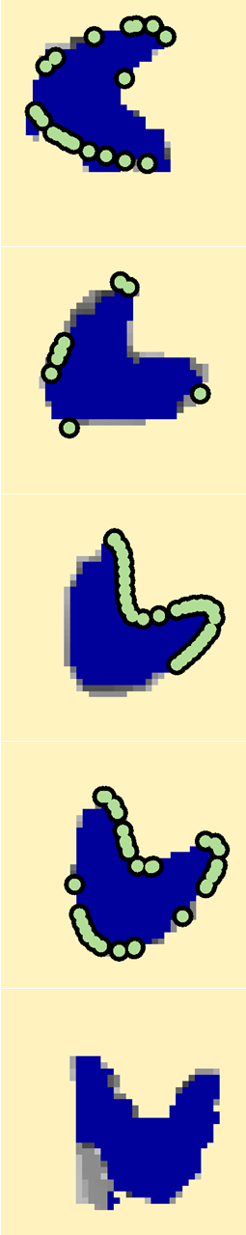
Results (2D) – empty frames completion
Notes:
To illustrate the merits of the flow solution, we use some 2D time examples. we show a two-dimensional “boomerang shaped” object moving through time. We leave large portions of the moving object un-sampled in many frames, mimicking the effects of occlusion. Furthermore, in order to explore our method’s limits and robustness, we leave some frames completely empty.
The areas of the final 2D cross sections are roughly equal across all frames; they are not perfectly identical since the clamping of material values to either zero or one at most voxels leads to rounding errors.

Slide 24
Results – hand puppet from 2 views
Notes:
The point data is noisy and has a persistent wide strip of missing data on the sides of the head. The front-facing arm sometimes occludes the face, and the back arm is sometimes occluded.
The topology of the head and both arms is correctly reconstructed with the flow solution, and the geometry is fairly consistent. The thin palms of the puppet are too small to be recovered well given the flow grid resolution.
3D meshes representing the time-slices of the solid are computed independently. Thus the connectivity can change between consecutive frames. In low resolution, this can cause some visual flickering. Algorithms for temporally coherent meshing are an interesting
research direction.

Slide 25
Results - garments
Notes:
results of applying our method to real scans of moving garments.
The data was captured using a set of sixteen high-definition video cameras combined with a multiview stereo registration step [Bradley et al. 2008].
Although the scans contain holes due to occlusions, irregular sampling and noise, our flow system successfully generates a coherent 4D volume that smoothly varies across time and fills the missing data.

Slide 26
Results – large deformation
Notes:
We also tested our method on inputs for which our incompressibility assumption is only approximately satisfied, such as the garment
scans in Figures 12 and 13. Leveraging our iterative solver’s ability to solve the system inexactly, even in the case of singularities, our
method succeeds in reconstructing these inputs and filling holes due to occlusion.

Slide 27
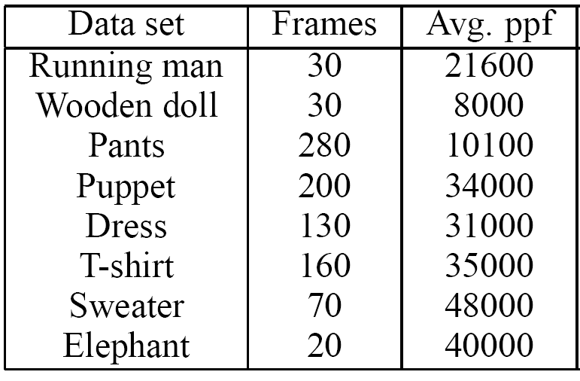
Results 3D+time
20 frames at constant resolution
Solver converges in 100 iterations.
Time: 1 minute per-frame
3.73 GHz CPU, memory requirements up to 4.5GB
Notes:
We tested our method on several synthetic and real 3D space-time data-sets
In our computations we are staying within the limit of 20 frames at constant resolution for the flow solver which converges in about 100 iterations.
Using this framework we achieve an average computational time of one minute per-frame, roughly split into 20sec per flow solver and 40sec post-processing on a workstation with 16GB RAM3.73 GHz CPU. The memory requirements of our method are up to 4.5GB for the flow-solver and up to 2GB for the post-processing.
We note that these times are an order of magnitude faster than those reported by Wand et al. [2007] and about twice as fast as those of the recent marker-based method of White et. al. [2007].

Slide 28
Conclusions and Limitations
Meshes representing time-slices of the solid are computed independently
Resolution limitation
Bounded deformation speed: at each time step material can only move to temporally adjacent cells
Notes:
Bounded speed: We expect the grid resolution in time to be sufficiently dense with respect to the deformation speed. Specifically, we assume that at each time step material can only move to temporally adjacent cells.
We observed above that volume is not perfectly preserved by our reconstruction. There are several reasons for this. The bounded speed assumption (Section 3), which might appear to be strictly enforced by our formulation, is not perfectly satisfied by several of the inputs we generated, with data moving more than one-cell distance between frames
our solution does not precisely satisfy the assumptions of the model, this flexibility in fact proves to be extremely useful. We can handle inputs that do not strictly meet the speed assumption or for which the volume does vary. Thus, when the constraints cannot be satisfied exactly, they are satisfied in a least squares sense.
3D meshes representing the time-slices of the solid are computed independently. Thus the connectivity can change between consecutive frames. In low resolution, this can cause some visual flickering. Algorithms for temporally coherent meshing are an interesting
research direction.
Despite the use of a specifically tailored solver, our method is still not suitable for tackling very large scale problems. One avenue for future work which will make it possible to solve problems with much higher resolution would be to consider a hierarchical or domain decomposition approach for optimizing the flow formulation.

Slide 29
Thank you!

