Slide 1
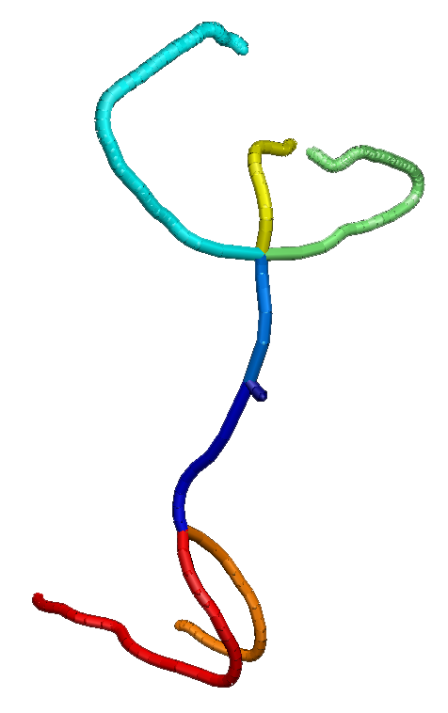
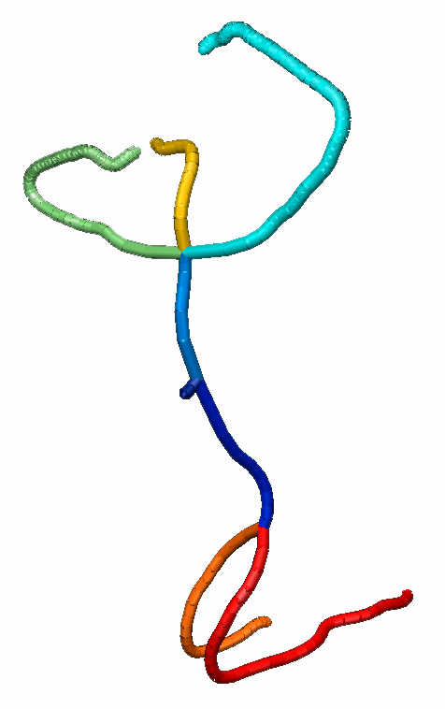
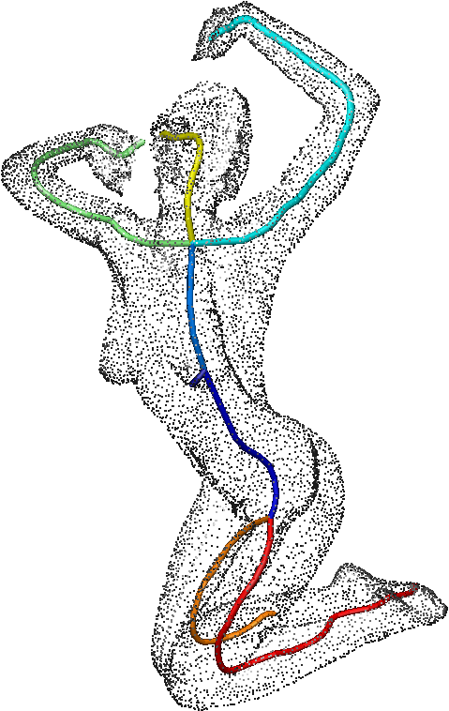
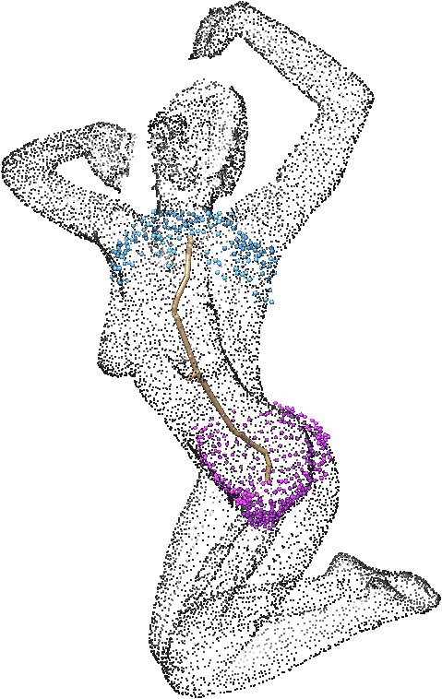
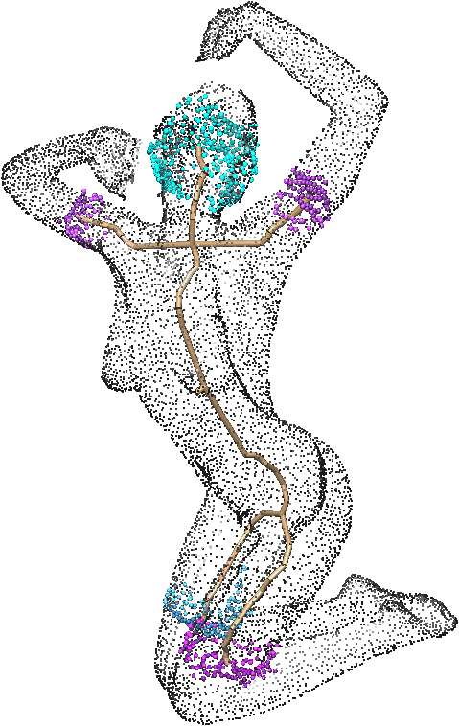

On-the-fly curve-skeleton computation for 3d shapes
Andrei Sharf, Thomas Lewiner,
Ariel Shamir, Leif Kobbelt
Tel Aviv University & PUC-Rio de Janeiro &
IDC Herzliya & RTWH Aachen
Notes:
A interpretação de forma se tornou um problema central na computação
gráfica atual, em particular na hora de reconstruir objetos a partir
de dados incompletos ou de representar de maneira sucinta modelos
complexos. A origem diversa dos dados, incluindo amostras escaneadas,
rabiscos, modelos poligonais completos e incompletos, assim como a
falta de controle sobre a qualidade desses dados impõem métodos
extremamente robustos para interpretar as formas.
Modelos evolutivos e competitivos são conhecidos por oferecer uma
grande capacidade de adaptação em situações variadas. Originalmente
usados em modelos biológicos e financeiros, aplicamo-los na computação
gráfica a dois problemas: reconstrução de superfícies e extração de
esqueletos. Os algoritmos resultantes são extremamente rápidos e
robustos, conseguindo resultados positivos em casos particularmente
delicados.

Slide 2
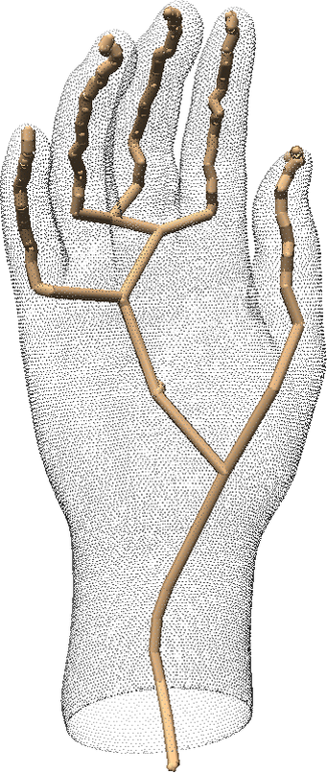
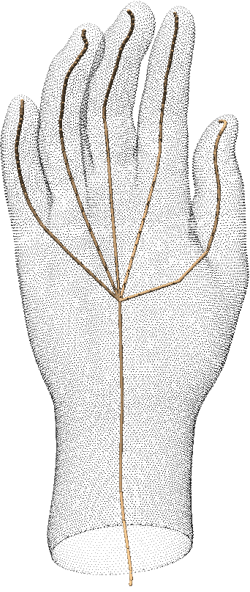
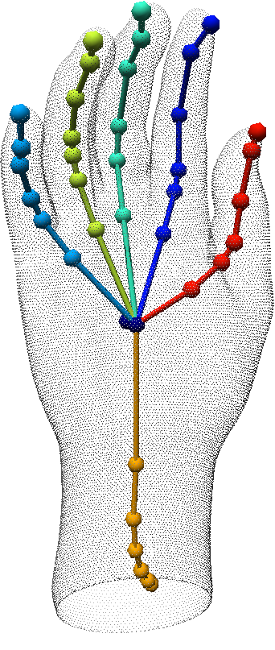
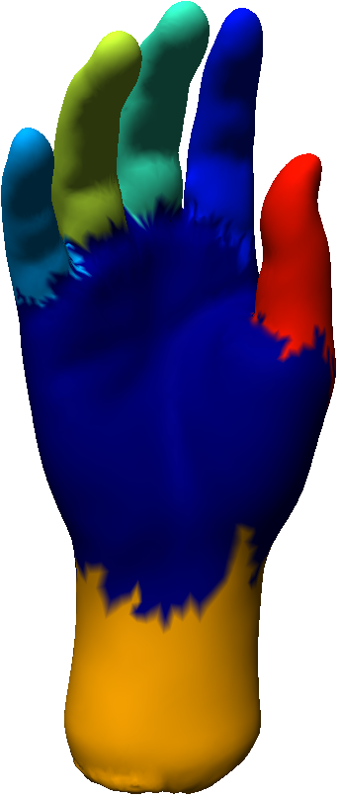
Curve-skeleton
Shape abstraction

Slide 3
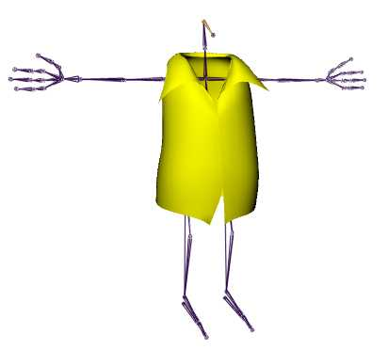
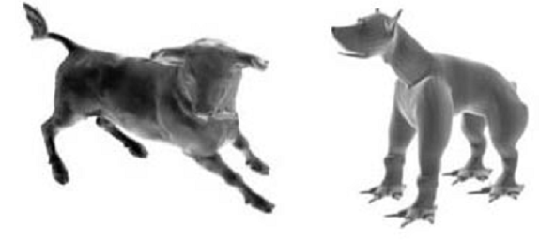
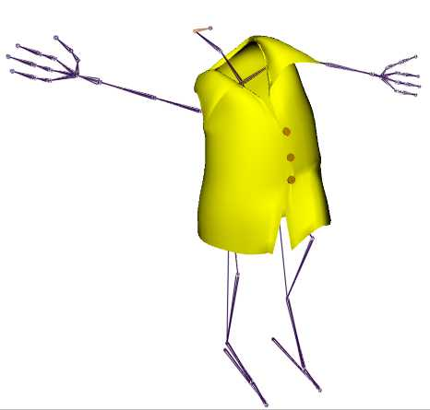
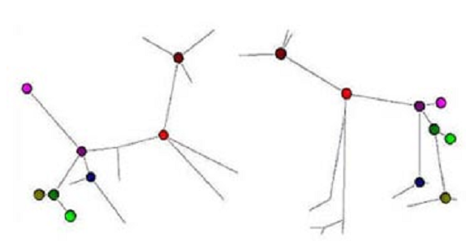
Motivation
animation, matching, modelling…
© 3dtreat.com , © Sundar et al. 2003

Slide 4
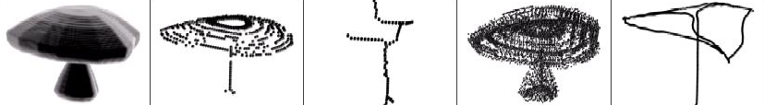
Curve-skeleton issues
[Cornea et al. 2005]
  Homotopic
  Rigid invariant
  Thin
  Centered
  Robust
  Reliable
  Efficient
  Hierarchic

Slide 5
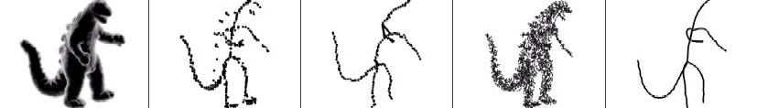
Related works
Thinning
  Borgefors et al. 1999, Gagvani and Silver 1999
Medial axis
  Attali and Montanvert 1997, Amenta et al. 2001
  Wu et al. 2003
  Dey and Sun 2006
Implicit
  Schirmacher et al. 1998, Palagyi and Kuba 1999, Bitter et al. 2001
  Zhou and Toga 1999, Hassouna and Farag 2005, Cornea et al. 2005
  Golland and Grimson 2000
Notes:
Thinning
Borgefors et al. 1999, Gagvani and Silver 1999
Medial axis
Attali and Montanvert 1997, Amenta et al. 2001: medial axis of the medial axis
Wu et al. 2003: distance on the medial axis
Dey and Sun 2006: geodesic on the medial axis
Implicit
Schirmacher et al. 1998, Palagyi and Kuba 1999, Bitter et al. 2001: ridge points
Zhou and Toga 1999, Hassouna and Farag 2005, Cornea et al. 2005: fast marching
Golland and Grimson 2000: active contours

Slide 6
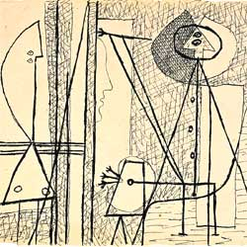
Shape and interpretations
Interpretation levels
  independent lines
  characters
  whole scene
Interdependent
Robustness
Pablo Picasso
Le peintre et son modèle

Slide 7
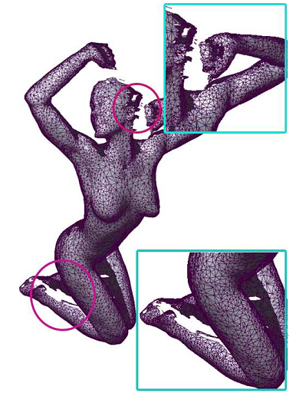
Shapes?
Point set
Explicit/mesh
Implicit/volumetric

Slide 8
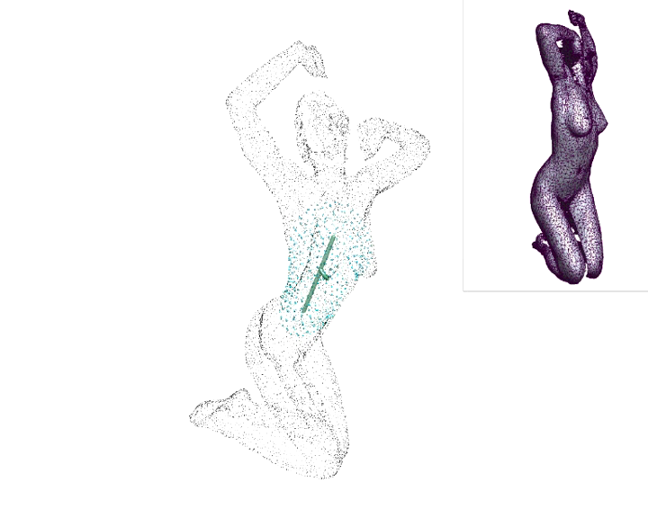
Menu
Deformable
model
  shape
  interpretation
Front tracking
  skeleton
  topology
Filtering
  skeleton
  geometry

Slide 9
Recipe
Combinatorial:
fast
robust
3D geometry computation:
slow
prone to error
Front tracking
  skeleton
  topology
Filtering
  skeleton
  geometry
Curve geometry:
simple
efficient

Slide 10
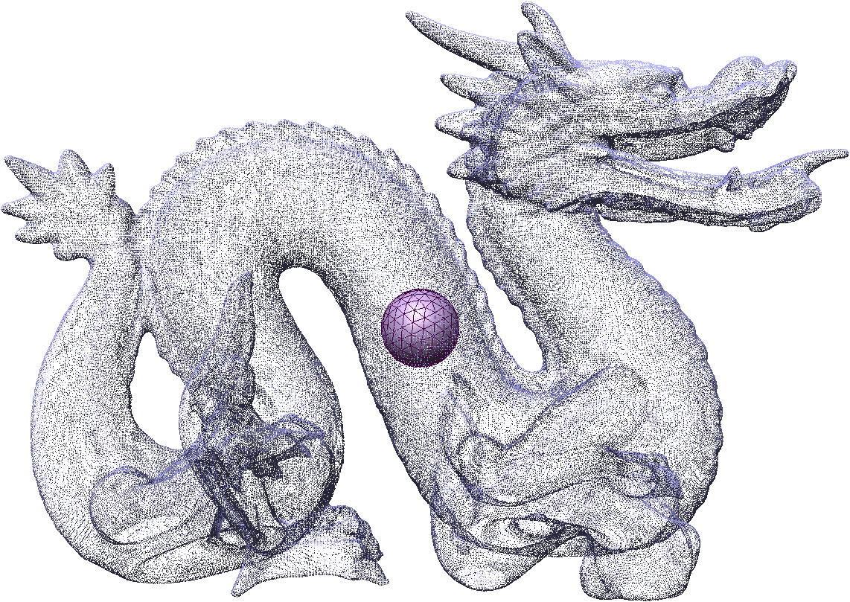
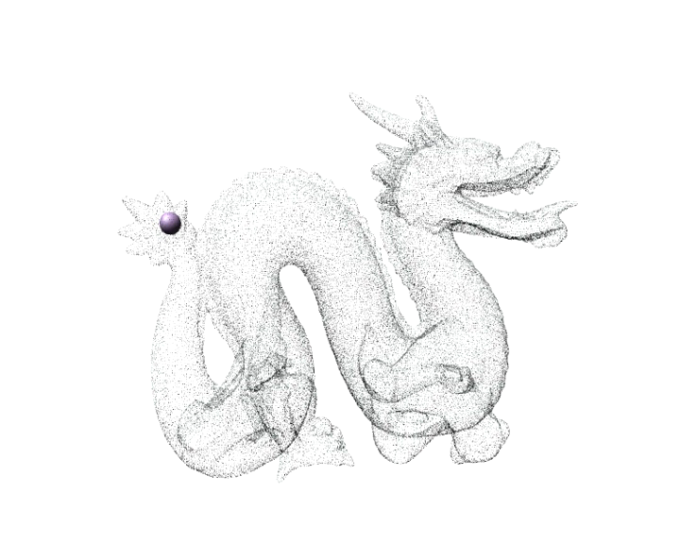
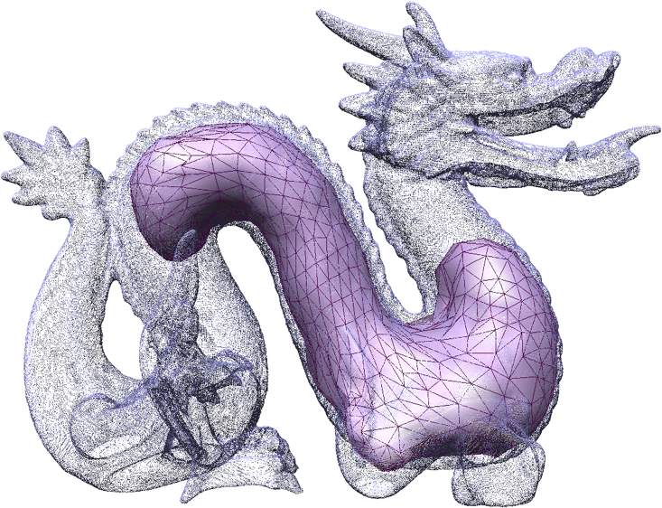
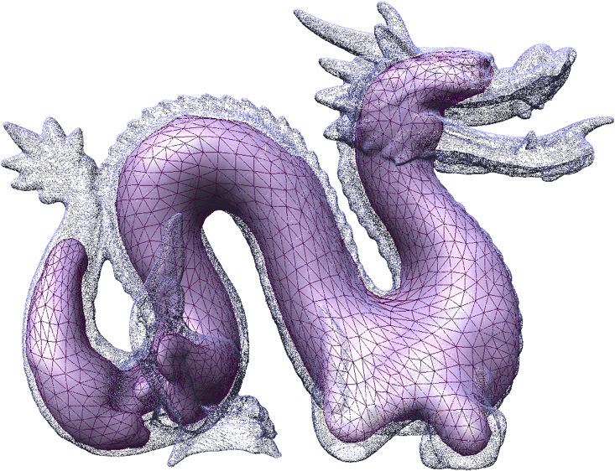
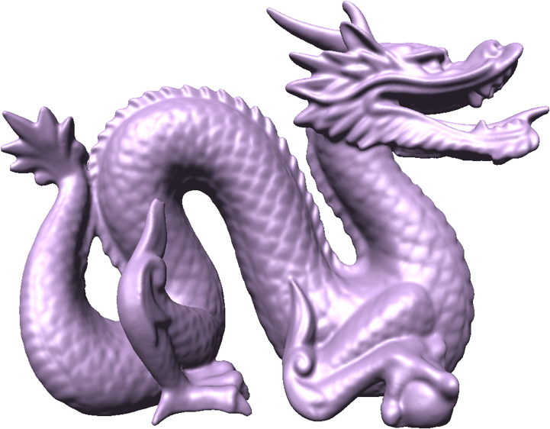
Deformable model
Sharf et al.
EG 2006

Slide 11
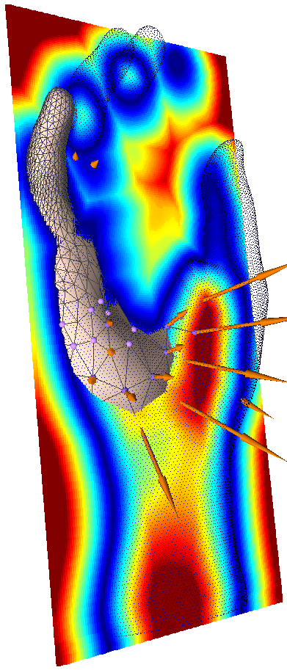
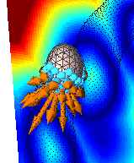
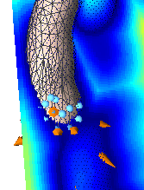
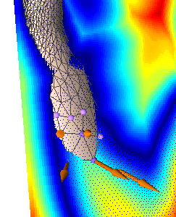
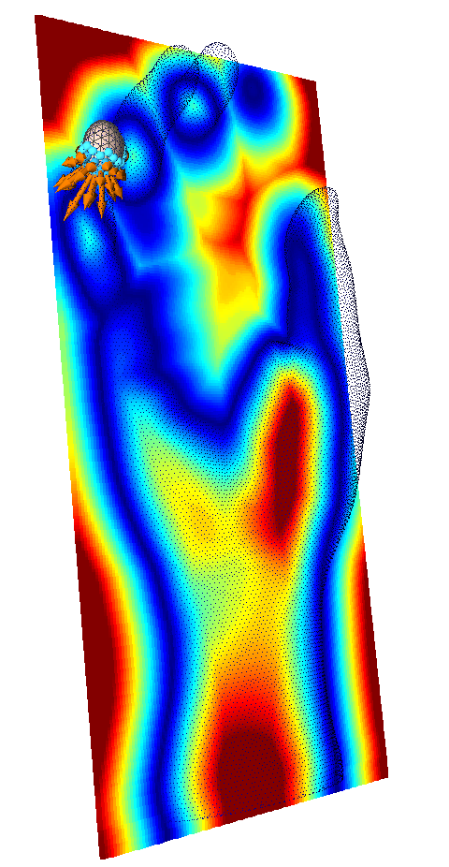

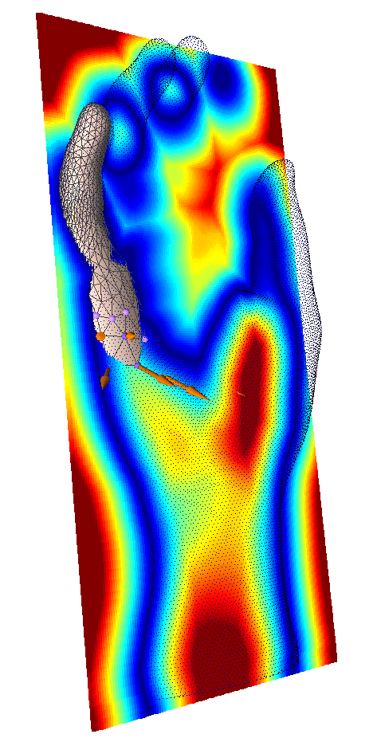
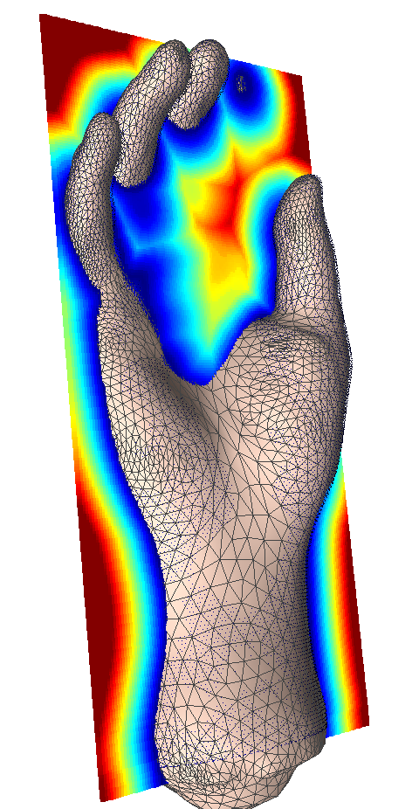
Hybrid implicit/explicit
Explicit mesh inside implicit field
Deformation along the normal

Slide 12
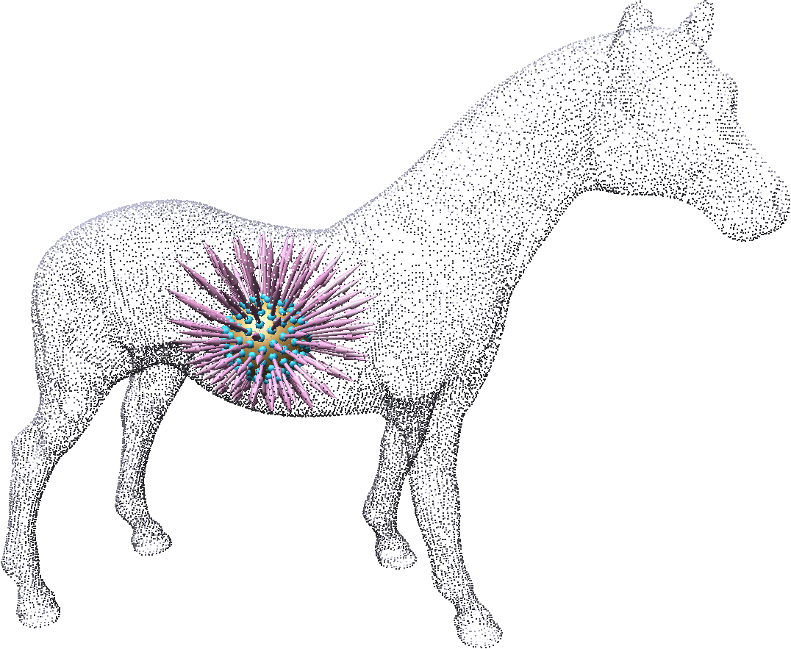
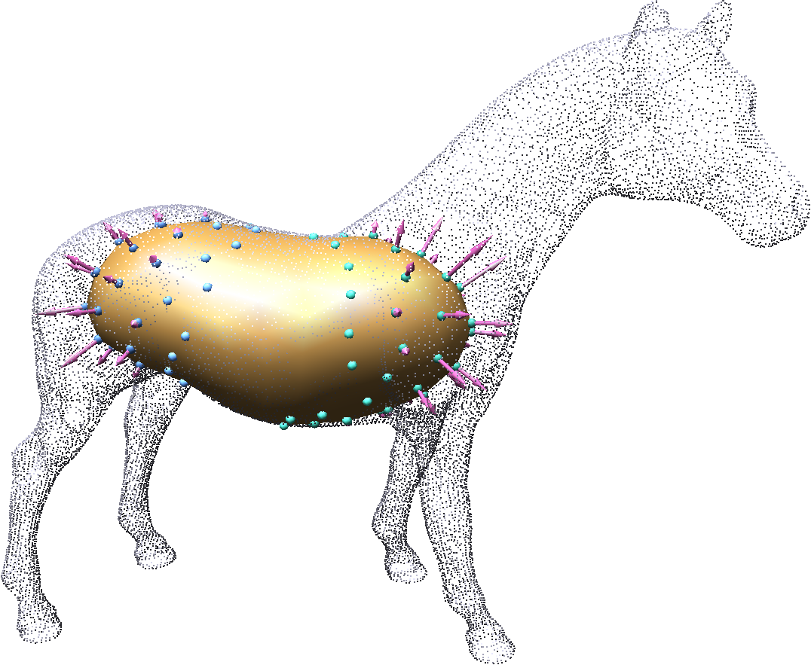
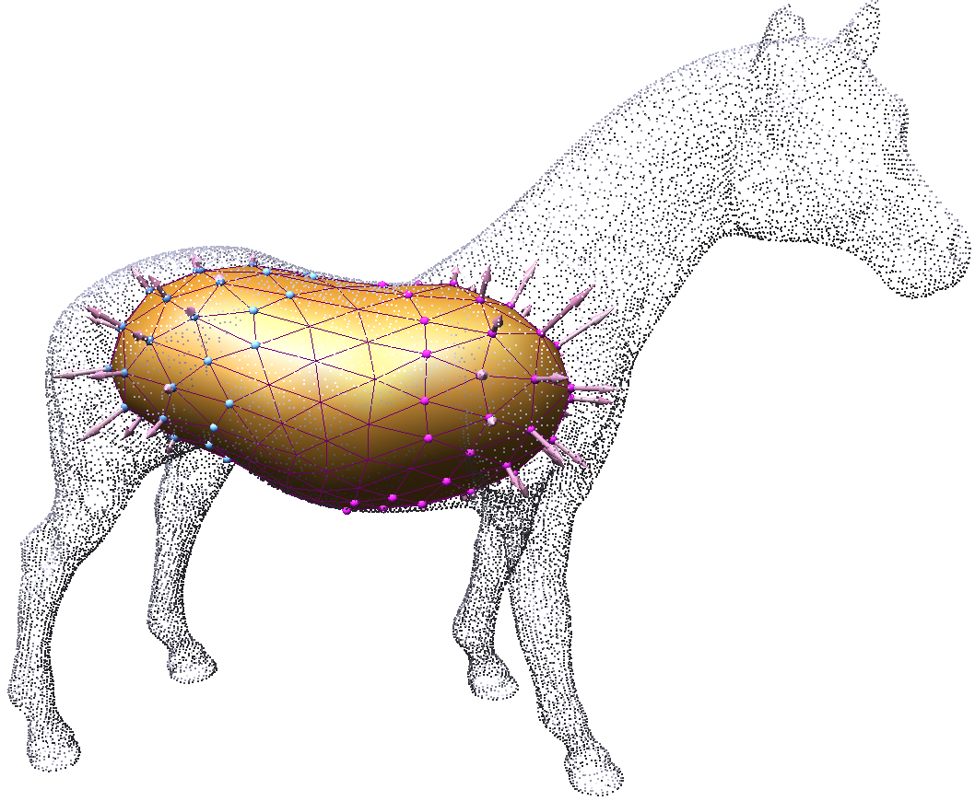
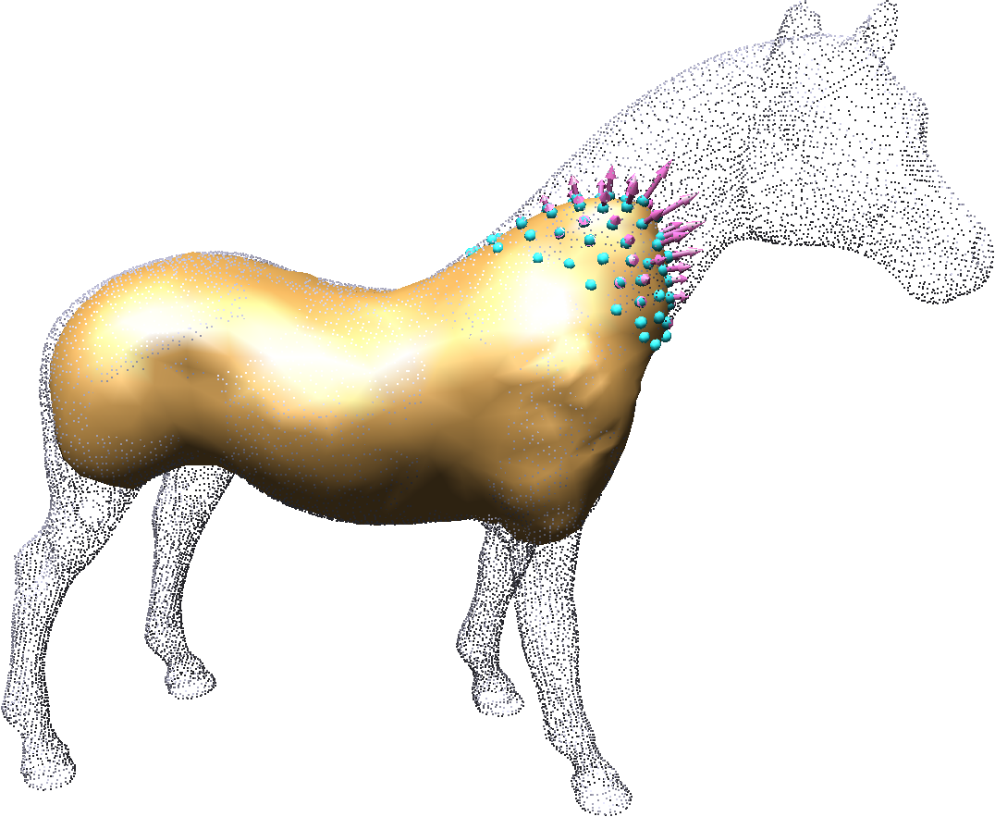
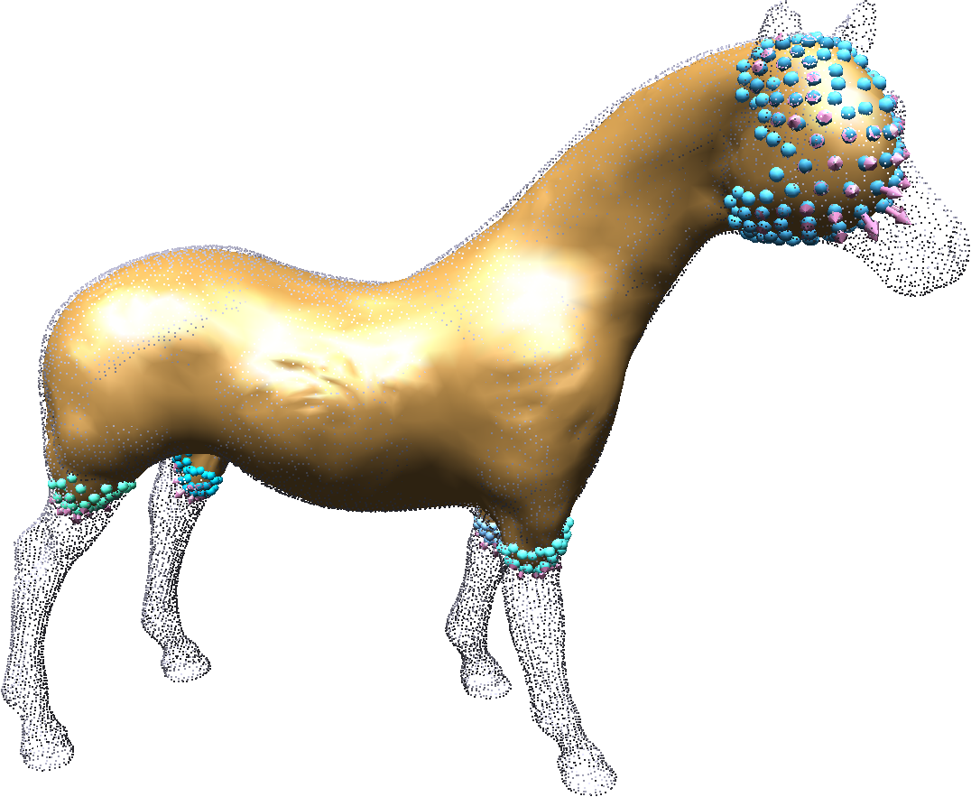
Fronts and competition
Front nº1
Front nº2
Front = connected parts
far from the model

Slide 13
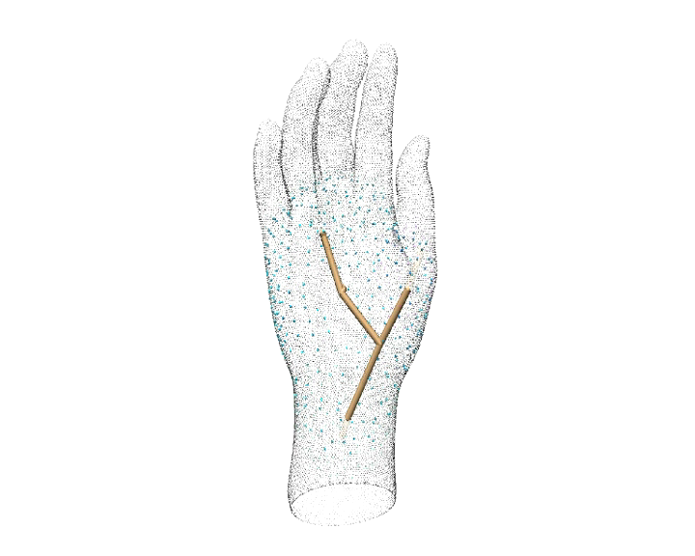
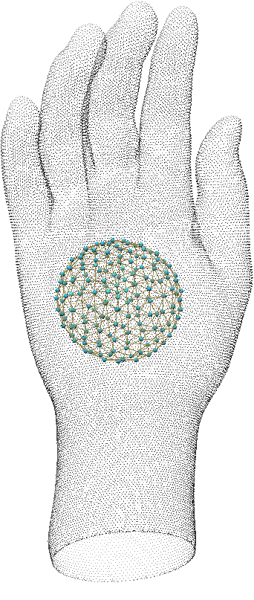
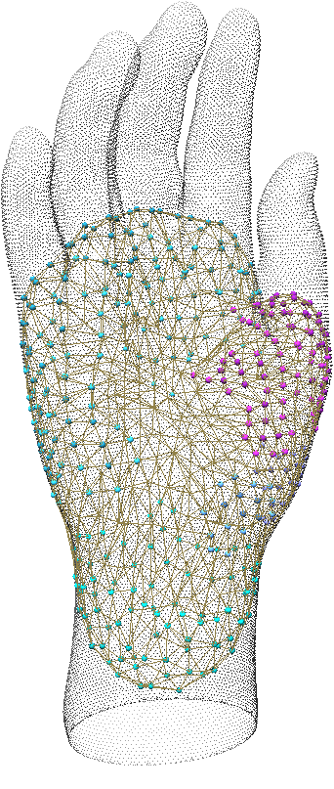
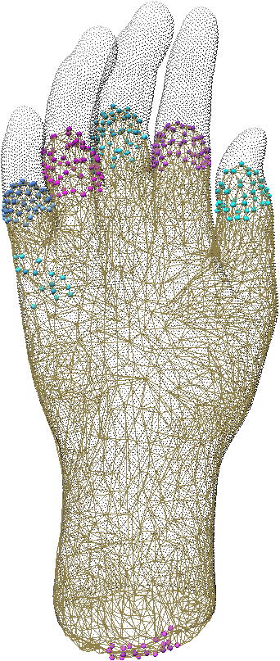

Curve-skeleton computation
1) front tracking
2) filtration

Slide 14
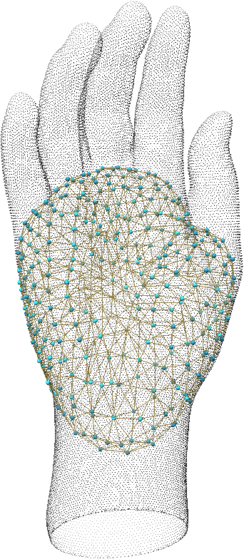
Front tracking
Skeleton id at each vertex :
front id + iteration number
Front → skeleton node
front nº2
iter n° 20
front nº2
iter n° 20
front nº1
iter n°20
front nº1
iter n°20
front nº1
iter n°10
front nº1
iter n°10

Slide 15
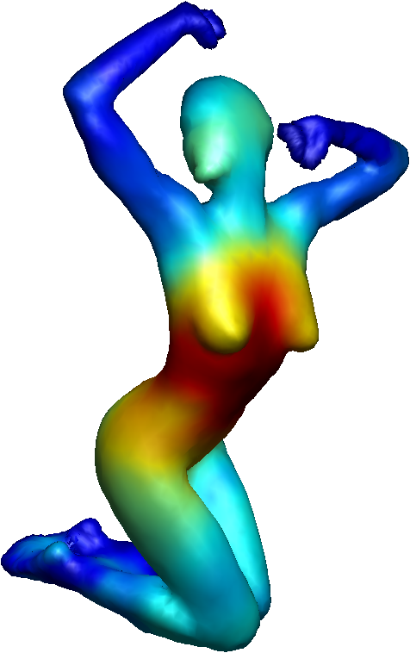
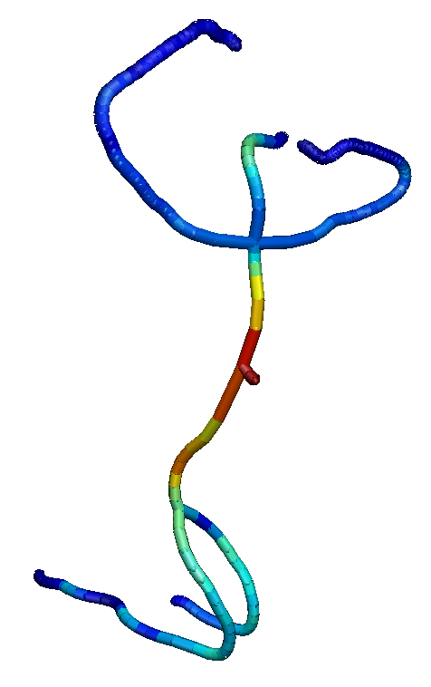
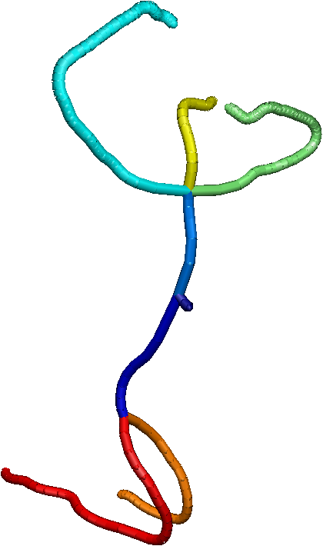
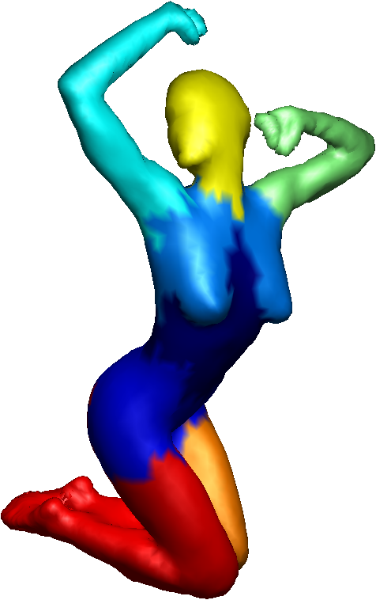
Direct correspondences
model → skeleton
skeleton → model

Slide 16
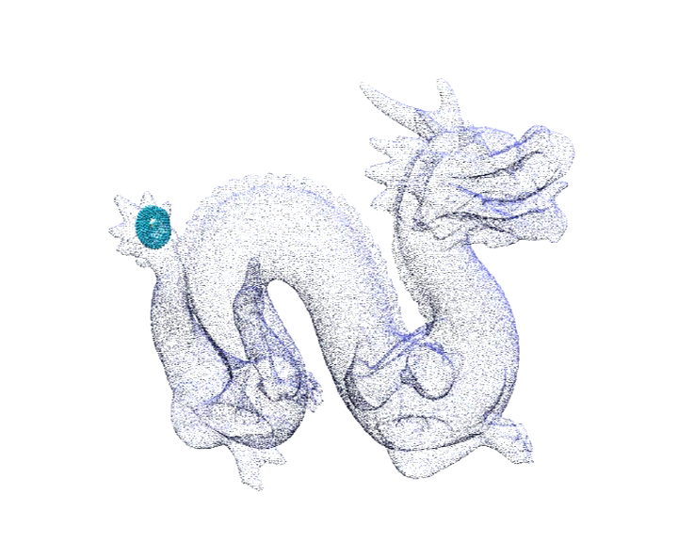
Skeleton homotopy
Topological events are
applied to the skeleton

Slide 17

Skeleton geometry
skeleton node
= front barycenter

Slide 18
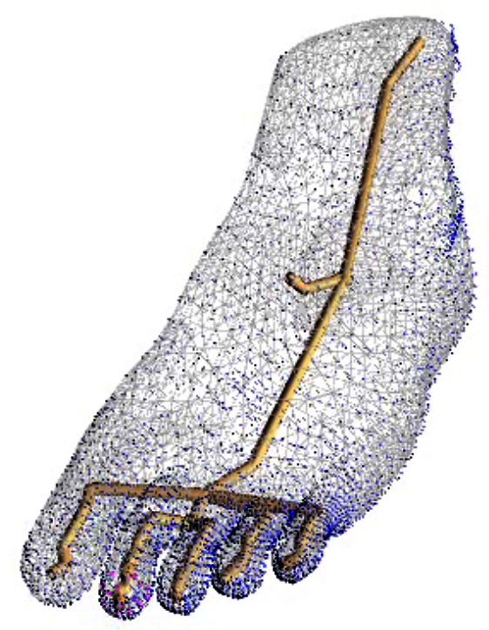
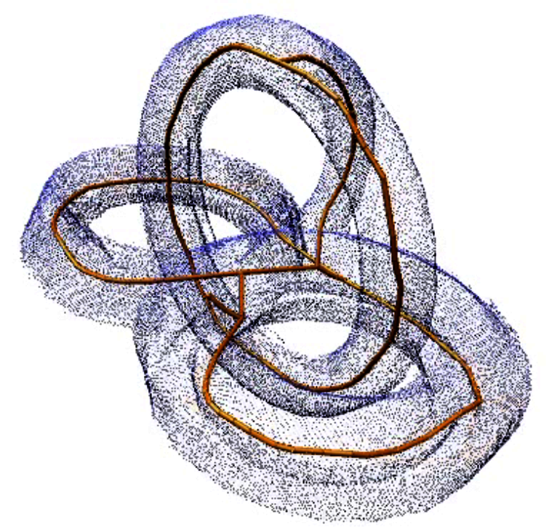
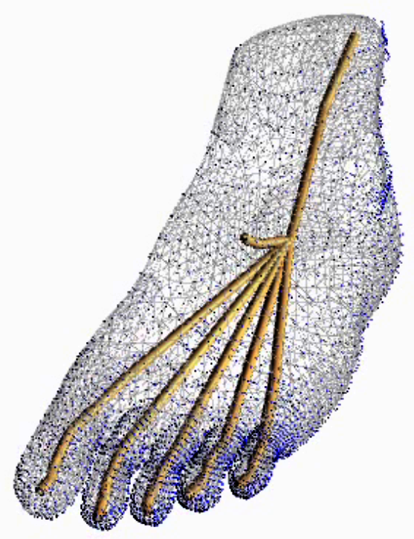
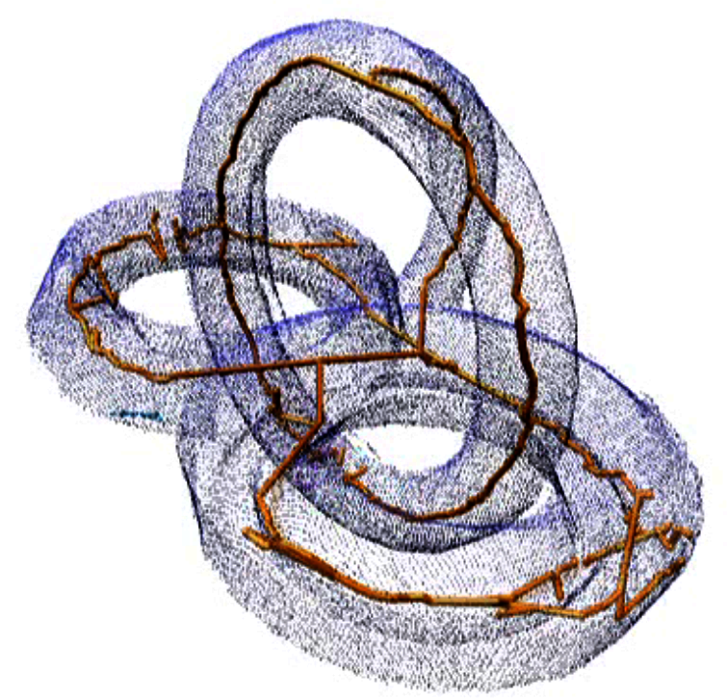
Filtering & smoothing
branch pruning & merging
smoothing between junctions

Slide 19
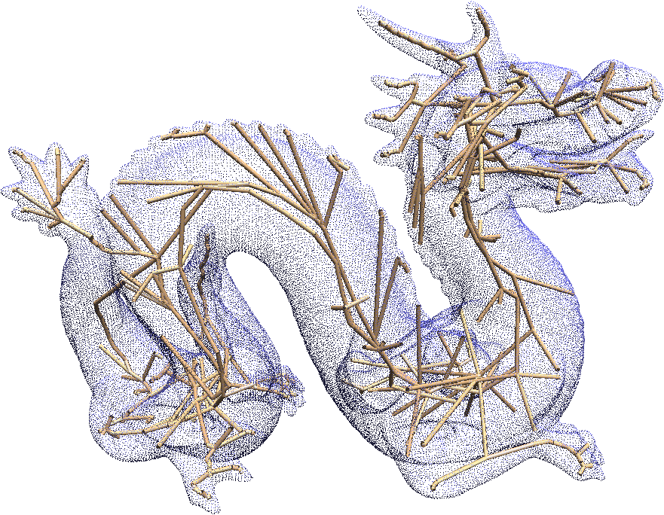



Multi-resolution
adjust the
filter threshold

Slide 20





Comparisons
distance : 16 sec
[Gagvani and Silver 1999]
thinning : 92 sec
[Palagyi and Kuba 1999]
potential : 16 min
[Cornea et al. 2005]
ours: 3 sec

Slide 21




Reliability

Slide 22



Robustness

Slide 23


Evaluation
  Homotopic
  Rigid invariant
  Thin
  Robust
  Reliable
  Efficient
  Hierarchic
  Centered

Slide 24










Future works
© bestanimation.com

Slide 25


Thank you for your attention!
http://www.mat.puc-rio.br/~tomlew
Israeli Ministry of Science
Brazilian Ministry of Science and Technology

Slide 27
Pseudo-code
1: while evolvingfronts() do
2: count++
3: for all evolving_front f do
4: create skeleton node s_{f}
5: s_{f}.arc_id := ( count, f )
6: for all vertex v in front f do
7: (old_count, old_f) = v.arc_id
8: Arcs += [ ( old_count, old_f ) , ( count, f ) ]
9: v.arc_id := ( count, f )
10: filter(Arcs)
11: remap vertices to skeleton nodes
12: return Arcs

Slide 28
Filtration parameters
Connectivity simplification
  prune + merge of :
  short arcs
  arcs with low front tension
Geometry simplification :
  spline filter smoothing
  between junctions
Preserves topology

Slide 29





Topology control

Slide 30


Front evolution
Attraction (E_{a})
  Outward normal direction
  Unsigned distance field speed
Tension (w)
  Laplacian operator (E_{t})
Laplace system:
Local re-meshing and subdivision
E_{a}
E_{t}

Slide 31




Fronts competition

Slide 32

Distance field
Adaptive octree structure :
  Point set :
  CRBF/PU & distance-field
  Polygonal model / Implicit model :
  distance transform

Slide 33




Adaptive mesh

Slide 34
Final projection
ε-close + Orthomap

