Slide 1
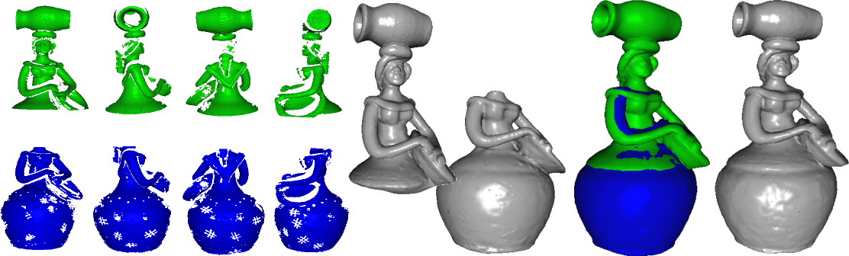
An iterative framework for registration with reconstruction
Thales Vieira – PUC-Rio / UFAL / IMPA
Adelailson Peixoto – UFAL
Luiz Velho – IMPA
Thomas Lewiner – PUC-Rio

Slide 2
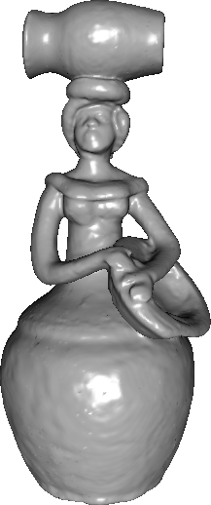
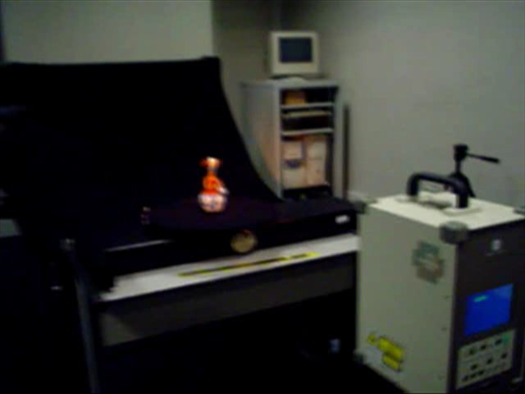
3D scanning
Real object
Digital model

Slide 3
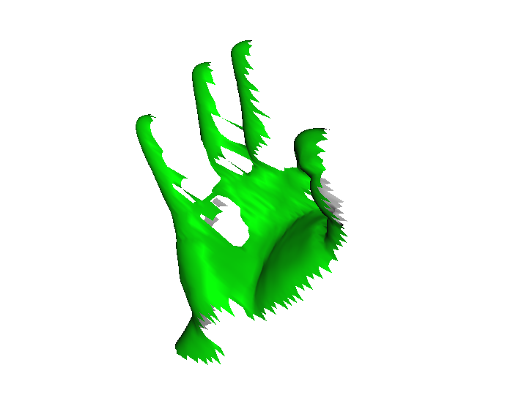
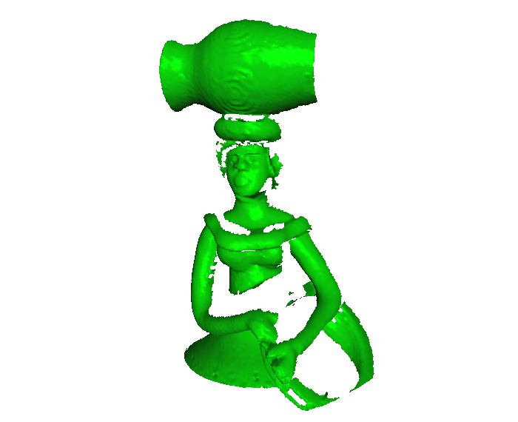
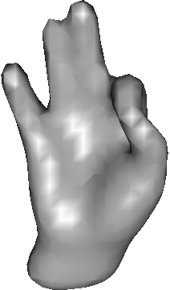
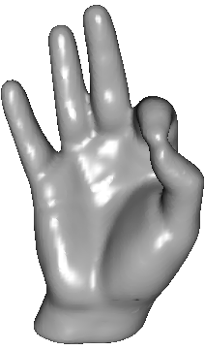
Challenges
Missing parts
Measure defects
Noise
Accurate representation

Slide 4
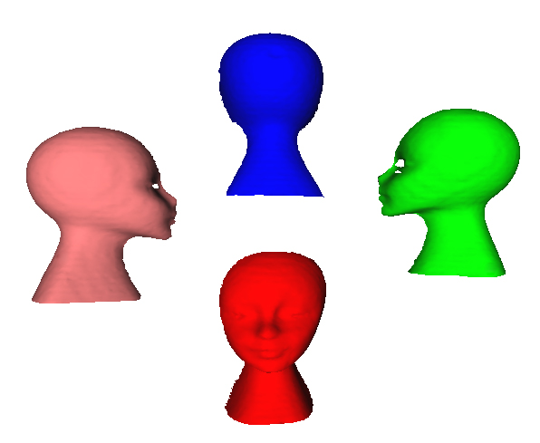
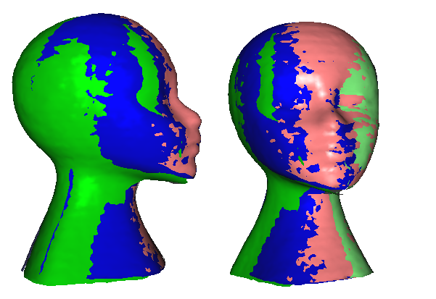
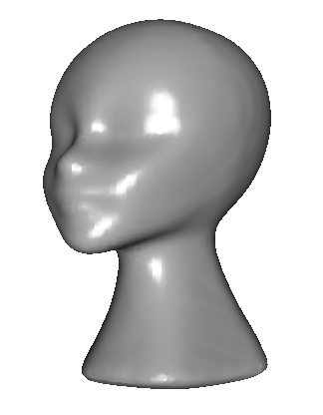
Classical approach
Scanning
Registration
Reconstruction
Problems:
global misalignment ➔ bad reconstruction
reconstruction priors not used for registration

Slide 5
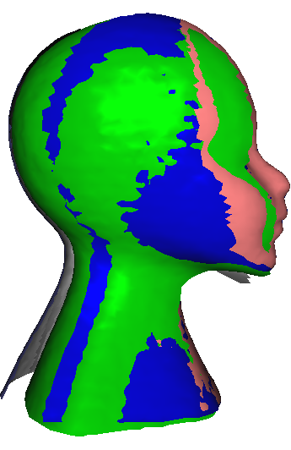
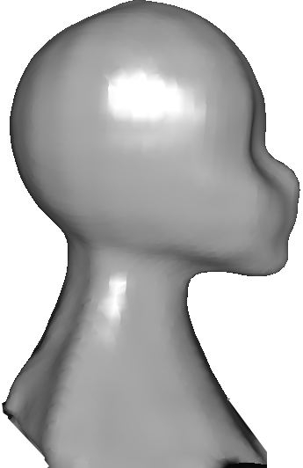
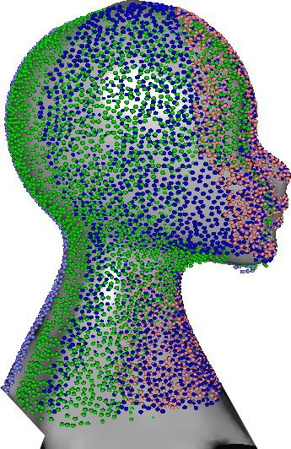
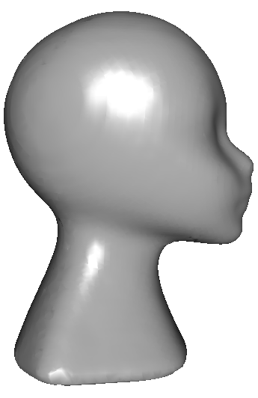
Our approach
Iterative registration/reconstruction global coherence
scans are meshes and reconstruction generates a mesh
Intermediate
registration
Intermediate
reconstruction
Realignment
Final
reconstruction

Slide 6
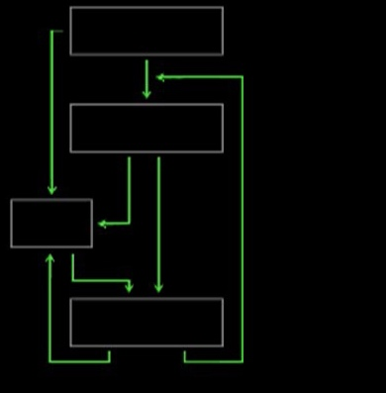
Summary
Framework Elementary Steps
  Initial positioning
  Alignment
  Reconstruction
Registration with Reconstruction Framework
  Basic Framework
  Overlapping maximization
  Dynamic registration
  Divergence correction
  Multi-resolution

Slide 7
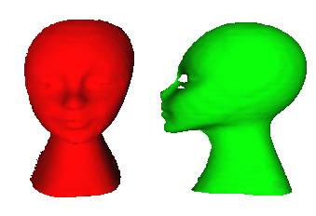
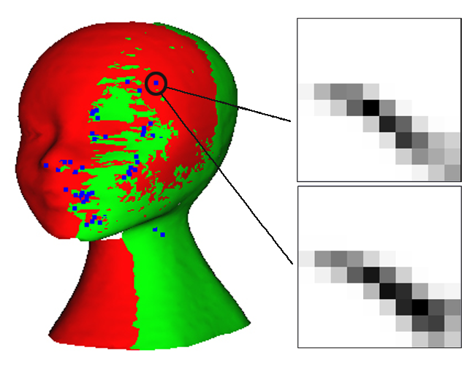
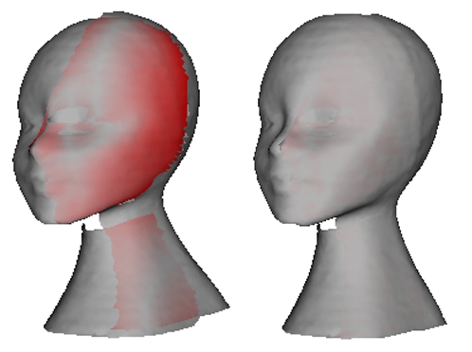
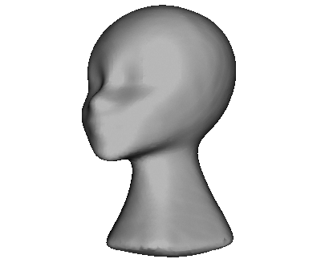
Framework Elementary Steps
Initial positioning
Alignment
Reconstruction

Slide 8
Initial Positioning:
Spin-image Descriptors
Gray-scale image.
Describes surface shape around a reference point.
Bidimensional radial coordinate system
Invariant to rigid transformations

Slide 9
Alignment:
Point-to-point ICP Algorithm
Iteratively refines an alignment of two meshes

Slide 10
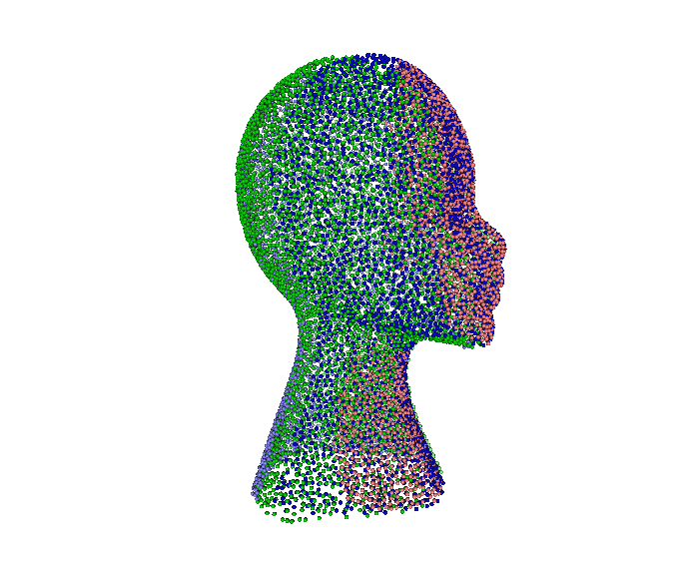
Reconstruction
Continuous surface representation from a set of isolated points in space.
Sample implementation : MPU and Poisson

Slide 11
Registration with Reconstruction Framework
positioning
alignment
reconstruction

Slide 12
Basic Framework
Initial
pairwise
registration
Intermediate
reconstruction
Realignment
with reconstruction
Final
reconstruction
Basic Framework

Slide 13
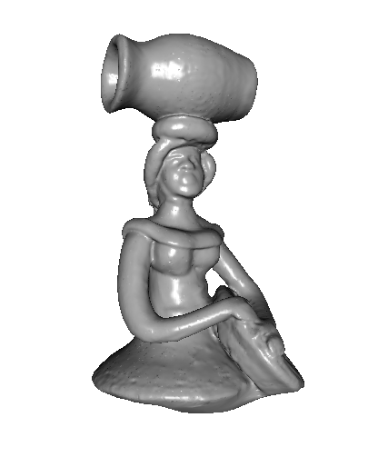
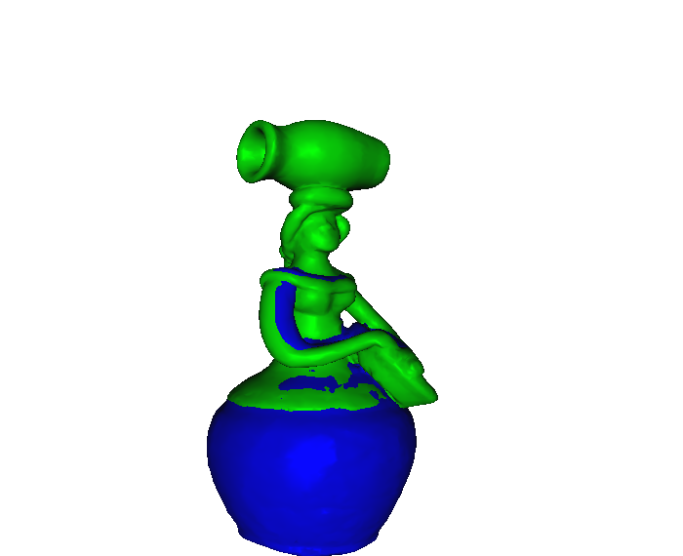
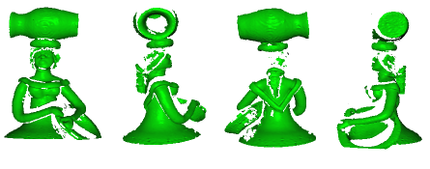
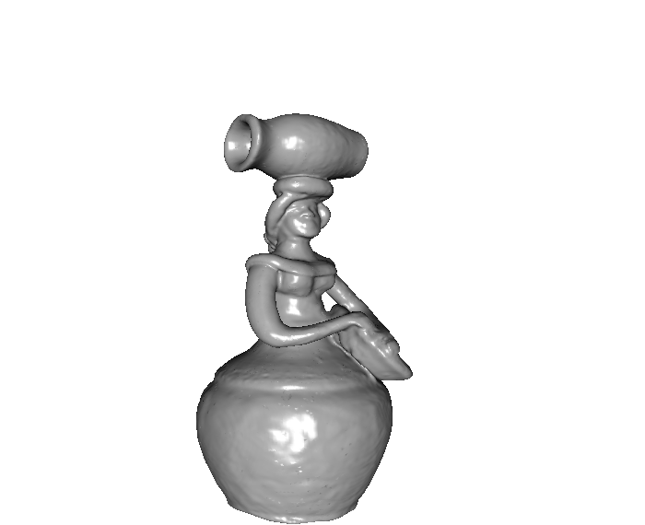
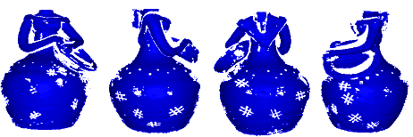
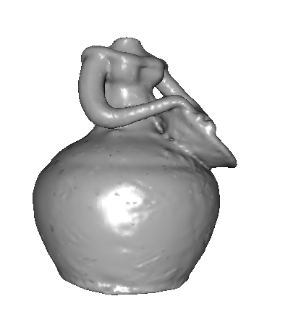
Overlapping Maximization
Scans
Reconstruction
First session
Scans
Reconstruction
Bigger overlap
alignment
Final
reconstruction
Second session

Slide 14
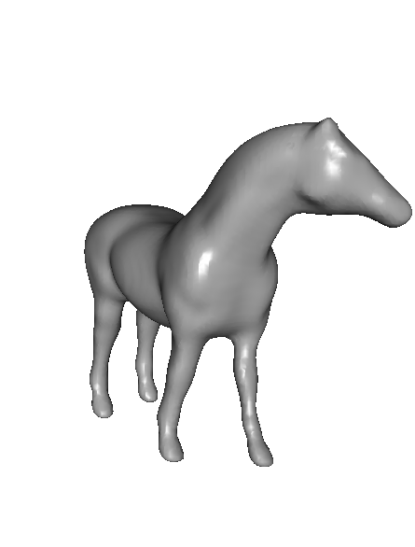
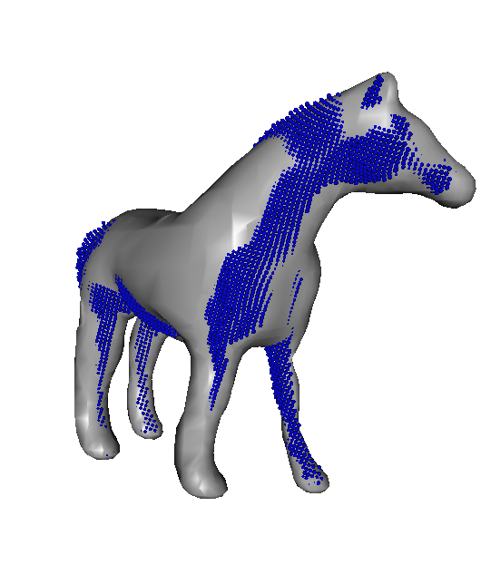
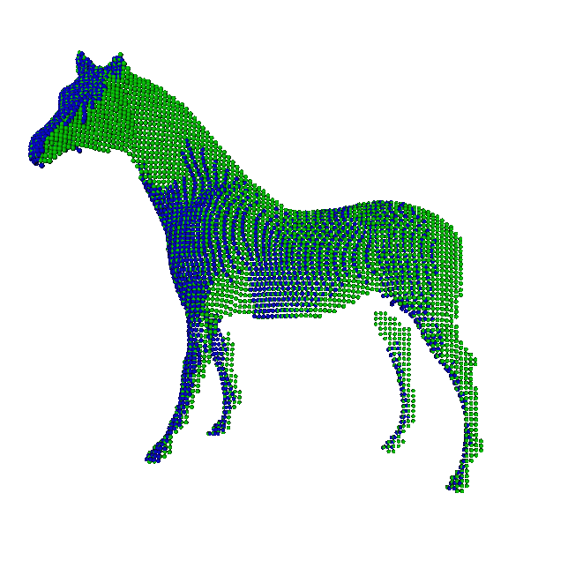
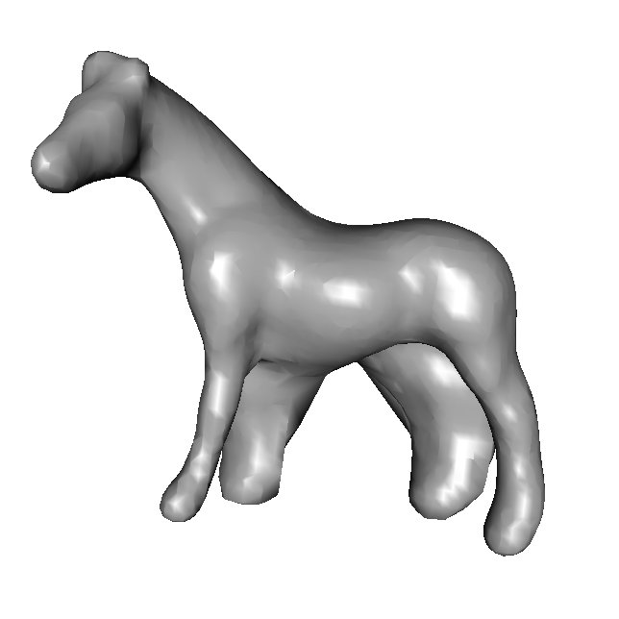
Dynamic Registration
Initial
pairwise
registration
New scan
alignment with
reconstruction
Intermediate
reconstruction
Final
reconstruction
Dynamic Registration

Slide 15
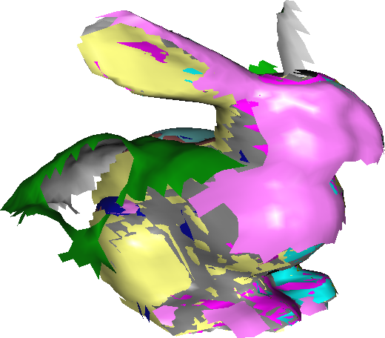
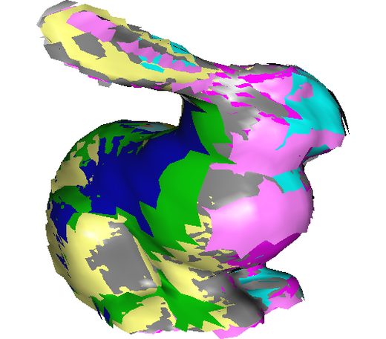
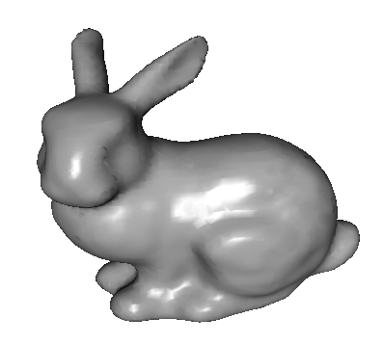
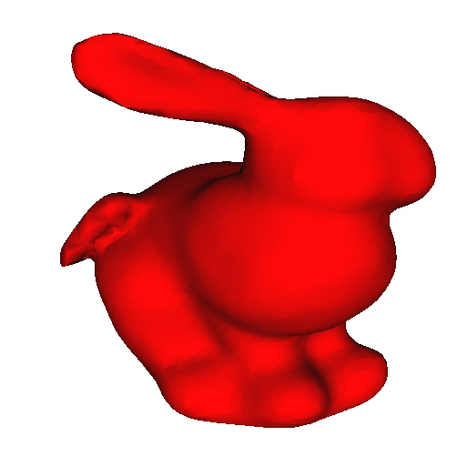
Divergence correction
Initial alignment
Error > ε ?
Scan
Repositioning
Final
reconstruction
Initial reconstruction

Slide 16
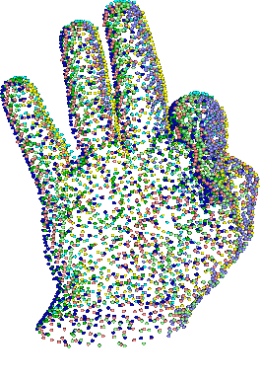
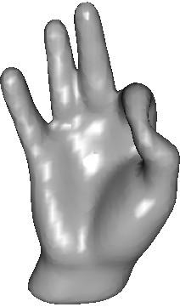
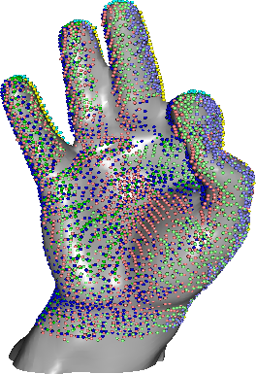
Multiresolution
Lower resolution
pairwise registration
Lower resolution
reconstruction
Higher scans
alignment with lower
reconstruction
Final
reconstruction
Multiresolution

Slide 17
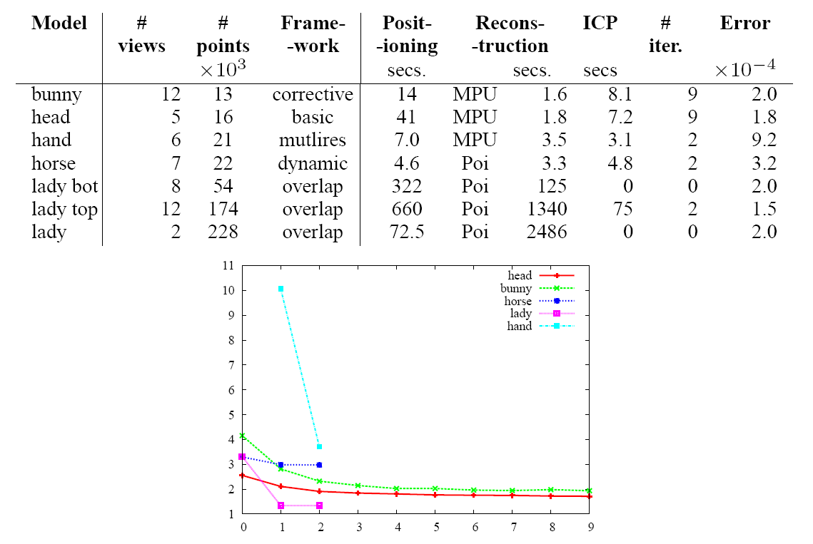
Experiments

Slide 18
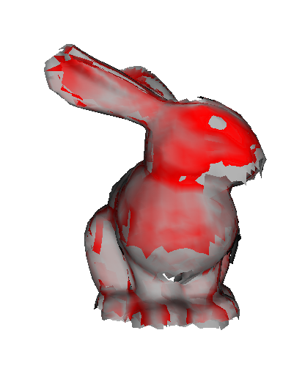
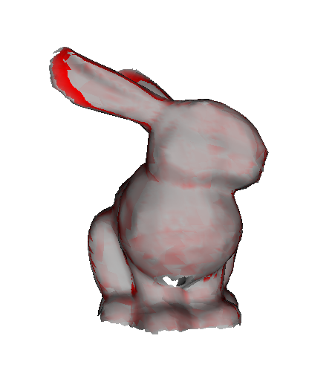
Conclusions
Precision
  Significant improvement compared to classical approach.
  Similar using MPU or Poisson Reconstruction.
Limitations
  Data structure integration for registration/reconstruction depends on the methods used.

Slide 19
References
P. J. Besl and N. D. Mckay. A method for registration of 3D shapes. Pattern Analysis and Machine Intelligence, 14(2):239–256, Feb. 1992.
A. Johnson. Spin-Images: A Representation for 3D Surface Matching. PhD thesis, Carnegie Mellon University, Pittsburgh, Aug. 1997. Advised by Martial Hebert.
M. Kazhdan, M. Bolitho, and H. Hoppe. Poisson surface reconstruction. In Symposium on Geometry Processing, pages 61–70. ACM/Eurographics, 2006.
Y. Ohtake, A. Belyaev,M. Alexa, G. Turk, and H.-P. Seidel. Multi-level partition of unity implicits. In Siggraph, volume 22, pages 463–470, New York, 2003. ACM.
H. Jin, H. Hoppe, T. Duchamp, J. A. McDonald, K. Pulli, and W. Stuetzle. Surface reconstruction from misregistered data. In Human Vision and Electronic Imaging, pages 324–328. SPIE, 1995.

Slide 20

Overview

Slide 21
Thank you for your attention!
http://www.mat.puc-rio.br/~thalesv

