Slide 1
Projective Estimators for Point/Tangent Representations of Planar Curves
Thomas Lewiner/ Marcos Craizer
Dep. Matemática -PUC-Rio

Slide 2



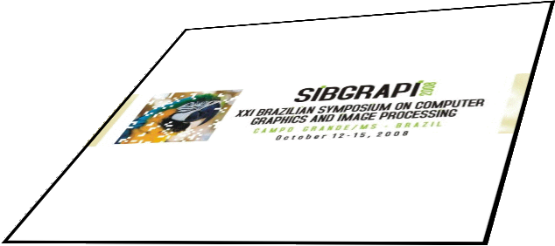
T

Slide 3
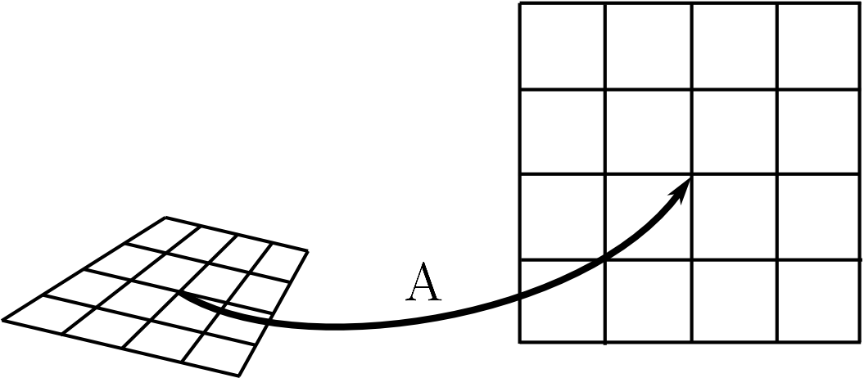
Projective Geometry
Projective Geometry :
  Invariance by translations, rotations, shearing and projections.

Slide 4
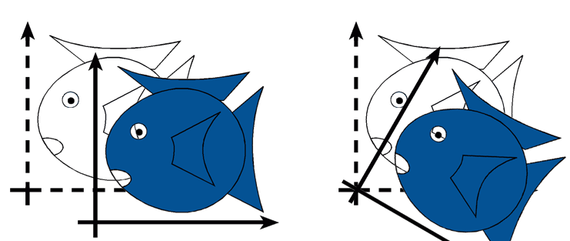
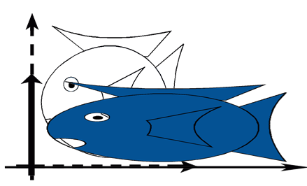
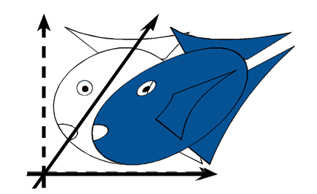
Euclidean and
Affine Geometry
Euclidean Geometry:
  Invariance by translations and rotations.
Affine Geometry:
  Invariance by translations, rotations and shearing.

Slide 5
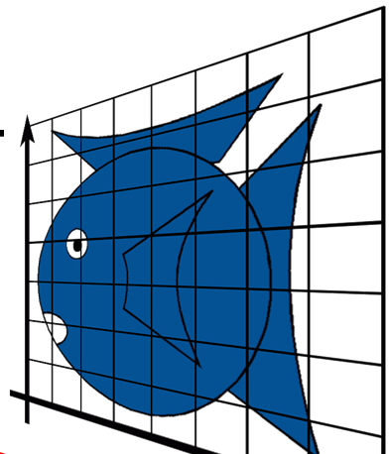

Projective Transformations in homogeneous coordinates
Assuming det T=1 → 8 parameters

Slide 6
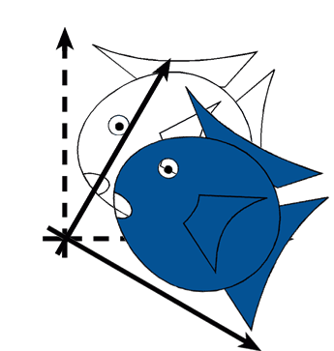
Affine and Euclidean Transformations
Assuming det T=1 → 5 parameters
Assuming det T=1 → 3 parameters

Slide 7
Euclidean and Affine Invariants
Euclidean length and curvature
Affine length and curvature
Differential Invariant of order 2.
Differential Invariant of order 4!

Slide 8
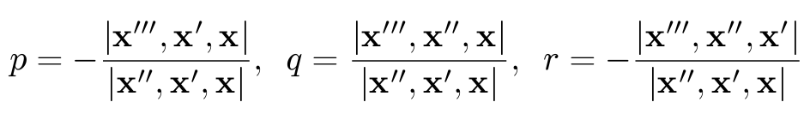

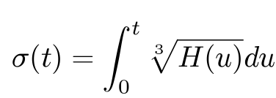



Projective Length and Curvature
Differential Invariant of order 7!!

Slide 9
Euclidean Estimators
Plenty of estimators proposed in the literature.
  Example: The euclidean length of a polygon is the sum of the lengths of its sides. And the total curvature of a polygon is the sum of its external angles.

Slide 10
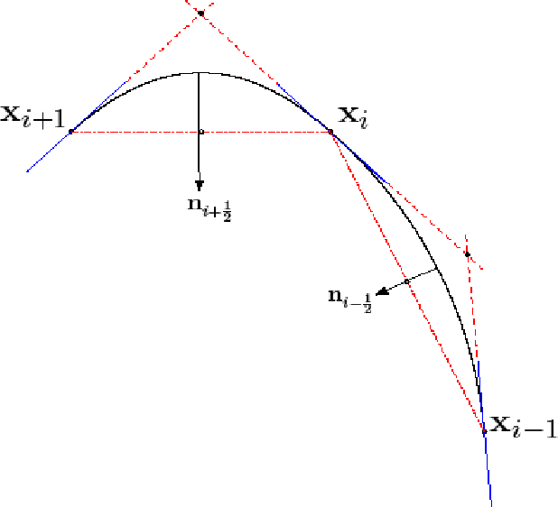
Parabolic Polygons
Quadratic Spline
SIBGRAPI 2006

Slide 11
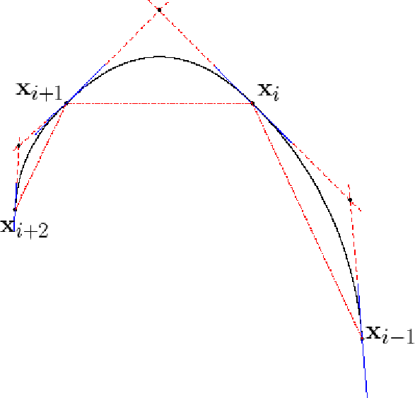
Affine Estimators-Signature
  Estimator for the derivative of the affine curvature with respect to affine
  arc-length.
Convergent and Affine Invariant

Slide 12
Projective length estimator
Although convergent, this estimator is not projective invariant.

Slide 13
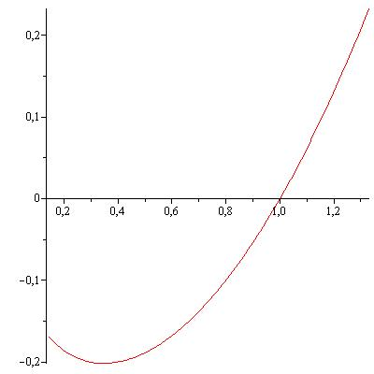
Curves with constant projective curvature: Spirals

Slide 14
General Spiral
General spiral with zero projective curvature:
Assuming det T=1 → 8 parameters

Slide 15
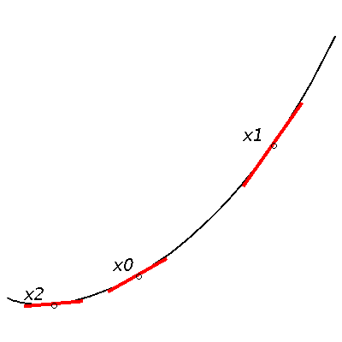
Adapting spirals to three point/tangent pairs
  Unknowns: 8 parameters + 2 projective lengths σ.
  Knowns: 3 points + 3 tangents → 9 data
Underdetermined system !!
We must estimate first the projective legths. Options:
  Use the affine estimator for projective lengths.
  Projective estimation by geometric methods (on going work).

Slide 16
Adapting spirals to three point/tangent pairs
After estimating 2 projective lengths
→ 8 parameters and 9 data
We drop the middle tangency condition

Slide 17
Linear equations for the fitting problem
Known projective lengths σj
  15 unknowns and
  15 linear equations.

Slide 18
Curvature Estimator
Frenet Formulas
  From the Frenet thriedron at each sample, one can estimate the curvature k by:
  where

Slide 19
Results
Length estimator
Curvature estimator with exact length
Curvature estimator with estimated length

Slide 20
Convergence
Length estimator
Curvature estimator with exact length
Curvature estimator with estimated length

Slide 21
Projective Invariance
Length estimator of the transformed curve
Curvature estimator of the transformed curve
from exact lengths
Curvature estimator of the transformed curve
from estimated lengths

Slide 22
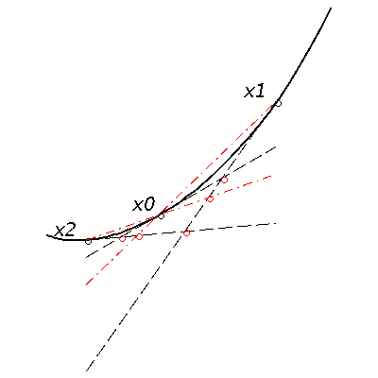
On-going works
  Estimators guaranteeing invariance more than convergence (projective spline).
  Direct geometric construction.
  Statistical scheme to cope with noise.

Slide 23
Thank you for your attention!

