Slide 1
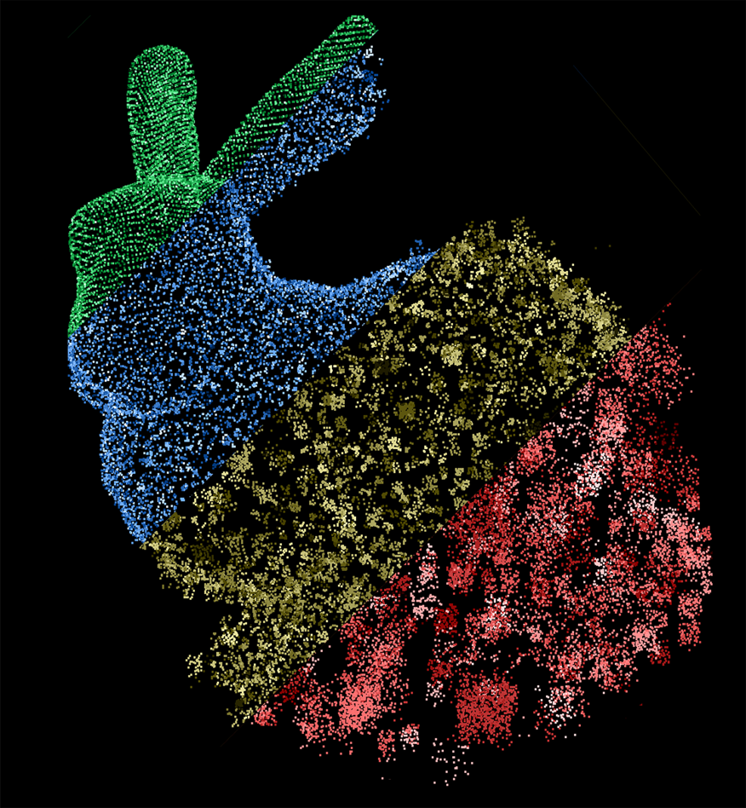
Point-set compression through BSP quantization
A. Bordignon, T. Lewiner, H. Lopes,
G. Tavares and R. Castro
Departamento de Matemática – PUC-Rio

Slide 2
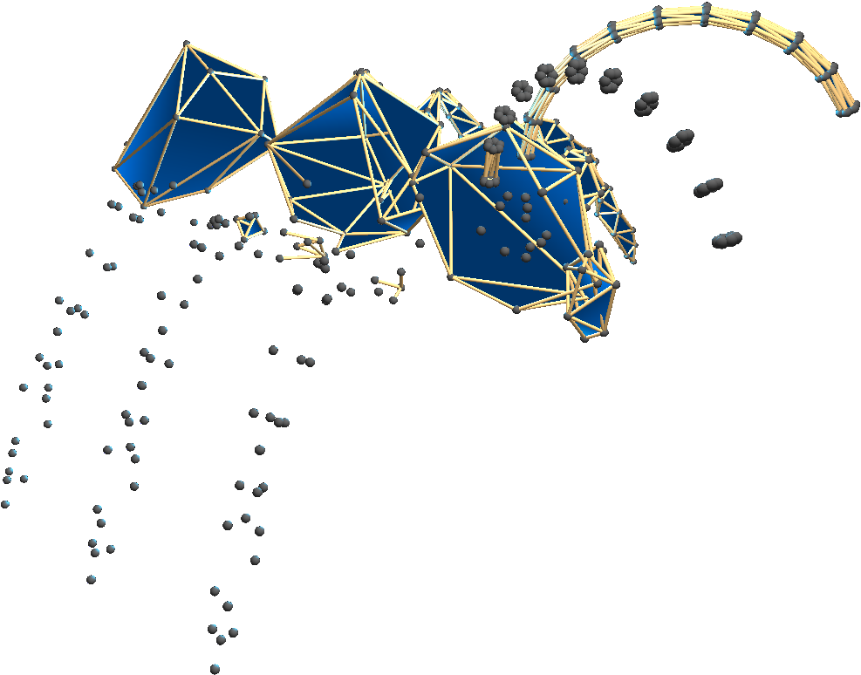
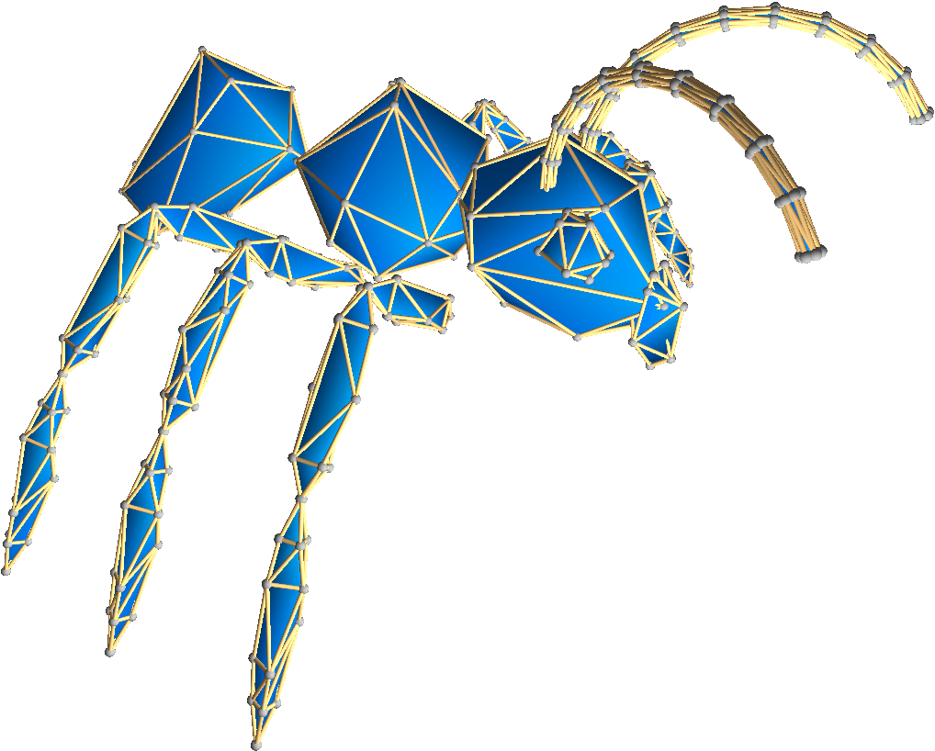
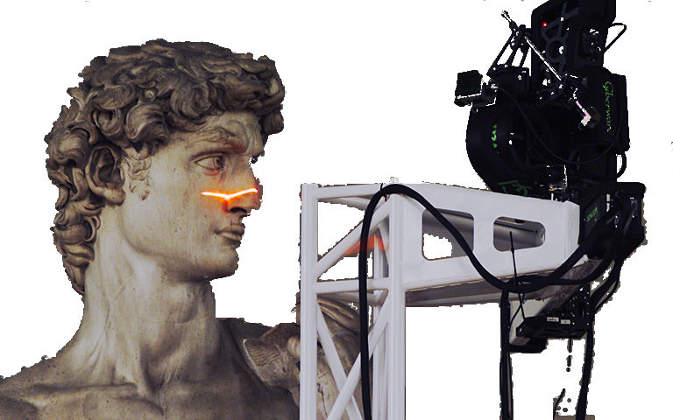
Point sets

Slide 3
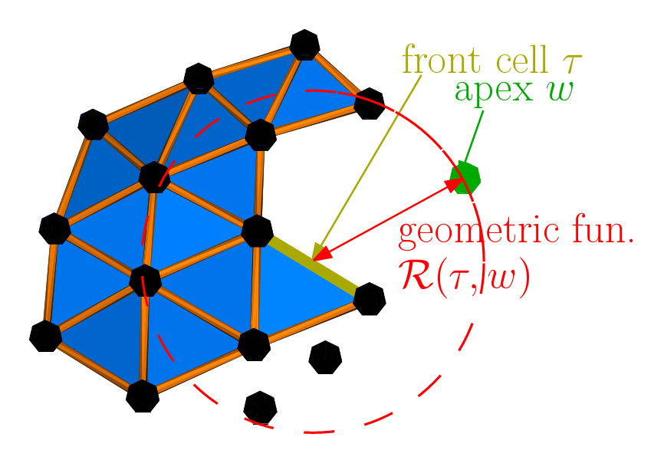
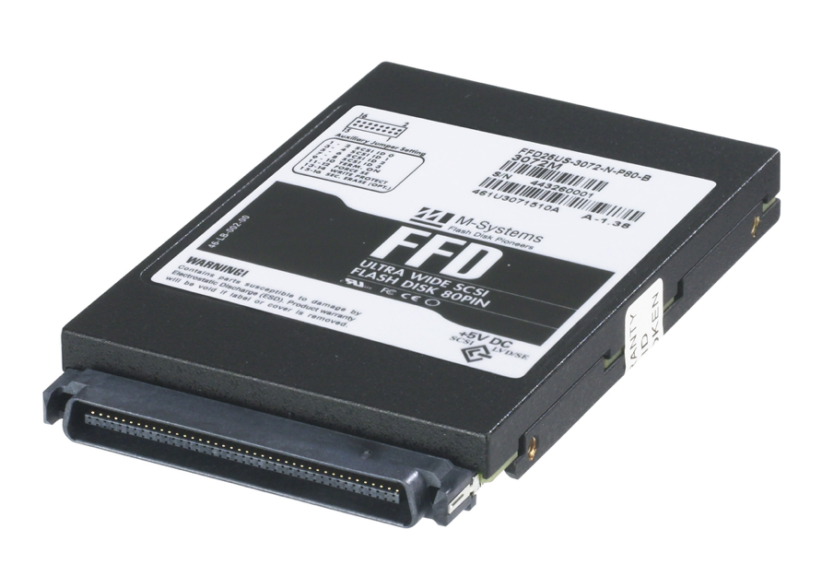
Compression

Slide 4
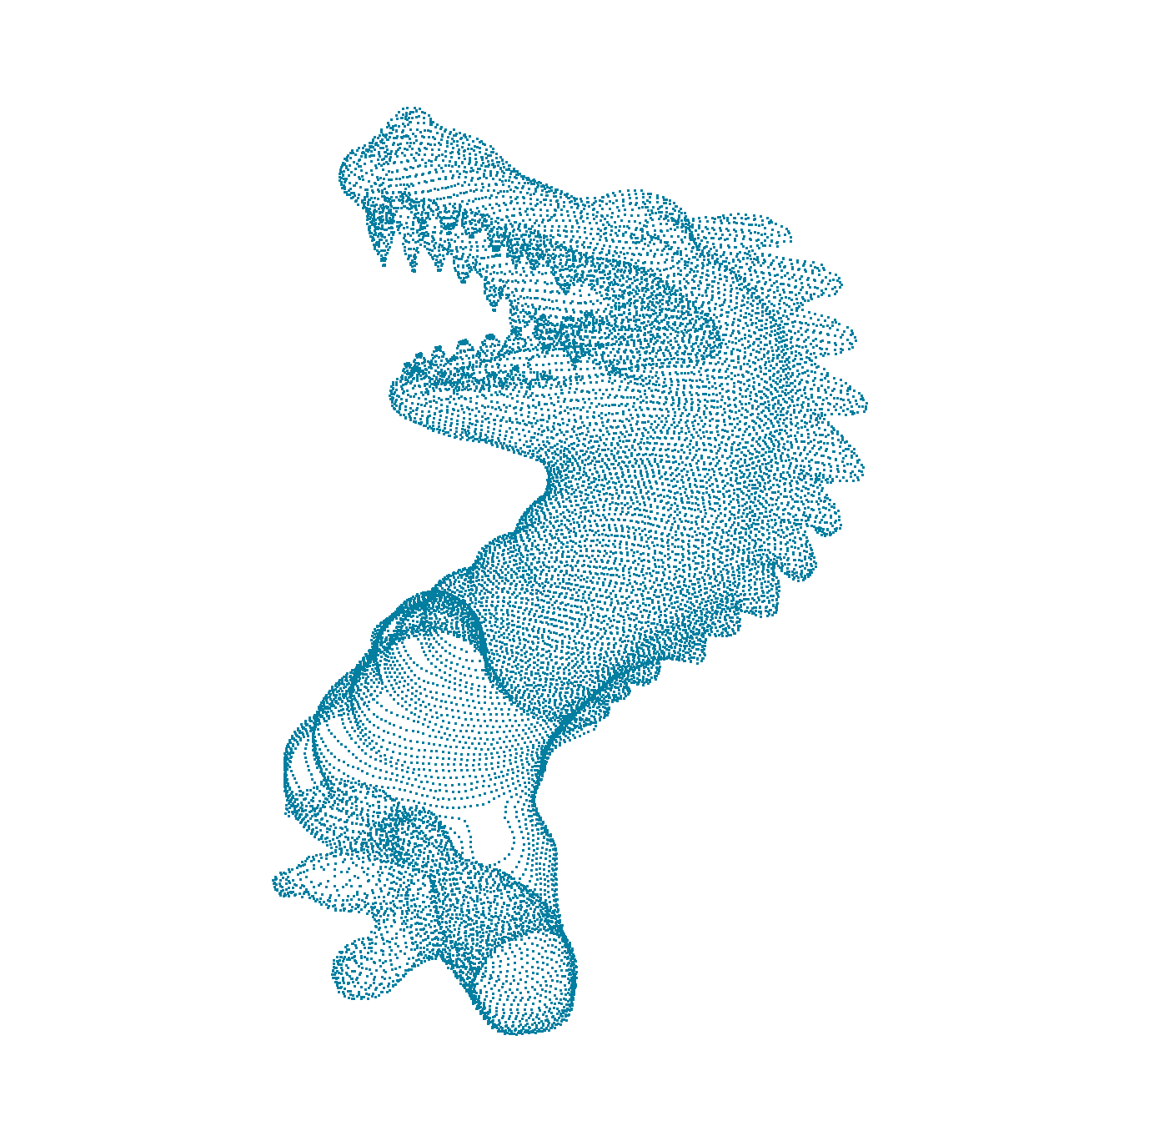
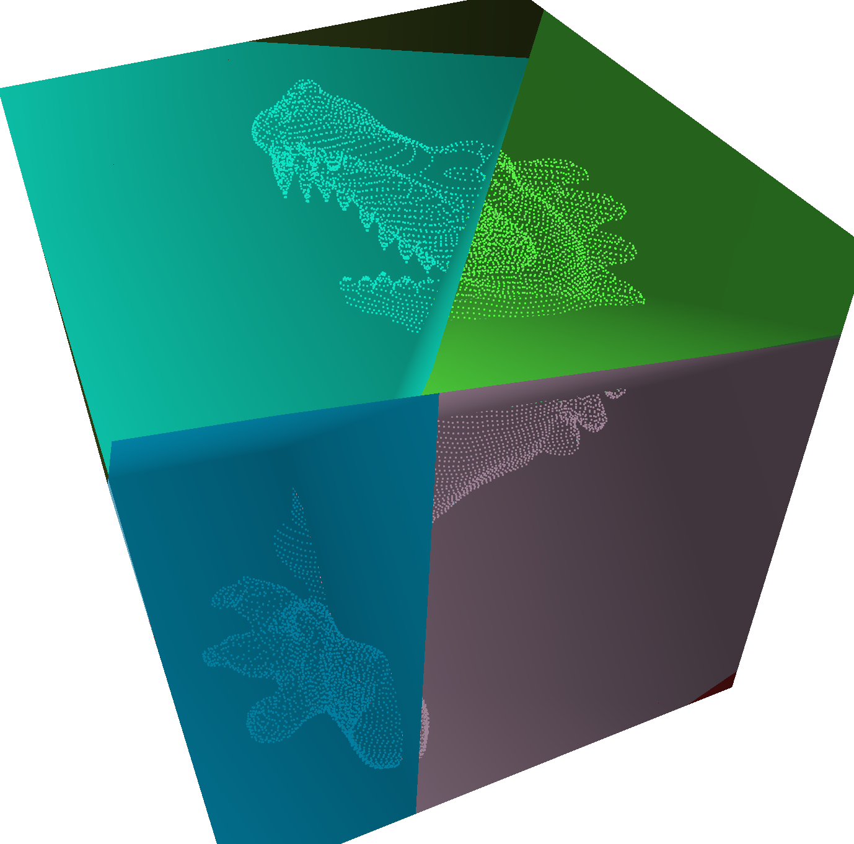
Contributions
Geometry compression with geometry instead of combinatorics
BSP quantization
Progressive compression
15% improvements in compression ratios

Slide 5
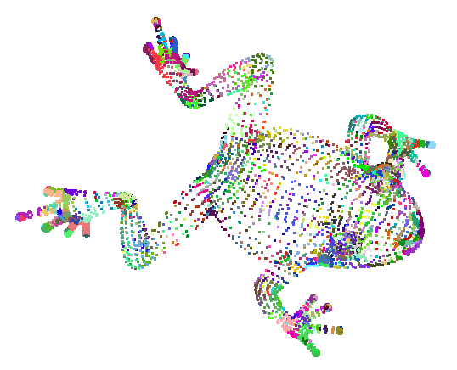
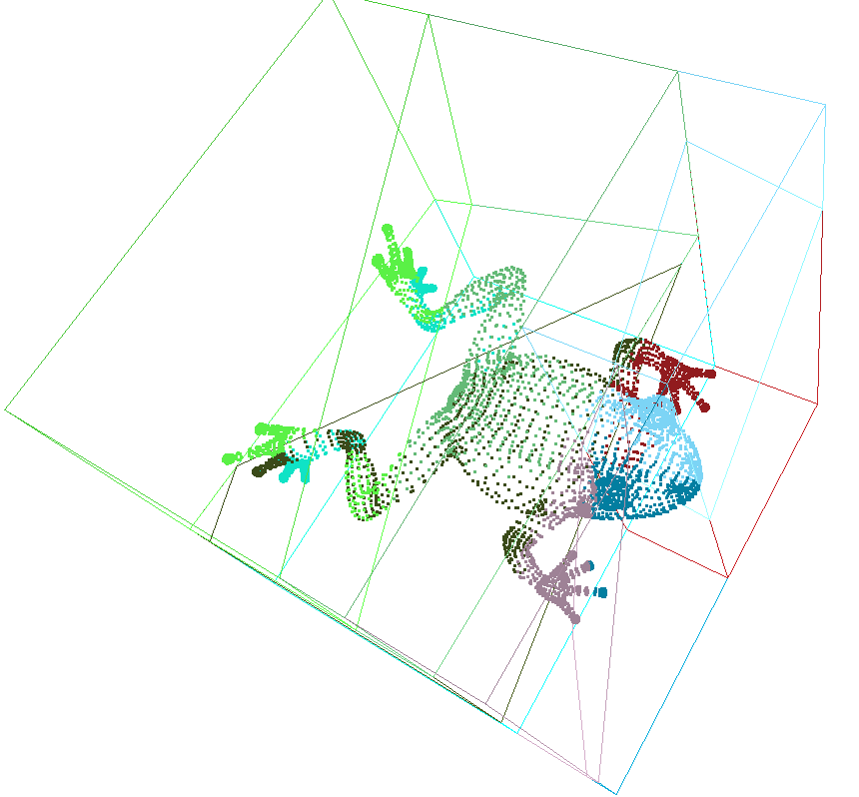
Overview
  Tree-based compression
  Cost repartition
  BSP generation
  Adaptative quantization
  Results

Slide 6
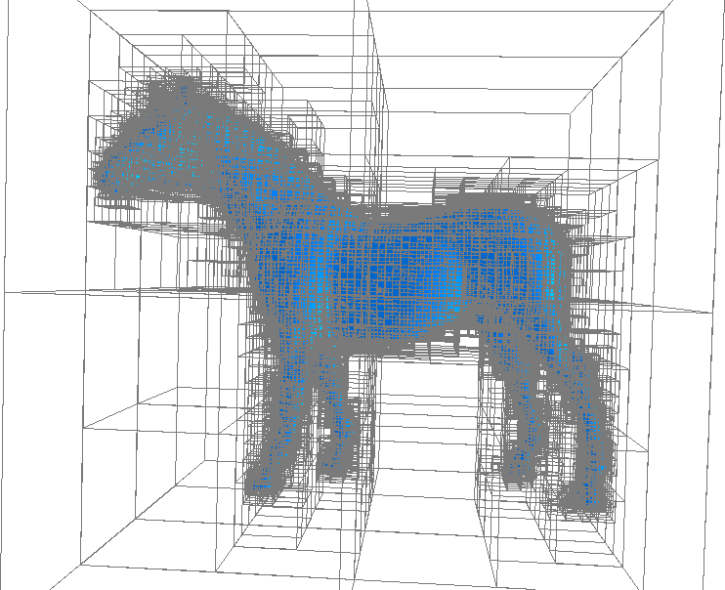
Tree-based compression
LB RT LT
LT
RT
Recursive subdivision
Ambient space combinatorics
Point position
LT
RT
LT
RT
LB
RB
LB
RB
LB
RB

Slide 7
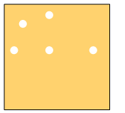
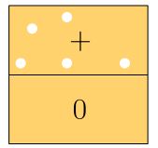
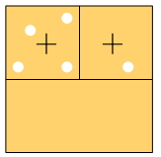
Subdivision symbols

Slide 8
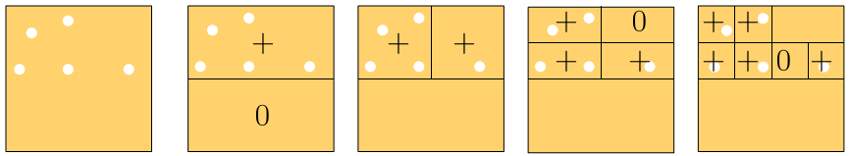
Emptyness symbols
+0 ++ ++ 0+ ++ ++ 0+

Slide 9
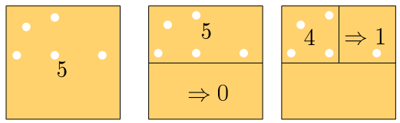
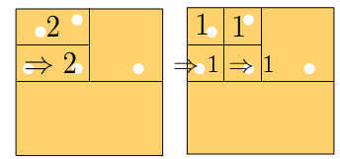
Counting symbols
005 5 4 2 1 1

Slide 10
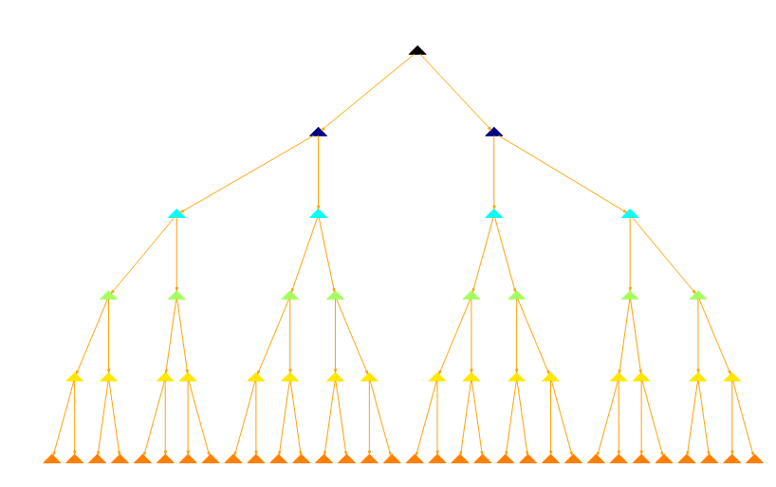
Cost repartition
count
emptyness

Slide 11
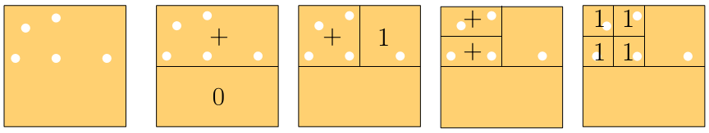
Previous blending
++ +1 1+ 11 +0 0+ 10 01

Slide 12
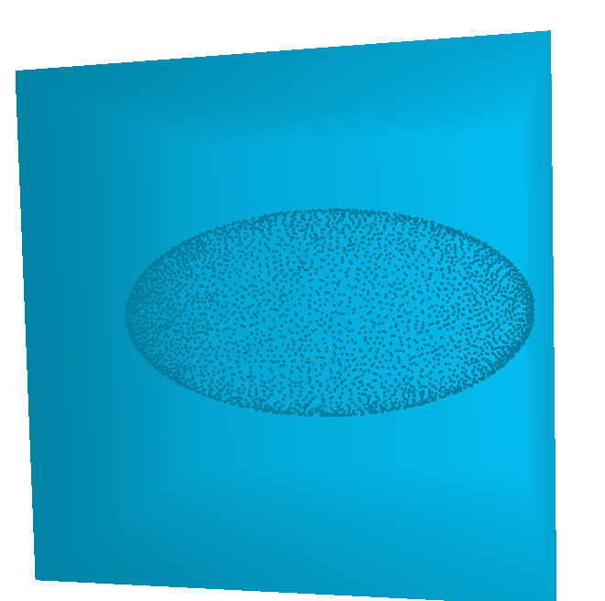
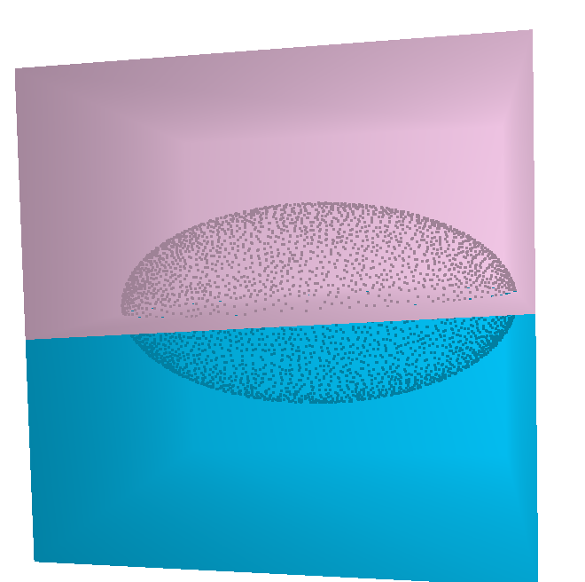
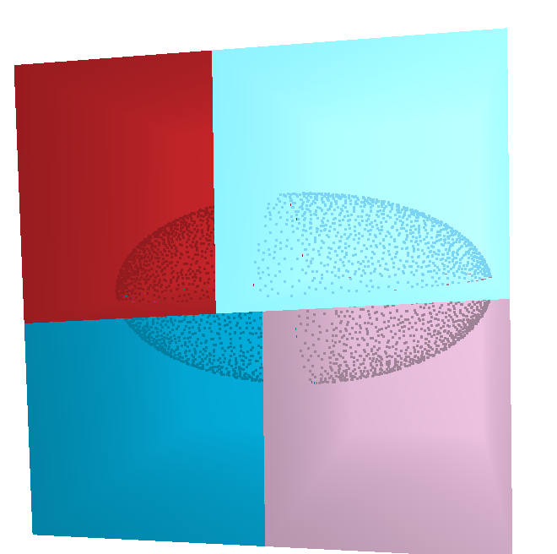

Binary Space Partition
Bet:
  much more information
  better distributed

Slide 13
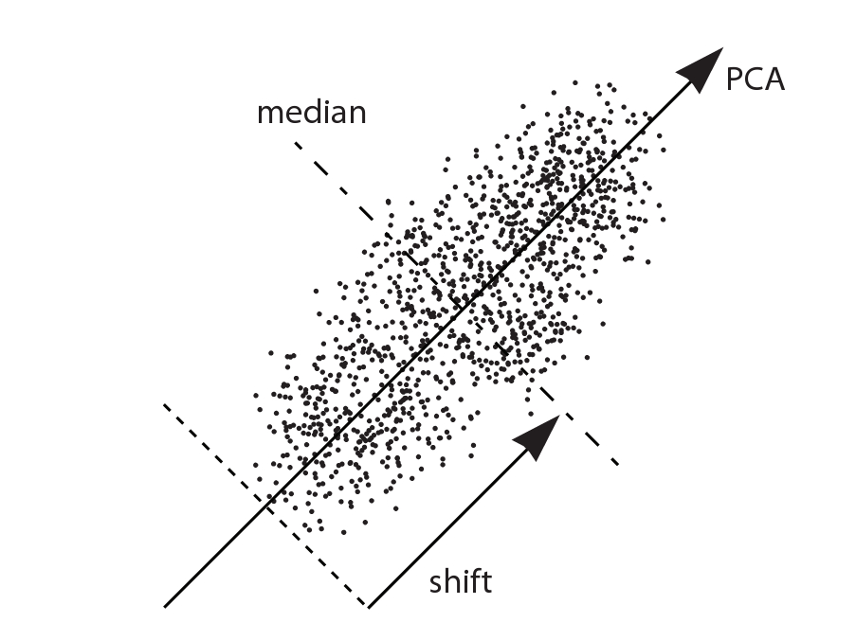
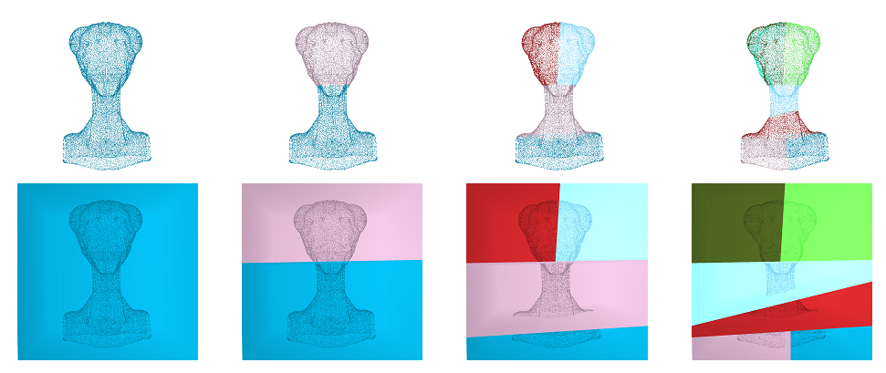
BSP construction
Adapted to local statistic of points

Slide 14
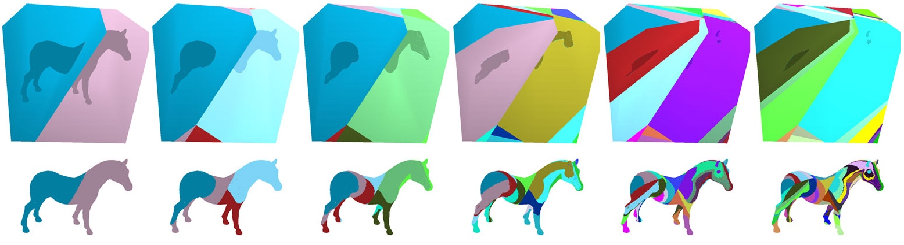
BSP compression
Cut planes codes: Euler angles
Subdivision codes: counting symbols

Slide 15
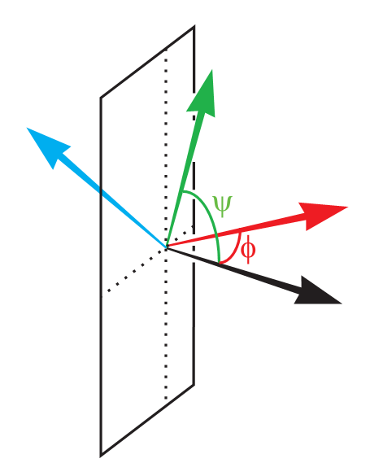
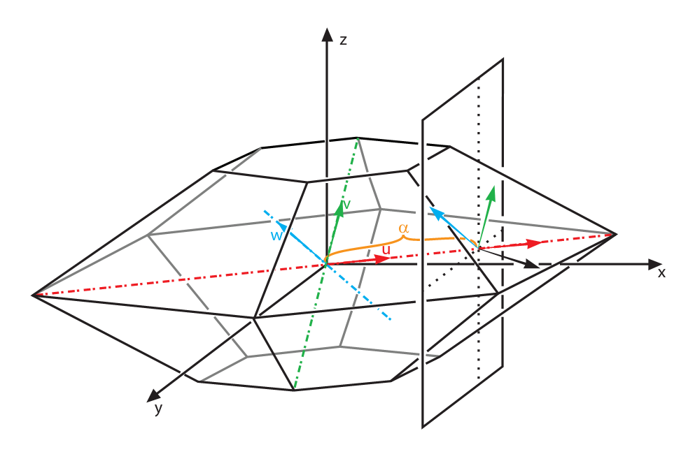
Angles of the cut planes
Euler angles

Slide 16
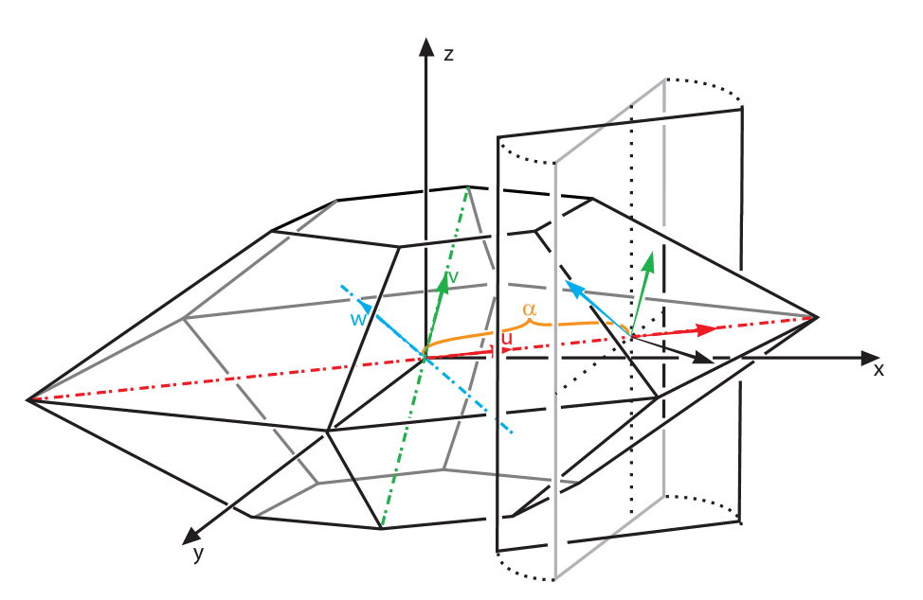
Quantization
a ≈0.5
φ ≈ 0
ψ ≈ 0

Slide 17
Small cells guarantee
10 bits quantization
5 bits quantization
0 bit quantization
  0 bit quantization:
  middle orthogonal cut
  regular cut to reduce the cell size

Slide 18
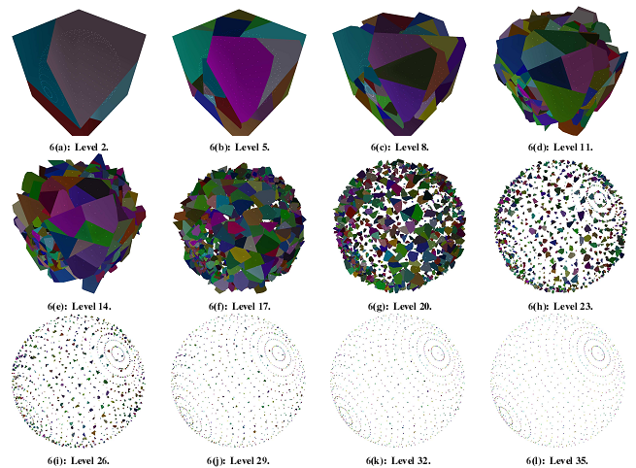
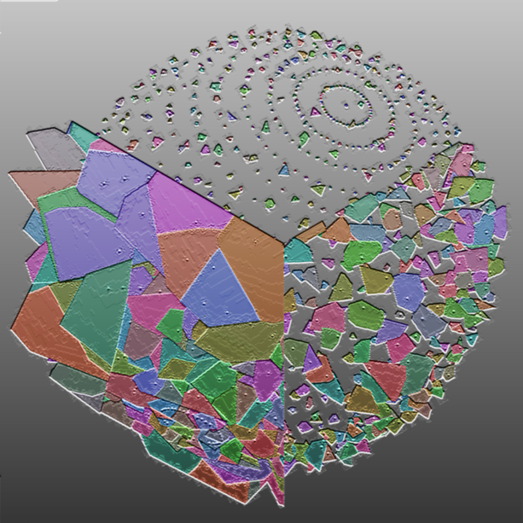
Adaptation

Slide 19
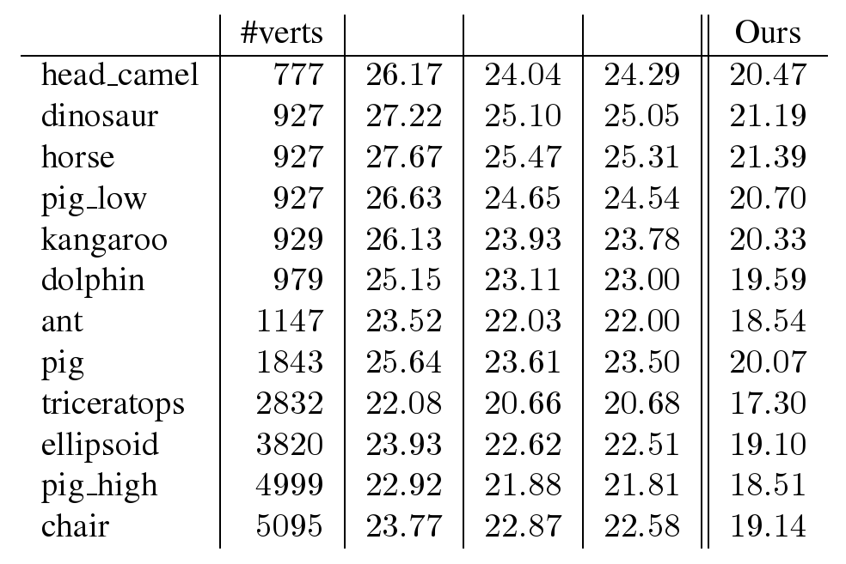
Compression Ratios
Empty
Count
Blend

Slide 20
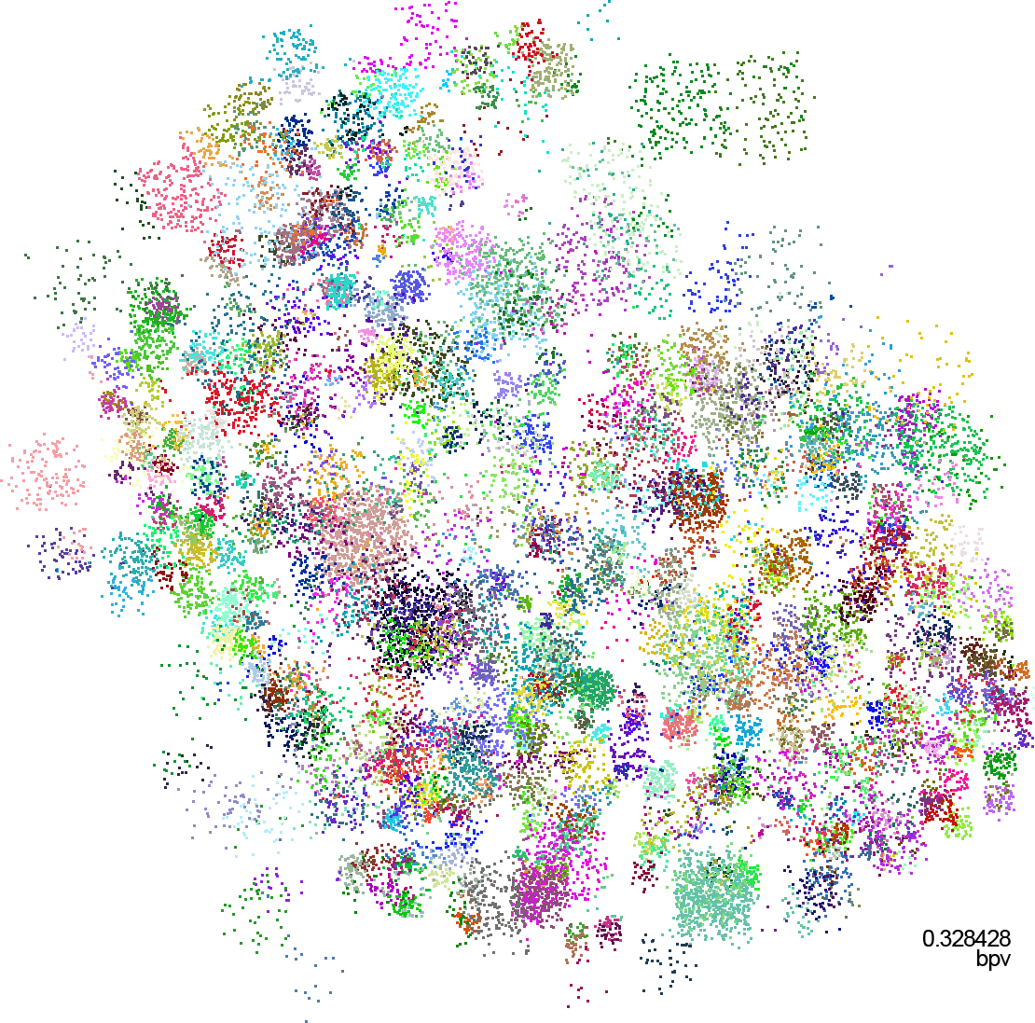
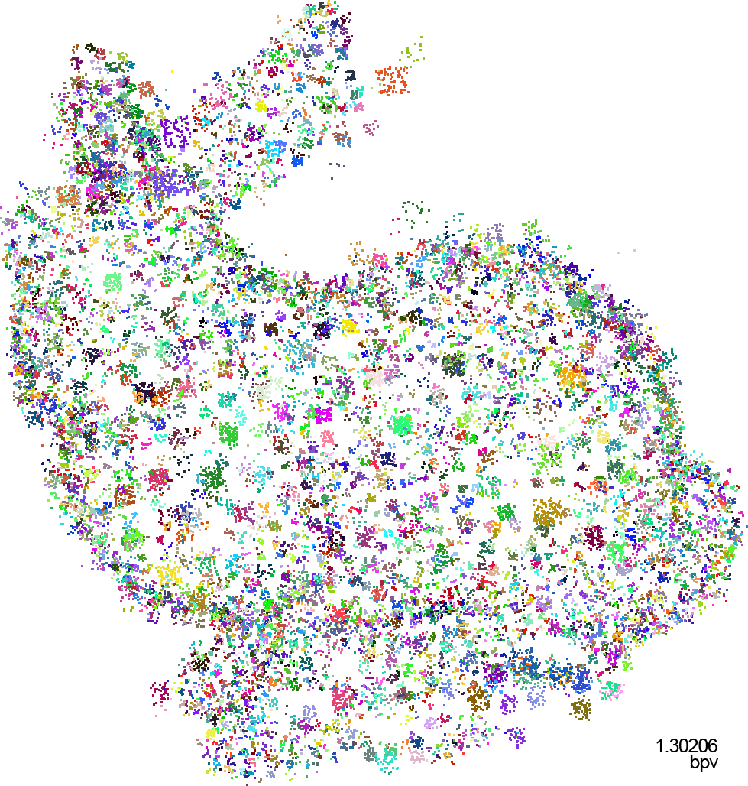
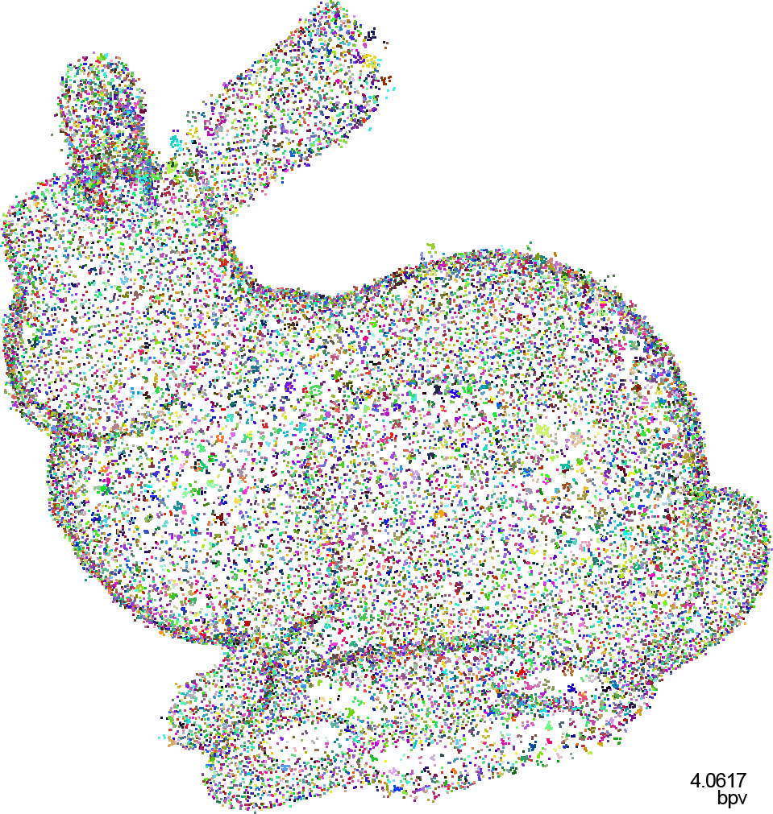
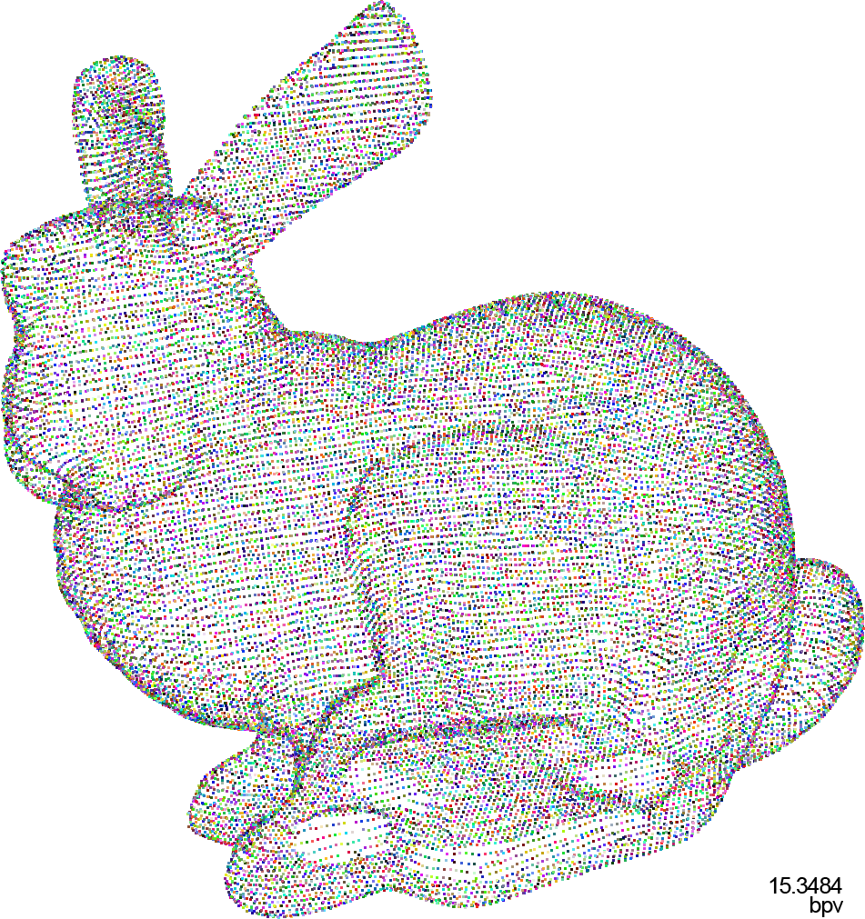
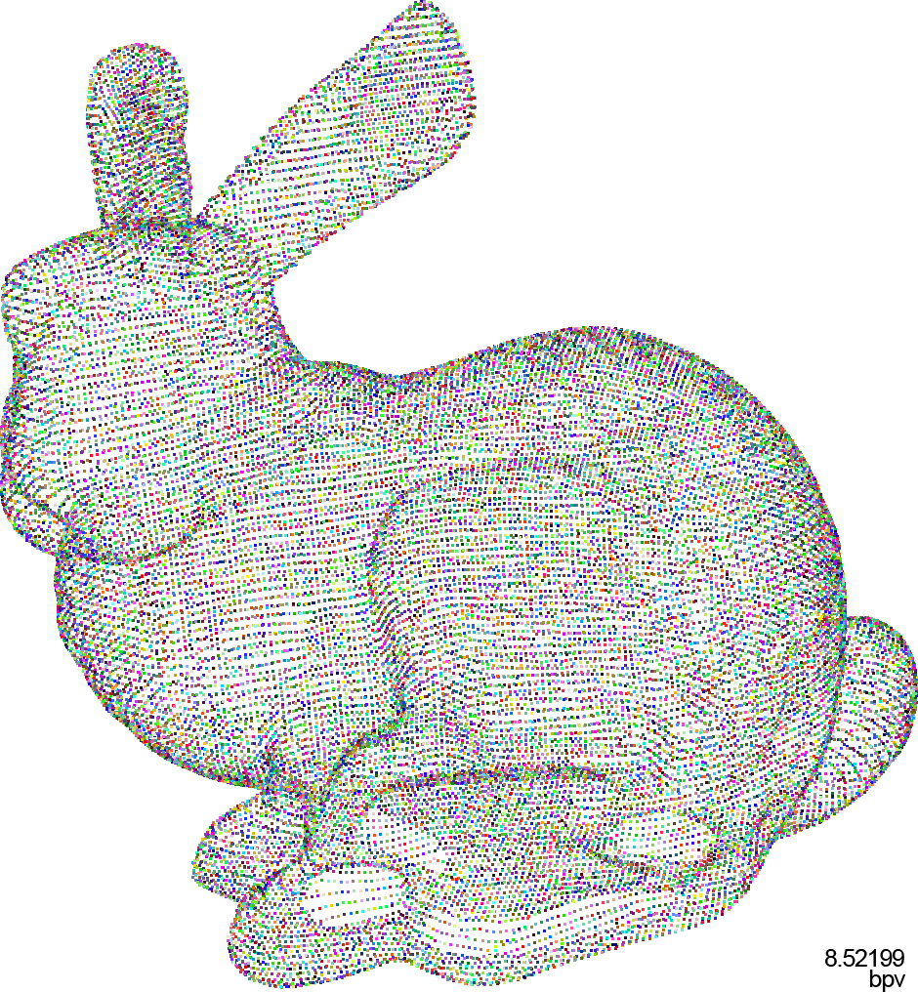
Progressive
(bpv = bit per vertex)
0.33 bpv
1.30 bpv
4.06 bpv
8.52 bpv
15.35 bpv

Slide 21

For now... and next
Won the bet:
  geometric symbols
  15% improvement in compression ratio
Won more:
  fast, adapted BSP construction
  explicit BSP cell with a local frame
Next bet?
  Improve progressivity
  Progressive GEncode

Slide 22
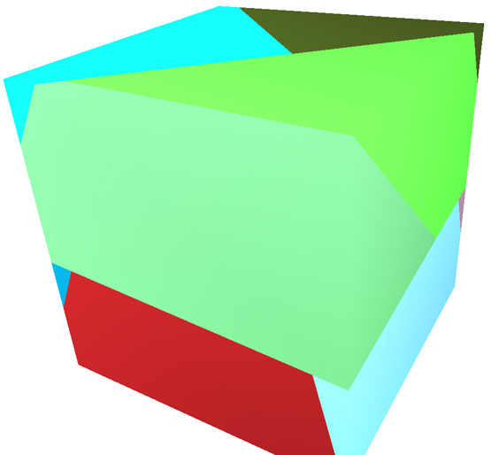
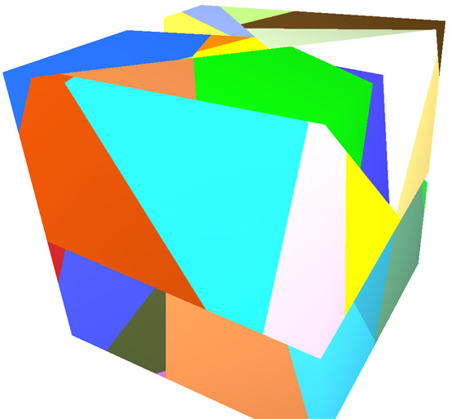
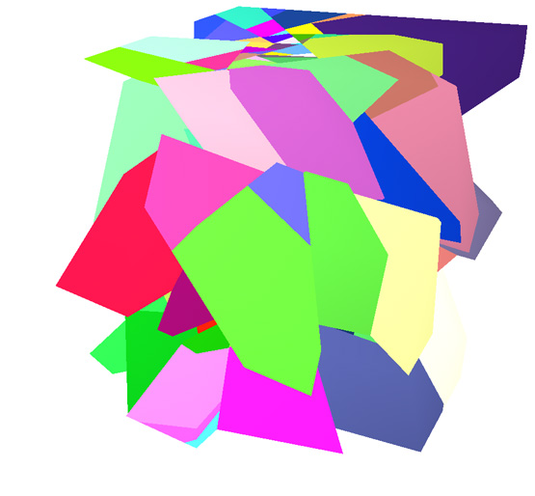
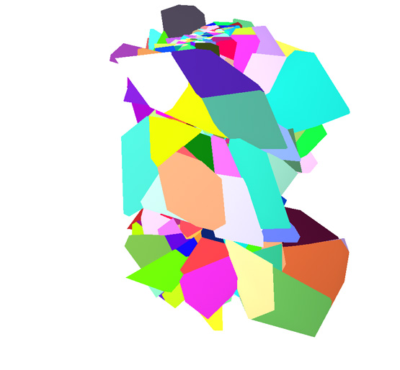
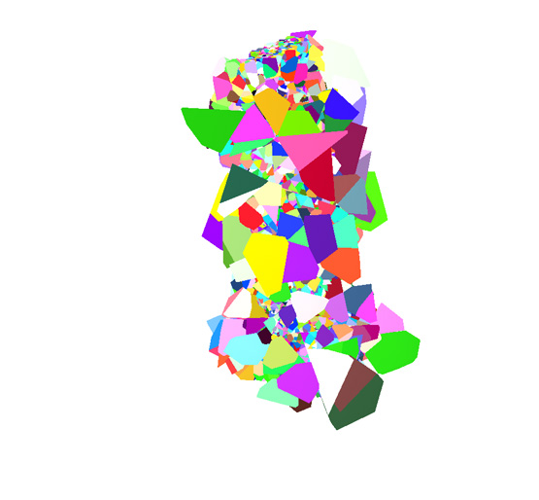
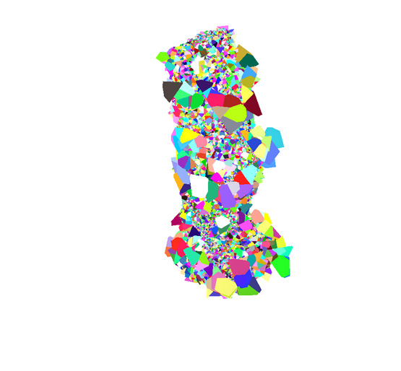
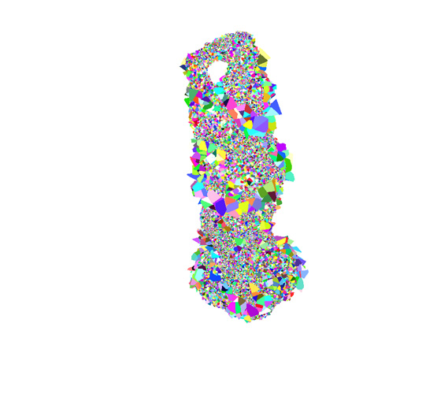
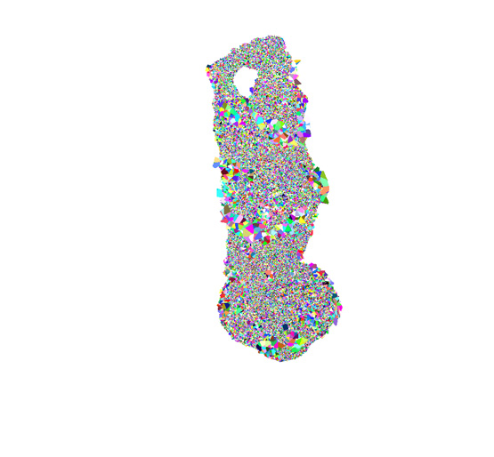
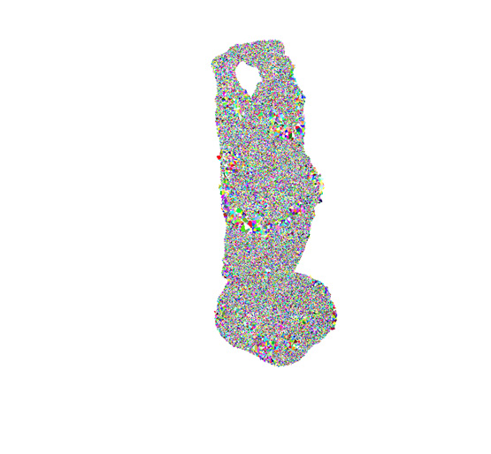
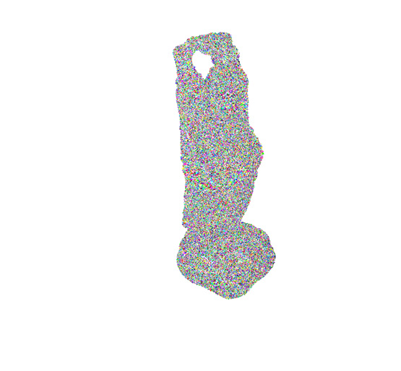
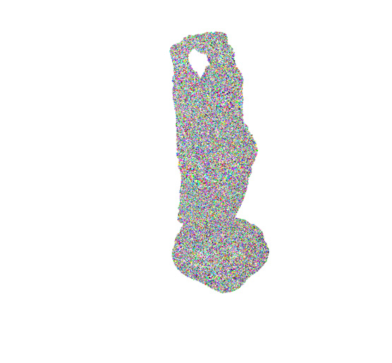

Thank you for your attention!
http://www.mat.puc-rio.br/~tomlew

