Slide 1
Parabolic Polygons and Discrete Affine Geometry
M.Craizer, T.Lewiner, J.M.Morvan
Departamento de Matemática – PUC-Rio
Université Claude Bernard-Lyon-France

Slide 2
Motivation: affine geometry
length
length
radius
radius
...projective geometry
Euclidean
Geometry
Affine
translation
rotation
shearing

Slide 3
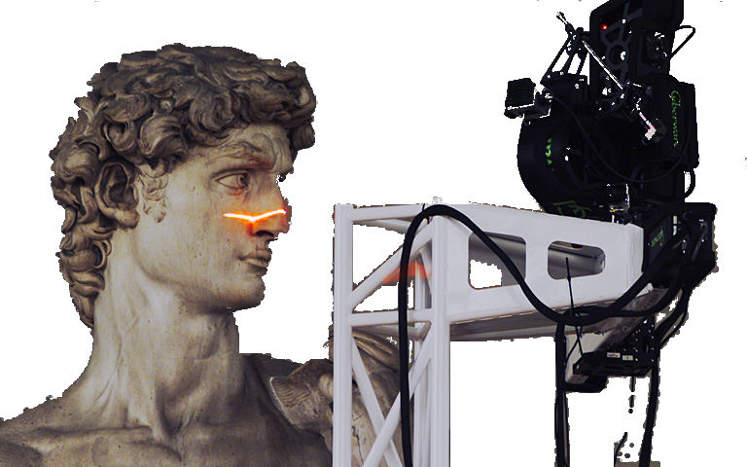
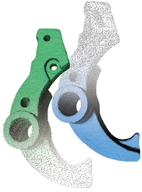
Motivation: reconstruction
Tangent at sample points
  available or easily computable
  surely improve reconstruction
Intrinsic in the model

Slide 4
Summary
The Parabolic Polygon Model
  Planar curves : points + tangents
  Affine invariant
Properties
  Affine length estimation
  Affine curvature estimation
Application
  Affine curve reconstruction

Slide 5
Geometry
Euclidean geometry (rotations, translations)
→ length, curvature
→ straight line polygon: point, edges
Affine geometry (rotations, translations + shearing)
→ affine length, affine curvature
→ parabolic polygon: point + tangents, edges

Slide 6
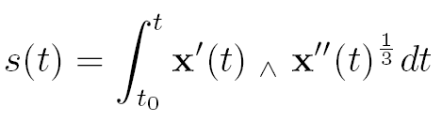



Affine geometry of curves
Notes:
For the affine parameter s, the area of the parallelogram formed by the affine tangent v(s) and the affine normal n(s) is equal to 1.
The affine length is total variation of the affine parameter. The affine curvature at a point x(s) is given by
[n(s),n’(s)]

Slide 7
Discrete curve model
Ordered sample points
AND tangents
Notes:
The data are sample points and tangents of a smooth plane curve

Slide 8
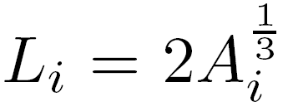
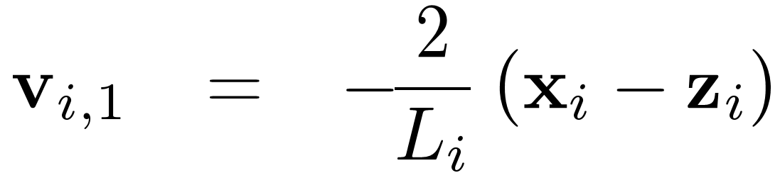
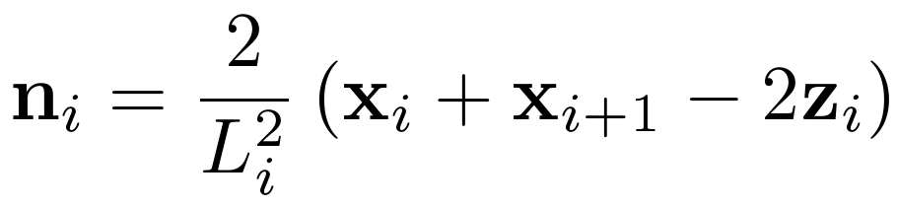
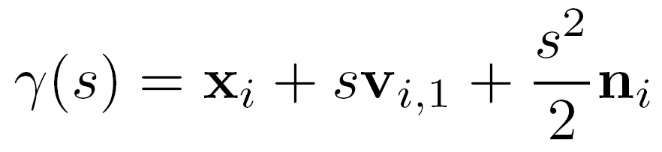
Elementary parabola
Support triangle
Notes:
Given 2 samples (points and tangents) of a convex curve, one can pass a unique parabola through them.

Slide 9
Parabolic Polygons
Parabola = flat affine curve
Polygon with parabolic arcs
Notes:
Taking toghether the parabolic arcs, one obtain parabolic polygons

Slide 10
Affine Invariance
Notes:
The same planar object from 2 different perspectives
The parabolic polygon and its affine normals are affine invariant

Slide 11
Affine length estimator
affine length of an arc of the curve
=
affine length of the arc of parabola
Notes:
One can estimate the affine arc-length of a curve as the sum of the affine lengths of the parabolic arcs.
The affine length of a parabolic
arc is twice the cubic root of the area
of the support triangle.

Slide 12
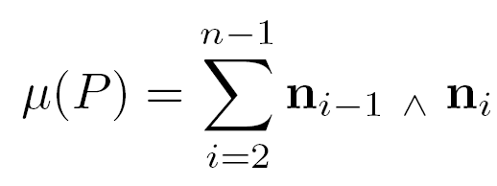
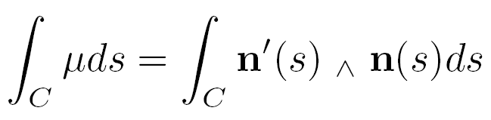
Affine curvature estimator
n_{i}
  Estimated from 3 samples
  Curvature concentrated at the vertices
Notes:
One can estimate the affine curvature from 3 sample points. Our proposal is to take the area of the parallelogram formed by two consecutive normals.
As usual in defining discrete curvatures,
The affine curvature is concentrated
at the vertices.

Slide 13
Estimators convergence : ellipse
Length
Curvature
Notes:
Sampling of an ellipse and a hyperbola
Convergence of the length and affine curvature estimators for a circle of radius 1

Slide 14
Estimators convergence : hyperbola
Length
Curvature
Notes:
Convergence of the length and affine curvature estimators for a hyperbola xy=1

Slide 15
Affine Curve Reconstruction
Variation of:
L. H. Figueiredo and J. M. Gomes.
Computational morphology of curves.
Visual Computer (11), 1994.
Connect to the affine closest point
preventing high curvatures
Notes:
The point x_5 is at a small affine distance from x, but the affine curvature at x would be big.

Slide 16
Affine vs Euclidean Reconstruction
Points + tangents
Only points
Notes:
Affine and euclidean reconstruction. The intrinsic use of tangents improves the reconstruction.

Slide 17
Affine Reconstruction:
Invariance
Points + tangents
Only points
Notes:
Affine and euclidean reconstruction. The intrinsic use of tangents improves the reconstruction.

Slide 18
Affine Reconstruction: inflection points
Curvature threshold to
detect inflection points
Notes:
Reconstruction close to an inflection point. Three different thresholds for the affine curvature.

Slide 19
Conclusion & Ongoing works
  Intrinsic use of tangent in the curve model
  Affine invariant
  Differential estimators
  Affine curve reconstruction
  Surface model
  Cubic splines at inflection points
  Projective invariance
  Applications to object detection and matching

Slide 20
Thank you for your attention!
http://www.mat.puc-rio.br/~craizer
http://www.matmidia.mat.puc-rio.br/

