Slide 1
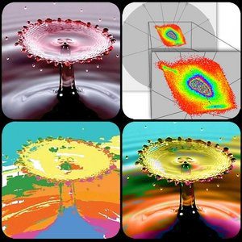
Exploratory visualization based on multidimensional transfer functions and star coordinates
Alex Laier Bordignon,
Rener Castro,
Hélio Lopes,
Thomas Lewiner and
Geovan Tavares
Department of Mathematics – PUC-Rio

Slide 2
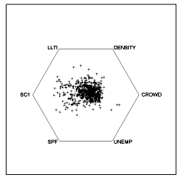
Introduction/Motivation
How to analize multi-dimensional data in 2D ?

Slide 3
Star Coordinates

Slide 4
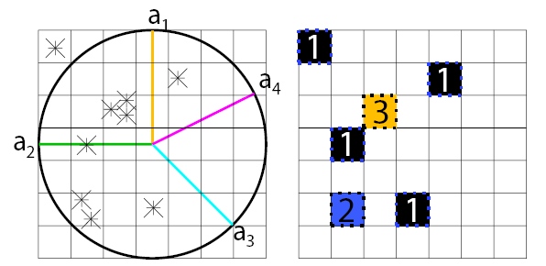
Star coordinates analysis
1) project the points
2) generate the density map

Slide 5
Interactive axis choice

Slide 6
Giving weight to an axis

Slide 7
Multidimensional transfer functions
Six dimensional space
Map to color space
Transfer function

Slide 8
Real time feedback
Painting the clusters,
interactively building a
transfer function

Slide 9
Results

Slide 10
Results

Slide 11
Results

Slide 12
Next steps
Automatic cluster detection
GPU
Improved paint tools
Best projection computation

Slide 13
Thanks for your attention!
http://www.mat.puc-rio.br/~alexlaier
http://www.matmidia.mat.puc-rio.br/

