Slide 1
Curvature Motion for Union of Balls
Thomas Lewiner♥♠, Cynthia Ferreira♥,
Marcos Craizer♥ and Ralph Teixeira♣
♥ Department of Mathematics — PUC-Rio
♠ Géométrica Project — INRIA Sophia Antipolis
♣ FGV -Rio

Slide 2
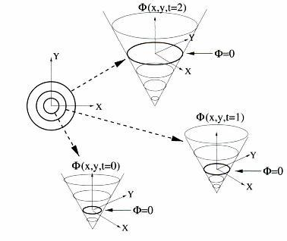
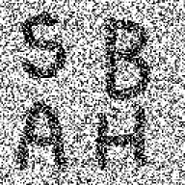
Morphological Motions

Slide 3
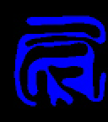
Expected Properties of Motion
No self-intersection
No singularities
No disconnection
Convexification
Simplification
Curvature Motion

Slide 4
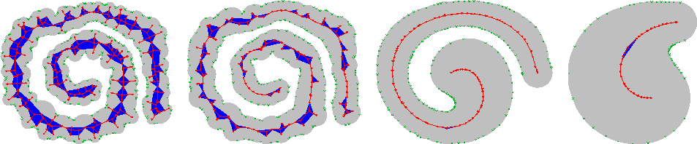
Curvature Motion
@
Q
(
t
)
s
;
K
(
t
)
N
(
t
)
=
s
¢
s
@
t
;
;

Slide 5
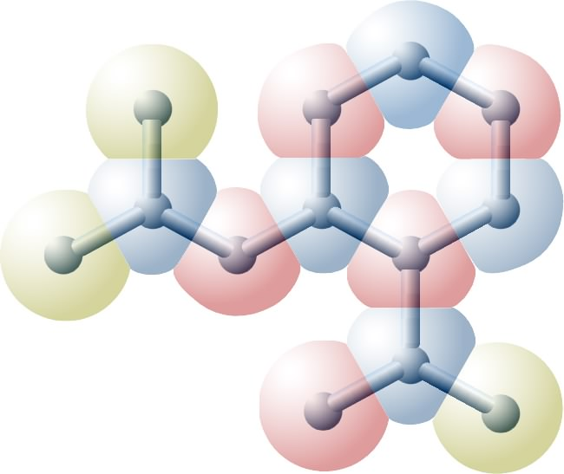
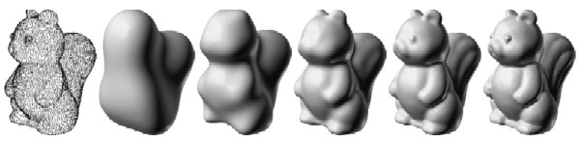
Union of Balls
Original model
Modelling and approximation
Curve discretisation
(medial axis)

Slide 6
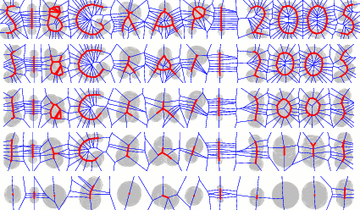
Contributions
Explicit curvature motion for union of balls
Sampling conditions on the union of balls
Derivative approximations for the union of balls

Slide 7
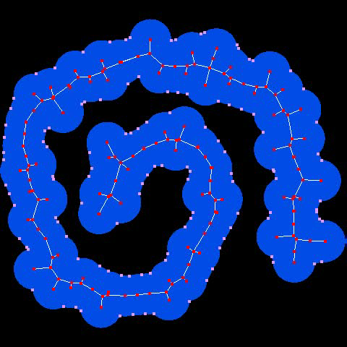
Summary
Medial Axis
Curvature Motion from the Medial Axis
Curvature Motion for Union of Balls
Implementation Issues
Results

Slide 8
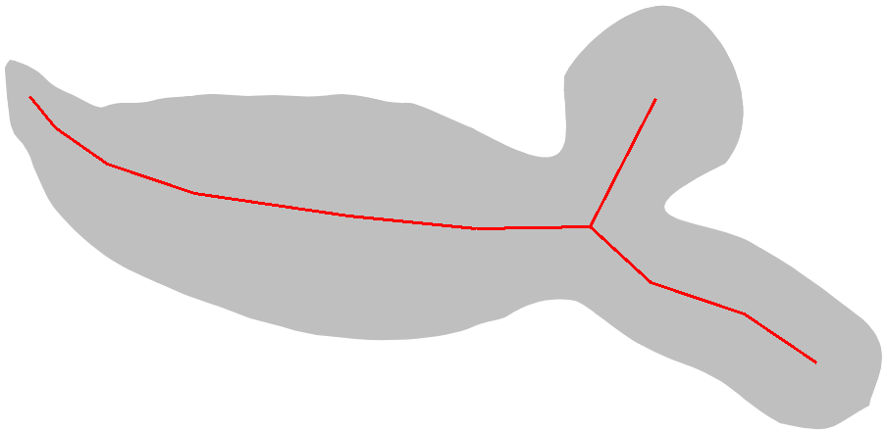
Medial Axis
Inner symmetries of a shape
Singularities of the distance function
Captures the topology of the shape

Slide 9
Medial Axis of a Union of Balls
Classical Algorithmic Geometry (Amenta et al., CGTA 2001)
Medial axis inside the alpha-shape

Slide 10
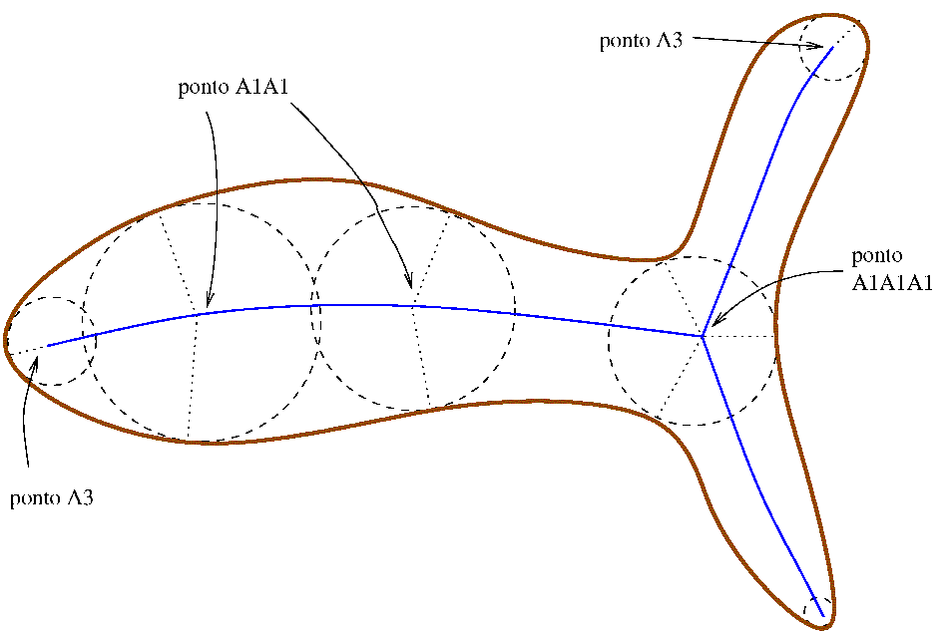
Points of the Medial Axis
End Points Bifurcation Points
Regular Points

Slide 11
Balls of the Union

Slide 12
Curvature Motion from Medial Axis: regular points
@
Q
(
s
t
)
K
(
)
N
(
)
;
=
s
t
¢
s
t
@
t
;
;
8
K
(
1
¡
2
)
M
r
v
N
>
t
=
(
1
¡
2
¡
)
2
¡
2
K
2
(
1
¡
2
)
>
r
r
r
r
r
<
v
v
v
v
>
K
2
(
1
¡
2
)
+
(
1
¡
2
¡
)
>
r
r
v
r
v
r
v
r
r
v
v
:
r
t
=
(
2
)
2
2
K
2
(
2
)
1
¡
r
v
¡
r
r
v
v
¡
r
1
¡
r
v

Slide 13
Regular balls
8
K
(
1
¡
r
v
2
)
>
M
t
=
(
2
)
2
2
2
(
2
)
N
>
1
¡
r
¡
r
r
¡
r
K
1
¡
r
<
v
v
v
v
>
r
K
2
(
1
¡
r
v
2
)
+
r
v
(
1
¡
r
v
2
¡
r
r
v
v
)
>
r
:
t
=
(
1
¡
r
2
¡
r
r
)
2
¡
r
2
K
2
(
1
¡
r
2
)
v
v
v
v
1st and 2nd derivatives on the medial axis:
[Lewiner et al., Sibgrapi 2004]
T
N
K
)
r
r
;
;
;
v
;
v
v

Slide 14
Clean end balls
½
M
¡
K
t
=
s
s
r
=
¡
K
¡
K
t
s
s
Ellipse of 2 circles
K
K
)
;
s
s

Slide 15
Noisy end balls
½
M
¡
K
t
=
s
s
r
=
¡
K
¡
K
t
s
s
®
s
h
a
p
e
Ã
Ellipse tangent to the circles
K
K
)
;
s
s

Slide 16
Bifurcation balls
Estimate the symmetry set
mean evolution of three regular points
)

Slide 17
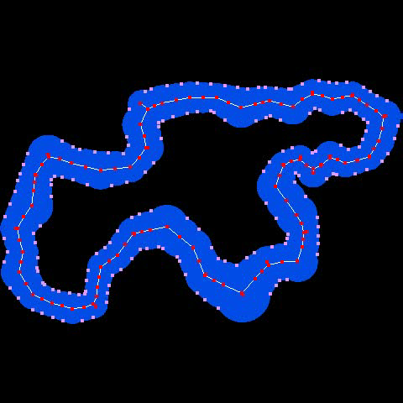
Sampling Conditions
1
i
(
0
)
·
k
¡
0
k
·
i
(
0
)
m
n
r
r
c
c
m
n
r
r
2
0
;
;
Adjacent balls:
Over-sampling (rarefaction) : add ball
Sub-sampling (numerical) :
replace balls by
B
(
)
B
(
0
0
)
c
r
c
r
;
;
B
(
c
+
c
0
r
+
r
)
2
;
2
B
(
c
+
c
0
r
+
r
)
2
;
2

Slide 18
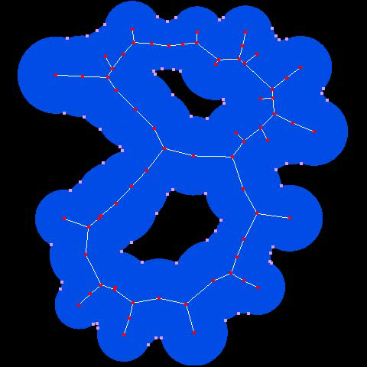
Numerical Issues
Inner balls
Bifurcation
regular topological change
Avoiding non-existent holes
Numerical validation : fallback to end ball case
$

Slide 19
Comparison with Megawave
[Craizer et al., Math Imaging & Vision, 2004]

Slide 20
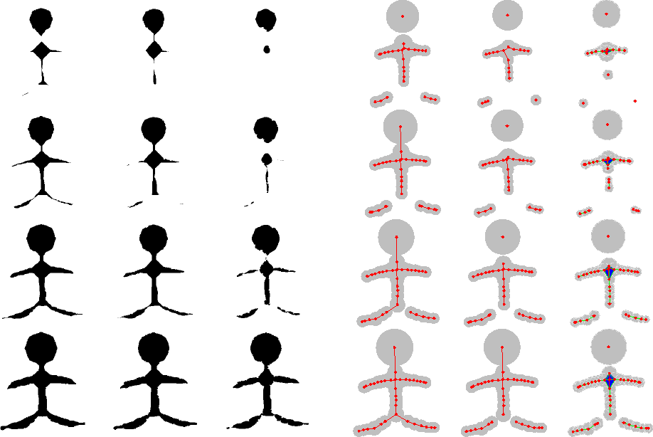
Reaction-Diffusion Scale-Space
Q
(
s
t
)
(
®
+
¯
K
(
s
t
)
)
N
(
s
t
)
t
;
=
;
;

Slide 21
Future works: 3D?

Slide 22
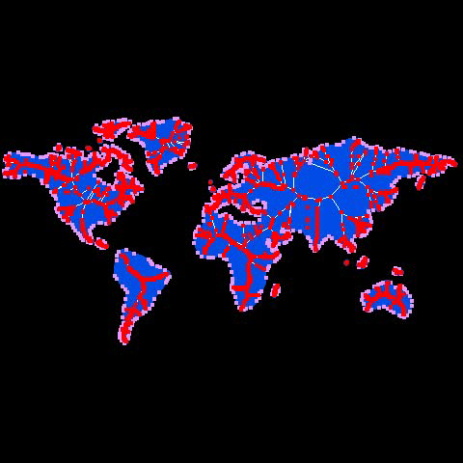
Thank you!

