Slide 1
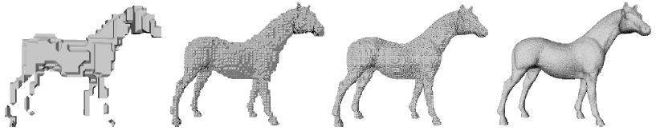
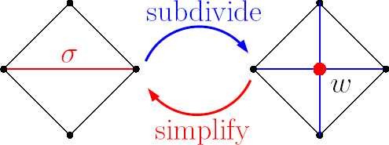


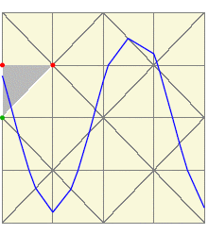
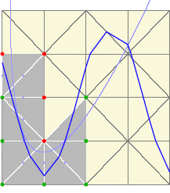
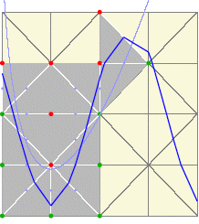
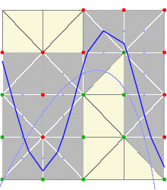
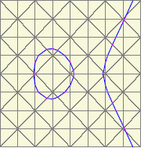
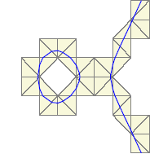

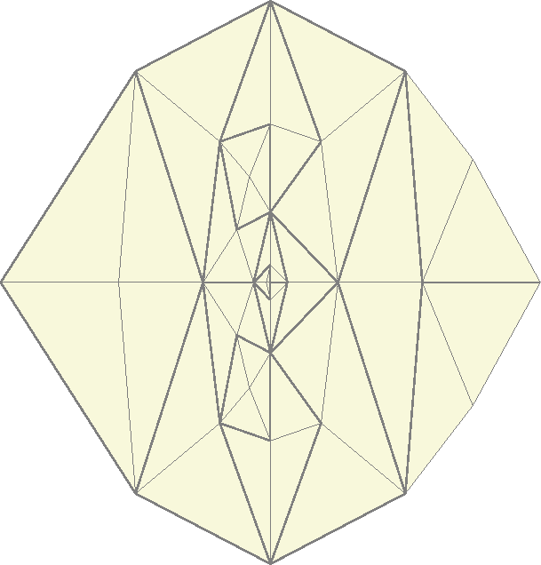

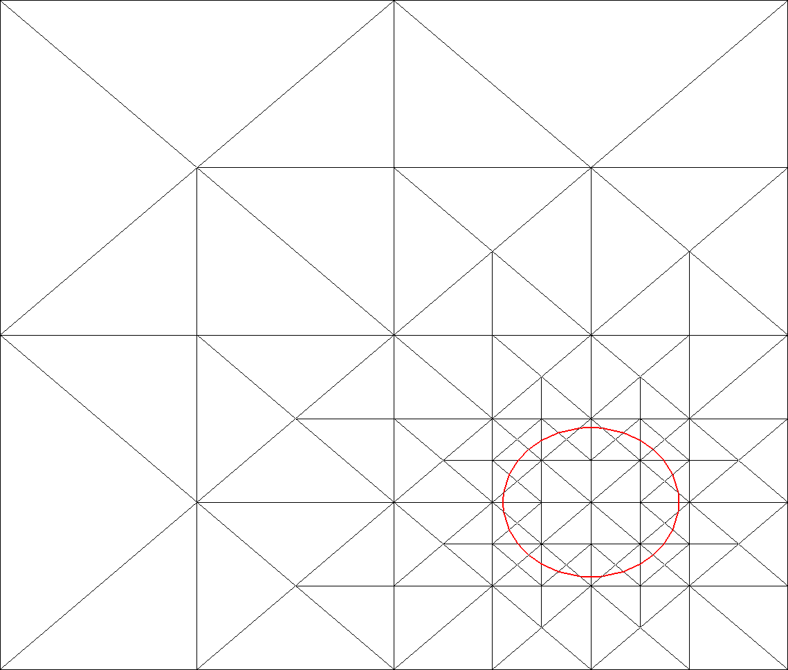
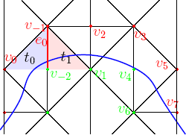
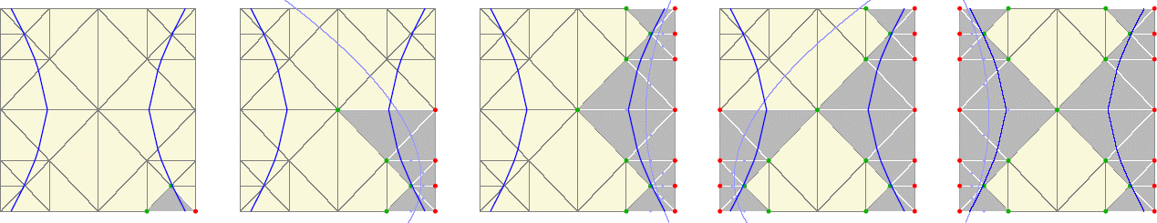
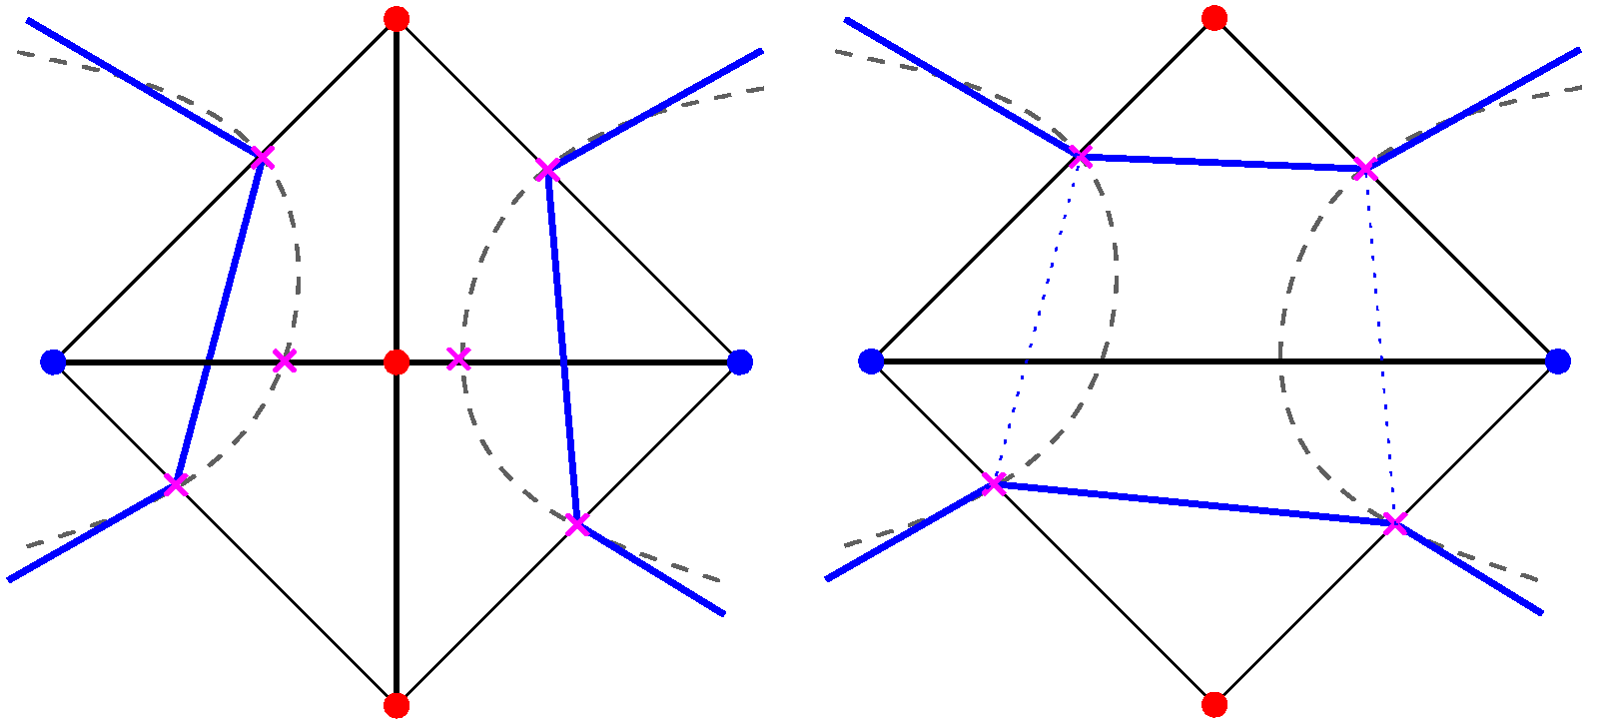
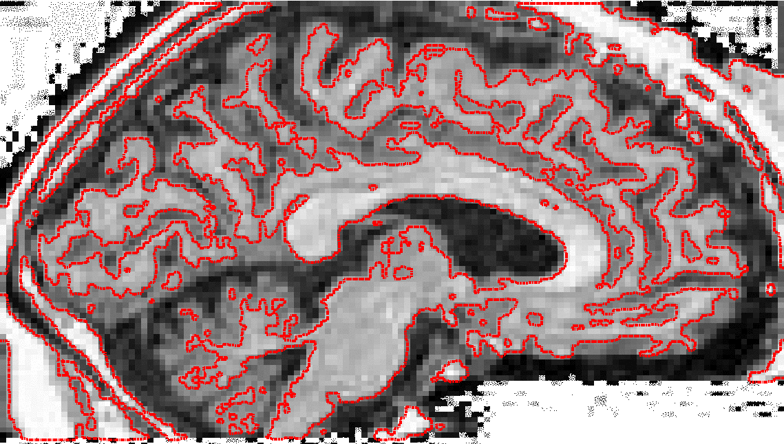
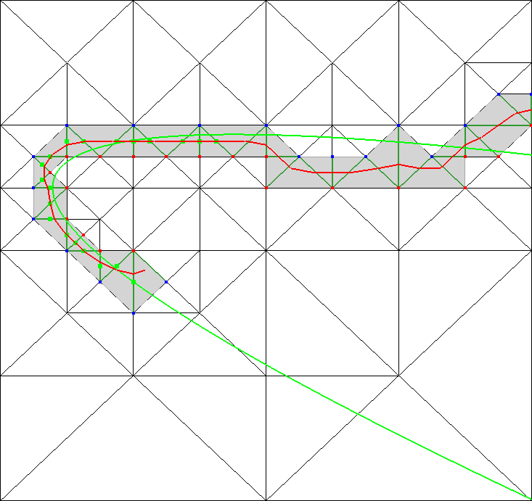
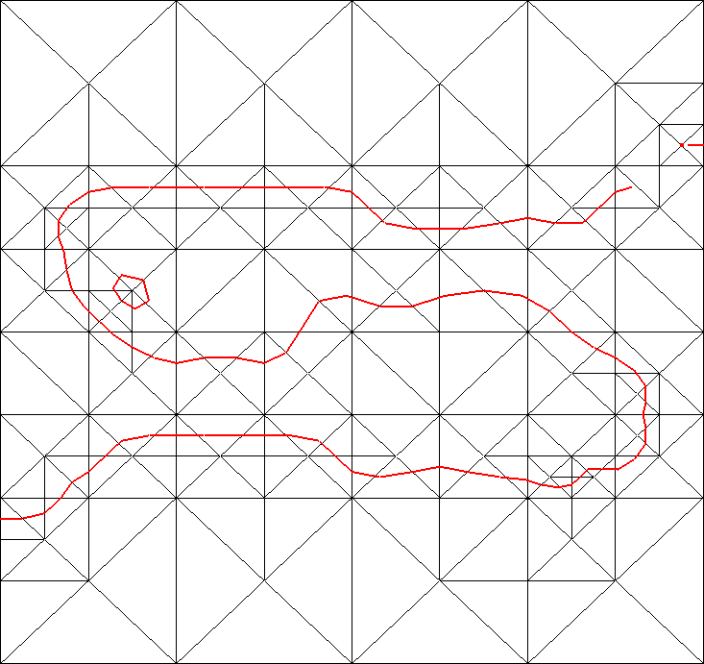
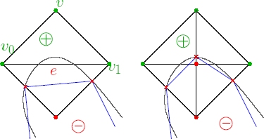
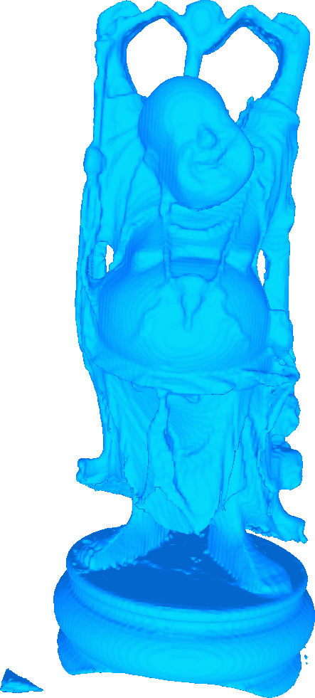
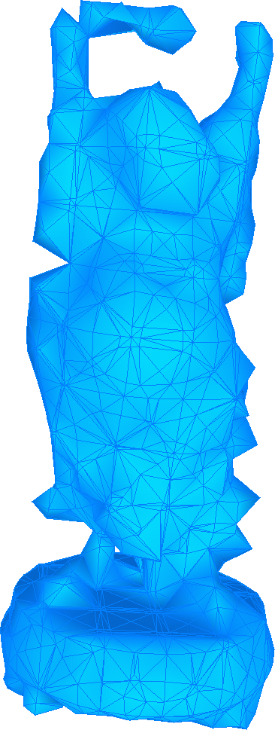
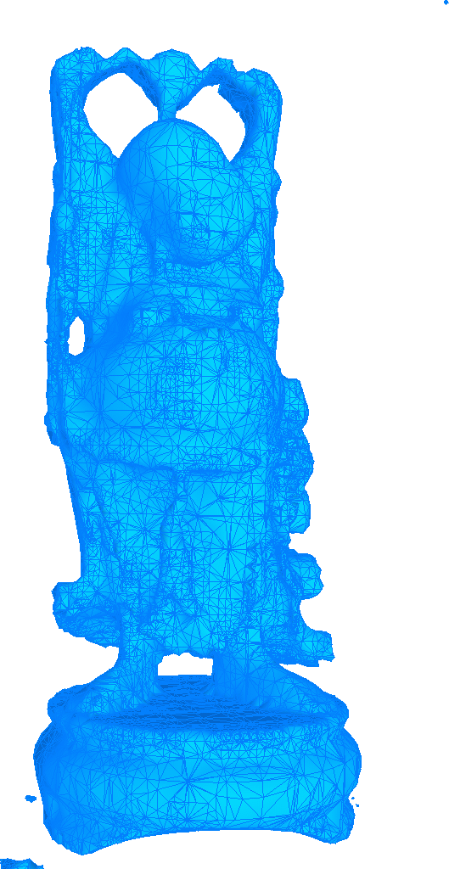
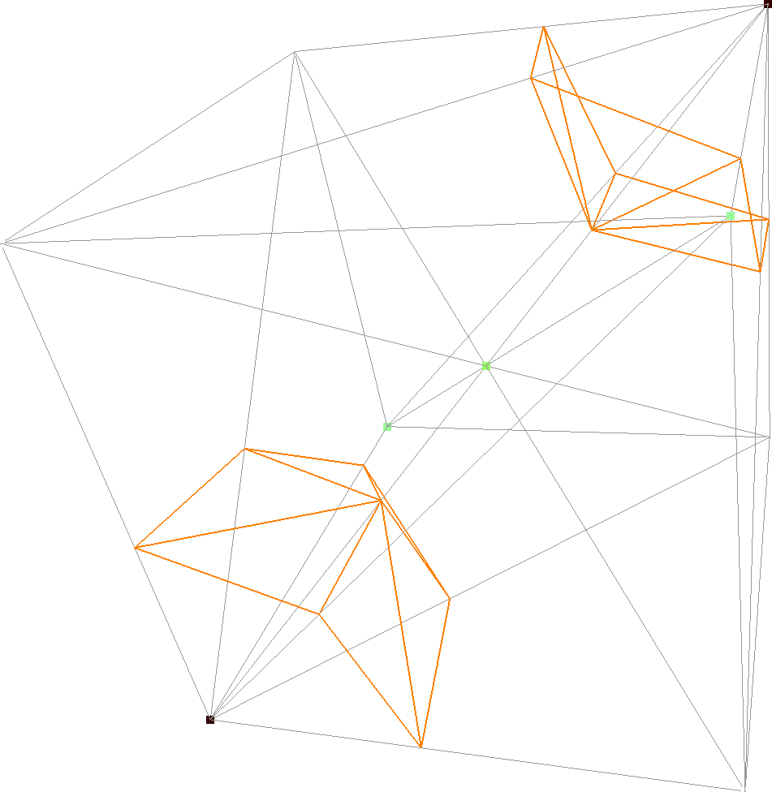
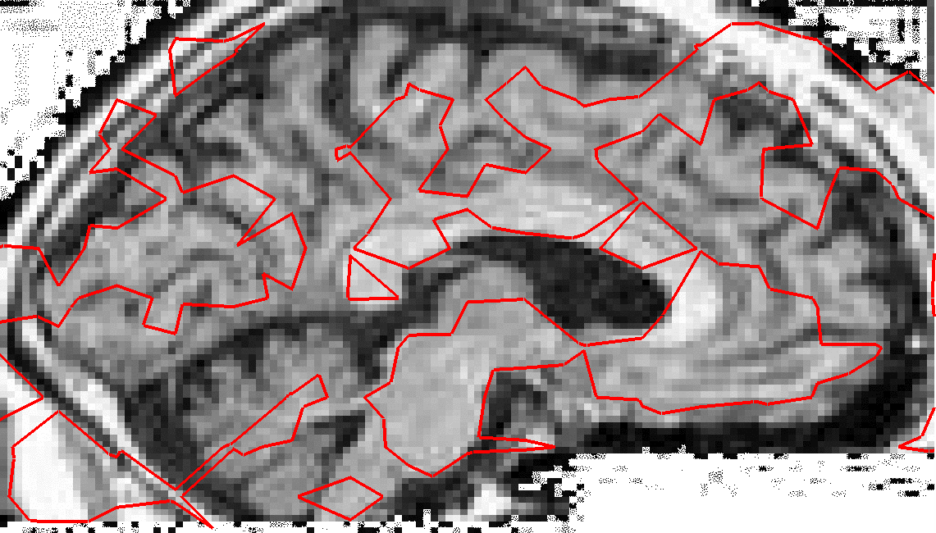
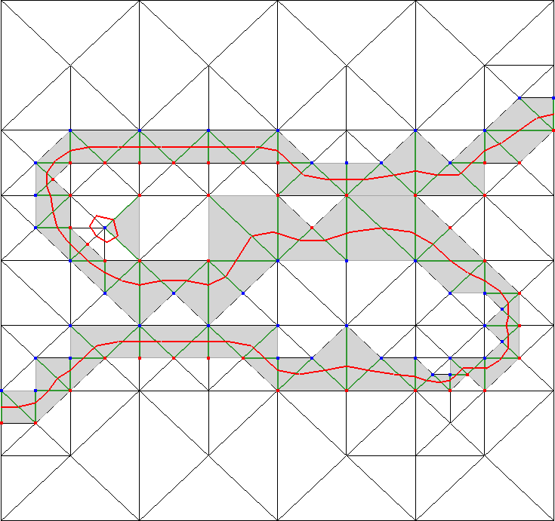
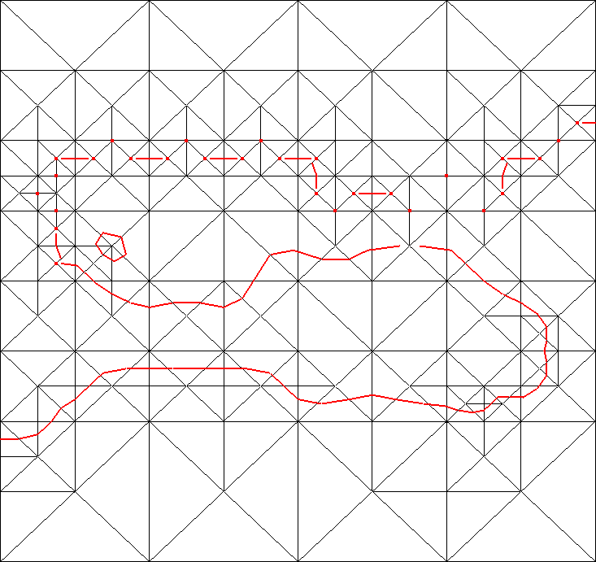
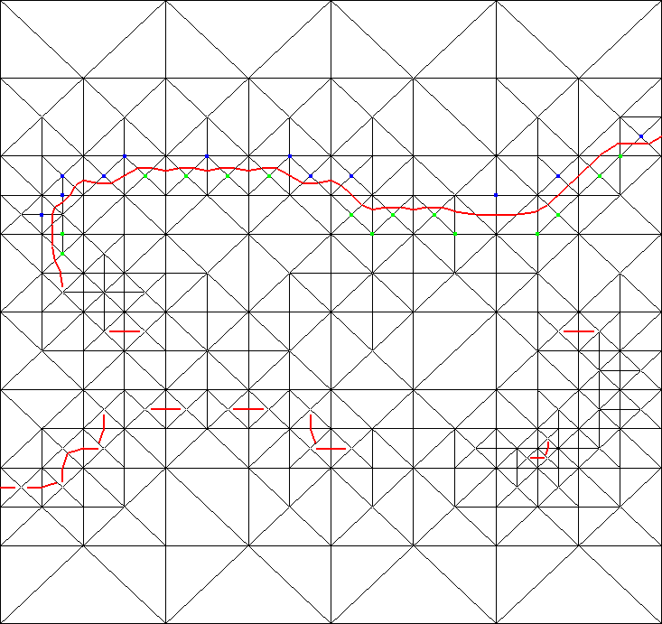
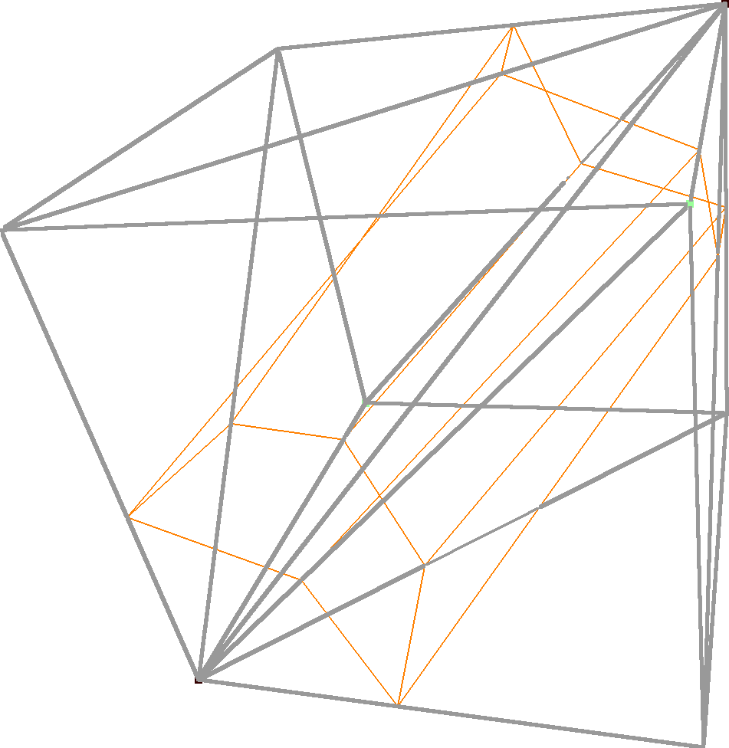
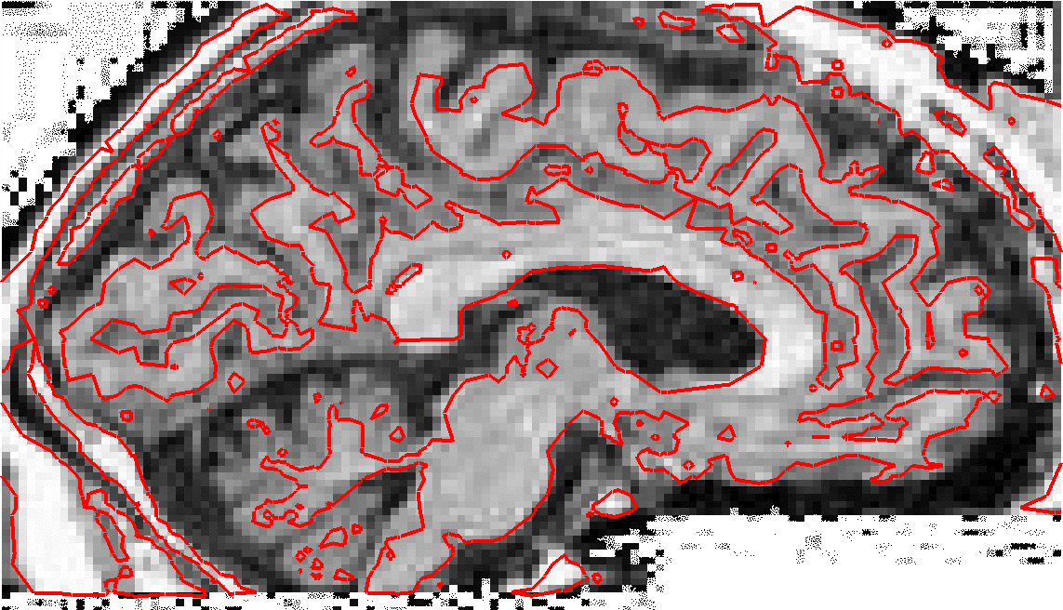
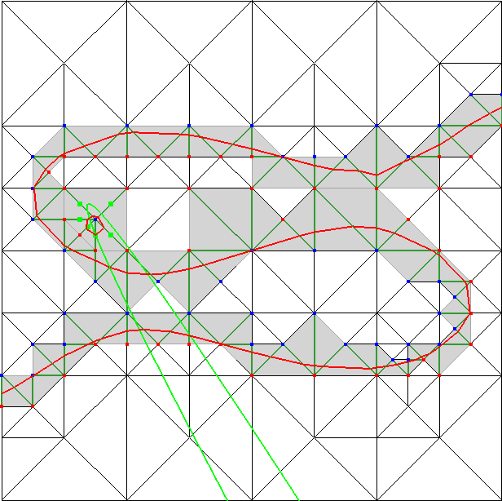
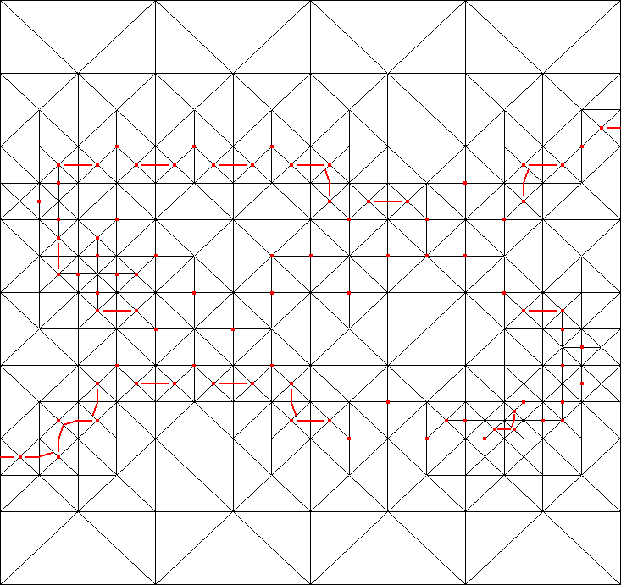
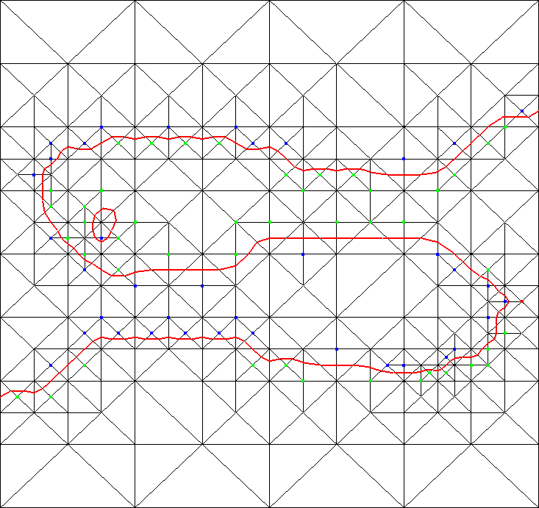
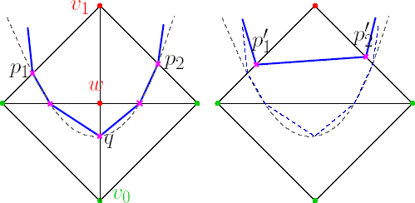


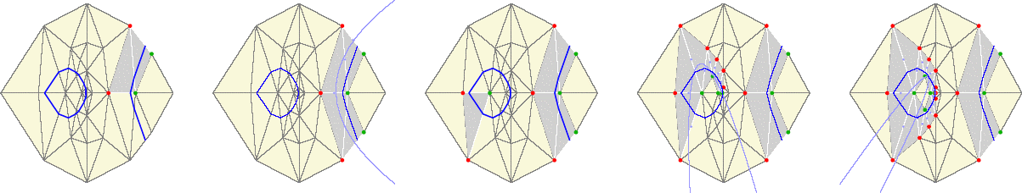

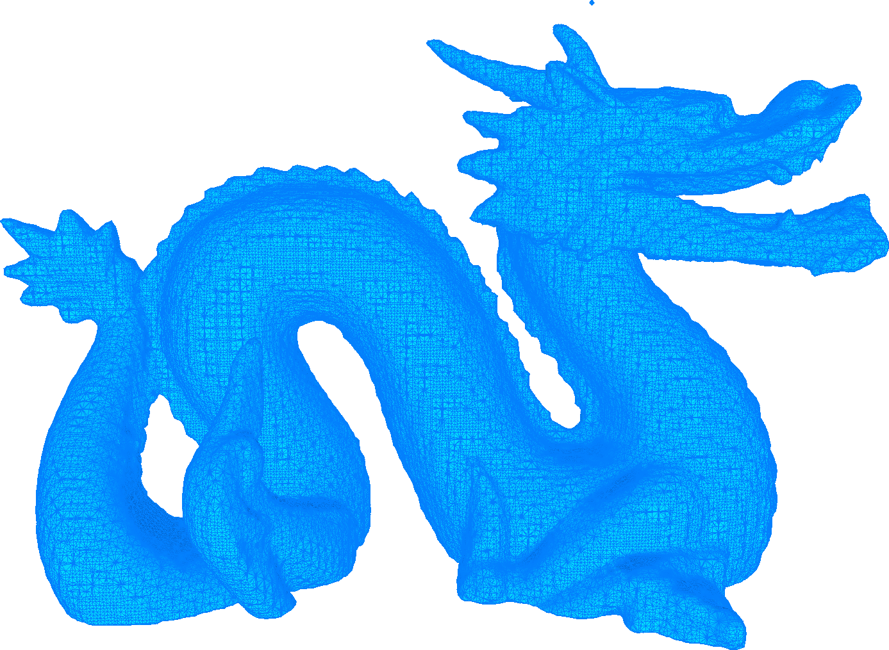
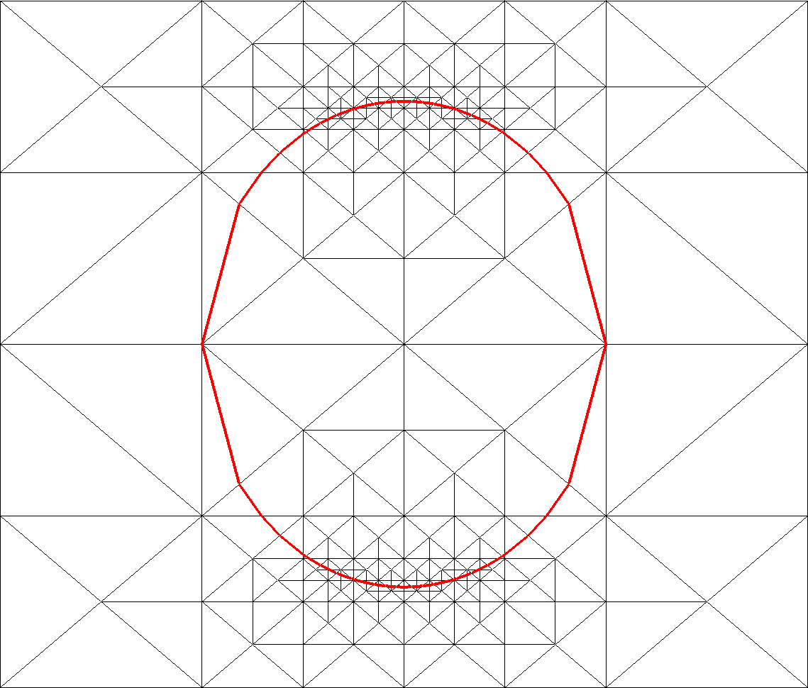
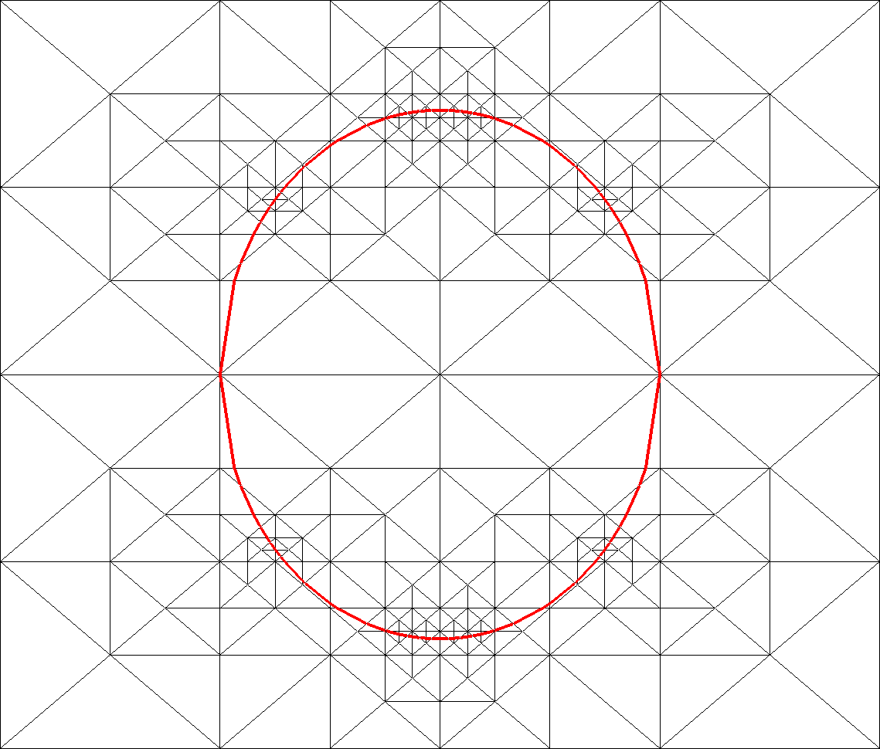
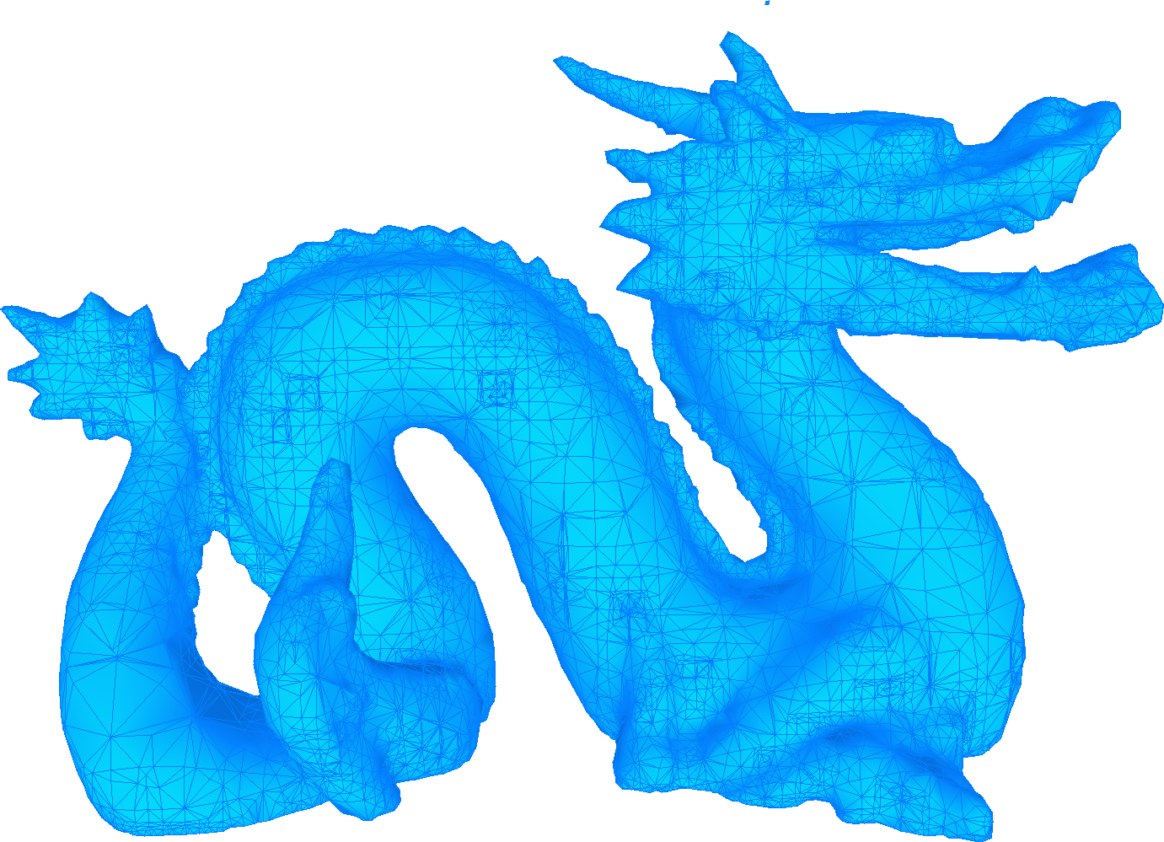
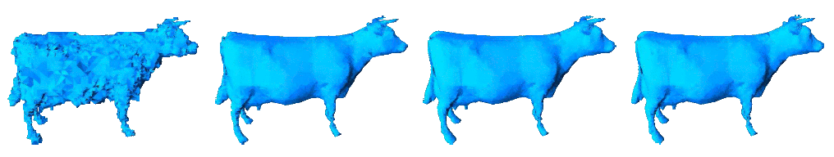







Simplicial Isosurface Compression
Regular Binary Multi-Triangulation
Encoding only the tubular
neighbourhood :
Uniform neighbourhood compression
Base Level Compression
Stellar Operations :
Traversal along the tubular
neighbourhood :
Location: level 4,
up, Left, Right, L, R.
First triangle: - - +
Vertex signs:
- - + + + + + + - - - - + + - +
(2 known vertices) - + -
Adaptive neighbourhood compression
Regular Base Data
Irregular Base Data
Location: level 5,
down, L R L L L.
First triangle: - + +
Vertex levels and signs
> - = - <
= + > - > + > - = - < +
Loc: 5, down,
L L L L L.
First: - + +
Vertex levels and signs
> - = (known)
= + > - > + > - = - < +
Topology Control
Adaptive neighbourhood compression
Progressive Refinements
Topology Characterization :
Original Image
Tubular
neighbourhood extensions:
Multi-component
using decoded information
Decoding
refinements
of the RBMT
No Control
Final geometry encoding with prediction
Decoding of the signs of the new close vertices.
Original Model
No Control
Topology Control
Topology Control
Distortion Control
Arithmetic encoding with context and prediction :
Results
Distortion Approximation :
No Control
Original Image
No Control
Original Model
Curvature Control
Distortion Control
Uniform Refinements
Adaptive Refinements with geometry
Distortion Control
Thomas Lewiner
Luiz Velho
Hélio Lopes
Vinícius Mello
9th International Fall Workshop
VISION, MODELING, AND VISUALIZATION 2004
November 16 - 18, 2004
Stanford (California), USA
PUC-Rio de Janeiro
INRIA - Sophia Antipolis
IMPA - Rio de Janeiro
PUC-Rio de Janeiro
IMPA - Rio de Janeiro

