Slide 1
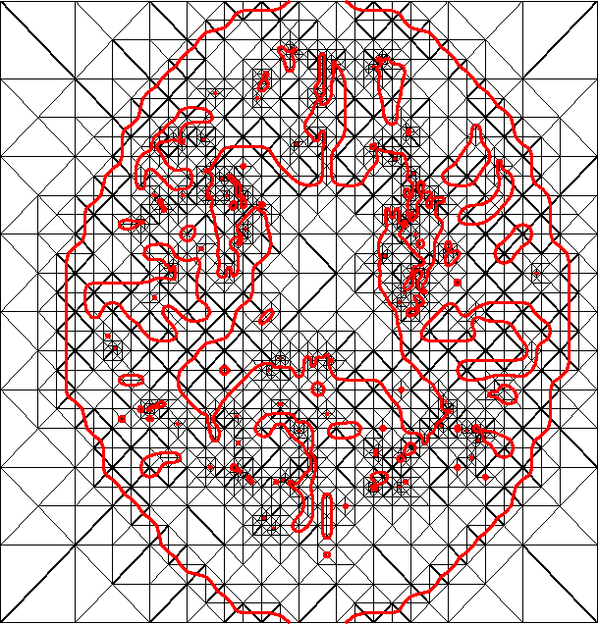
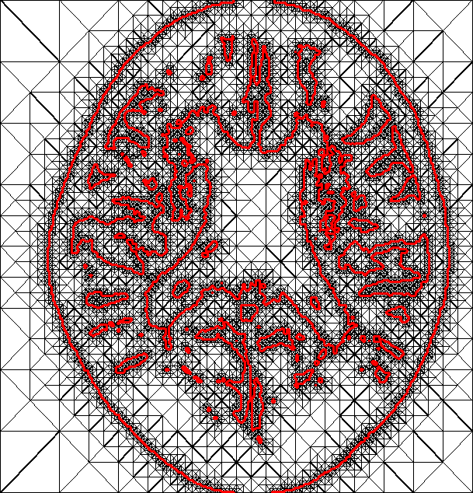
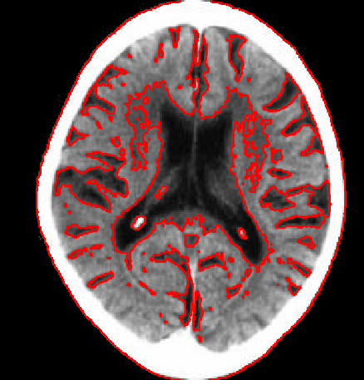
Hierarchical Isocontours Extraction and Compression
Thomas Lewiner^{1,2}, Luiz Velho³,
Hélio Lopes¹, Vinícius Mello³
¹PUC-Rio — Departamento de Matemática
²INRIA — Géométrica Project (France)
³IMPA — Laboratório Visgraf

Slide 2
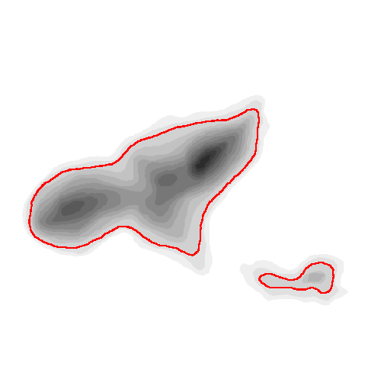
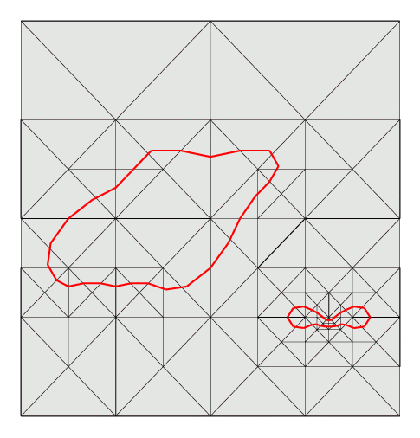
Motivation
Encoding an isocontour is cheaper than encoding the whole image

Slide 3

Outline
Hierarchical Extraction :
Regular Binary Multi-Triangulation
Geometry and Topology Controls
Progressive Compression :
Coarser Resolution
Refinements
Prediction

Slide 4
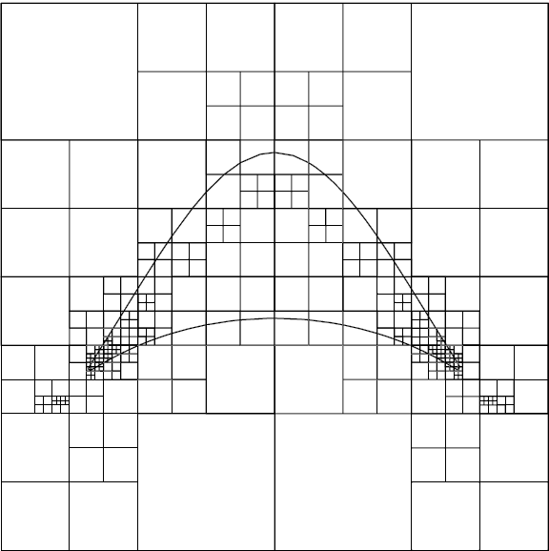


Prior Work:
Hierarchical Extraction
Implicit domain in multi-resolution :
quad-trees (Lopes et al, 2002)
Curve simplification:
Douglas-Peucker 1973,
Wu-Márquez 2003.
→ Binary Multi-Triangulation:
Mello et al. 2003.

Slide 5
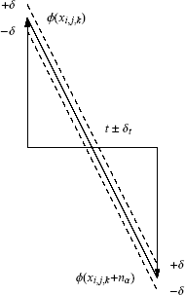
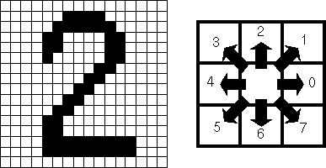
Prior Work:
Progressive Compression
Signal Map + vector displacement:
Bossen, Le Buhan and Ebrahimi 1997
Chain Code: Freeman 1974
→ Encode the signal along the multiresolution curve

Slide 6
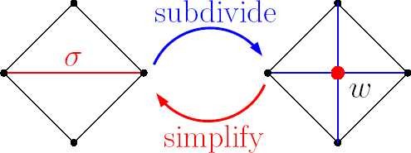

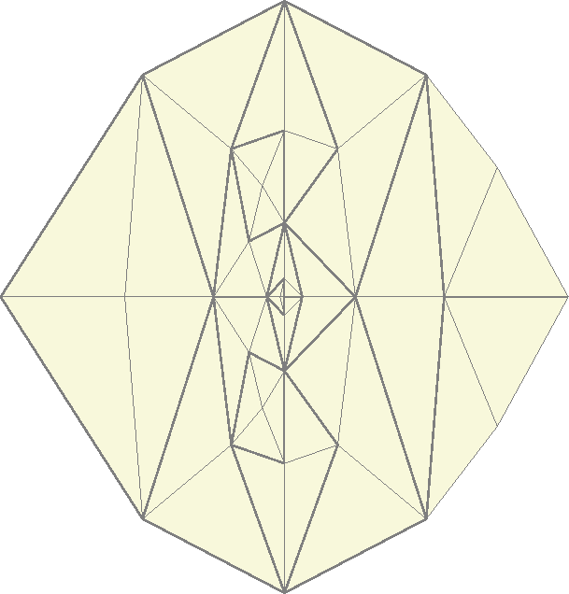
Extraction
Regular Binary Multi-Triangulation
Regular data set
Irregular data set

Slide 7

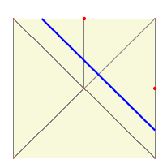
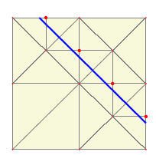
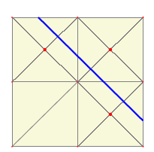
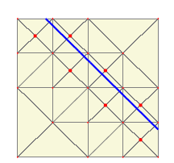
Hierarchy
Multi-Triangulation → Multiresolution curve

Slide 8
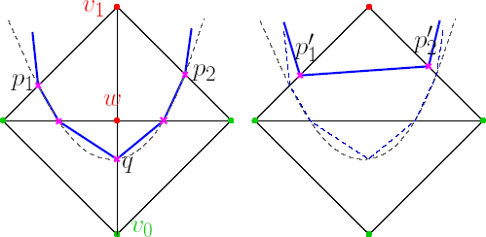

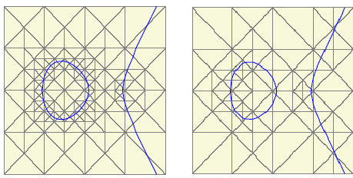
Geometry Control
No control
Distortion
Control
Curvature Control
Curvature Control
Distortion Control

Slide 9
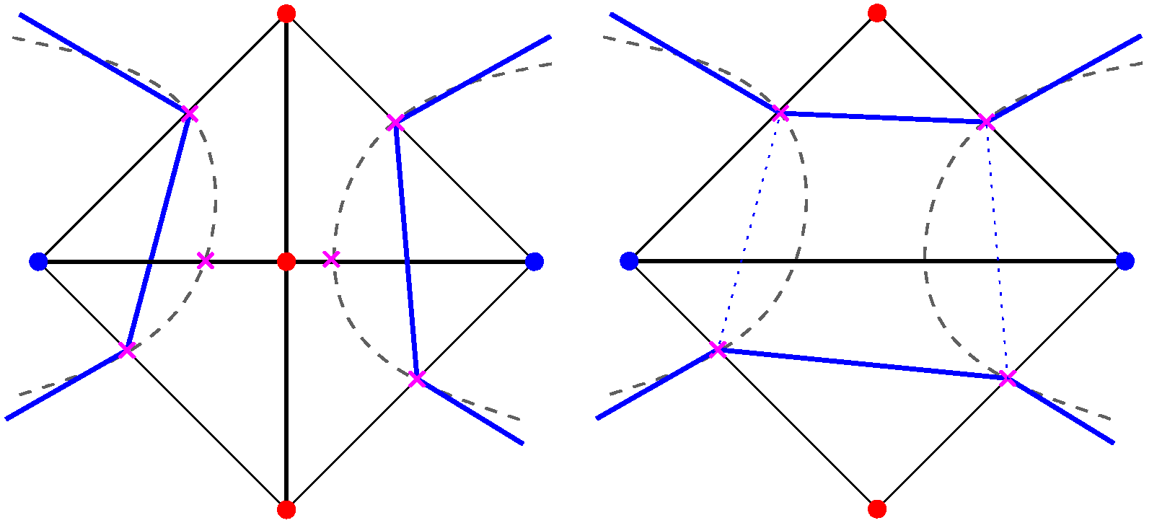
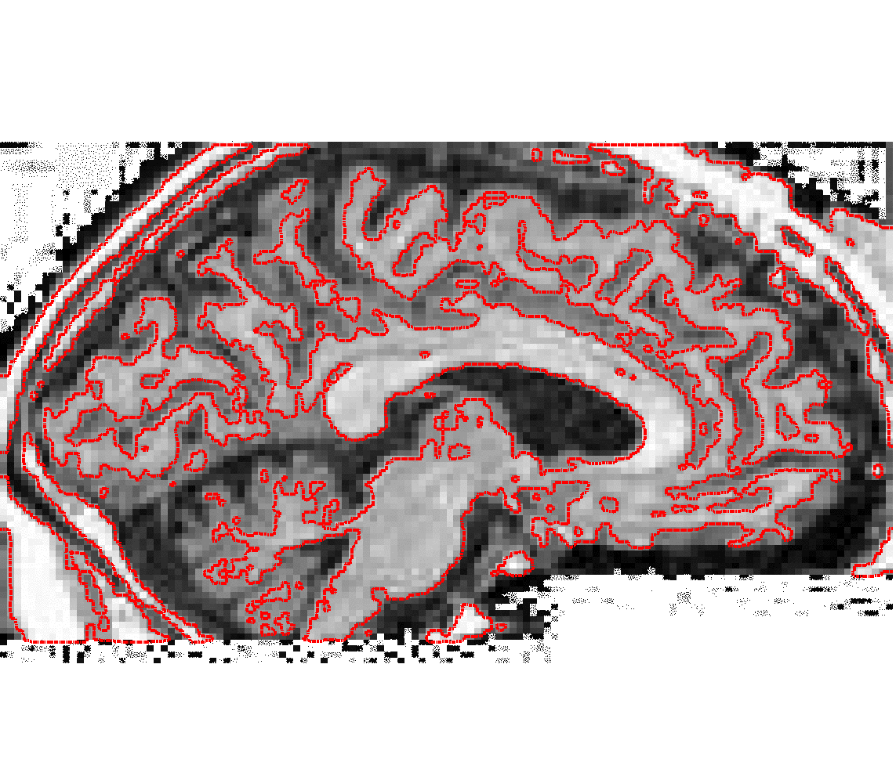
Topology Control
No control
Topology Control

Slide 10
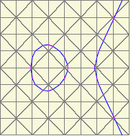
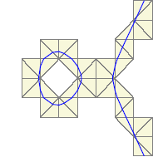
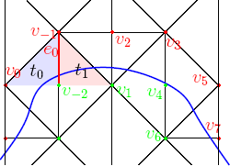
Progressive Compression
Encodes only the tubular neighbourhood
Encodes along with the curve

Slide 11
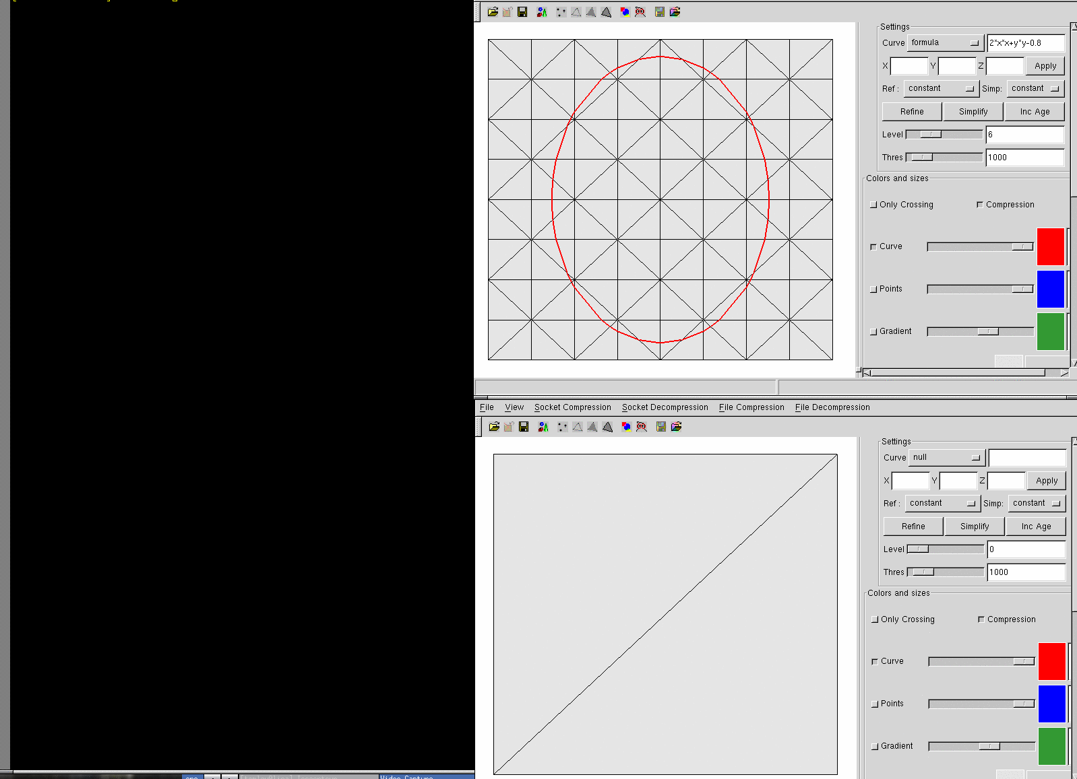
Uniform coarser Resolution
59 bits (8 bytes)

Slide 12
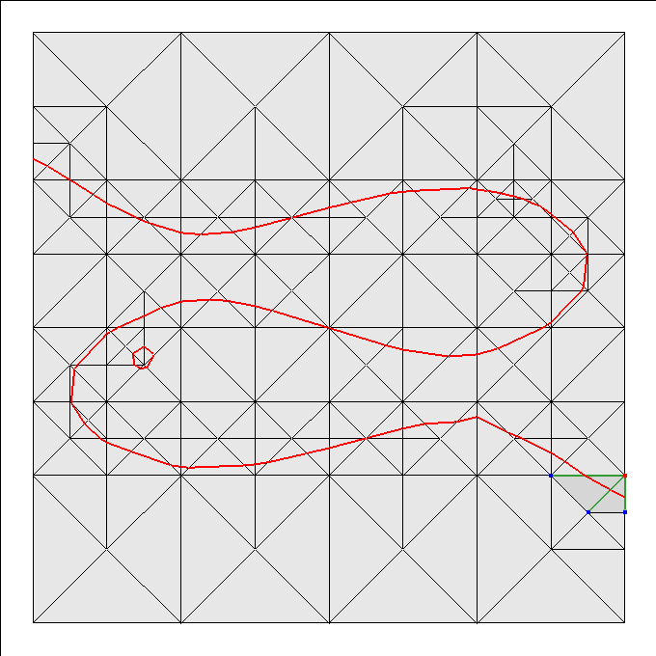
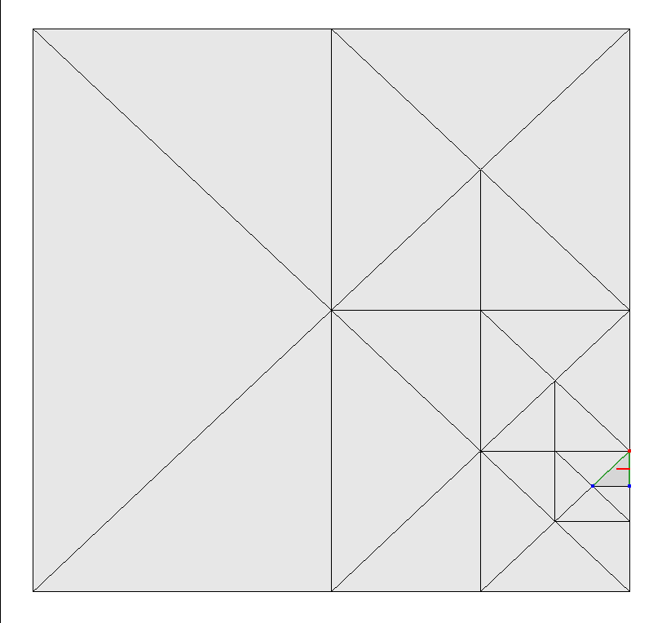
Adaptive coarser resolution
40 bytes
Compression
Decompression

Slide 13
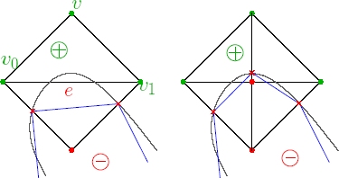
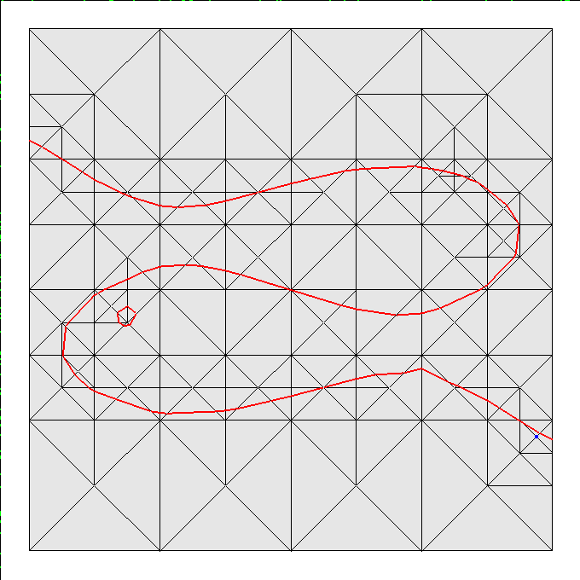
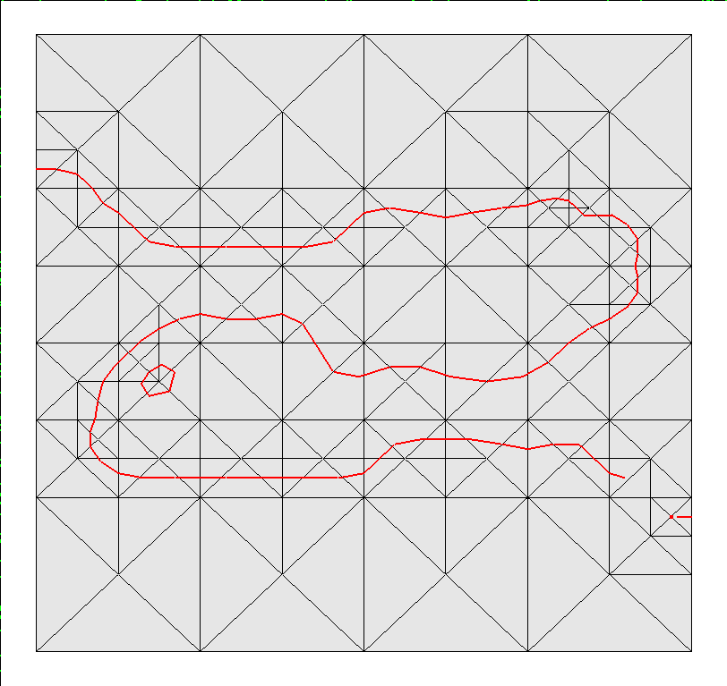
Refinements
Compression
+16 bytes
Decompression

Slide 14
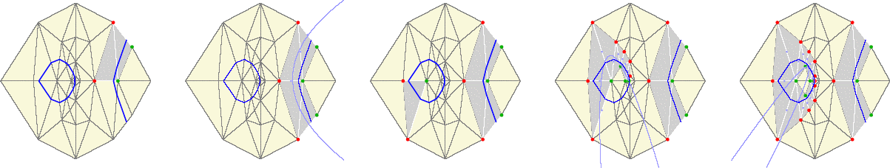
Prediction
Parabola fitting on the decoder's points.

Slide 15
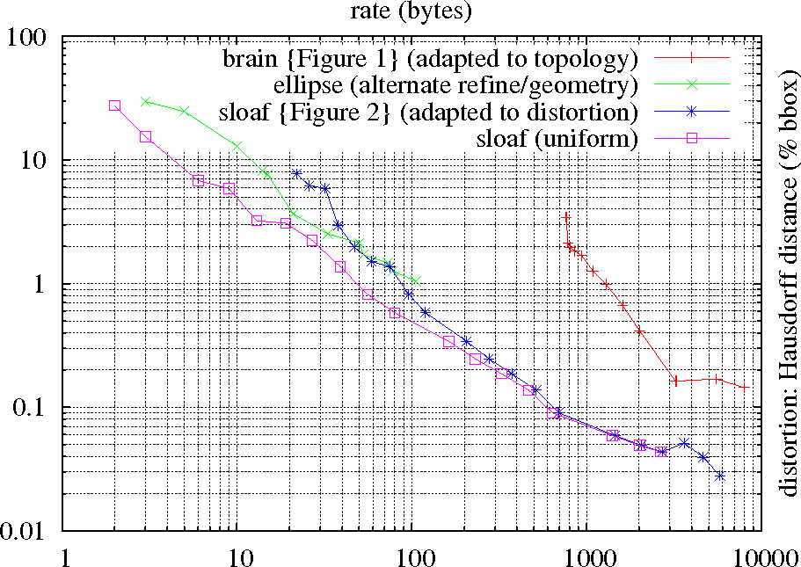
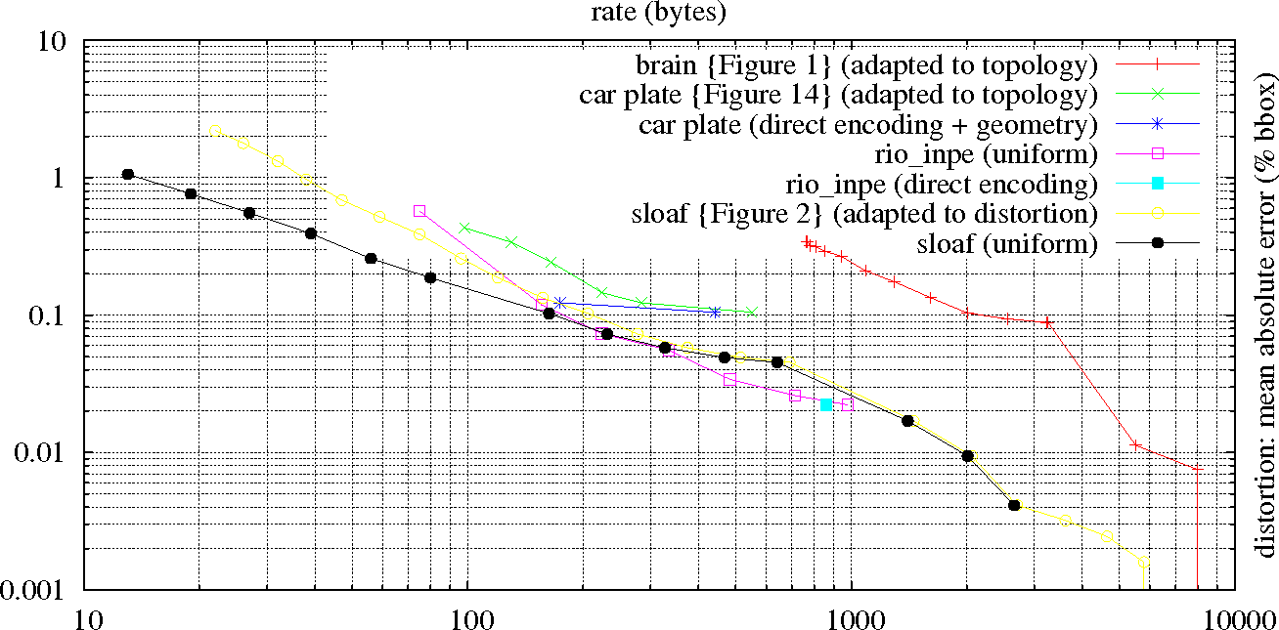
Results

Slide 16
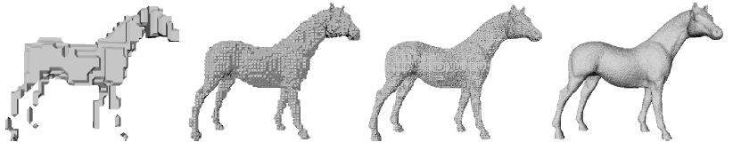
Extensions
Isosurfaces
nD level sets
Enhance prediction
Improve arithmetic encoder
Automatic tuning

Slide 17
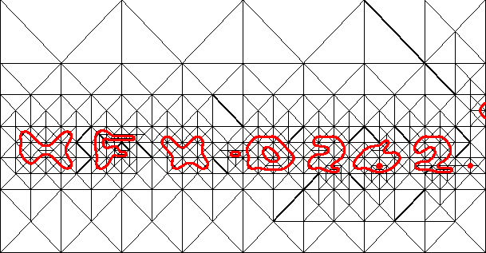
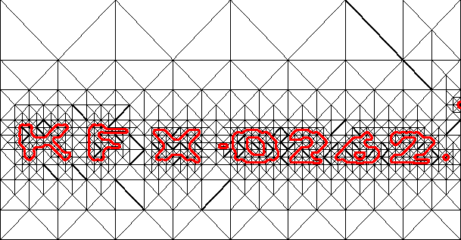
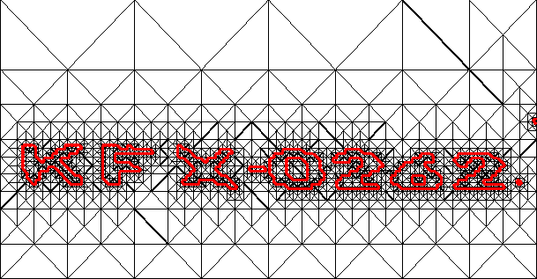
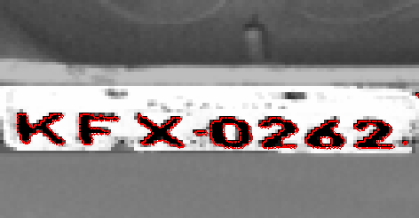
Thank you!

