Slide 1
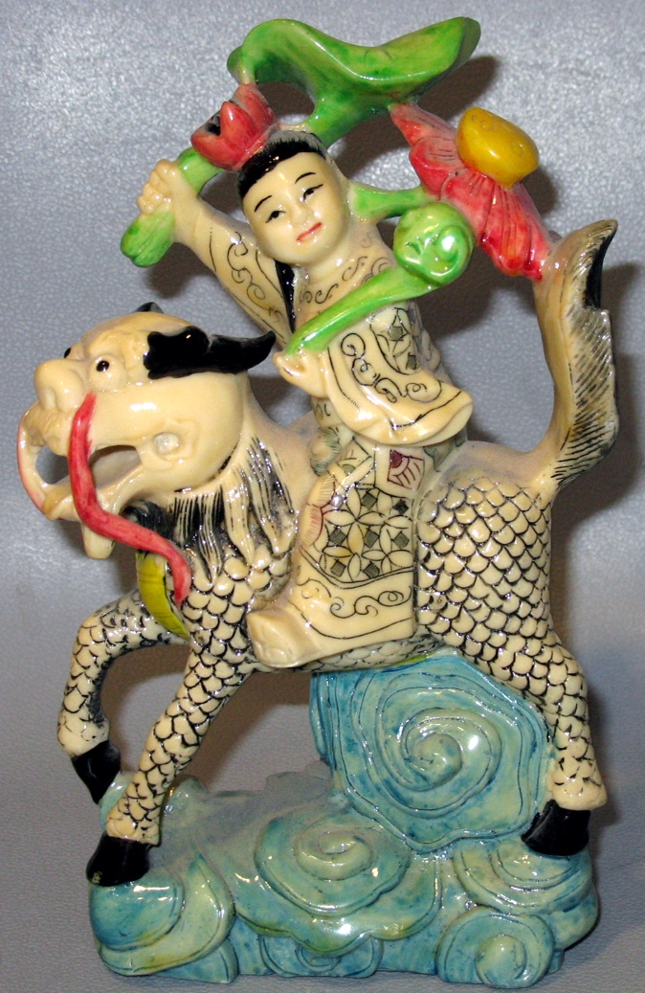
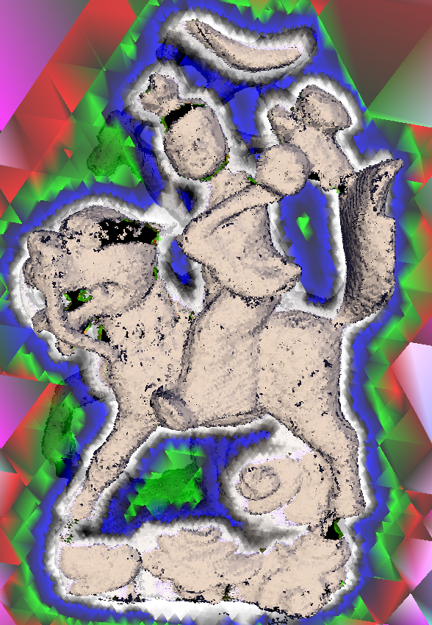
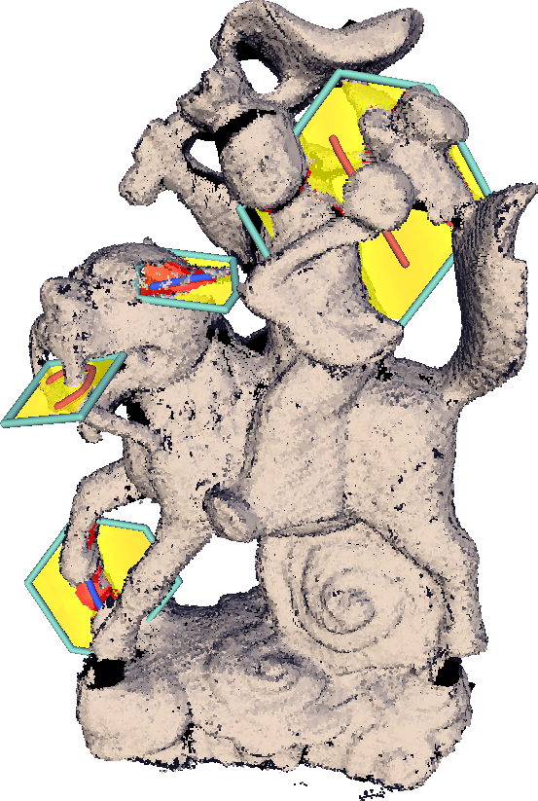
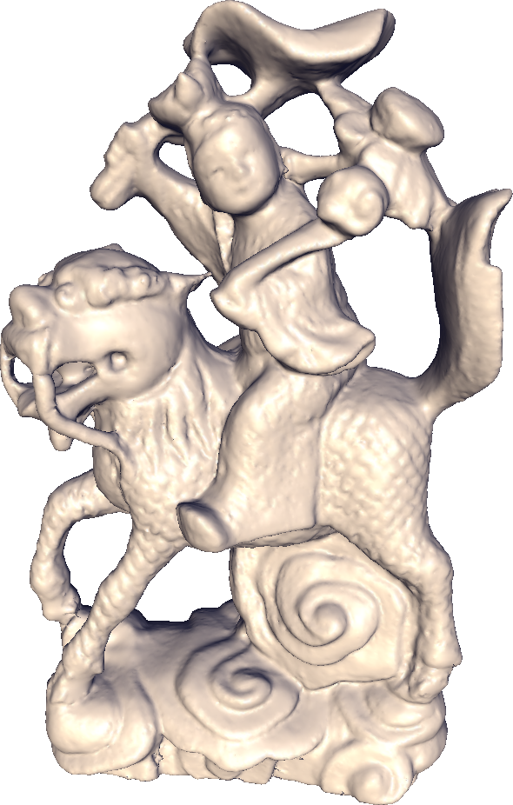
Interactive Topology-aware Surface Reconstruction
A.Sharf T.Lewiner G.Shklarski S.Toledo D.Cohen-Or

Slide 2
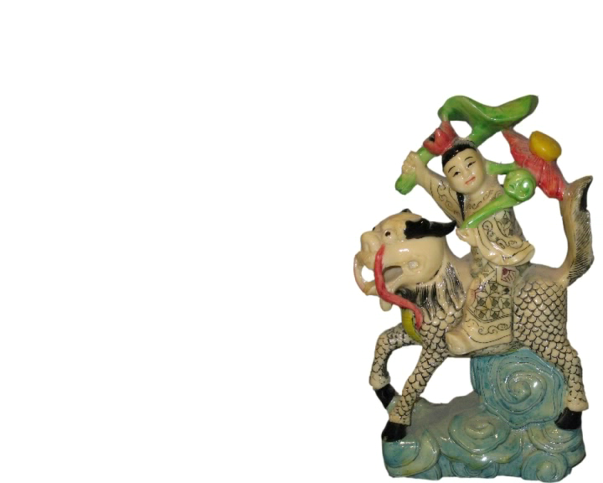
The Problem of Reconstruction
Expected shape cannot be determined automatically
Coverage problem - significant portions are missing:
  Physical inaccessibility
  Poor visibility
  Material properties
Notes:
Today, 3D scanners are becoming a common application in usage by end-users not necessarily professionals.
Therefore it is essential to allow users to create high-quality surfaces from scans, including imperfect scans in a fast and simple manner
However the reconstruction of a complete watertight model that is faithful to the original physical object is still a difficult process.
One of the major difficulties is the coverage of the scanned model: As a result of
Physical inaccessibility,
Poor visibility, Occlusions and
Material properties,
the coverage of the model by sample points is often imperfect and significant portions of the surface are either under-sampled or completely missing.

Slide 3
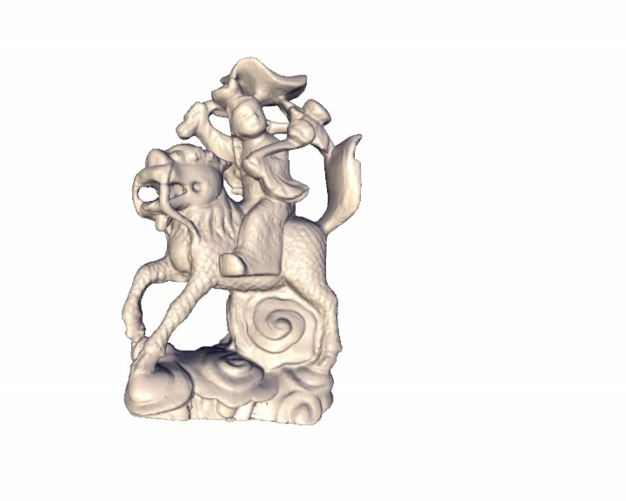
Method Concept
Automatic: detect ambiguous regions
Interactive: minimal user guidance
Result after a session of few minutes :
Notes:
We present a method that is interactive and topology-aware:
It uses minimal user input to make correct decisions
at regions where the topology of the model cannot be automatically induced with a reasonable degree of confidence.

Slide 4
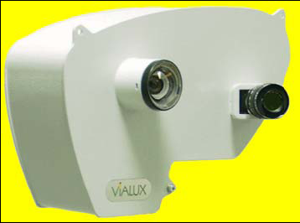
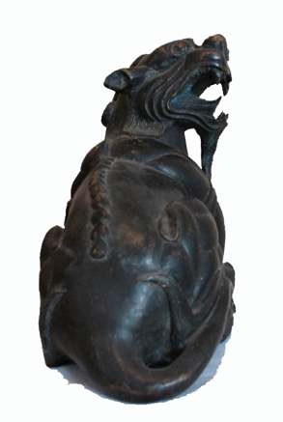
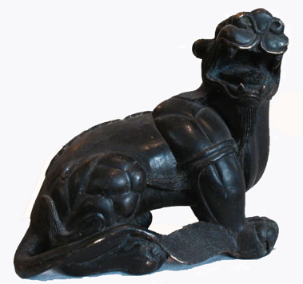
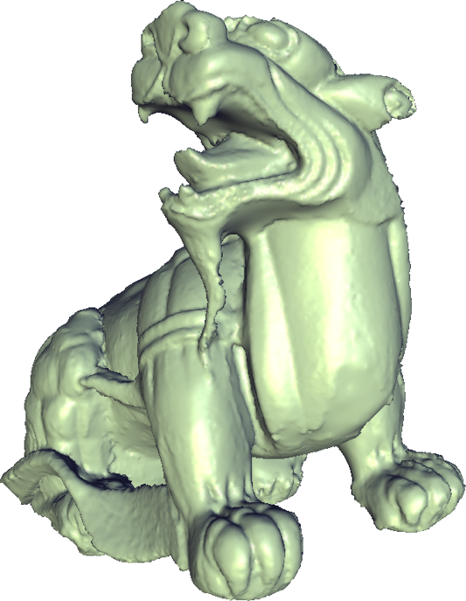
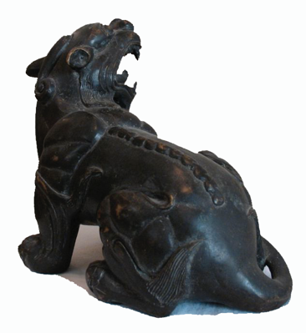
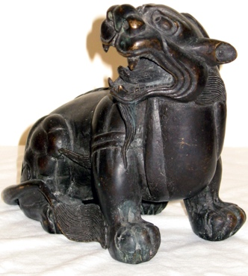
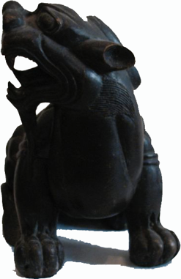
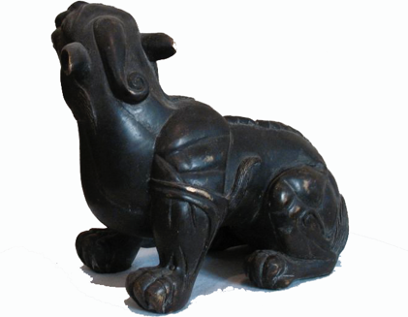
Structured Light Scanners
Imperfect coverage (<15 views)
Fast acquisition (<2s per exposure)
Notes:
In this work we focus on reconstructions of models acquired by a structured-light scanner.
This relatively inexpensive technology has the advantage of being fast:
Each model was scanned from 6 to 15 angles
Where each exposure of the camera is no longer then 2sec per exposure and
Thus, the whole scanning process took less than five minutes.

Slide 5
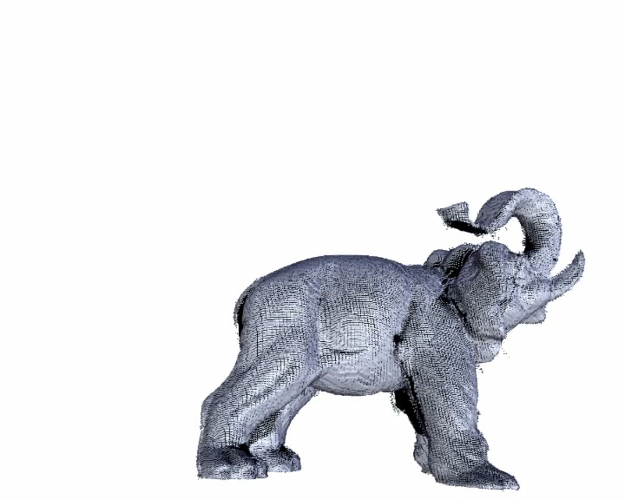
Ill-Posed Reconstruction Problem
Expected shape reconstruction is ill posed: many surfaces pass through or near points
Reconstructed object is not expected one!
Notes:
While it is reasonable to assume that scanning hardware will advance,
future reconstruction systems will still need to reconstruct under-sampled areas.
The coverage problem is even more acute for complex shapes with deep cavities and bifurcations
Therefore, techniques that reconstruct poorly-sampled areas automatically without any user intervention
fail in many cases to faithfully reconstruct the expected shape.
This is since the automatic reconstruction of the expected shape is an ill-posed problem:
an infinite number of surfaces pass through or near the data points
At the other extreme, systems that rely only on explicit manual surface editing are too tedious.

Slide 6
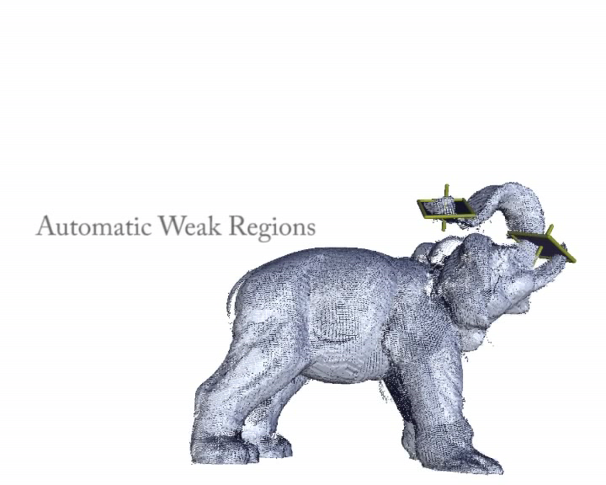
Our Solution
Automatic: detect topologically ill-conditioned regions
Interactive: in/out scribbles to locally resolve ambiguities
Notes:
In this paper we present an interactive topology-aware reconstruction technique.
Our method is based on the observation that:
It is often possible to automatically detect the ill conditioning where the topology of the model cannot be automatically induced with a reasonable degree of confidence
and to ask the user for inside/outside constraints to locally resolve them and achieve the expected shape.
Thus, the system prompts weak regions, where the user can add inside/outside constraints by merely scribbling over 2D planes.
Our work extends the effective power of scribbles to assist the ill-posed problems in surface reconstruction.
Nevertheless, we emphasize that a careful analysis of the data leads the user to where assistance is needed.

Slide 7
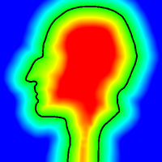
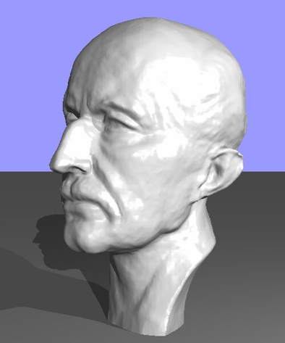
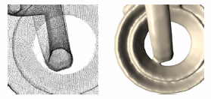
Related Work
Interactive scribbles: image segmentation [Li04], matting [Wang05], colorization [Levin04], mesh editing [Nealen05]
Global linear system reconstruction: [Carr01; Ohtake04; Kazhdan06]
Raw-scans reconstruction: [Davis02; Dey04; Kolluri04; Sharf06; Hornung06]
Nealen05
Ohtake04
Hornung06
Notes:
Recently, the use of scribbles as an interactive tool has gained a lot of popularity in various computer graphics applications, such as…
Scribbles are easy-to-use, loose, and do not require meticulous work.
At the same time, they provide the algorithm minimal but necessary hints needed to solve a problem.
The problem of reconstructing a surface from scans has been researched extensively.
Several works define the surface as a solution of a global linear system.
In contrast to other these, we do not rely on points’ orientation which is often unreliable.
Instead we interactively reconstruct the surface using only the positions of raw scanned data.
Several works are concerned with the reconstruction of a surface from inhomogeneous sample density or missing data…
However, at problematic regions these algorithms cannot guarantee the generation of an expected topologically-correct shape.

Slide 8
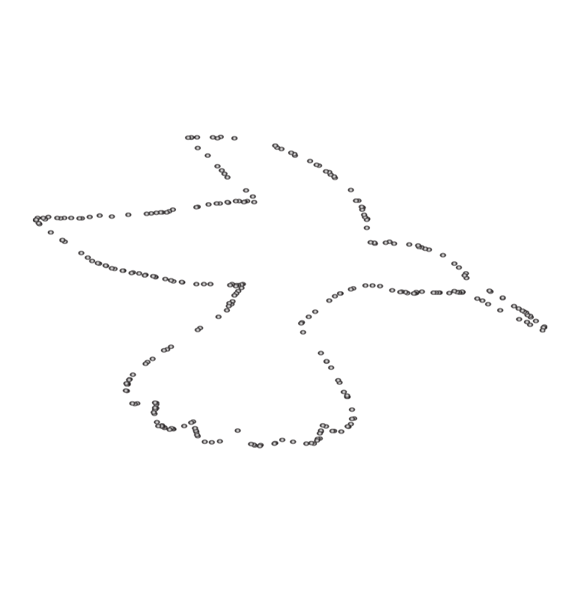
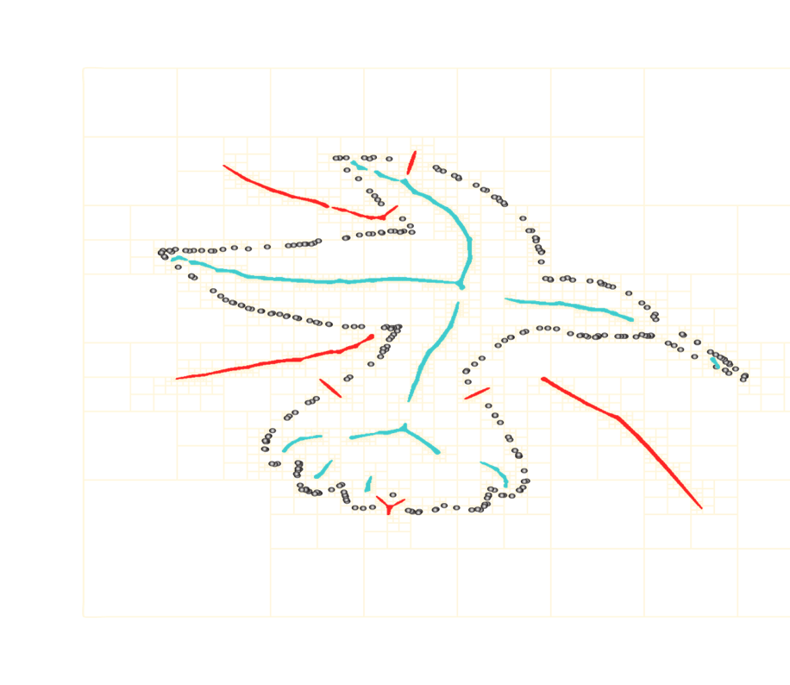
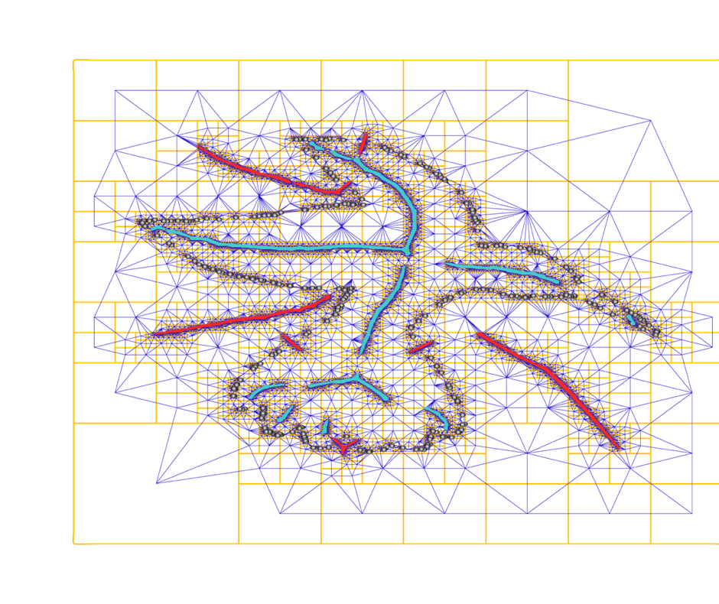
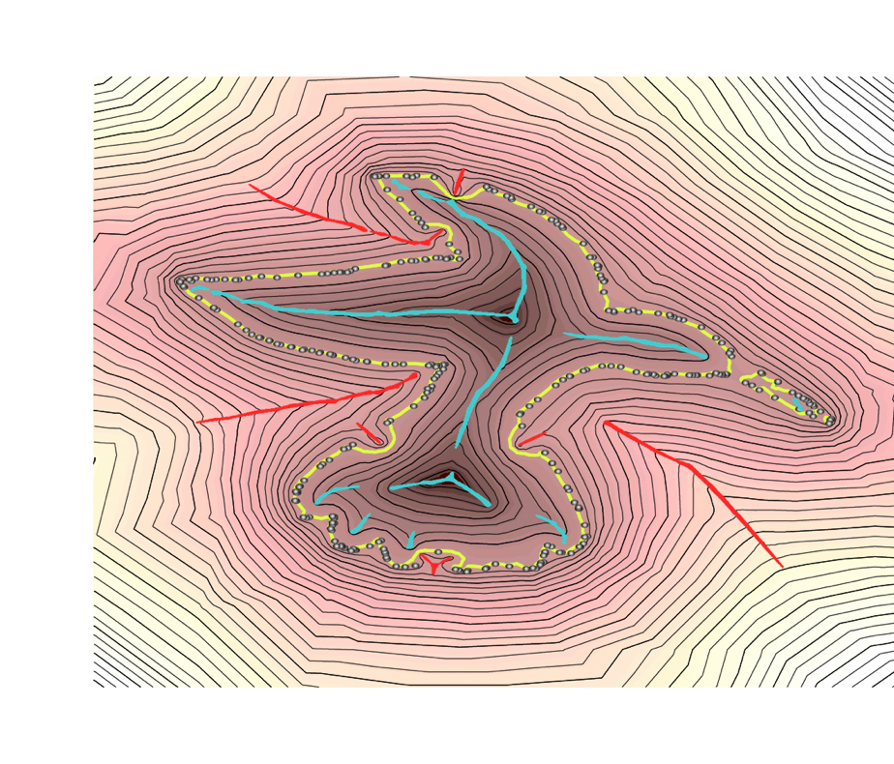
Method Overview – 2D
Initial in/out constraints
Adaptive structure domain
Implicit distance field - FEM formulation
Notes:
To reconstruct a watertight surface given raw scans with no normals:
We first construct a continuous distance function in R3
That is defined over a 3D adaptive domain
Its zero crossing is the approximation of the surface
From this field we compute some initial in/out constraints

Slide 9
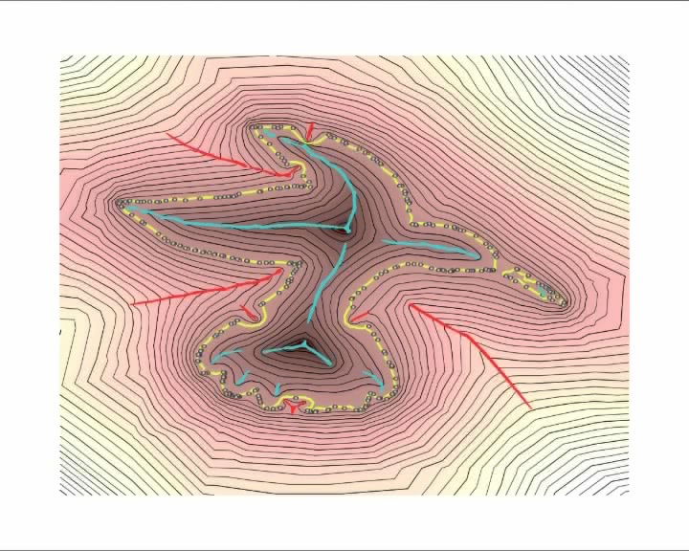
Method Overview – 2D cont’d
Weak region detection
User-scribbles update
Notes:
Careful analysis of the data detects topological ambiguous regions
The FEM formulation of the problem allows the user to interactively add constraints and resolve these ambiguities.

Slide 10
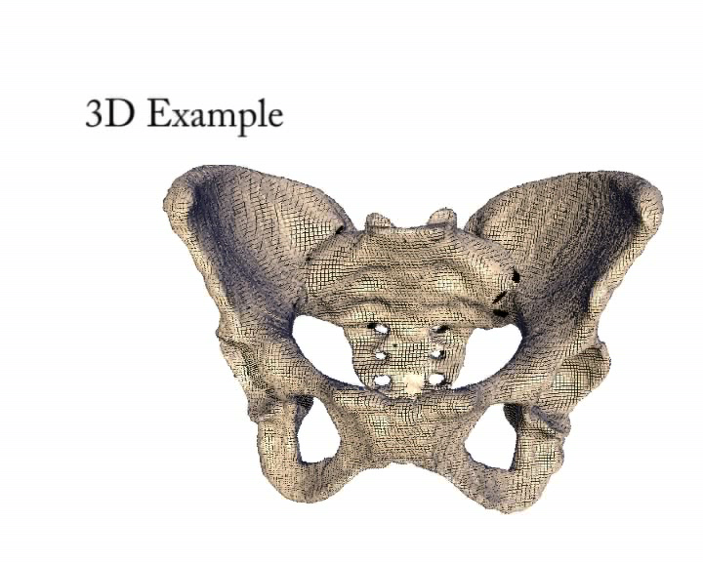
Method Overview – 3D
Few scribbles effectively remove wrong interpretation of initial reconstruction
Notes:
As can be seen here few scribbles effectively remove wrong interpretation of initial reconstruction

Slide 11
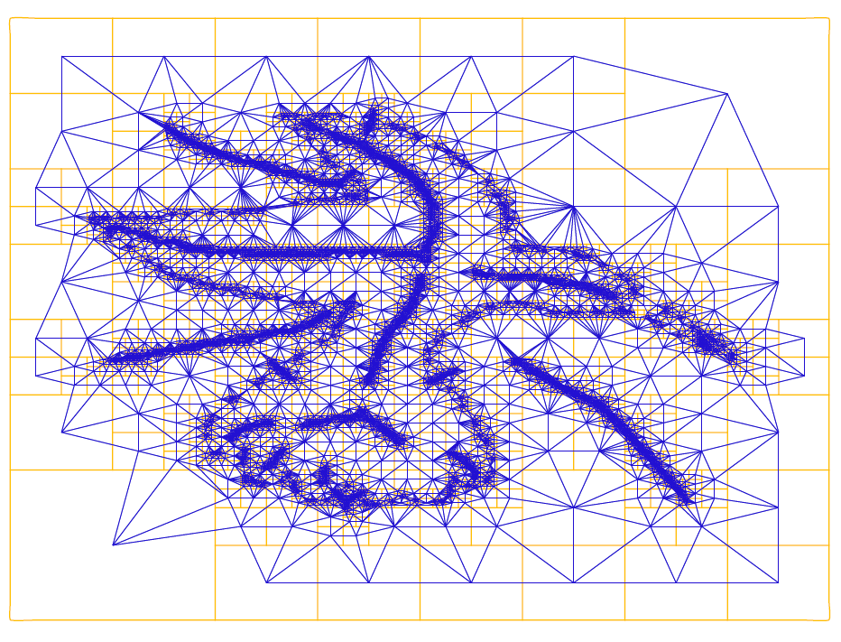
Discrete Underlying Structure
Adaptive octree on top of point cloud
Dual tetrahedral mesh graph
Notes:
In this work we use a dynamic octree hierarchy that adapts to the data points and to additional constraints.
We also construct a dual tetrahedral mesh by triangulating the octree cells centers.
This dual allows a better representation of continuous functions, as required by the FEM and the topological
analysis.
Our reconstruction process performs in a coarse-to-fine, incremental manner. At each iteration, the hierarchy
is locally refined close to the zero level-set of the current implicit function.

Slide 12
Implicit Formulation
Implicit function u(p):
Surface Z=u⁻¹({0}):
P^{out}(-)
P^{in}(+)
P^{S}(0)
Notes:
We formulate our reconstruction problem as a constrained implicit function optimization in R3.
Our method uses priors to reconstruct the surface:
Two priors are assumed fixed: we assume that the surface is smooth almost everywhere, and that it should be watertight.
Furthermore, the system allows additional user inside/outside constraints and zero constraints at the point-set.
We define the reconstructing surface to be this function zero level-set solution

Slide 13

Topology-aware Detection
Defining constraints everywhere is tedious
Analysis of data leads to where assistance is needed:
Notes:
The implicit function is designed to incorporate user information as inside/outside constraints
However, to avoid the tedious task of defining constraints everywhere:
The system automatically detects weak regions of unstable topology where assistance is needed.

Slide 14
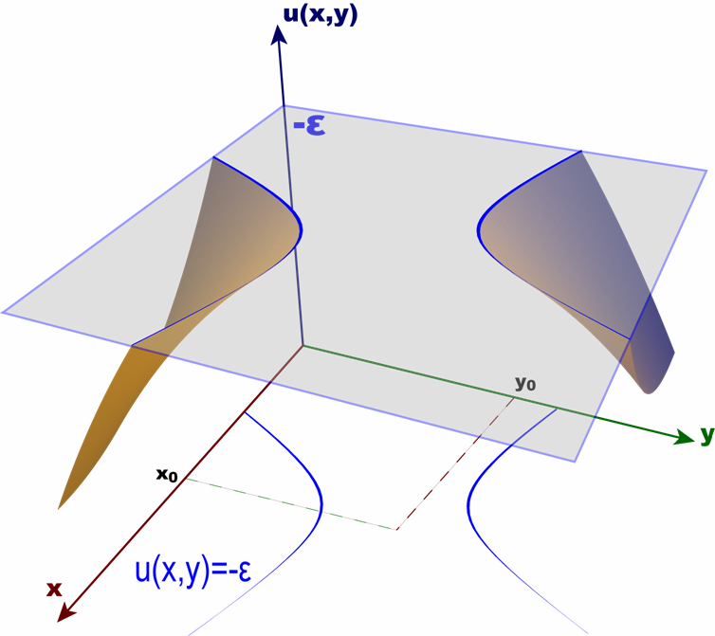
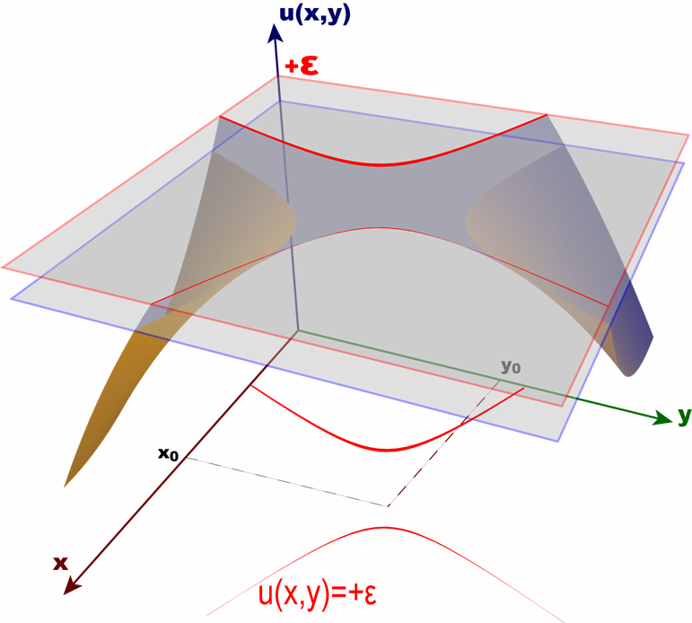
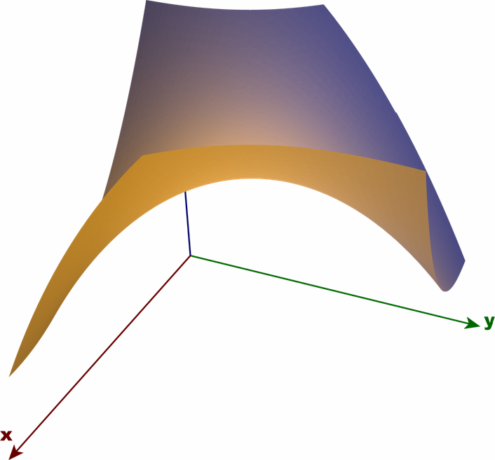
Topologically Weak Regions
Definition: little iso-value perturbation ↔
change of surface topology
2D field example
Notes:
This analysis is topology-aware.
The key point in our work is to analyze the implicit function and to identify
topologically weak regions, in the sense that small perturbations of
the field lead to very different topological interpretations of the data.
We define topologically unstable regions (weak regions)
where little perturbations of the data change the topology of the level-set surface.
For example when in a saddle-shaped terrain,
little perturbations of the level-set can lead to dramatic changes in the topology of the level curve.

Slide 15
Discrete Weak Regions
Morse critical points:
  Compute link graph per vertex
  Partition into positive/negative groups
  Detect critical points from groups
  Filter critical points far from zero
v
v
Notes:
Based on Morse theory:
the topological changes of implicit surfaces occur at critical points where the gradient vanishes.
Computationally we determine whether a vertex v of a tetrahedral mesh is critical by
analyzing its link graph
and counting the number of connected groups.

Slide 16
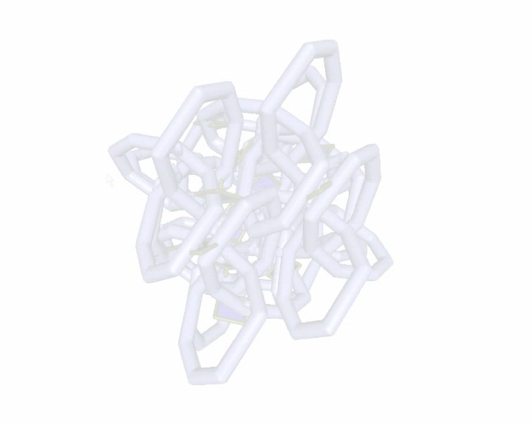
User Interaction
Tablets:
2D cross sections perpendicularly to critical points
Scribbles:
loosely define local inside/outside sign
System constraints:
signed distance field values
Notes:
We provide, for each weak region, a 2D tablet indicator for the user.
Then the user merely draws few scribbles over a corresponding 2D tablet that specify the correct local sign of the implicit function.
These scribbles are interpreted as constrains in our system thus correcting or reinforcing the local topology.
These constraints are interpreted by our system as discrete points having a signed distance
As the user draws scribbles over these weak regions:
the solution in that region is correctly constrained
their topological stability increases,
leading to a correct interpretation of the data.
As can be seen here such an automatic guidance is crucial for reconstructing complex shapes!

Slide 17
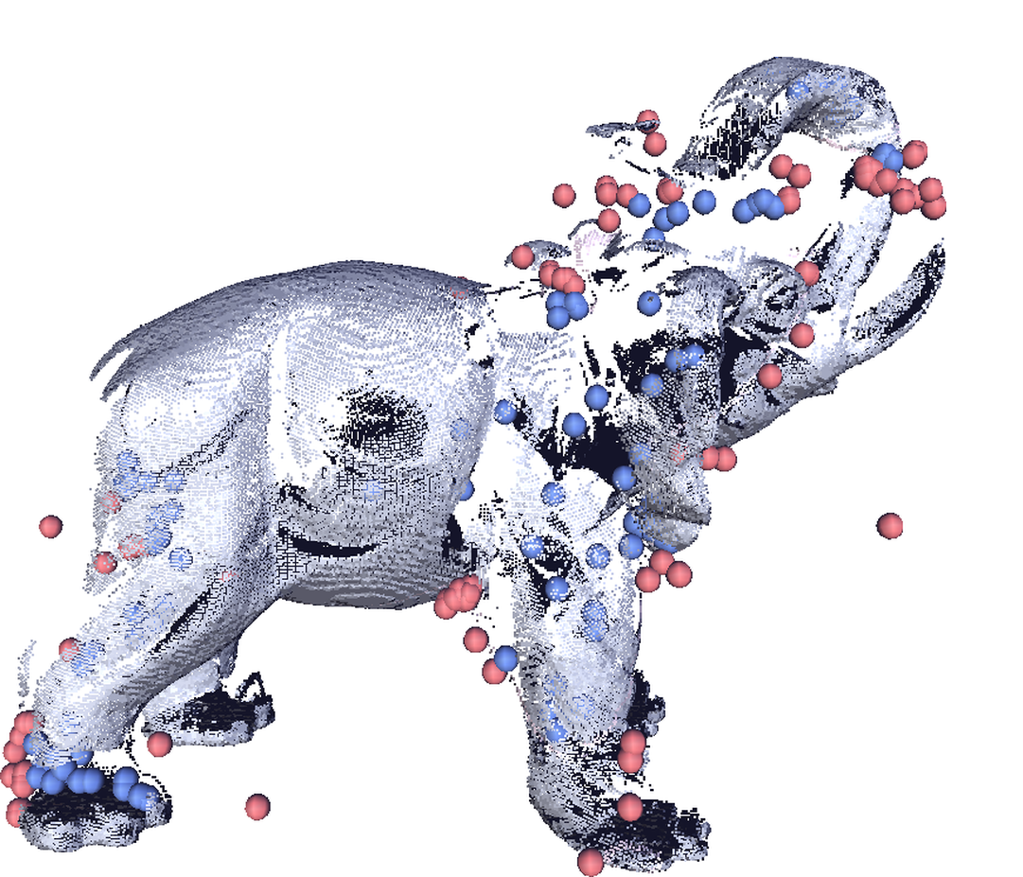
Initial Constraints
Automatically generated, inside/outside constraints:
  Unsigned distance transform from data points
  Local maxima as constraints
  Classify inside/outside using
  space carving
Notes:
Finally, to initiate the reconstruction process, we use few, automatically generated, loose inside/outside
constraints.
We use local maxima, detected by examining field gradients of the distance field as such initial constraints.
We automatically classify constraints as inside/outside applying a simplified space carving method.
Nevertheless, if required, this process could be easily skipped using only manual scribbles.

Slide 18
Matrix formulation
Smoothness constraints:
Zero/in/out constraints:
P^{out}(-)
P^{in}(+)
P^{S}(0)
Notes:
We define the smoothness constraint for any function u as the Laplace operator over the 3D volumetric domain.
The other function constraints, penalize u for being far from the scanned points or the additional user sign constraints.

Slide 19
FEM System
Solve smoothness using FEM:
  Piecewise tri-linear elements
  Compensates for bad triangulation
  Penalty is mesh independent
Sparse optimization problem (CHOLMOD) :
(0,1)
T=1-x-y
(0,0)
(1,0)
Notes:
Our optimization problem is formulated in a mesh-independent manner,
and mapped onto a specific mesh, using the FEM.
The main advantage of our FEM-based approach is that
it automatically adapts to functions interpolated on meshes with tetrahedrons of widely different
size and aspect ratio, common in our data structure
Computationally, the function and its zero crossing surface are constructed by solving a large sparse linear system,
which is pre-factorized once and constantly updated.

Slide 20
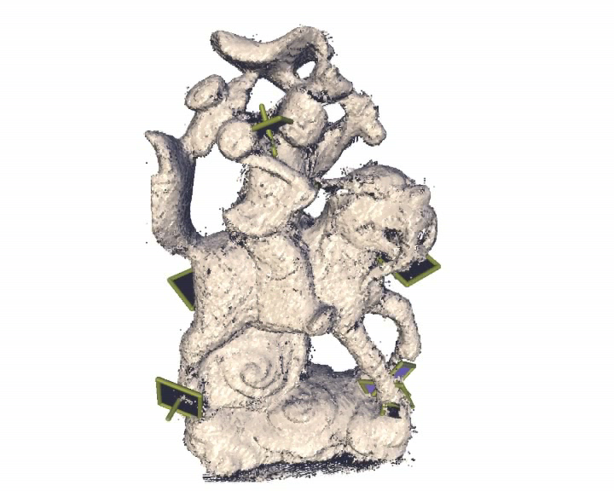
Recorded Reconstruction Session
Notes:
To demonstrate the effectiveness of the proposed method, we focus on complex objects,
which we acquired with a structured light scanner from only few viewpoints.
The advantage was acquiring scans fast and simple, however it produced noise ,outliers and missing parts.
We show extracts of the reconstruction session in real-time.
Note that the complete session from the registered scan to the final reconstructed mesh lasted not more than few minutes

Slide 21
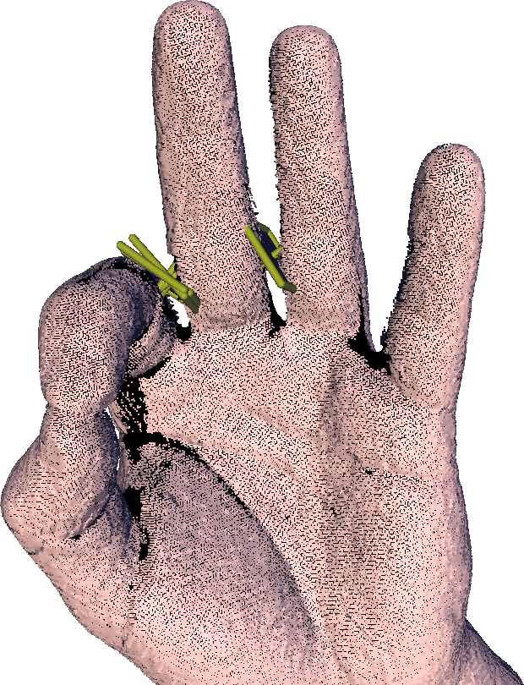
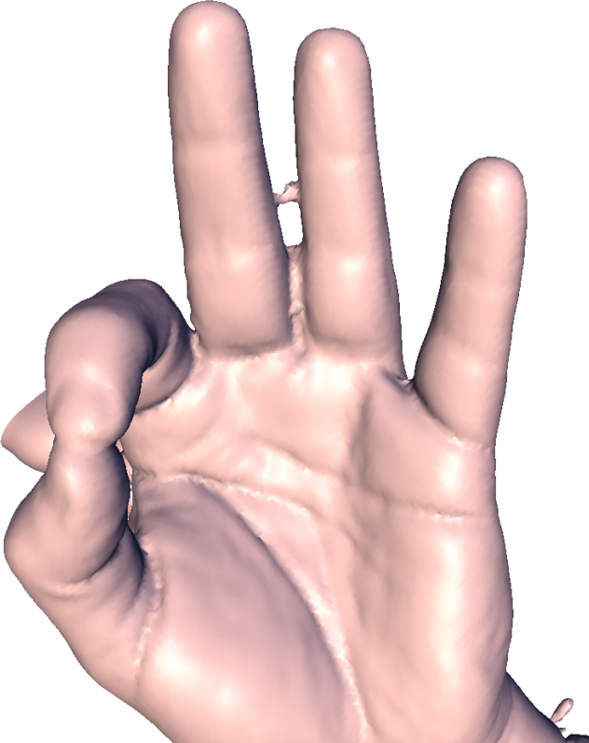
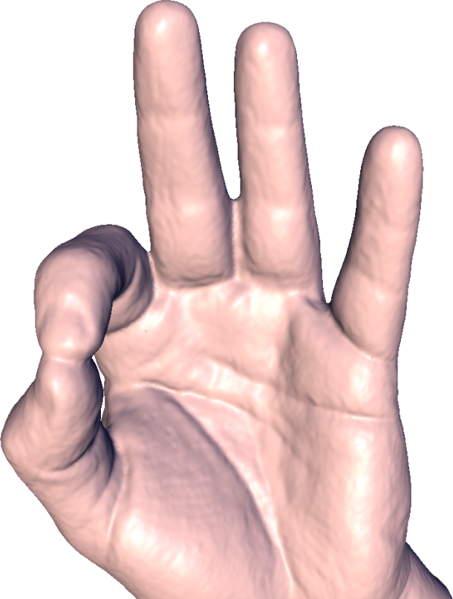
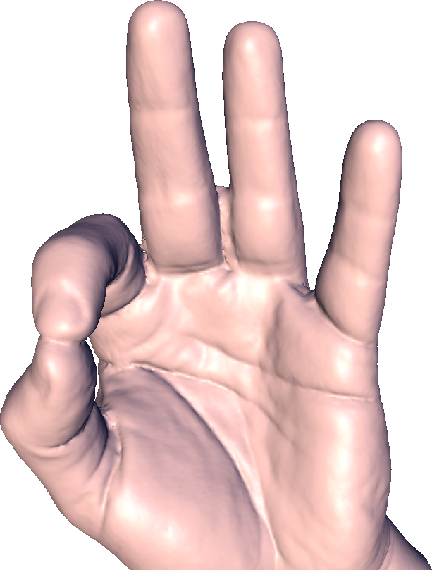
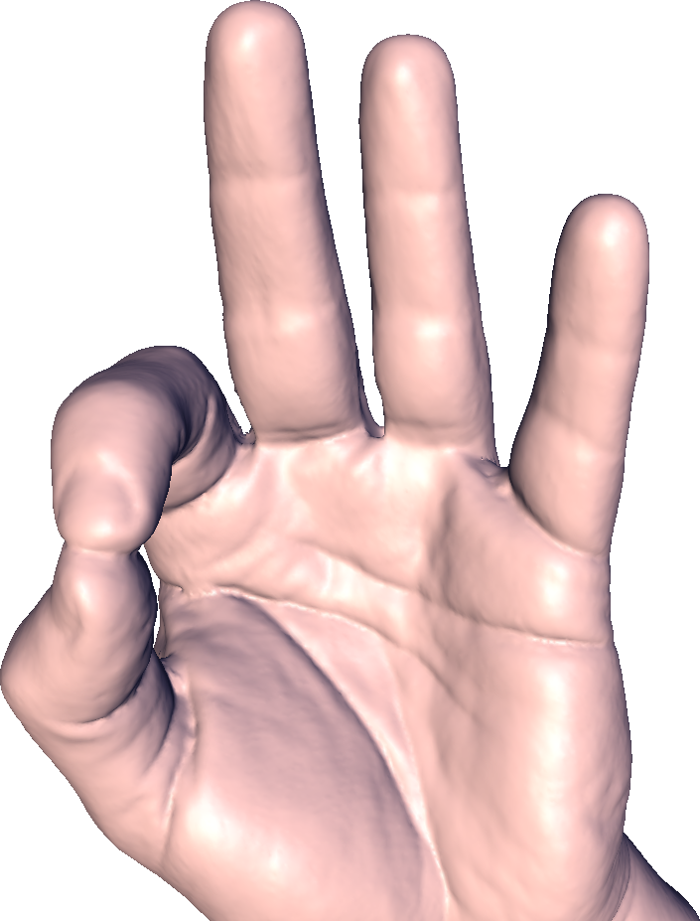
Comparison
Original
MPU Ohtake04
Kazhdan06
Sharf07–automatic
Sharf07–interaction
Notes:
We would like to show a comparison, demonstrating that without any interaction, our method quality competes with the recent method of Kazhdan06 however beter in timing. Nevetheles, the figure below interaction demonstrates the essentiality of interaction.

Slide 22
Timings
Pentium 4 2.41Ghz
512K RAM
NVIDIA 4800
Max octree depth 8
Max matrix size 70k²
 | #points | #shots | Recon-struction | Inter- Action | #scribbles
Monk | 469 k | 10 | 130s | 3min | 9
Elephant | 217 k | 6 | 88s | 2min | 7
Knot | 497 k | 15 | 206s | 4min | 10
Hand | 259 k | 8 | 92s | 30s | 2
Saddle | 284 k | 11 | 118s | 0min | 0
Hip | 222 k | 9 | 109s | 30s | 4
Tiger | 340 k | 10 | 157s | 6min | 12
Woman | 333 k | 9 | 116s | 5min | 12
Camel | 282 k | 12 | 128s | 3min | 6
Notes:
Some timings details emphasizing the low number of scans and the short interaction timings

Slide 23
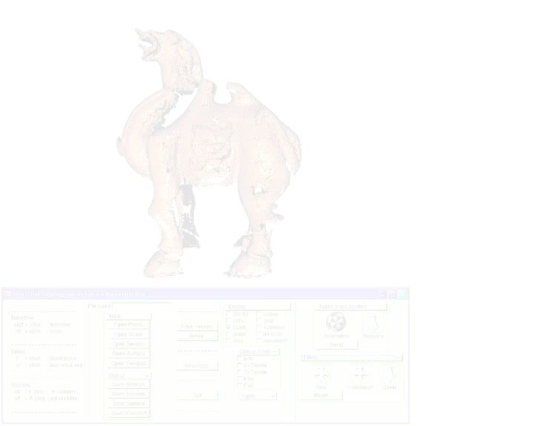
Interactive Reconstruction with Large Missing Regions
Notes:
We show a session of reconstructing scans with extremely large missing parts

Slide 24
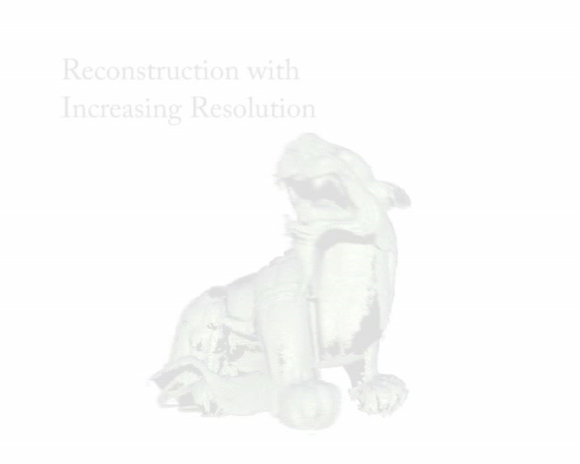
Coarse-to-fine Workflow
Notes:
Here we demonstrate our coarse to fine workflow

Slide 25
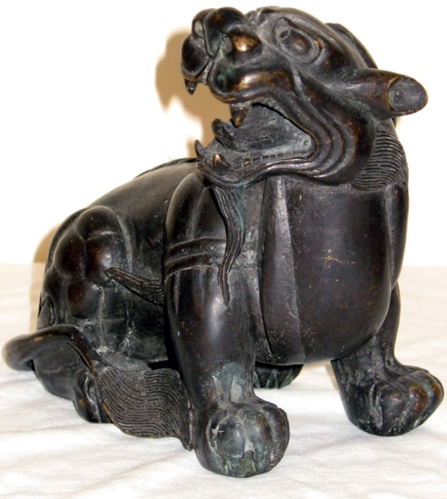
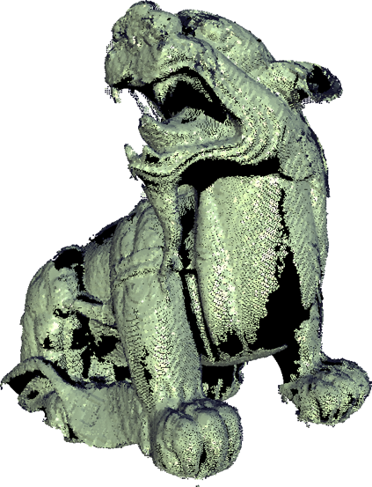

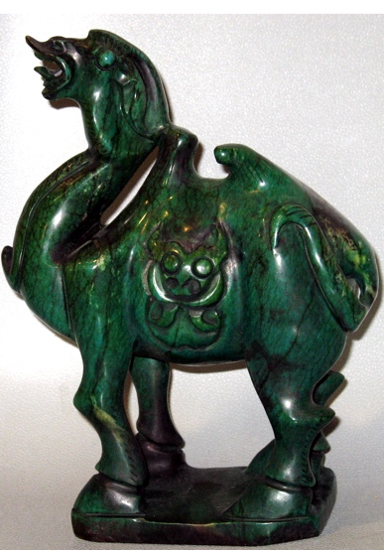
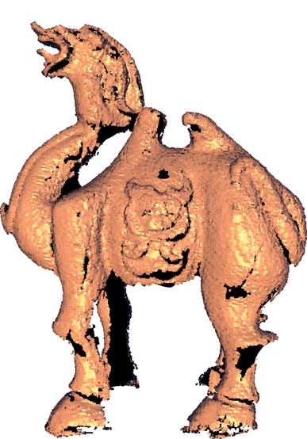
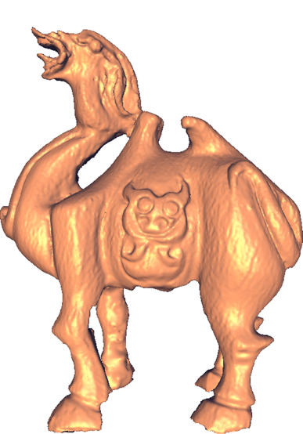
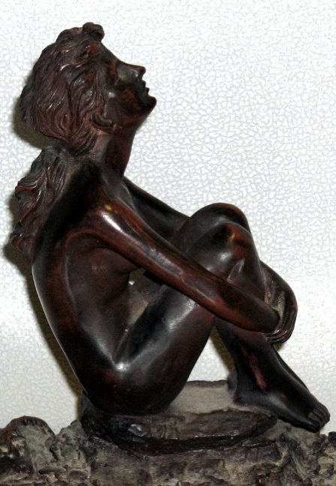
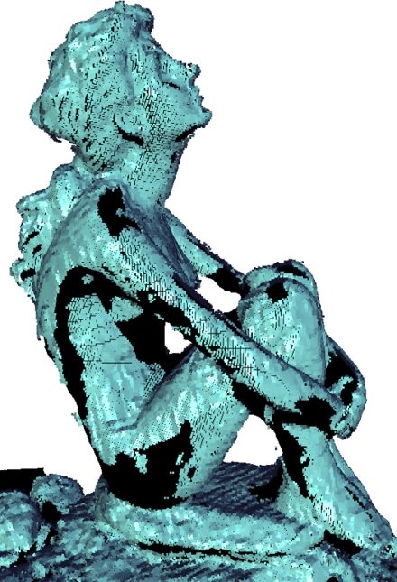
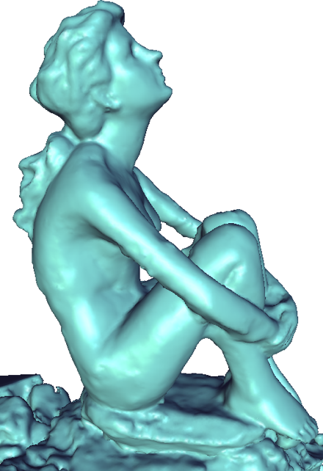
Thank you!

