Slide 1
Fast Stellar Mesh Simplification
Antônio W. Vieira^{1,2}
Luiz Velho³
Hélio Lopes¹
Geovan Tavares¹
Thomas Lewiner^{1,4}
¹PUC–Rio — Laboratório Matmídia — RJ
²UNIMONTES — CCET — MG
³IMPA — Laboratório Visgraf — RJ
⁴INRIA — Géométrica Project — Sophia Antipolis

Slide 2
Outline
Corner-Table Data Structure
Mesh Simplification
Four-Face Clustering
Fast Stellar Mesh Simplification
Multi-resolution
Results

Slide 3
Corner-Table Data Structure
Topology: 2 integer arrays:
V[c] = Vertex of corner c.
O[c] = Opposite of corner c.
V[0] = 0 O[0] = 4
V[1] = 3 O[1] = 9
V[2] = 1 O[2] = 8
V[3] = 3 O[3] = 10
V[4] = 2 O[4] = 0
V[5] = 1 O[5] = 7
V[6] = 3 O[6] = 11
V[7] = 0 O[7] = 5
V[8] = 2 O[8] = 2
V[9] = 2 O[9] = 1
V[10]= 0 O[10]= 3
V[11]= 1 O[11]= 6

Slide 4
Basic queries in CT
-c.t = c/3✗
-c.n = next(c) = 3 c.t + (c+1) mod 3;
-c.p = prev(c) = 3 c.t + (c+2) mod 3;
-c.l = O[prev(c)];
- c.r = O[next(c)].

Slide 5
Corner-Table Data Structure
Advantages:
Low memory alocation
Surfaces with boundary
Easy to implement
Easy for handling
Drawbacks:
Restricted to triangular meshes
Fixed number of elements

Slide 6
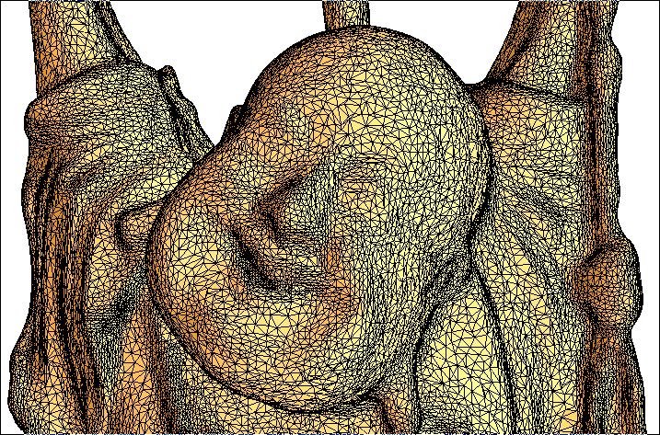
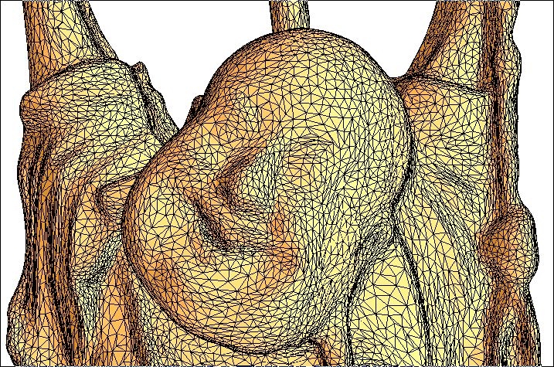
Mesh Simplification
Highly complex triangle meshes are expensive to process.
Simplification steps produce smaller models.

Slide 7
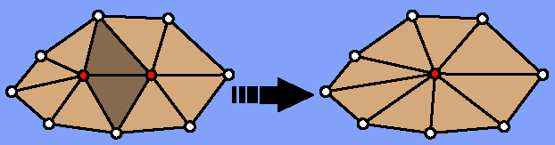
Local Topological Operators
The Edge-Collapse operator consists in contracting the two vertices of an edge onto a unique vertex.

Slide 8
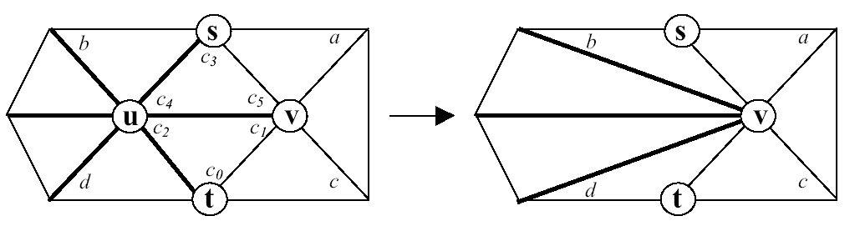
Edge-Collapse in CT
Edge-Collapse(c₀)
{
c₁=next(c₀); c₂= prev(c₀);
c₃ = O[c₀]; c₄ = next(c₃);
c₅ = prev(c₃); a = O[c₄];
b = O[c₅]; c = O[c₂]; d = O[c₁];
i=c₂;
do
{
V[i]=V[c₁]
i=next(right(i))
} while (i != c₂) ;
O[a] = b; O[b] = a;
O[c] = d; O[d] = c;
}

Slide 9
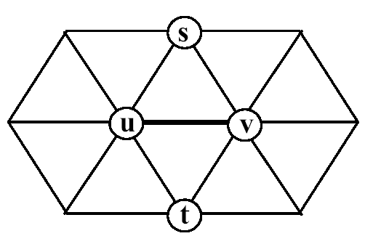
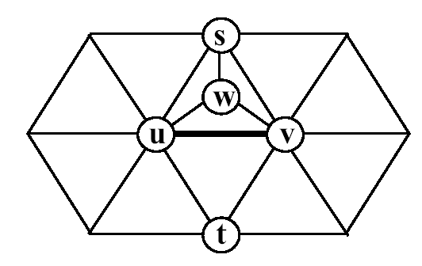
Topology Preservation
Allowed Contraction
Necessary and sufficient condition: Link Condition Lemma (Edelsbrunner)
Not Allowed Contraction

Slide 10
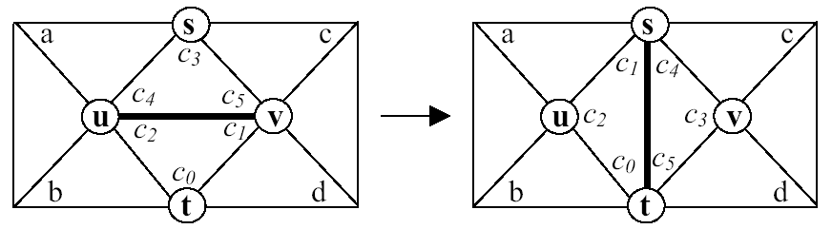
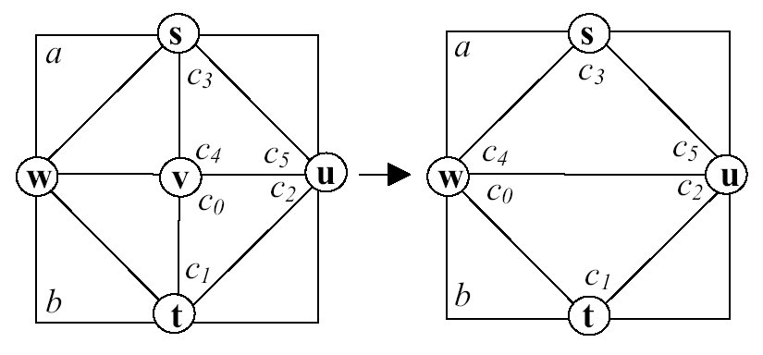
Stellar Operators
Edge-Flip
Edge-Weld

Slide 11
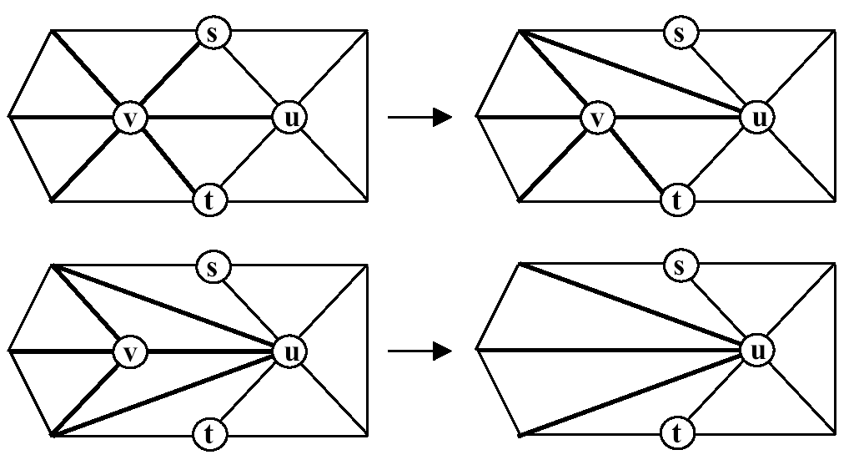
Four Face Clustering
Edge-Collapse =
      Edge-Flip
      Edge-Flip
      .....
      Edge-Flip
      Edge-Weld

Slide 12
Geometrical Cost Estimation
QEM – Quadric Error Metric
Map each face f to a 4x4 quadric matrix :
Qf = n.n^{t}, with nf.
For each vertex v, assign :
Qv = ∑_{i} Qf_{i} , where {f_{i}} are the faces incident to v.
Cost for contracting (u,v) to w :
C=w^{t}(Qu + Qv)w.
dw
u
w
v
f₁
f₂

Slide 13
Four Face Clusters Mesh Simplification
The cost for simplifying each vertex v is computed as
E(v)=αR(v)+βS(v), where:
  R(v) = min_{i}{w_{i}^{t}(Qw_{i}+Qv)w_{i}}, {w_{i}} are the vertex in Link(v).
  S(v) = ∑_{i} F(e_{i}), F(e_{i}) is the cost of Edge-Flips in Star(v) necessary to bring v to valence 4.

Slide 14
Steps of FFC Algorithm
1. Assign quadrics;
2. Compute E(v)=αR(v)+βS(v) for all v;
3. Mark all vertices as valid for removal;
4. Insert all vertices in the priority queue;
5. Get v from queue;
6. Perform Edge-Flips to bring v to valence 4;
7. Mark vertices wLink(v) as visited;
8. Remove vertex v, resulting the edge (a,b);
9. Re-compute quadrics Qa and Qb;
10. Compute error and update queue for vertices wLink(a)Link(b);

Slide 15
Fast Stellar Mesh Simplification
1. Assign quadrics;
2. Mark all vertices as valid for removal;
3. Choose 8 random vertices;
4. Select v from 8 random with lower E(v)=αR(v)+βS(v);
5. Perform Edge-Flips to bring v to valence 4;
6. Mark vertices wLink(v) as visited;
7. Remove vertex v, resulting the edge (a,b);
8. Re-compute quadrics Qa and Qb;

Slide 16
Results
Visual results of Stanford Bunny model simplified using FS and FFC
Original: 10000 faces
Simplified FS: 2000 faces
Simplified FFC: 2000 faces

Slide 17
Results
Visual results of Cow model simplified using FS and FFC
Original: 5800 faces
Simplified FS: 1200 faces
Simplified FFC: 1200 faces

Slide 18
Results
The geometric error, based on QEM, acumulated in both algorithms, FS and FFC, are similar.
Accumulated geometric error for simplifying Bunny model in diferent LOD.

Slide 19
Next Steps
Progressive encoding scheme
Surface parametrization
Hardware implementation
Thank you for your attention!

Slide 20
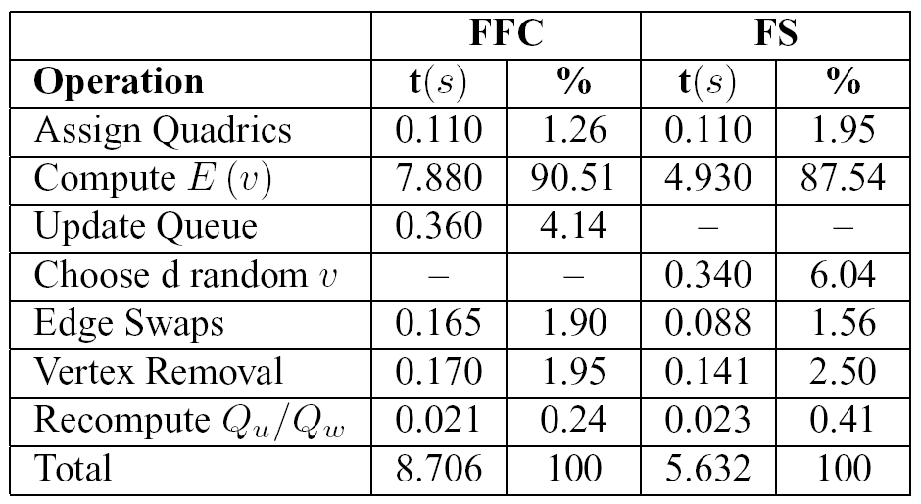
Results
Running time comparison of each routine for simplifying the Stanford Bunny model, using FFC and FS algorithms

Slide 21
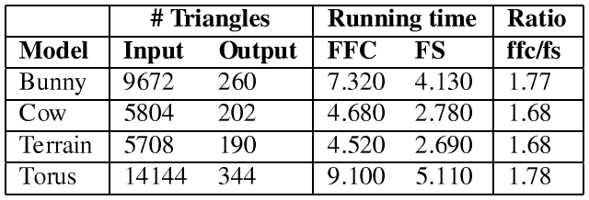
Results
FS is about 40% faster than FFC.
Running time comparison for some models

Slide 22
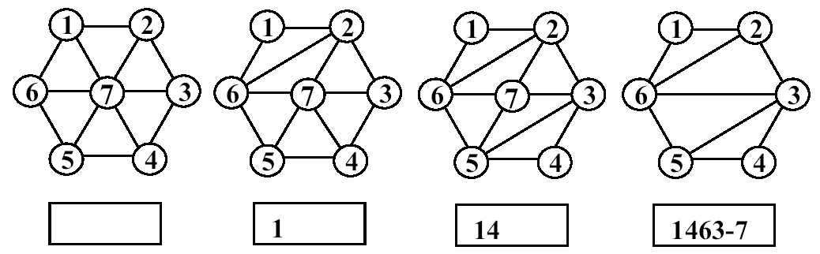
Multi-resolution
Parallel Encoding:
The connectivity of each surface M^{j} is represented by the arrays O^{j} and V^{j.}
Sequential Encoding:
The sequence of operations performed for simplifying each vertex is stored in a string of integers.

