Slide 1
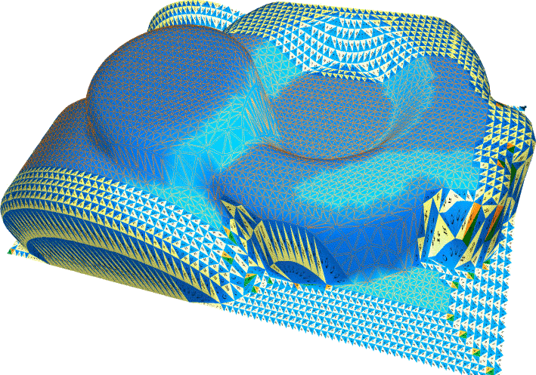
Efficient Edgebreaker for surfaces of arbitrary topology
Thomas Lewiner^{1,2} , Hélio Lopes¹,
Jarek Rossignac³ and Antônio Wilson Vieira^{1,4}
¹PUC-Rio — Departamento de Matemática
²INRIA — Géométrica Project (France)
³GATECH — Atlanta ⁴UNIMONTES — Montes Claros

Slide 2
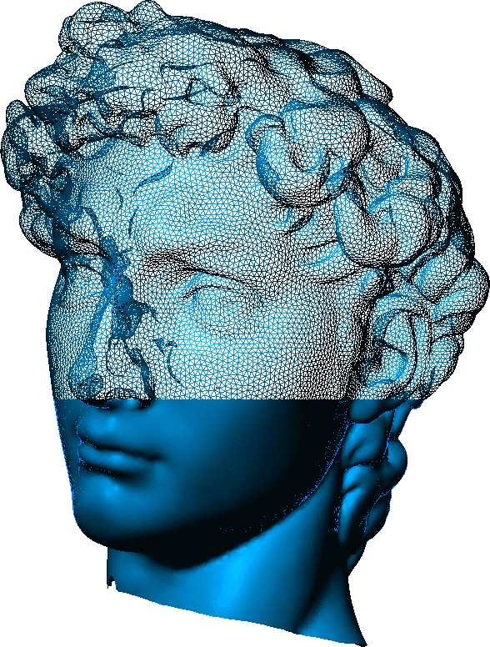
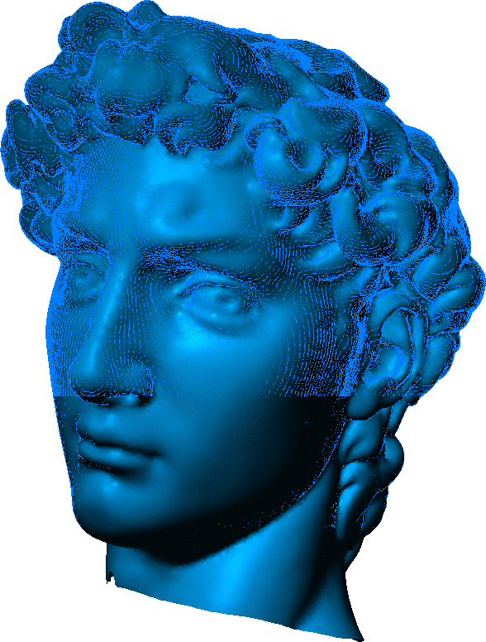
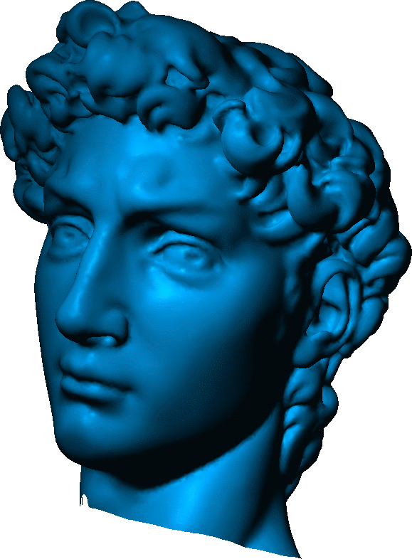
Motivation
Different 3D model generations
One efficient compression algorithm.

Slide 3
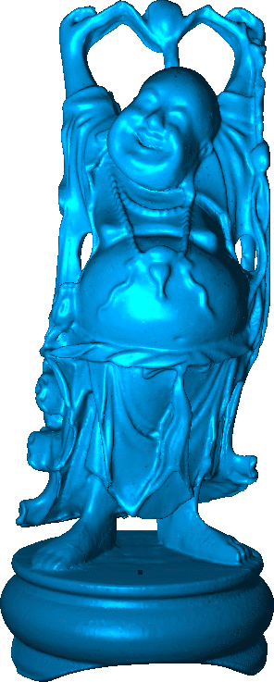
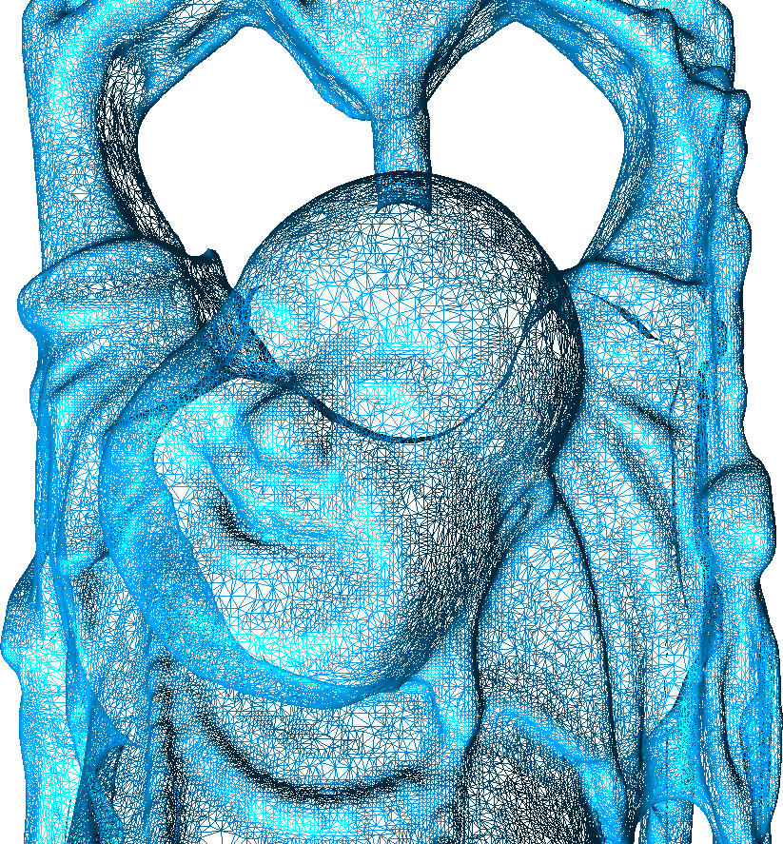
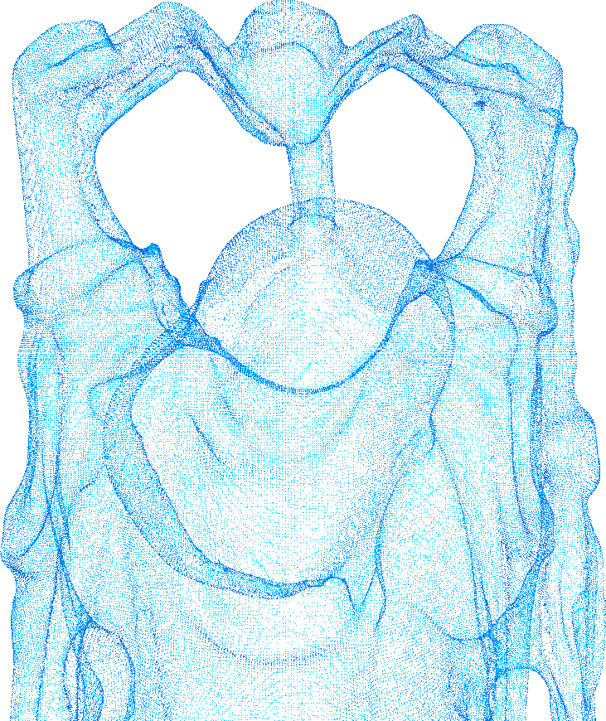
Compression
-0.0071 0.064825 -0.047272
-0.004643 0.064825 -0.04728
-0.004239 0.064825 -0.047272
-0.007875 0.065075 -0.047272
-0.007643 0.06503 -0.047272
-0.007143 0.065075 -0.0473
-0.003702 0.065075 -0.047272
-0.008394 0.065325 -0.047275
………………………
3 70 81 1
3 4 3 12
3 72 4 0
3 77 76 17
3 2 19 6
3 85 70 2
3 9 8 7
3 7 10 9
………………………
CCCRCCCCCCC
RCRCCCCCRRC
CCCCCCCRCCR
CRCCRCRCCCC
CCCCRRRLCRC
RCCCRCCCRSL
ECRCCCCCCRC
RCCCRCRSER…
Connectivity: 228 Kb
Topology: 1.53 Kb
Geometry:
2.33 Mb
543,652 triangles
1,087,716 vertices
PLY: 55.6 Mb
ZIP : 16.0 Mb
Total:
2.55 Mb

Slide 4
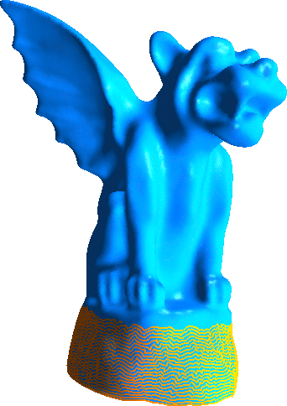
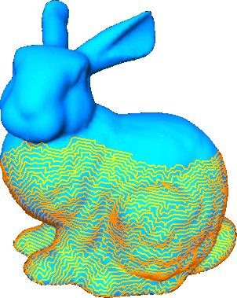
Outline
Edgebreaker compression
→ CLERS string
Mesh and graphs
→ primal remainder
Handles compression
→ boundaries compression

Slide 5
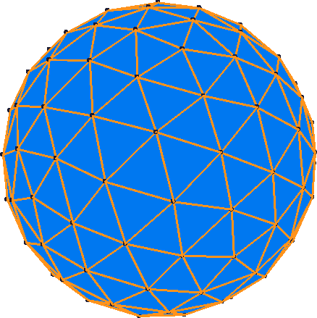
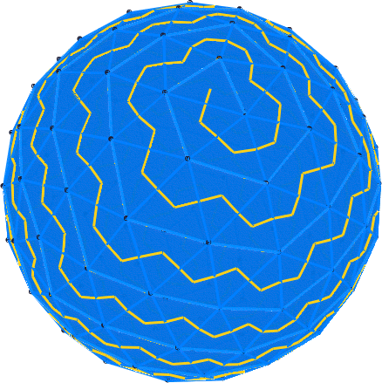
Edgebreaker
Topological Surgery
Taubin & Rossignac,
ACM ToGs 1998
Edgebreaker
Rossignac,
IEEE TVCG 1999
Spirale Reversi
Isenburg & Snoeyink,
CCG 2000
Edgebreaker with Handles
Lopes et al.,
C&G 2003

Slide 6
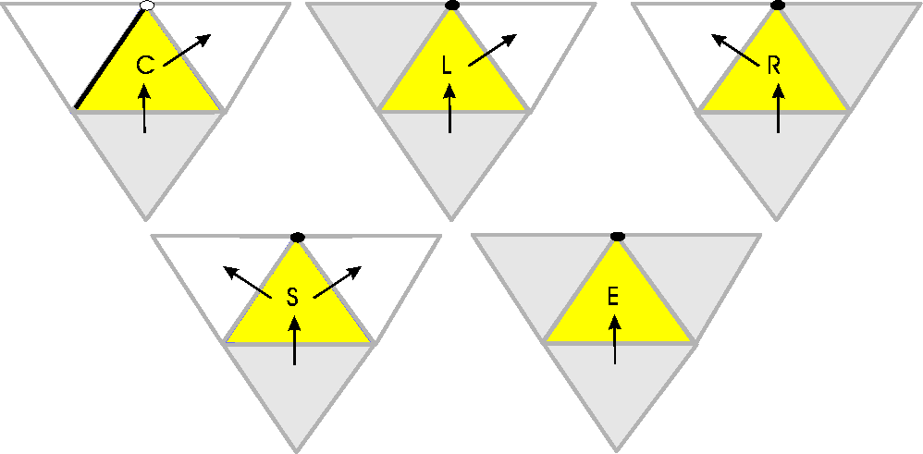
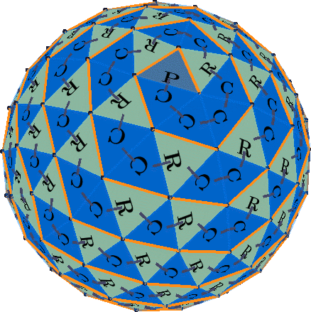
CLERS codes

Slide 7
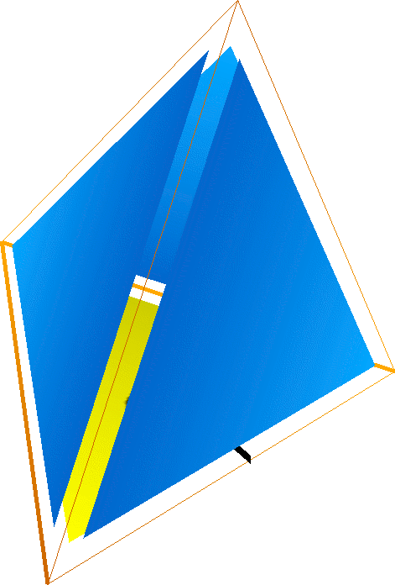
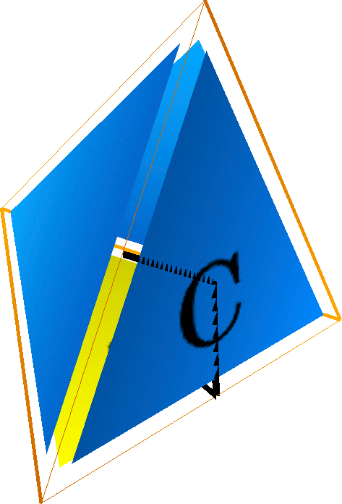
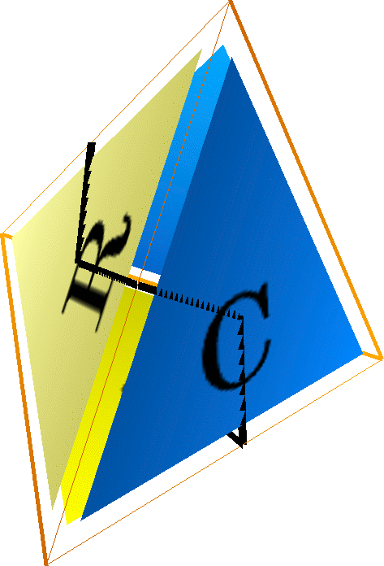
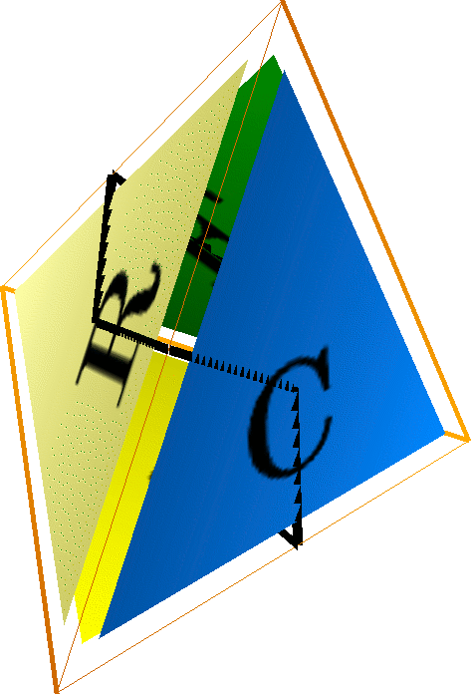
Example: Tetrahedron
P
C
R
E

Slide 8
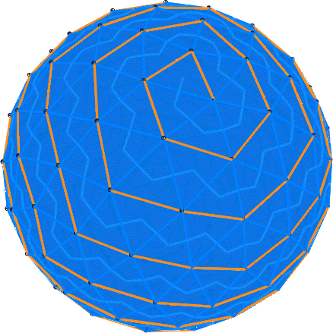
Spherical Meshes
Dual Tree → Primal Tree
(χ = V – E = 1) (χ = 1)
χ = V – E + F= 2

Slide 9
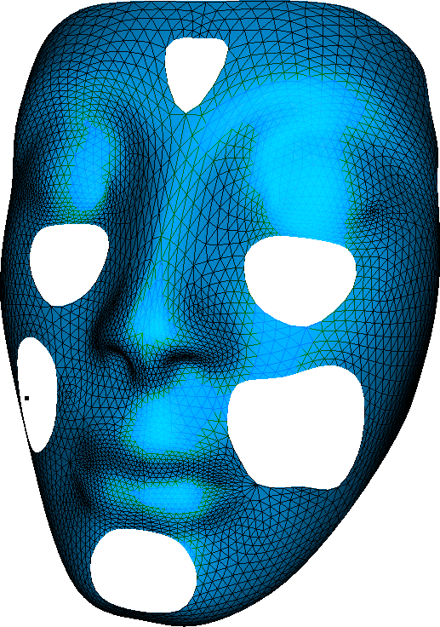
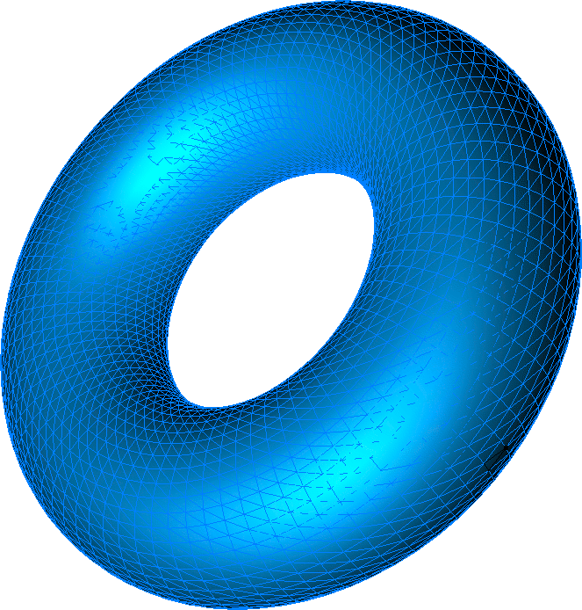
General Meshes
Orientable combinatorial manifolds:
χ = V – E + F
without boundary, genus g:
χ = 2 – 2g
with b boundaries, genus g :
χ = 2 – 2g – b

Slide 10
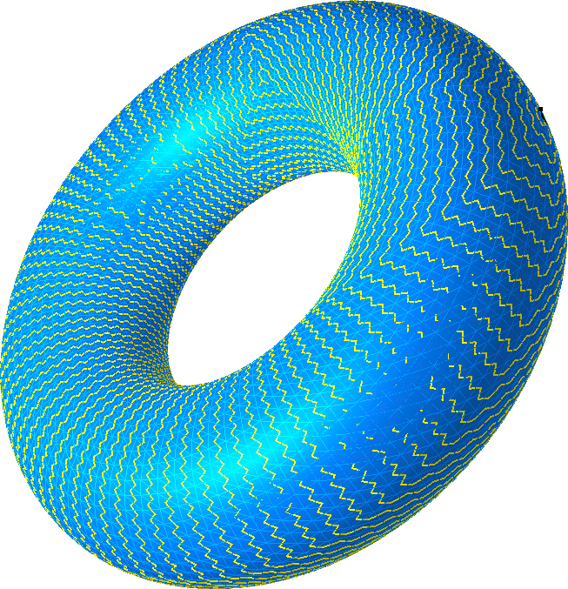
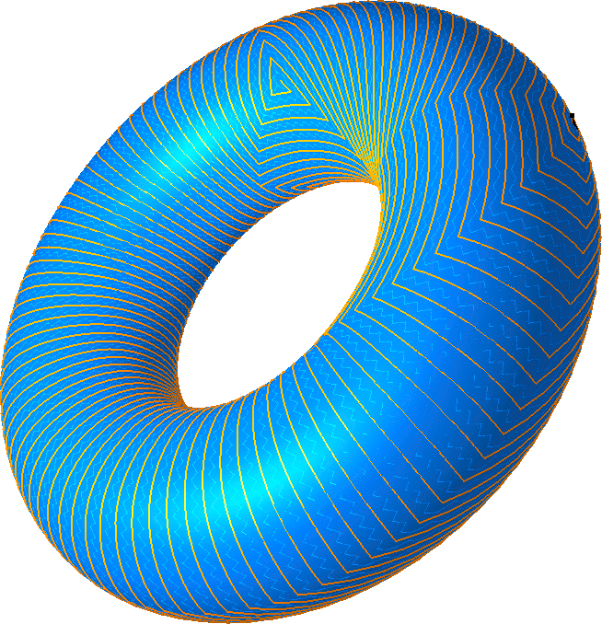
Primal Remainder
Dual Tree → Primal Remainder
(χ = 1) (χ = 1 – 2g – b)
χ = 2 – 2g – b

Slide 11
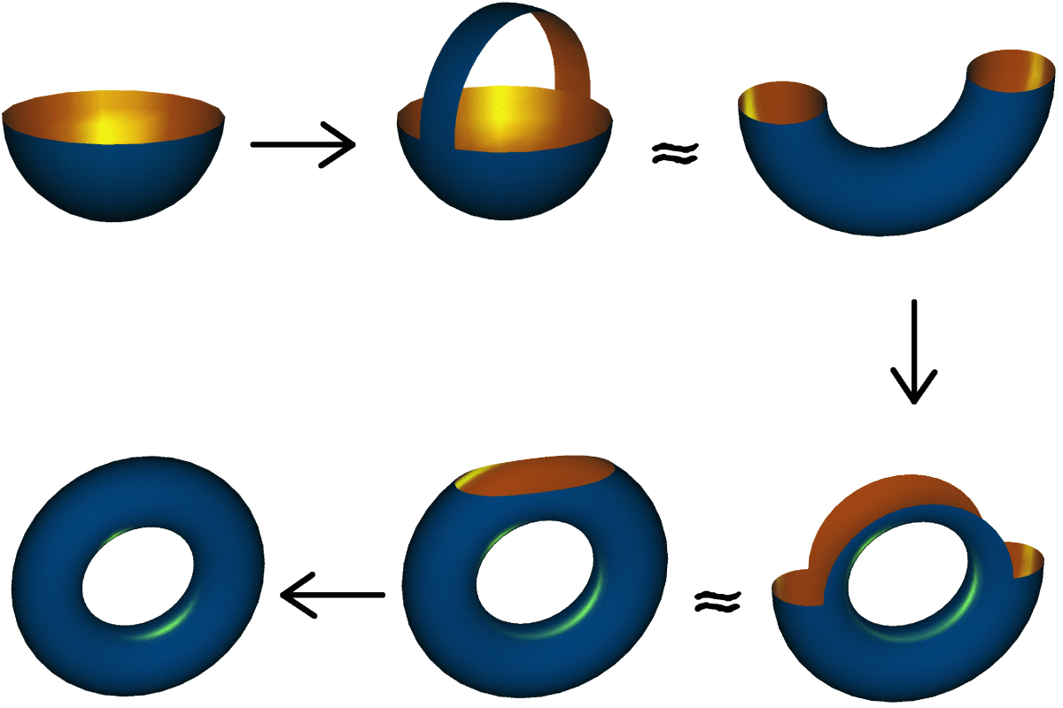
Surfaces with Genus
Explicitly encodes the 2g cycling edges of the primal remainder

Slide 12
Example: Torus
C
R
L
S
S*
E

Slide 13
Example: Torus
Explicitly encodes the 2g cycling edges (in red) of the primal remainder

Slide 14
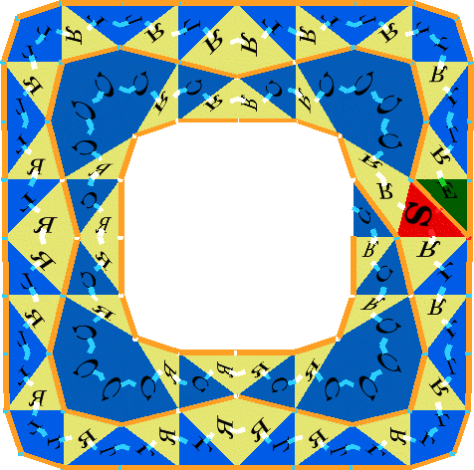
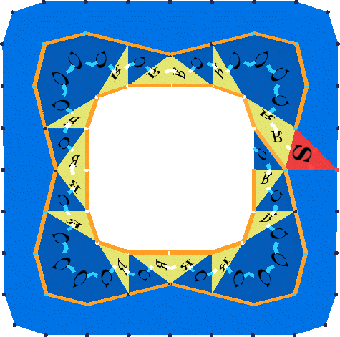
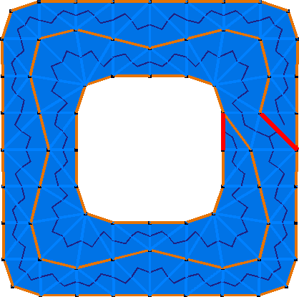
Surfaces with Boundaries
External boundary implicitly encoded
Explicitly encodes the 2g – b cycling edges of the primal remainder

Slide 15
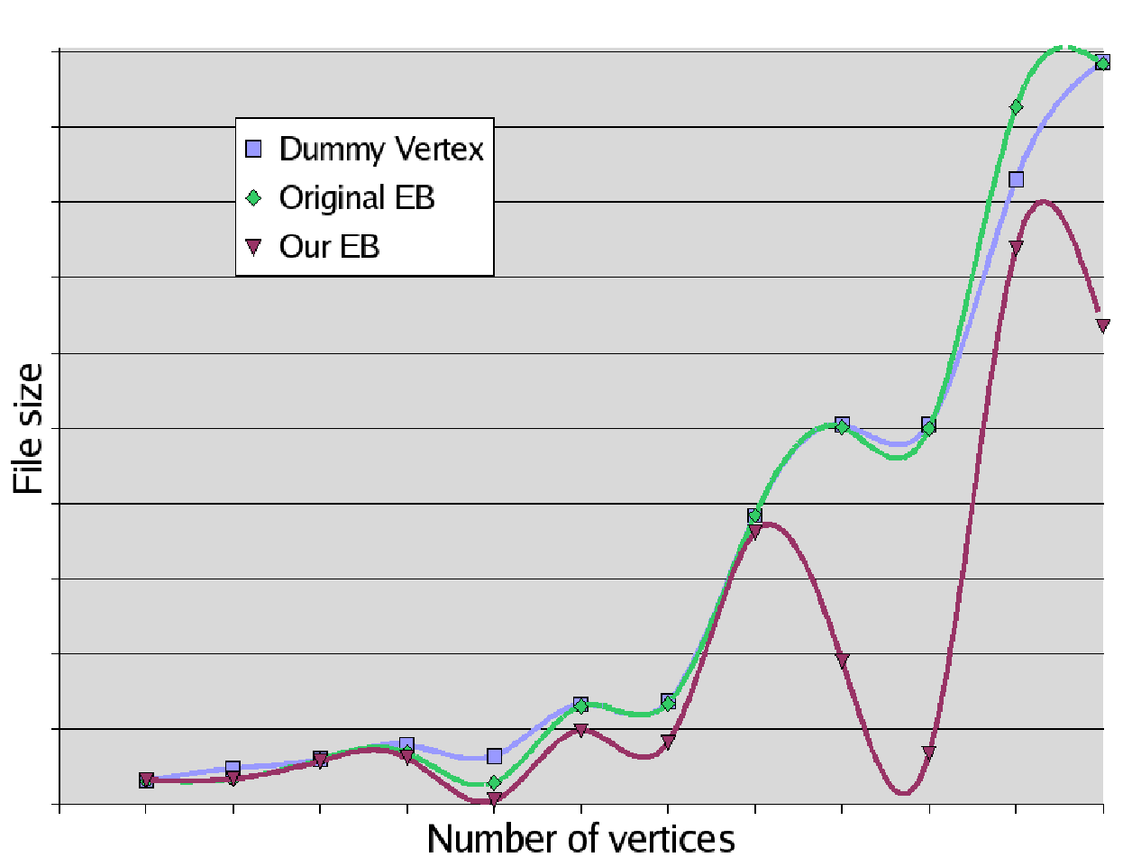
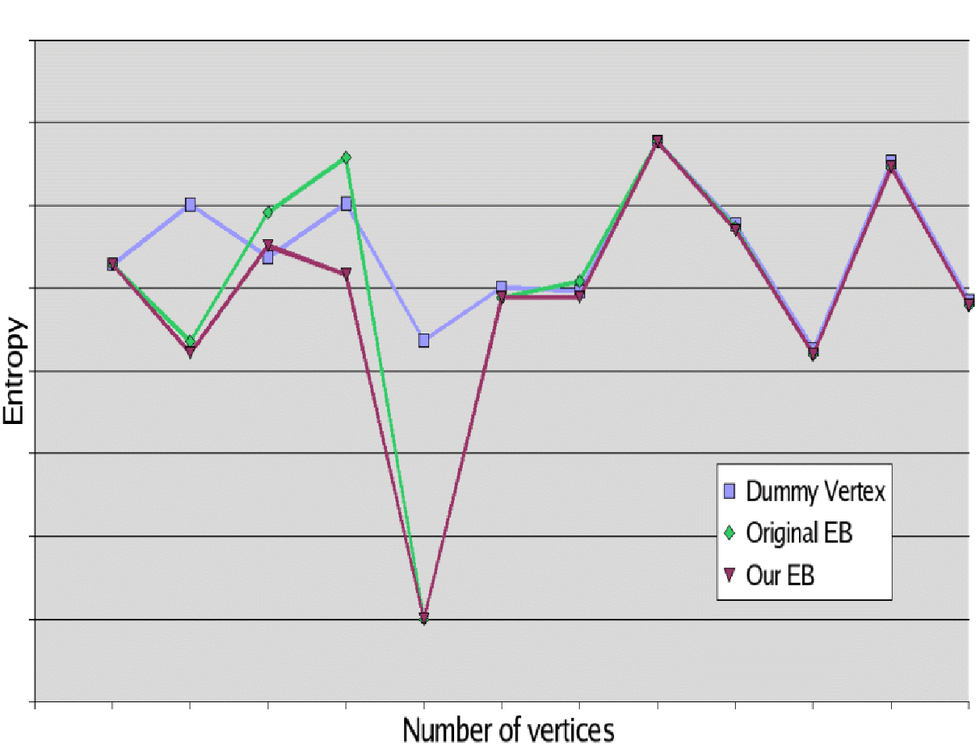
Results
Better entropy and rate
Separate topology representation

Slide 16

Extensions
Faster decompression
Non-triangular mesh
Improve the arithmetic coder
Tetrahedral meshes

Slide 17
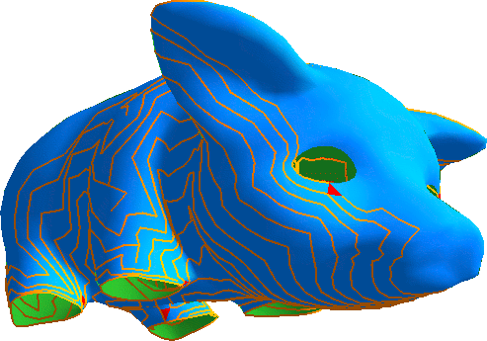
Thank you!

