Slide 1
Arc-Length Based Curvature
Estimator
Thomas Lewiner, João D. Gomes Jr. , Hélio Lopes, Marcos Craizer
{ tomlew , jgomes , lopes , craizer }@ mat.puc-rio.br

Slide 2
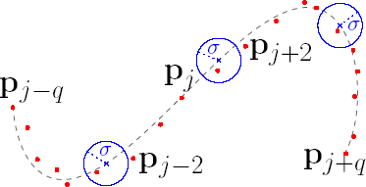
Scope
Digital Curves
Gaussian convolution : [Worring & Smeulders, 1993]
FFT :
[Estrozi, Campos, Rios, Cesar & Costa, 1999]
Sampled Curve

Slide 3
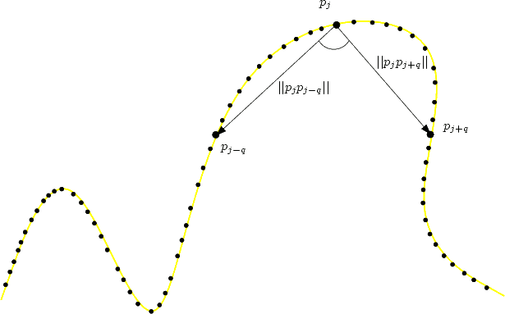


3-Points Methods
Angle Among Three Points
[Coeurjoly et al.,2001]
External Angle [Gumhold, 2004]

Slide 4
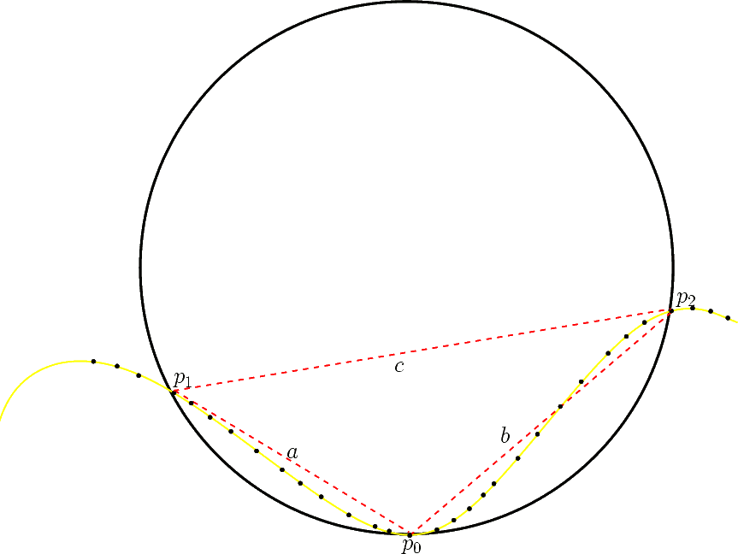
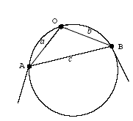
3-Points Methods
Circumscribed Circle [Coeurjolly & Svensson,2003]
Derivatives Estimations Among Three Points [Belyaev, 2004]

Slide 5

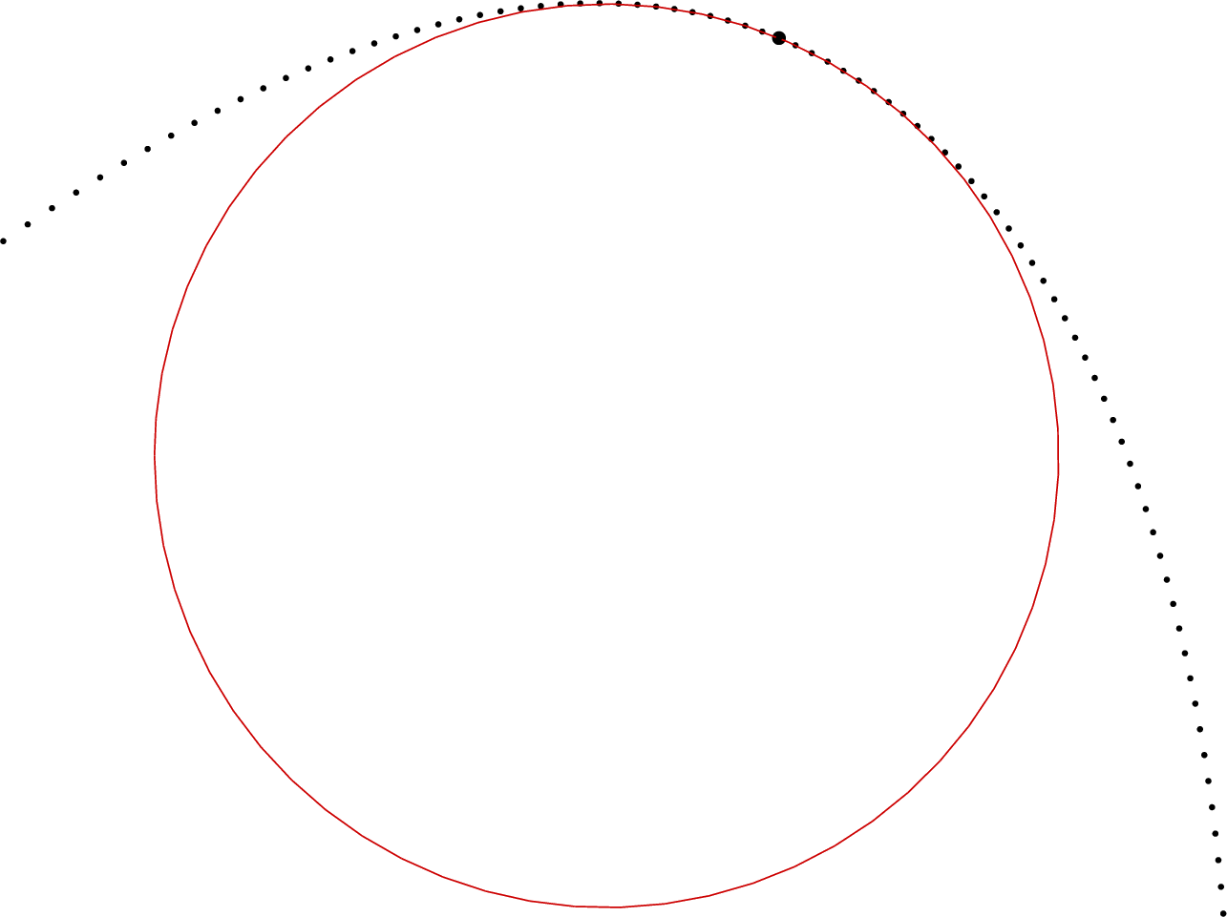
Least Square Methods
Rigid Parabola Fitting [Pouget & Cazals,2003]
Circle Fitting [Pratt,1987]

Slide 6
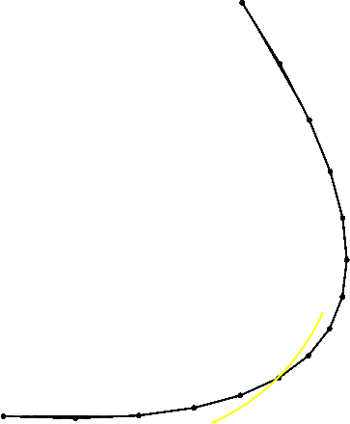
Rigid Parabola Fitting
Rotated Parabola

Slide 7
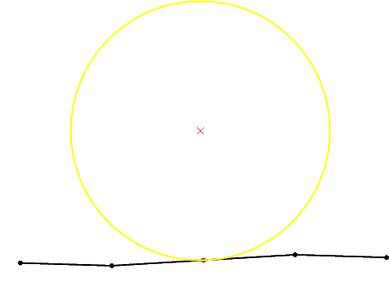
Circle Fitting
Circle fit in low curvature
A = 1

Slide 8
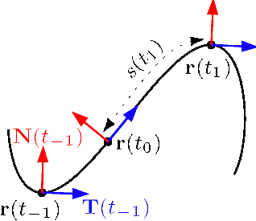
Objectives
Robust computation of:
Tangent Vector
Normal Vector
Curvature
with a least-square approach

Slide 9
Parametric Parabola
Fitting
We shall fit our data to parabolas of the form:

Slide 10
Model
where s^{j}_{i} approximates the arc-length between p_{i} and p_{j}

Slide 11
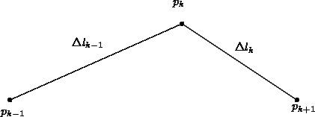
Estimation of s^{j}_{i}
The arc-length estimator from p_{j} to p_{i} is defined as

Slide 12
Weighted Least Squares Approach

Slide 13
Solution

Slide 14
Methods
Independent Coordinates
  Use x_{j}’, x_{j}’’, y_{j}’, y_{j}’’ as above
Dependent Coordinates (if y’_{j} > x’_{j})

Slide 15
Curvature

Slide 16
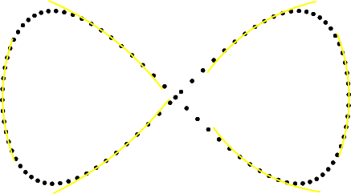
Example Eight Curve

Slide 17
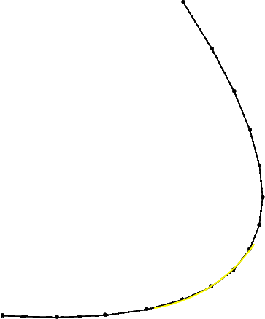
Comparison with Rigid Parabola Fitting
Rigid Parabola Fitting
Parametric Parabola Fitting

Slide 18
Comparison with
Circle Fitting
Circle fitting Parametric Parabola Fitting

Slide 19
Numerical Errors
Rigid Parabola Fitting Dependent
Ill-conditioned matrixes

Slide 20
Improvements
Dependent Rotated

Slide 21
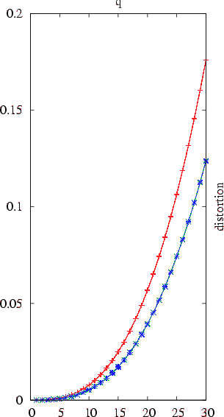
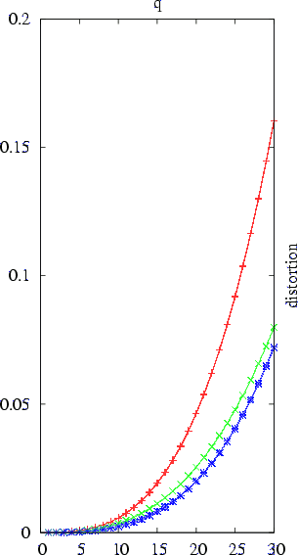
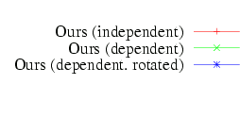
Calibration
Uniformly Sampled Not Uniformly Sampled

Slide 22
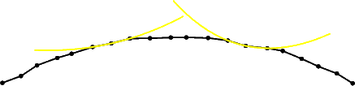
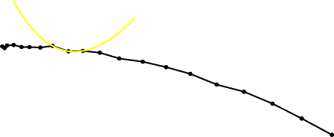

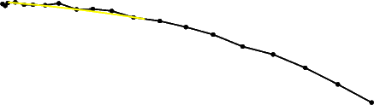
Calibration: Noisy case
Uniformly Sampled Not Uniformly Sampled
q = 1
q = 1
q = 5
q = 5

Slide 23
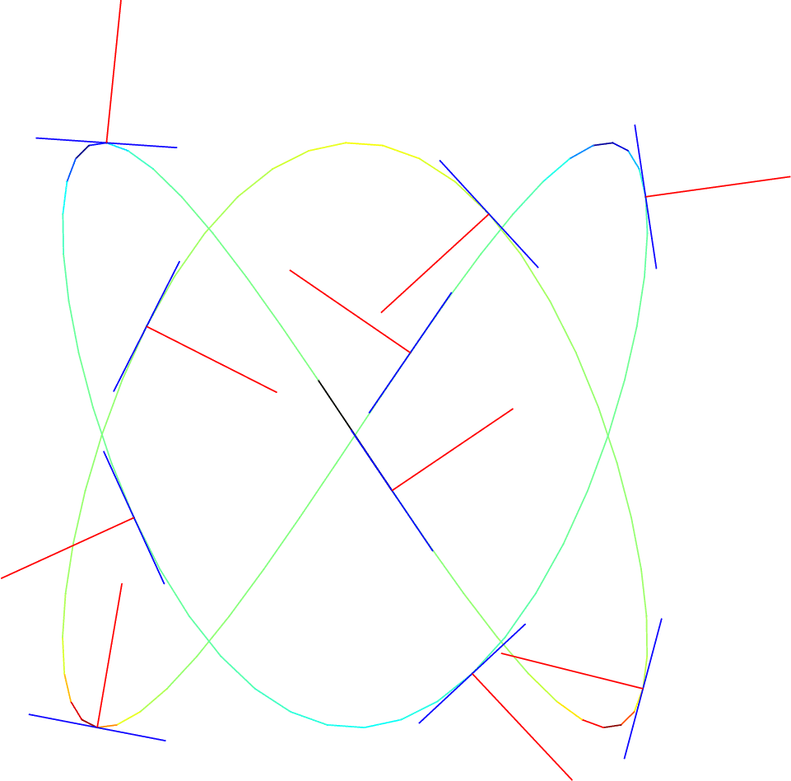
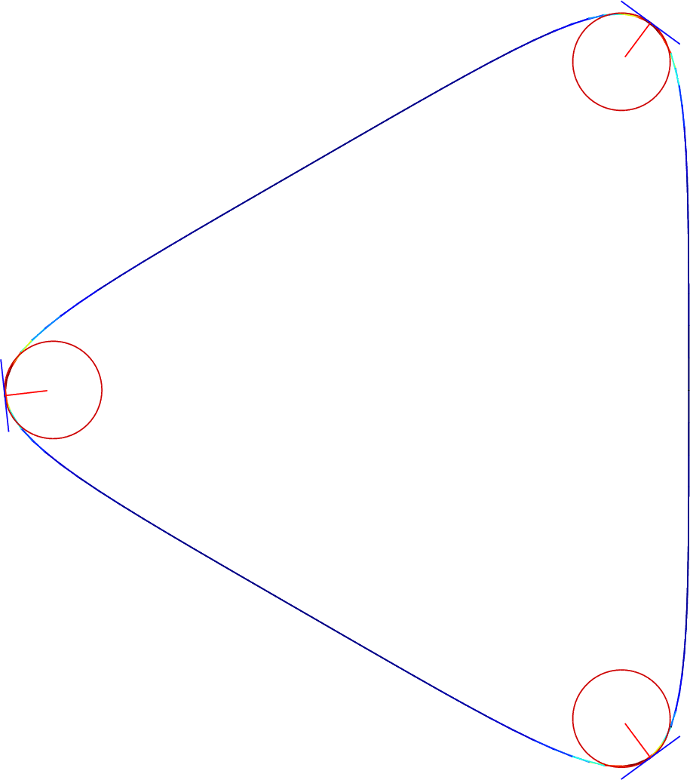
Example of curves

Slide 24
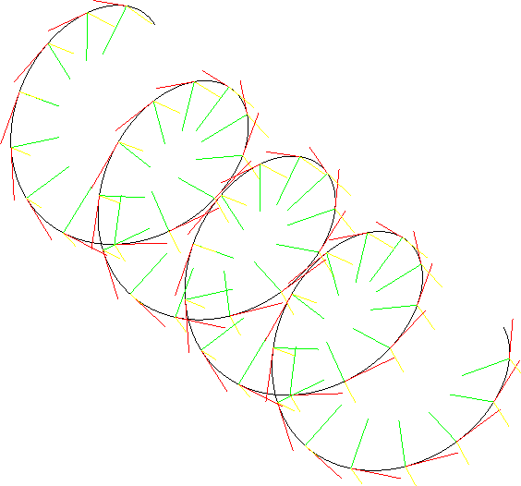
Future Works
Cubic fitting
Curves in the space
Surfaces

Slide 25
Thanks!!!!!

