Slide 1
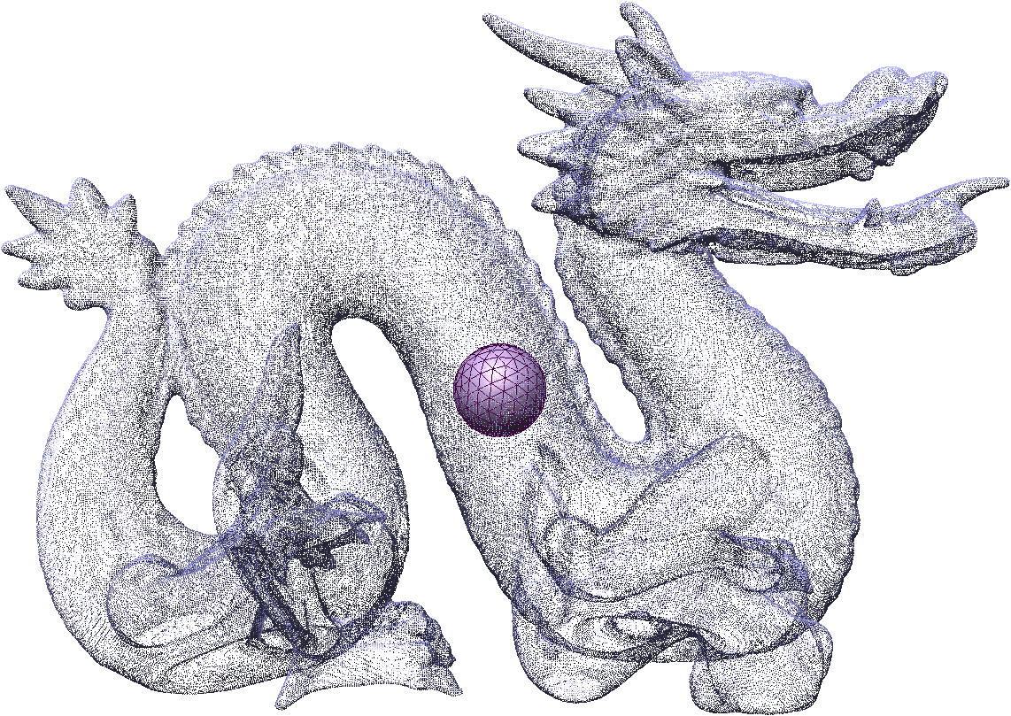
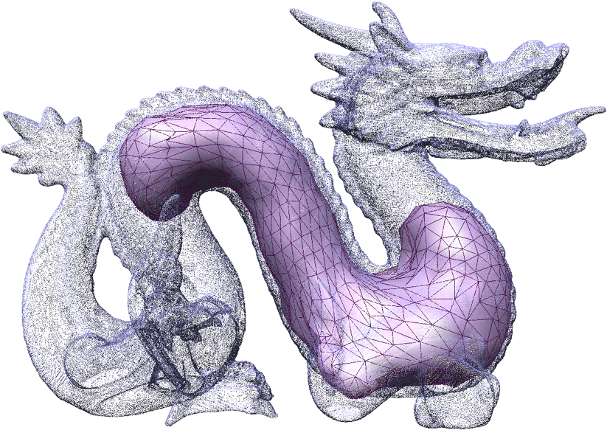
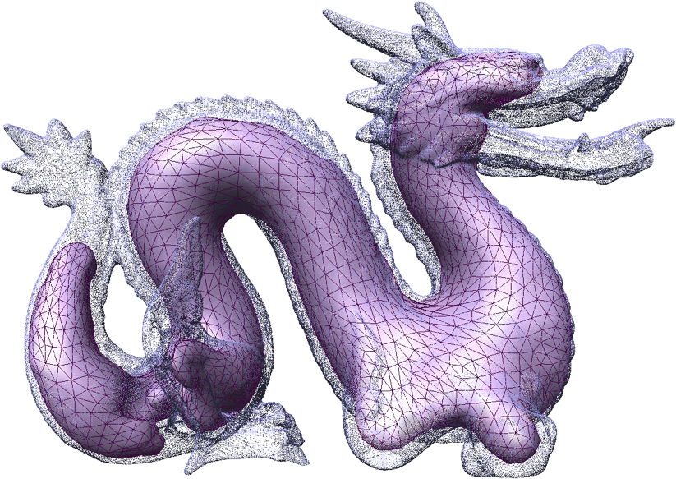
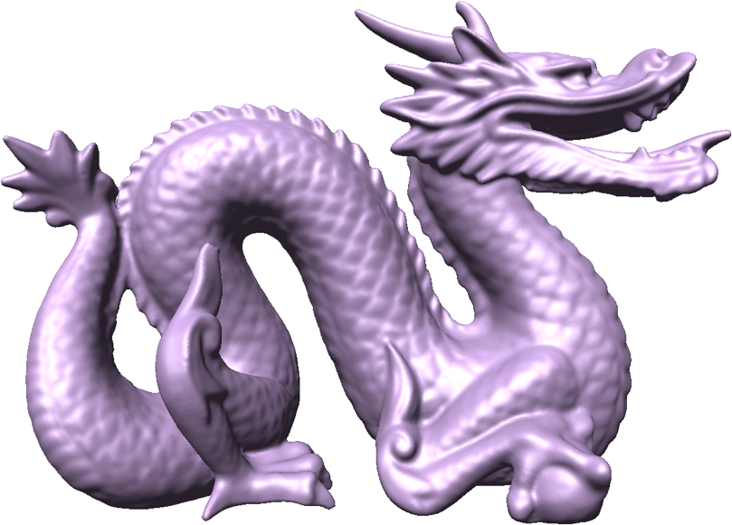
Competing Fronts for Coarse–to–Fine
Surface Reconstruction
Andrei Sharf, Thomas Lewiner, Ariel Shamir, Leif Kobbelt, Daniel Cohen–Or
Eurographics 2006

Slide 2
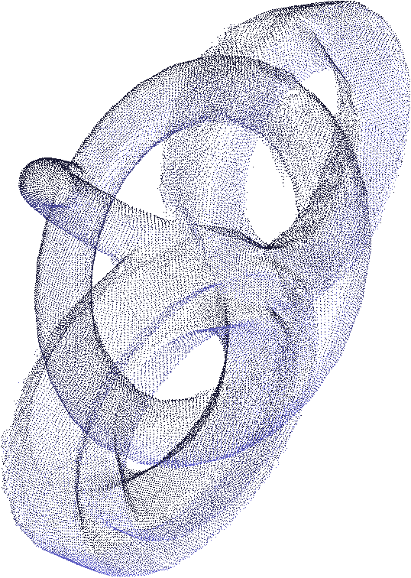
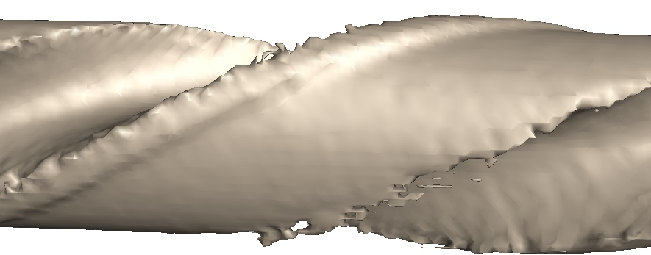
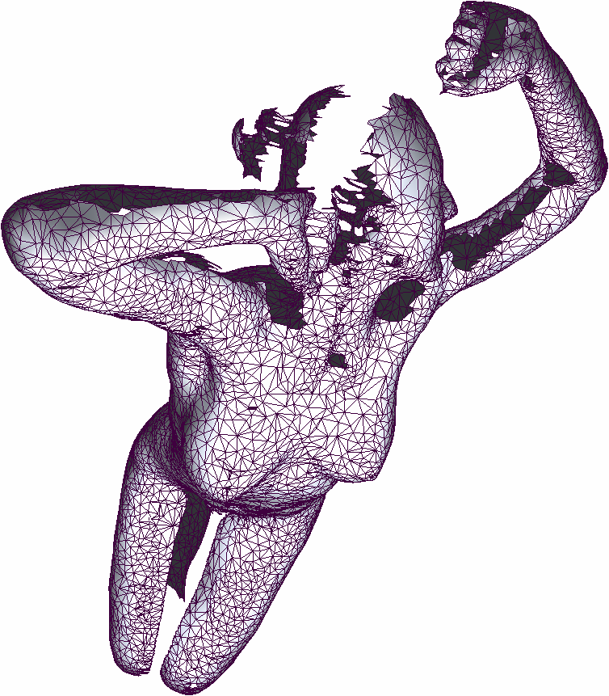
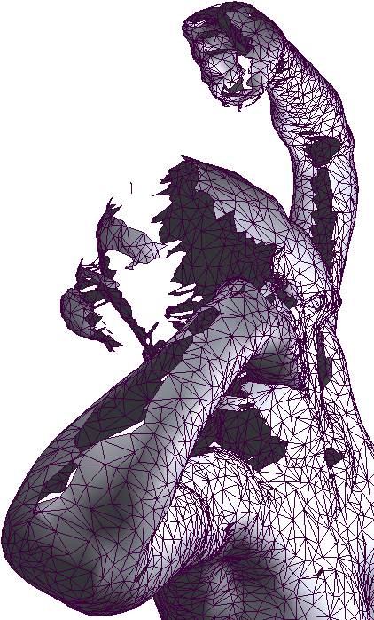

The problem of reconstruction
High genus
Fine details
Noise
Holes

Slide 3
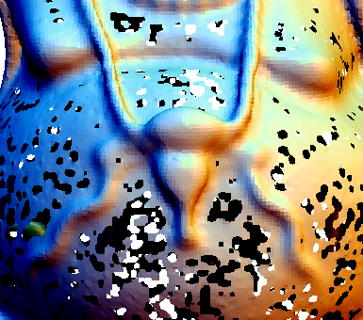
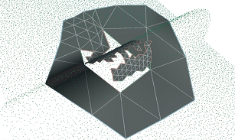
Previous Work
Implicit Surfaces
  RBF [Carr01] [Ohtake04], MPU [Ohtake03]
Voronoi-based Reconstruction
  [Amenta98][Boissonnat02][Dey03]
Wrapping techniques
  [Bernardini99]MLS[Alexa01][Scheidegger03]
Deformable Models
  [Cohen93][Kass88][Xu98][Sethian99][Bischoff03] [Esteban03] [Duan04] [Esteve05]
Notes:
we focus on methods that handle global topology and local scale details:

Slide 4
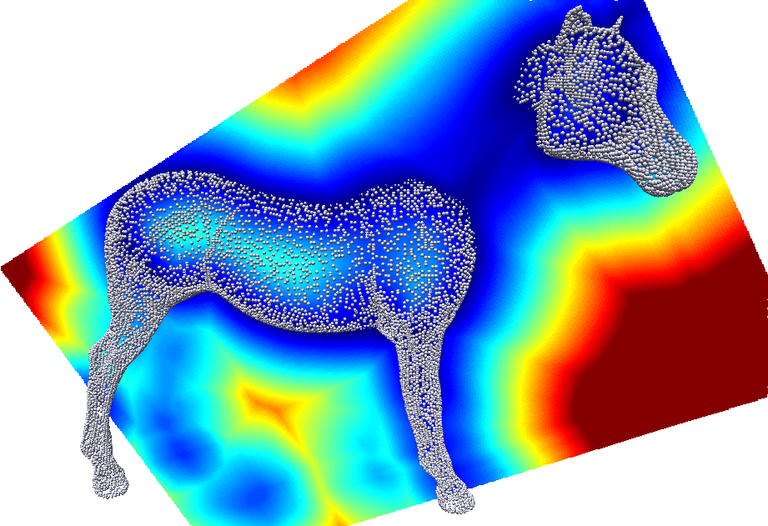
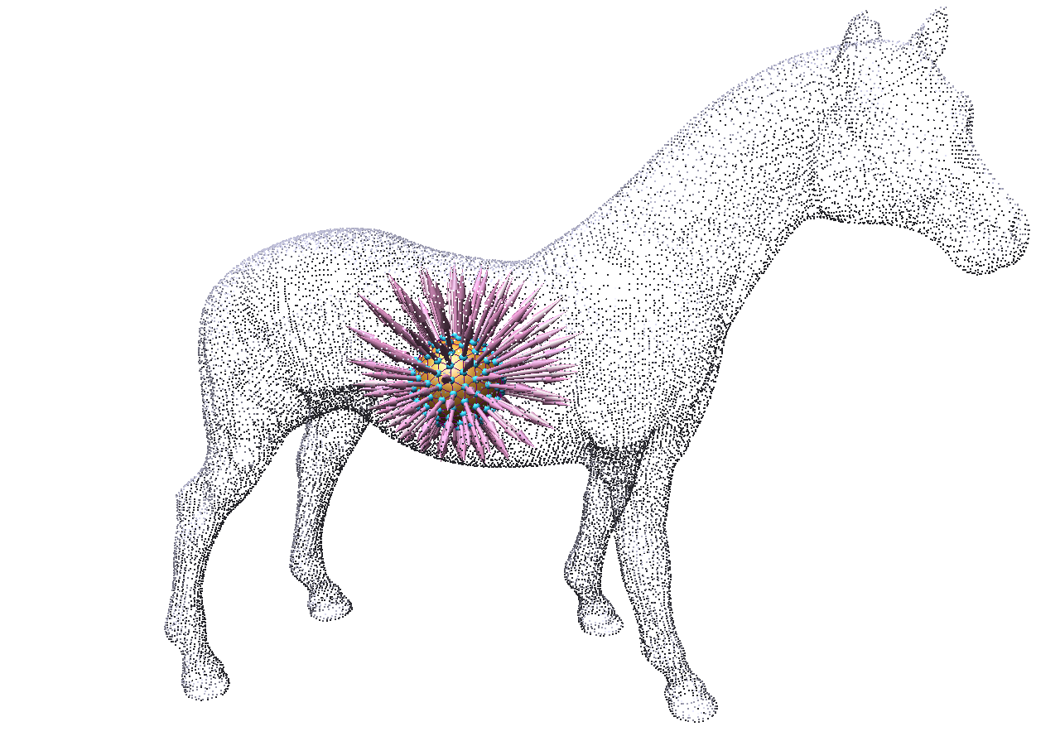
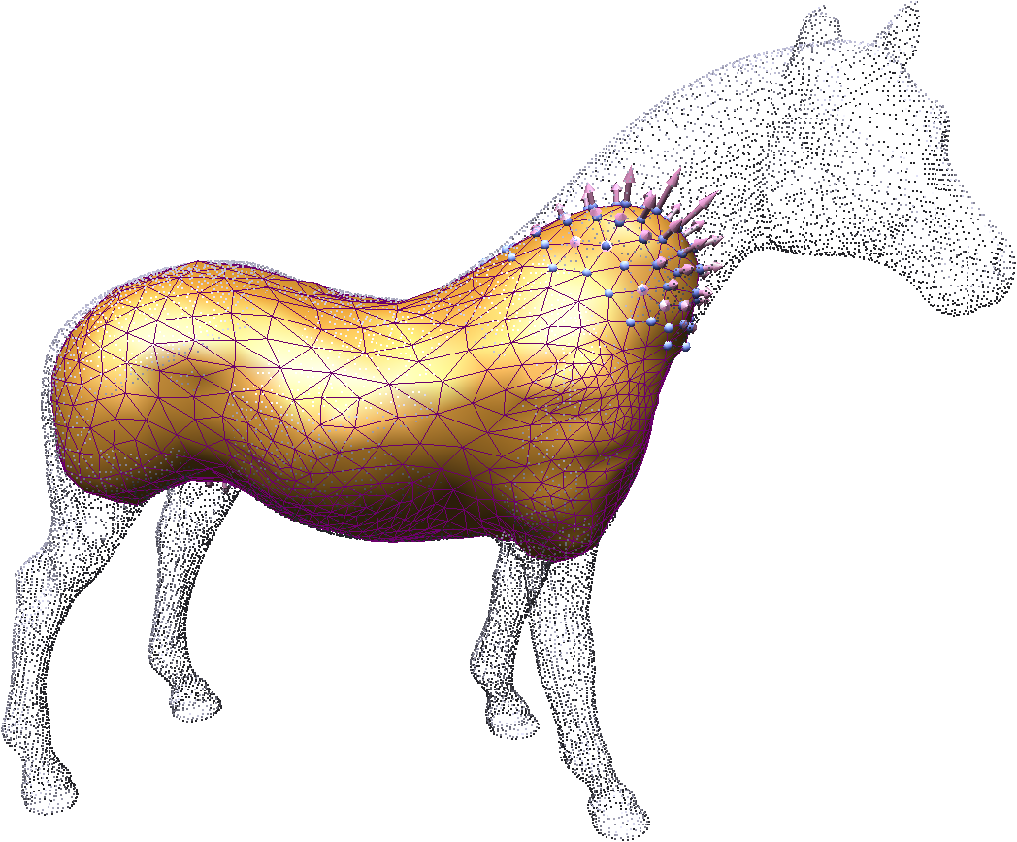
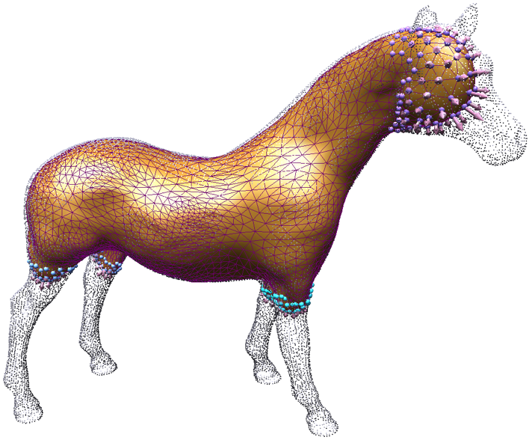
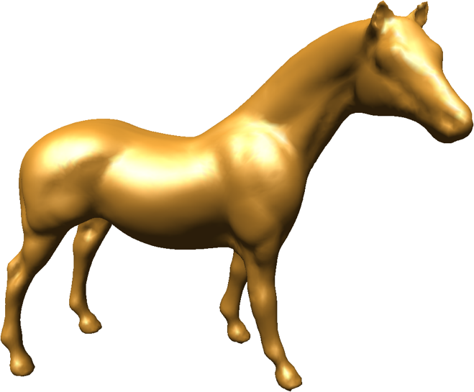
Our method
Implicit
  Coarse zero-level set
  Volumetric distance field
Explicit
  Deformable watertight model
  Controlled evolution

Slide 5
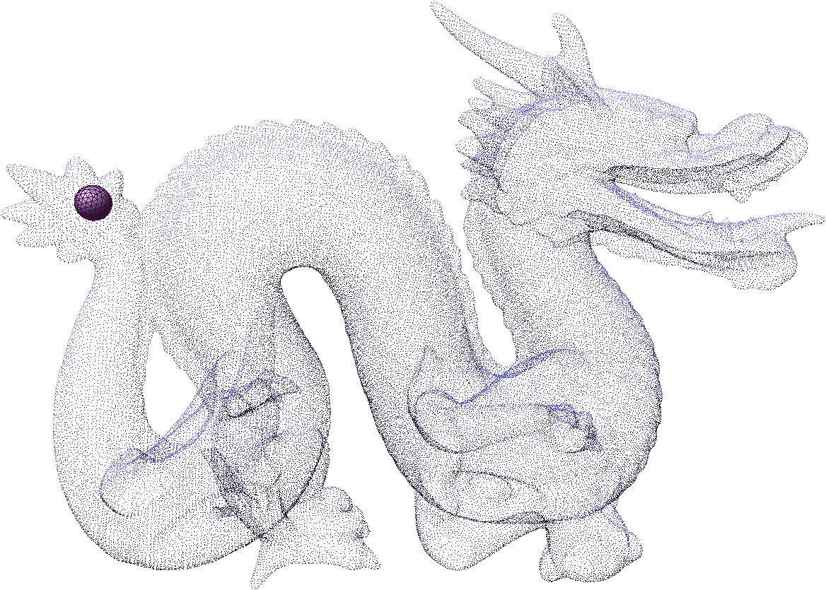
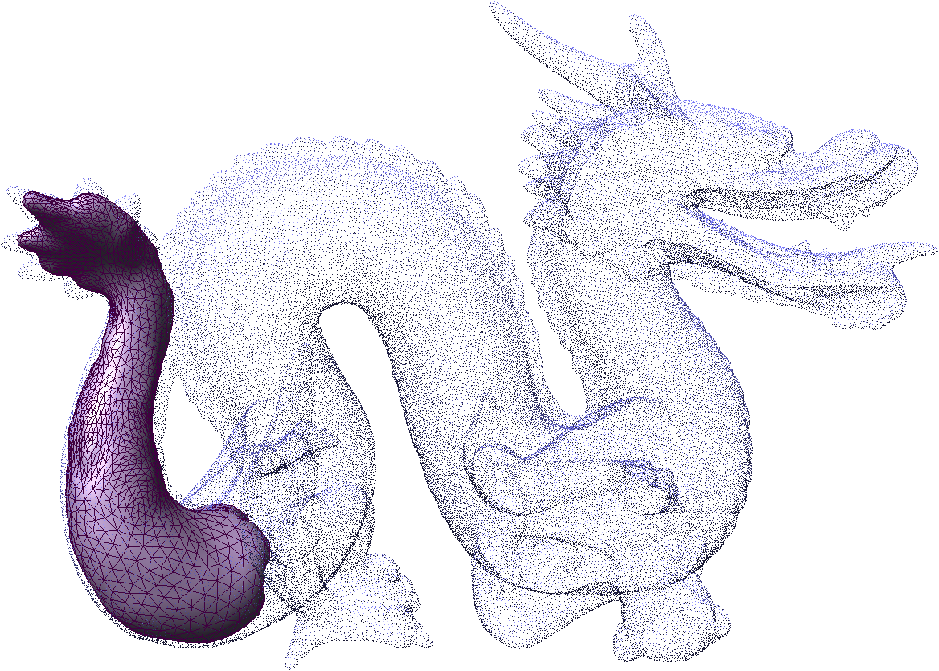
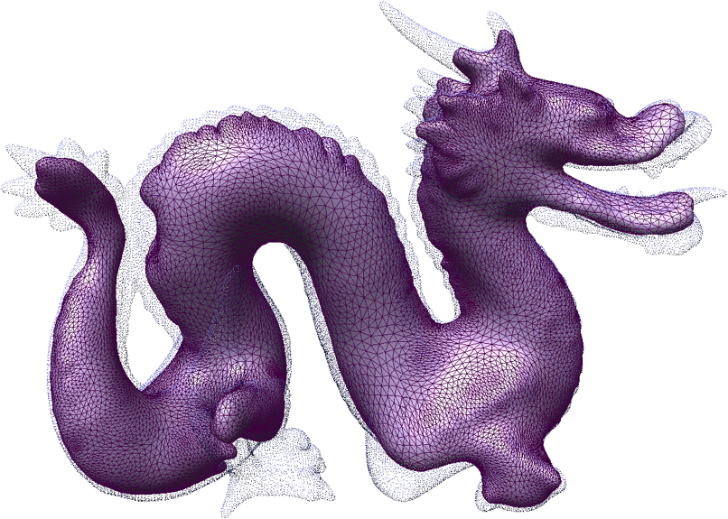
Our method
Evolution ingredients:
Distance field uphill/downhill progress
Laplacian system for smooth evolution
Dynamic remeshing
Coarse to fine competing fronts

Slide 6
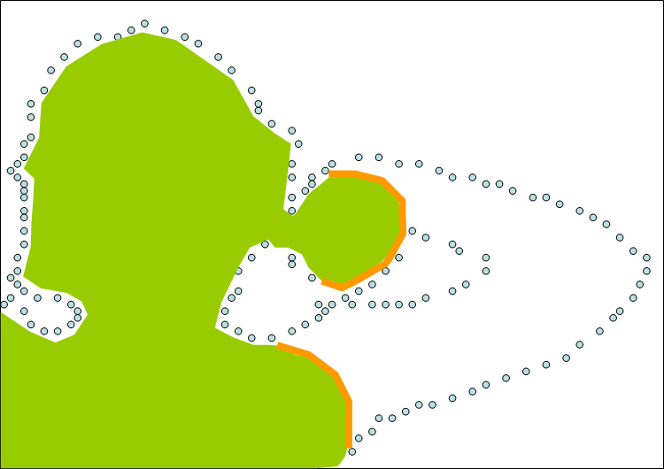
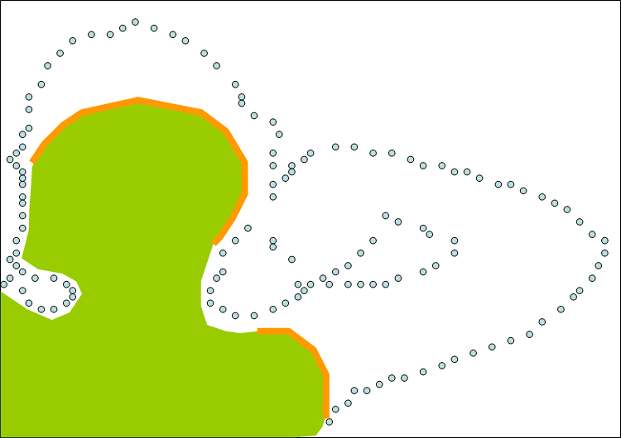
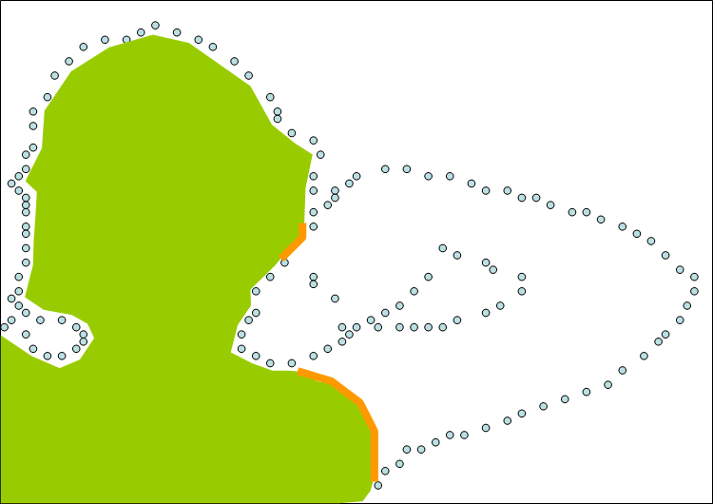
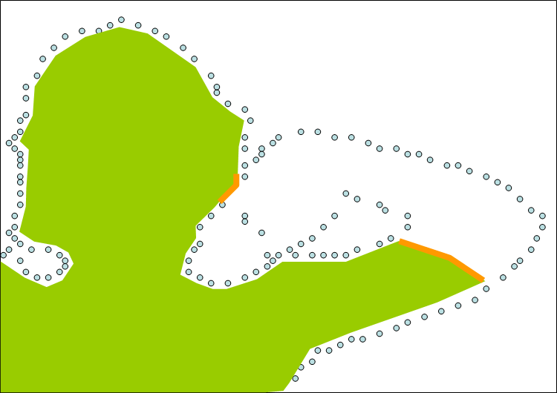
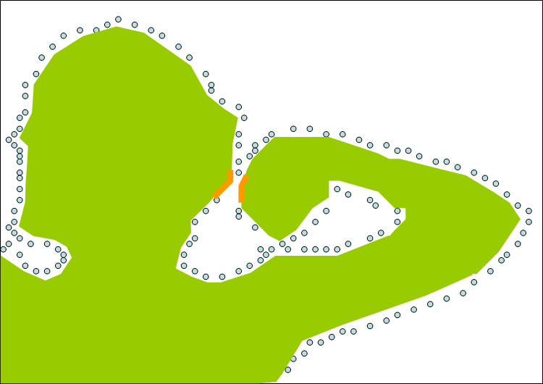
Controlled reconstruction
Smooth completion of holes
Fine recovery of details
Correct topology

Slide 7
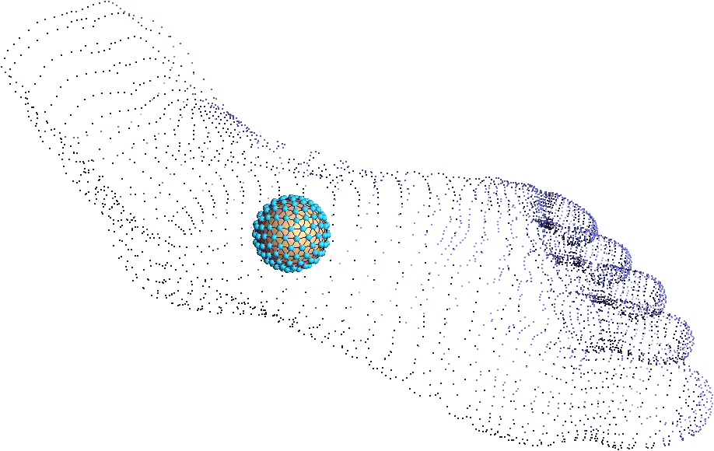
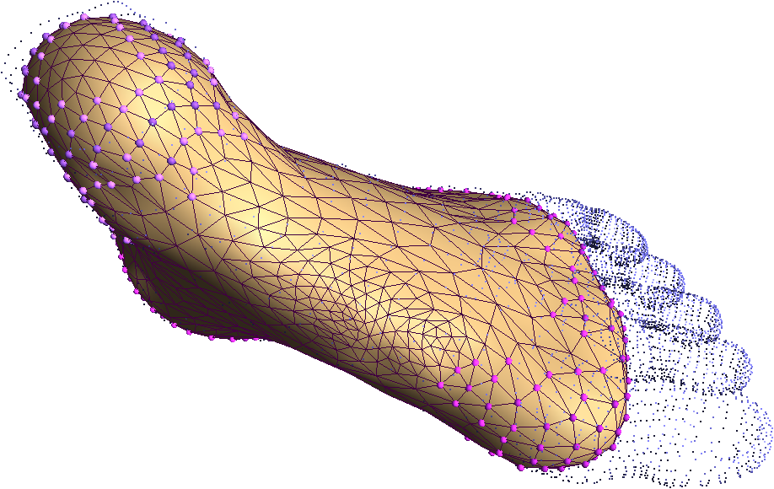
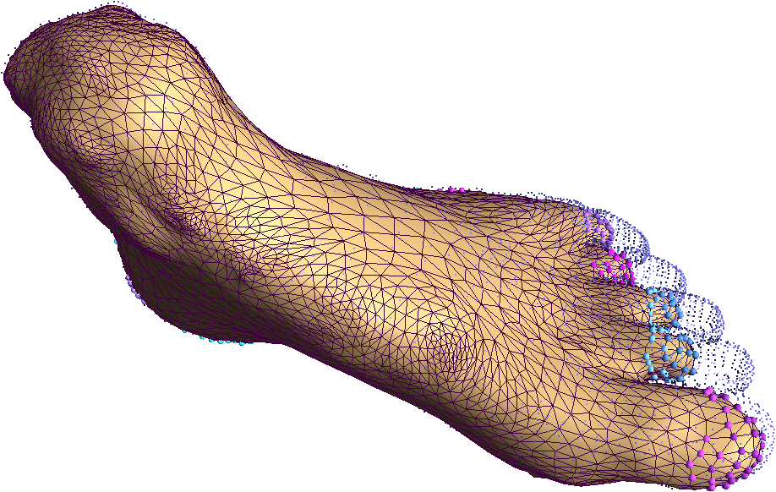
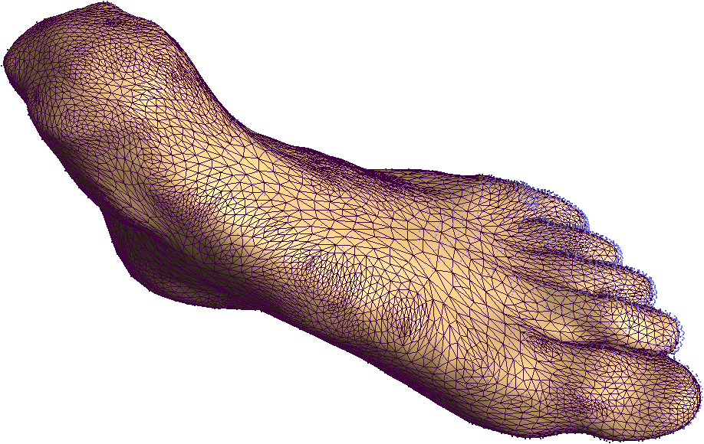
Controlled reconstruction
Coarse
  initial smooth reconstruction
  closing holes
Refinement
  fine details recovery
  intruding narrow tunnels

Slide 8
Algorithm
Goal: evolve deformable model such that all point cloud is ε-close (satisfied)
Orthomap[Chazal05]: normal projection is bijective if Hausdorff distance is ε of local feature size:

Slide 9
Algorithm
Initialization
Evolution:
  Parameters
  Control
Final projection

Slide 10
Initialization
Guidance field:
  CRBF/PU & distance-field
  adaptive octree structure
Deformable model D:
  triangular mesh
  a sphere placed in interior

Slide 11
Algorithm
Initialization
Evolution:
  Parameters
  Control
Final projection

Slide 12
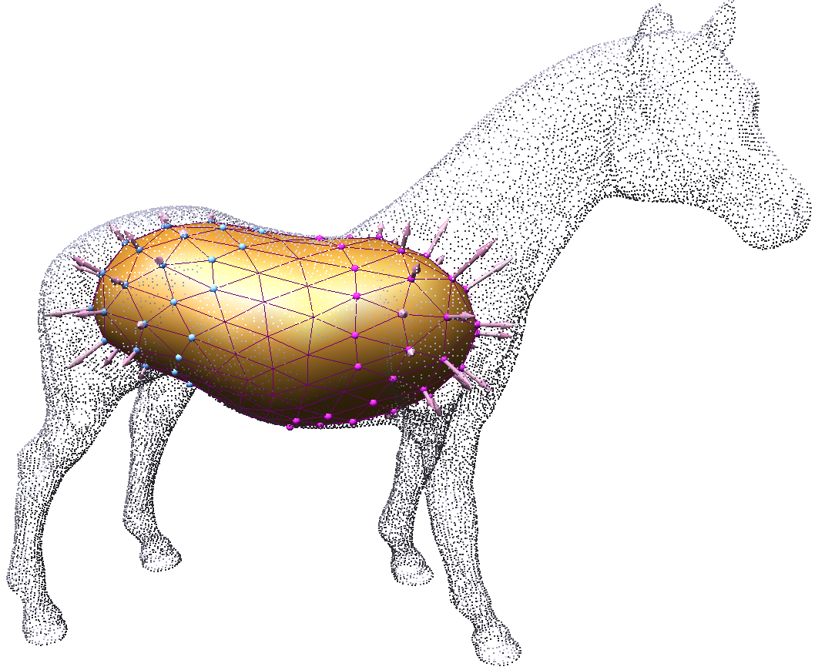
Fronts
Front definition:
  inactive vertex - ε-close vertices to zero level–set become inactive
  front: connected component of active vertices

Slide 13
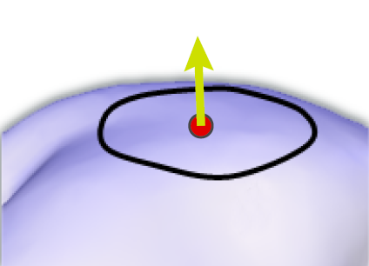
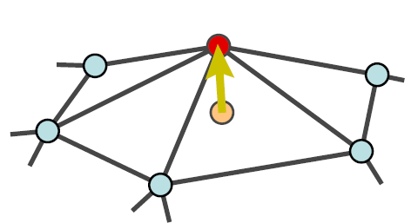
Evolution Parameters
E_{a}
Attraction (E_{a})
  Outward normal direction
  Unsigned distance field speed
Tension (w)
  Laplacian operator (E_{t})
Laplace system:
Local remeshing and subdivision
E_{t}

Slide 14
Algorithm
Initialization
Evolution:
  Parameters
  Control
Final projection

Slide 15
Control: Fronts Competition
tension control
  coarse fronts evolve faster
refinement control
  maintain triangle density

Slide 16
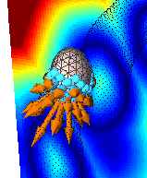
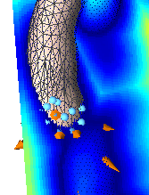
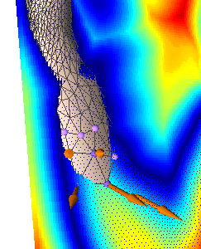
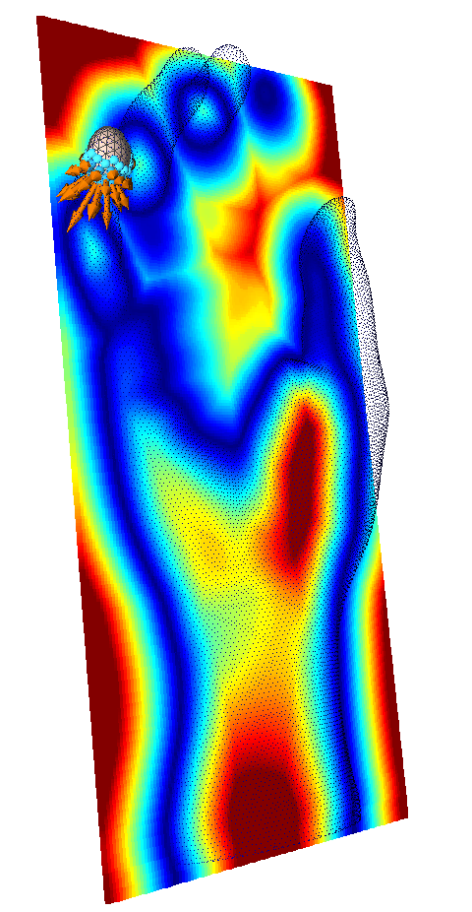

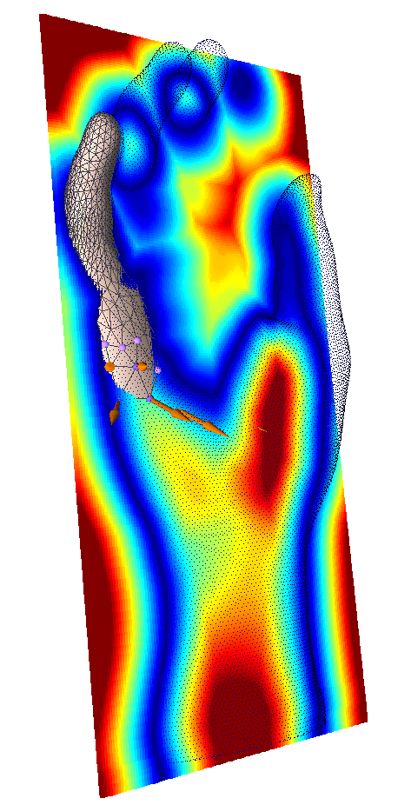
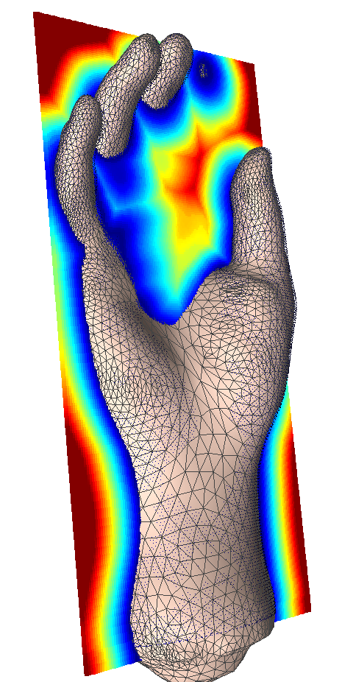
Control: Uphill Progress
Vertex Attraction (E_{a})
  Outward normal direction
  Unsigned distance field speed

Slide 17

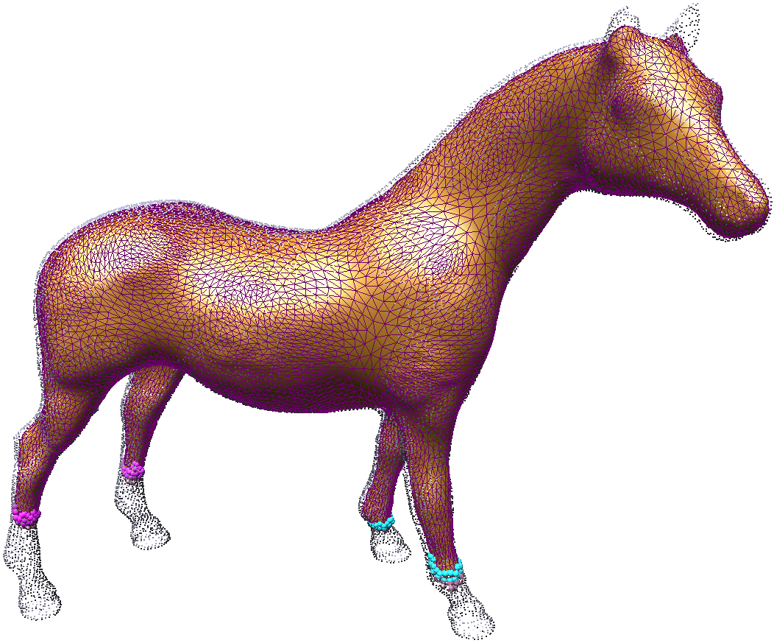
Control: ε-close criteria
satisfied points: point-cloud points ε-close to model
“wake up” procedure for unsatisfied points:
  Fronts revived and subdivided
  Tension released

Slide 18
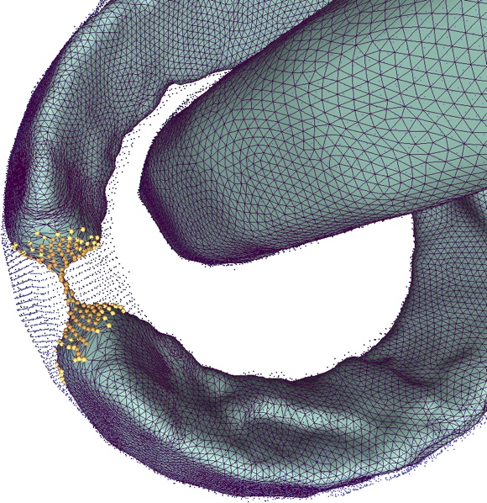
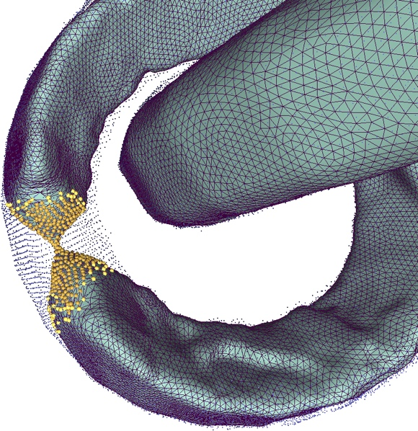
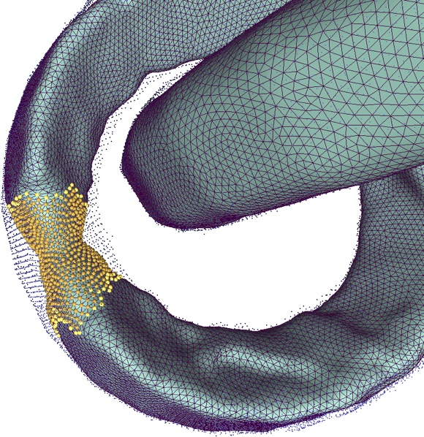
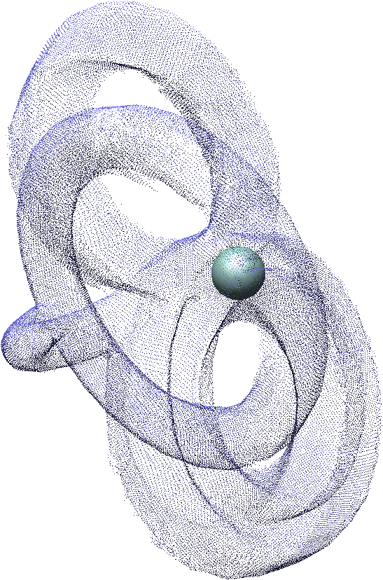
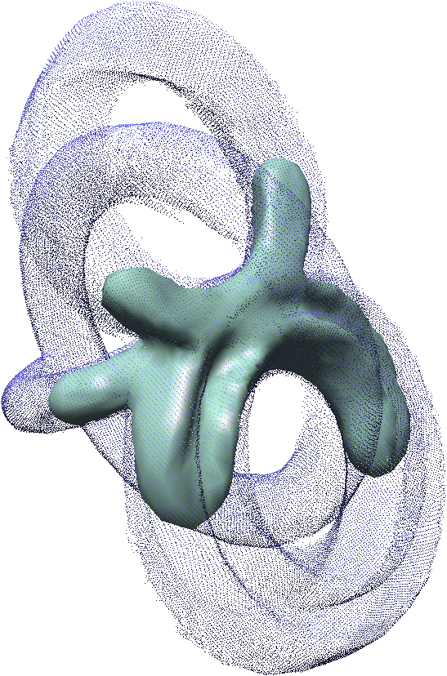
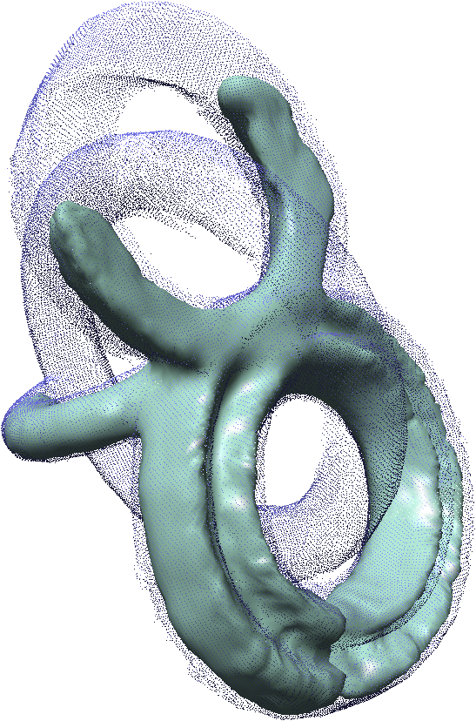
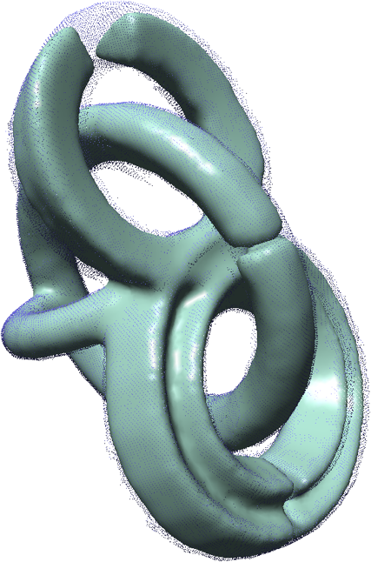
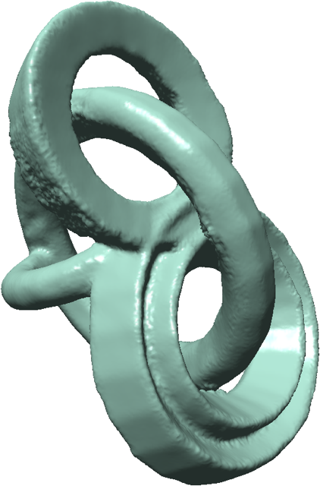
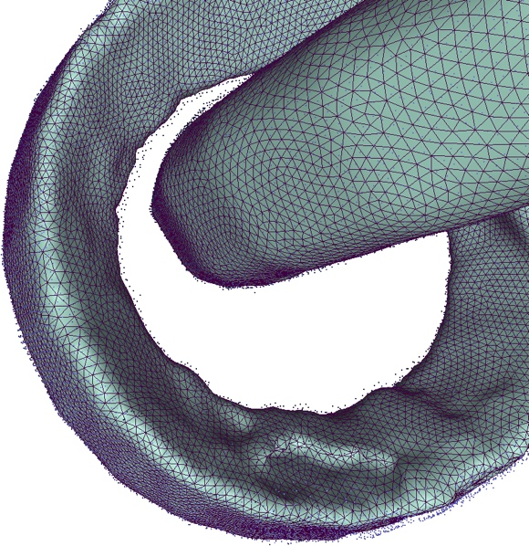
Control: Topology
High genus cases:
  Collision detection
  Merge fronts

Slide 19
Algorithm
Initialization
Evolution:
  Parameters
  Control
Final projection

Slide 20

Final Projection
ε-close vertices: project using tangent plane as MLS reference plane
far-vertices: interpolate solving the Laplacian system

Slide 21
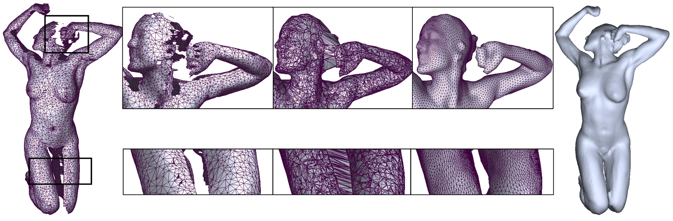
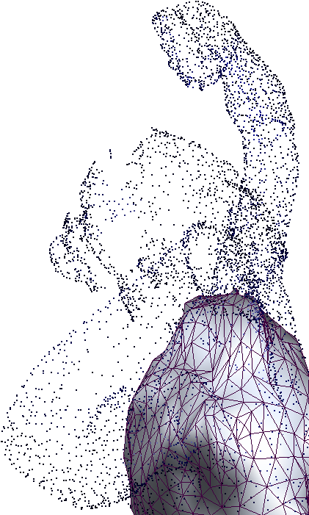
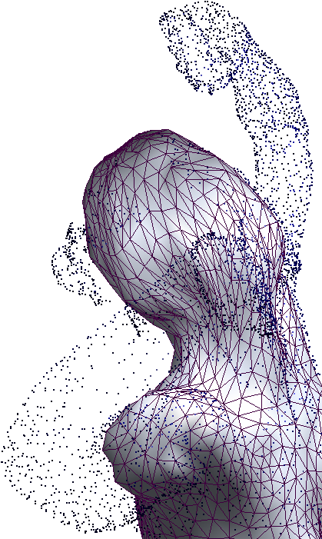
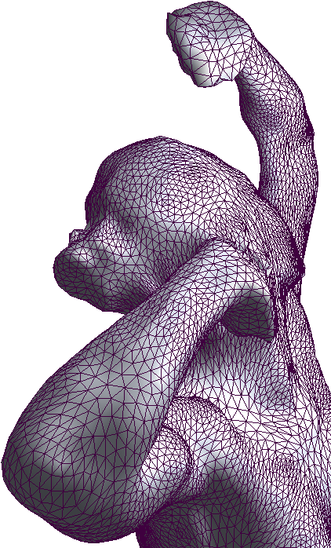
Results – coarse-to-fine

Slide 22


Results – noise outliers

Slide 23

Limitations

Slide 24











The End

Slide 25
Pseudocode
Initialize deformable model and guidance field
While point-cloud not ε-close to deformable model
  Evolve deformable model fronts:
    Remove inactive vertices & update fronts
    Update satisfied points from
  If fronts stuck & point-cloud not satisfied
    Release tension
    Subdivide fronts
  If no active fronts & point-cloud not satisfied
    wake up fronts
Final fitting

Slide 26
Motivation cont’d
Apriori assumptions:
  2-Manifold Surface
  Watertight
  Known topology
Controlled reconstruction:
  Smooth completion of holes
  Fine details recovery
  Correct topology

Slide 27
Introduction
Volumetric & Explicit Representation:
  Deformable explicit model
  Evolvement by a volumetric scalar field
Local features & Global structure:
  Coarse to fine
  Hole completion
  Fine details & narrow tunnels
Topological events tracking:
  Watertight
  Correct genus

Slide 28
Evolution Parameters
Outward normal direction
Distance field offset
Laplace solution

Slide 29
Fronts Evolution cont’d
Vertex attraction (E_{a}):
  Direction: outward normal
  Speed (t_{i}) : distance field unsigned value
Surface tension (E_{t}):
  Front elasticity
Laplacian system LSM formulation:

Slide 30
Fronts Competition cont’d
Evolvement is stopped:
  Tension too high
  Mesh resolution too low
“wake up” refinement procedure:
  Points not ε-close to deformable model
  Fronts are revived and subdivided
  Tension control is released

Slide 31

Final Projection
ε-close vertices: project using tangent plane as MLS reference plane
far-vertices: interpolate solving the Laplacian system

Slide 32




Results – topology control

Slide 33



Limitations

