Slide 1





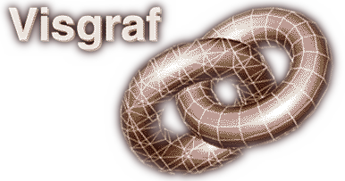
CHF: A Scalable Topological Data Structure for Tetrahedral Meshes
Marcos Lage¹, Thomas Lewiner¹,², Hélio Lopes¹, Luiz Velho³.
¹ PUC-Rio, Dept. de Matemática, Matmídia Project, Rio de Janeiro – Brazil.
² INRIA – Géométrica Project– Sophia Antipolis – France.
³ IMPA – Visgraf Project – Rio de Janeiro – Brazil.

Slide 2
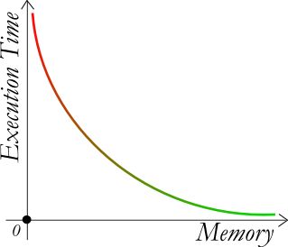
Introduction
Topological Data Structures:
  MEMORY x PERFORMANCE
Scalable ?
New Scalable Data Structure for manifold Tetrahedral meshes

Slide 3
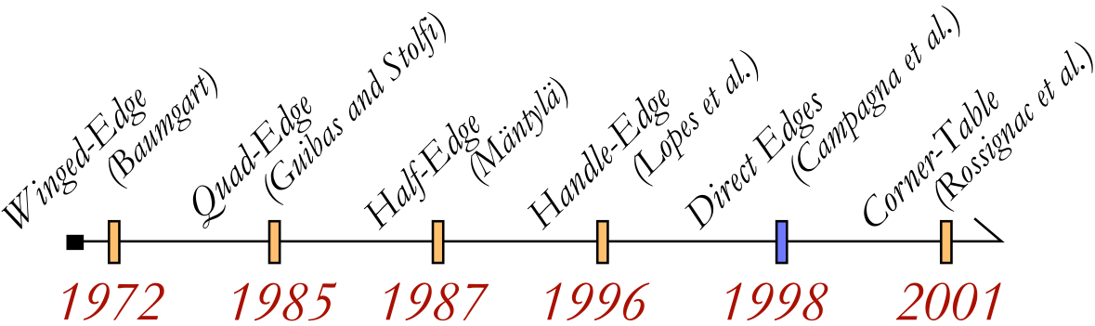
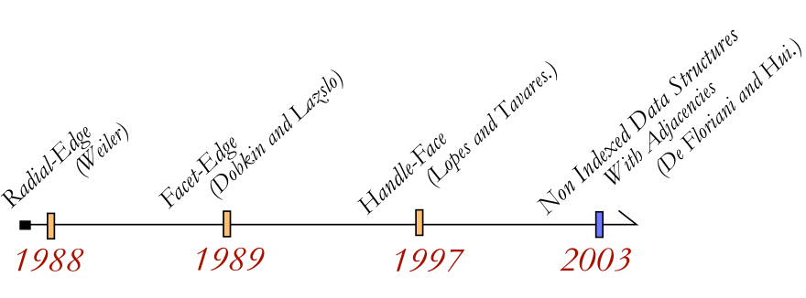
Previous Works
For surfaces:
For 3-Manifolds:

Slide 4
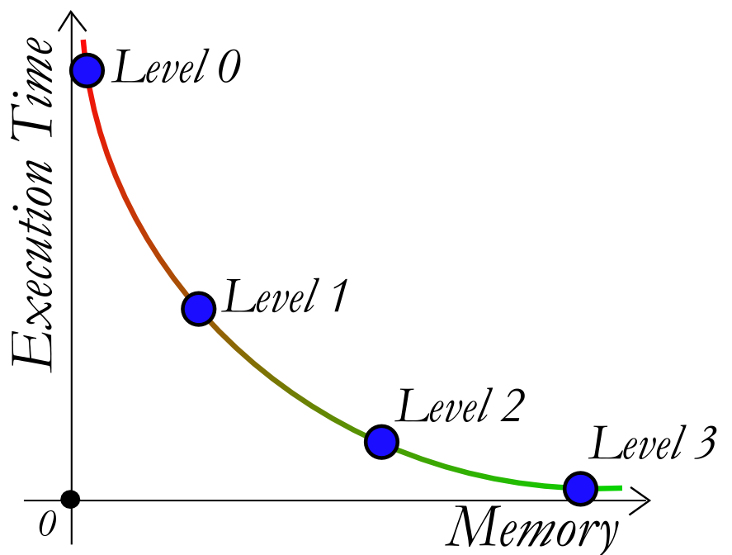
Contributions
Manifold tetrahedral meshes
Four levels
  MEMORY x PERFORMANCE
Generic containers
Bitwise rules

Slide 5
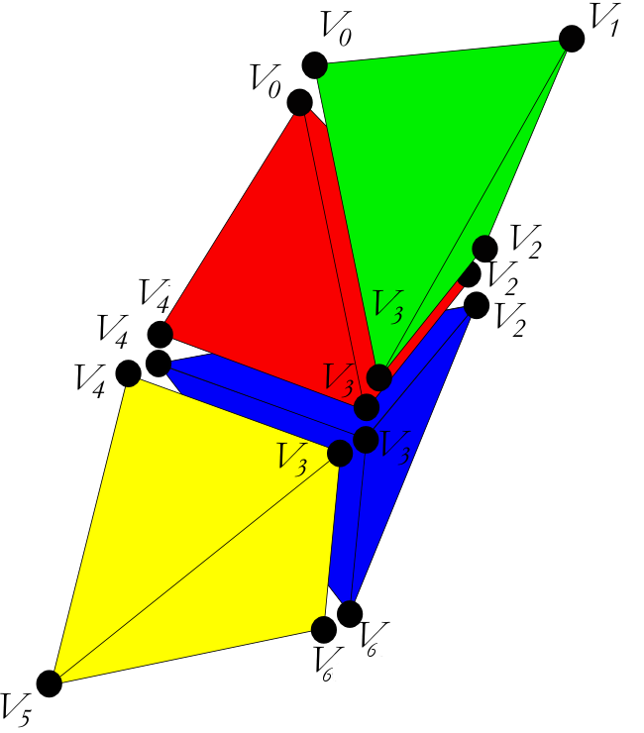
Level 0 – Overview
Characteristic:
  Tetrahedral “soup”
Application:
  Mesh Visualization

Slide 6
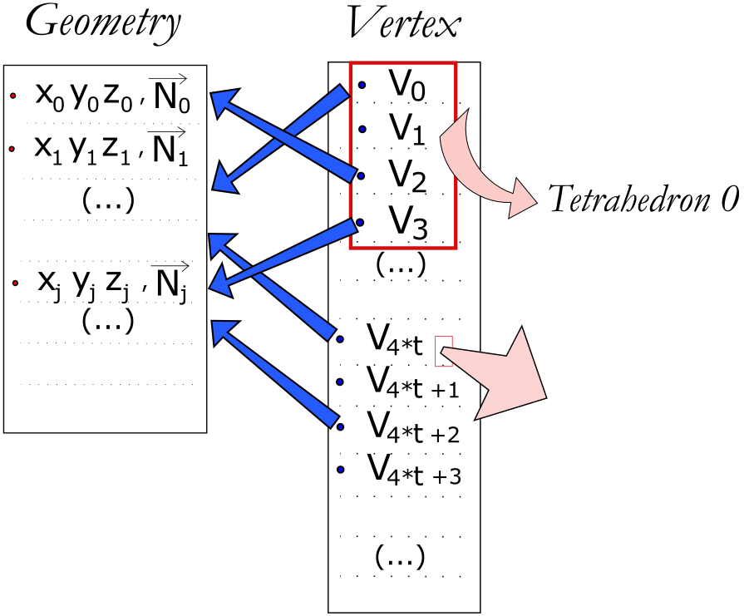
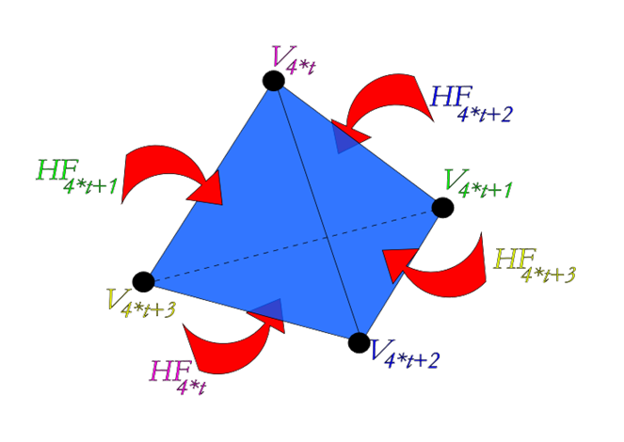
Level 0 – Basics

Slide 7
Level 0 – Rules
Tetra(hf) := [hf/4]
= hf>>2
Next_{hf}(hf) := 4*Tetra(hf) + (hf+1)%4
        = hf&(~3) + (hf|1)&3
Mid_{hf}(hf) := 4*Tetra(hf) + (hf+2)%4
        = hf&(~3) + (hf|2)&3
Prev_{hf}(hf) := 4*Tetra(hf) + (hf+3)%4
= hf&(~3) + (hf|3)&3

Slide 8
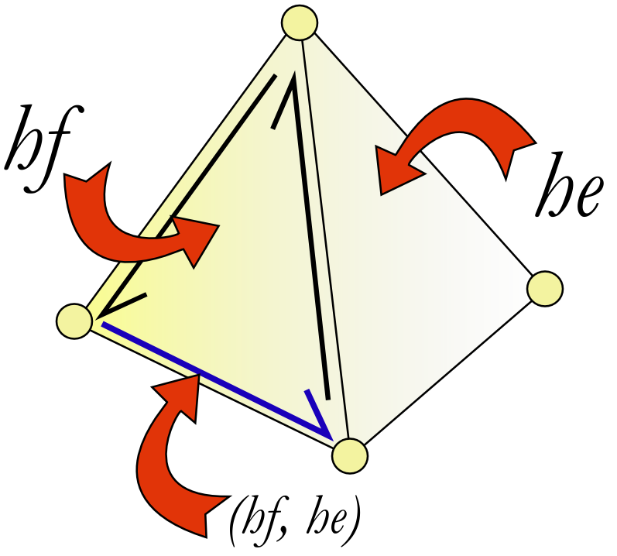
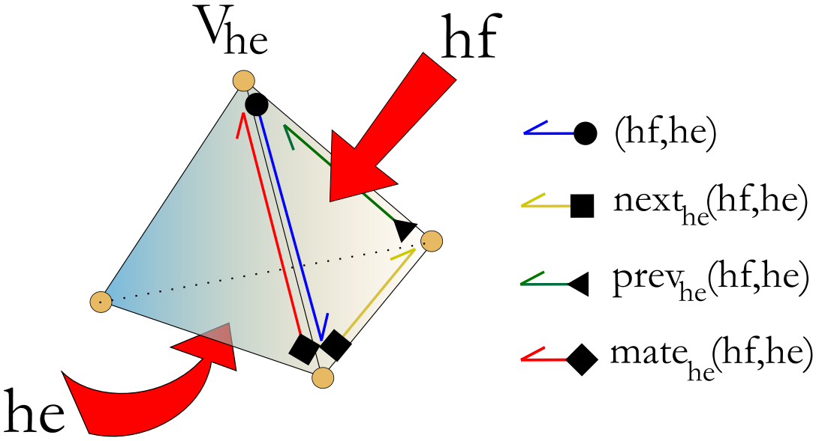
Level 0 – Half-Edges
Next_{he}(hf, he) := (hf, N[he%4][hf%4])
Prev_{he}(hf, he) := (hf, N[hf%4][he%4] )
Mate_{he}(hf, he) := (Prev_{he}(hf, he), Next_{he}(hf, he))

Slide 9
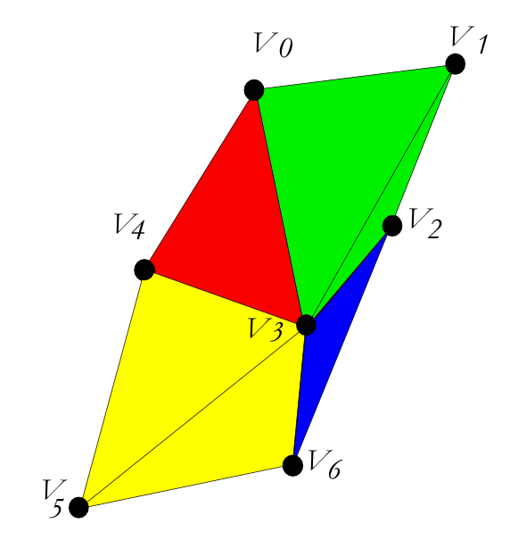
Level 1 – Overview
Characteristics:
  Neighborhood Information
Application:
  Traversal
  Subdivision

Slide 10
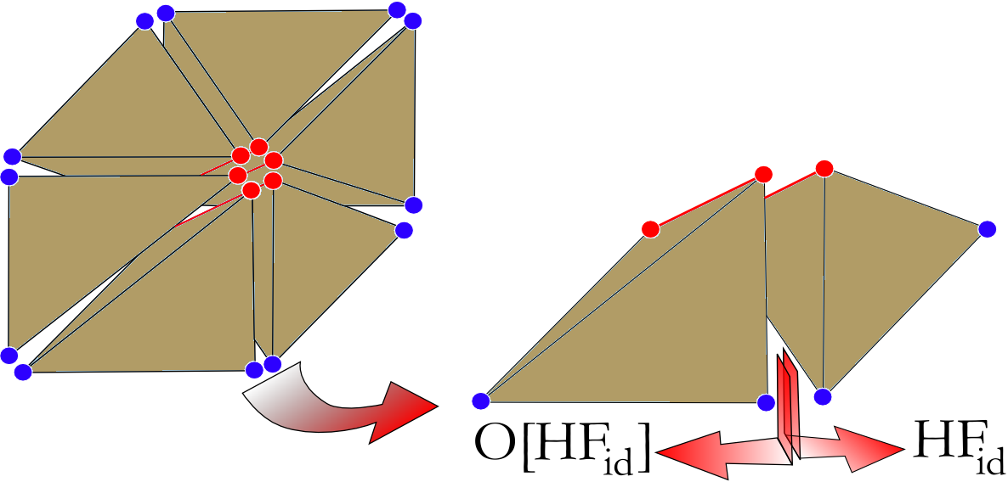
Level 1 – Opposite Half-Face
Opposites half-faces:
same vertices
opposite orientation

Slide 11
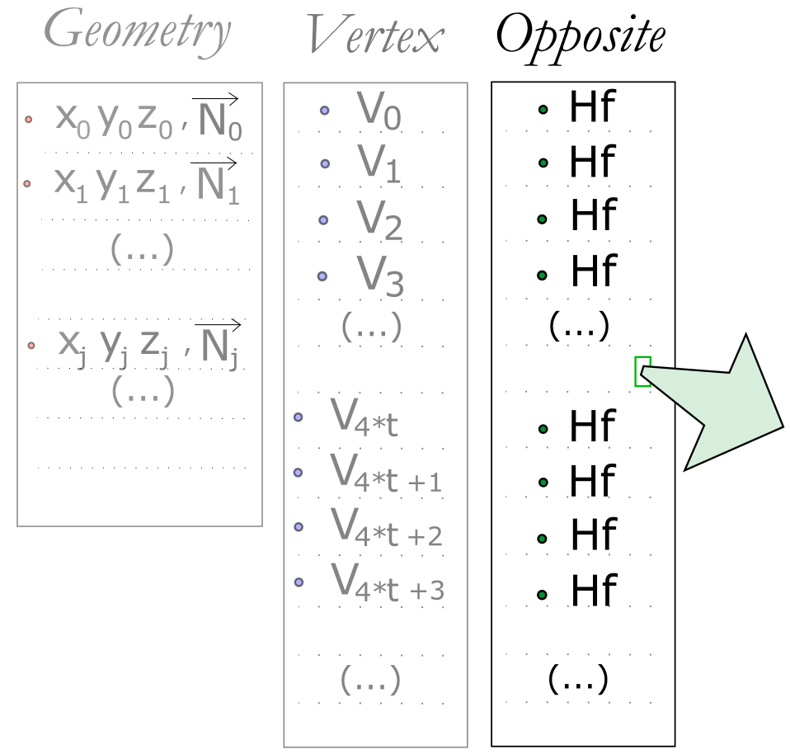
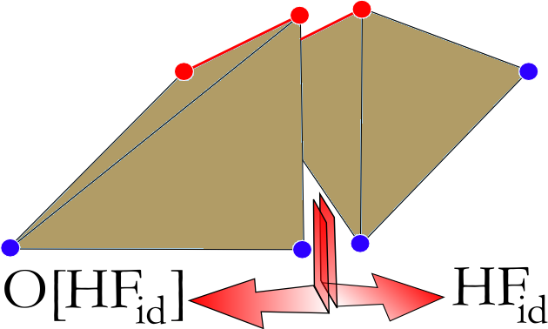
Level 1 – Opposite Container

Slide 12
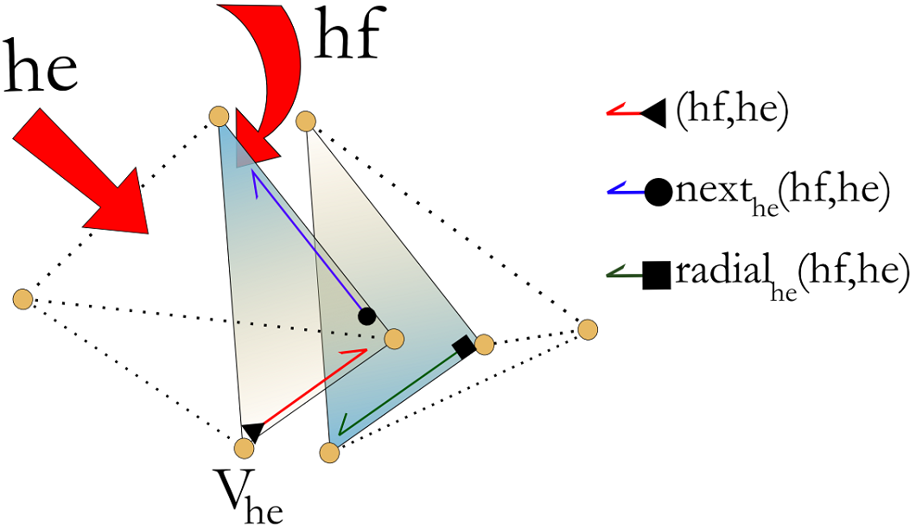
Level 1 – Edge Star
Radial_{he}(hf, he) := ( O[hf] , next_{he}(hf, he) )
  +
Mate_{he}(hf, he) := ( prev_{he}(hf, he), next_{he}(hf, he) )

Slide 13
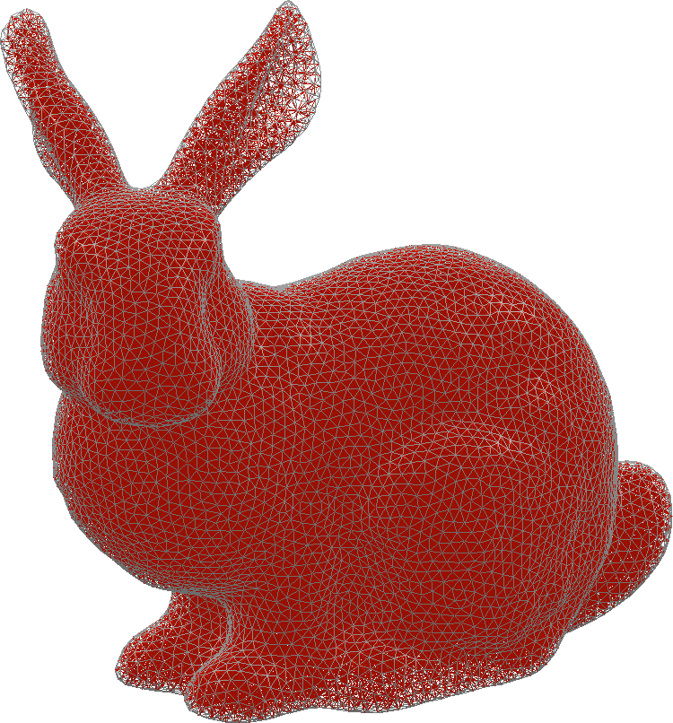
Level 2 – Overview
Characteristics:
Explicit representation of the cells
Applications:
  Attributes
  Simplification

Slide 14
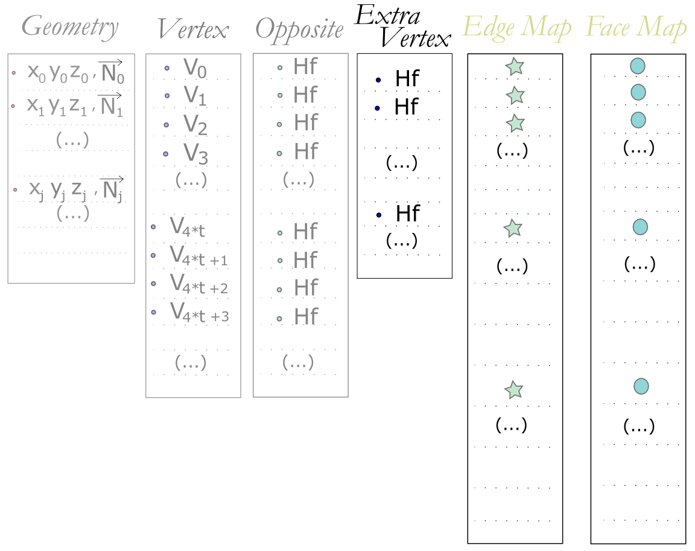
Level 2 – Extra Containers

Slide 15
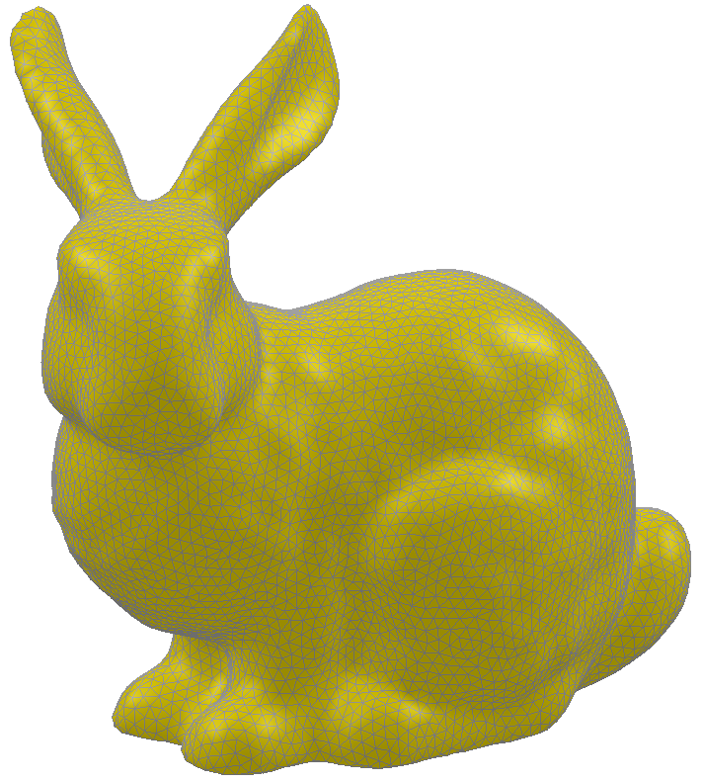
Level 3 – Overview
Characteristics:
Explicit representation of the boundary surface
Applications:
  Topology
  Direct Draw

Slide 16
Level 3 – Border CHE
CHE: Compact half-edge
  Version of CHF of surfaces
  Four levels of structure
    MEMORY x PERFORMANCE
  Generic containers
  Arithmetic rules

Slide 17
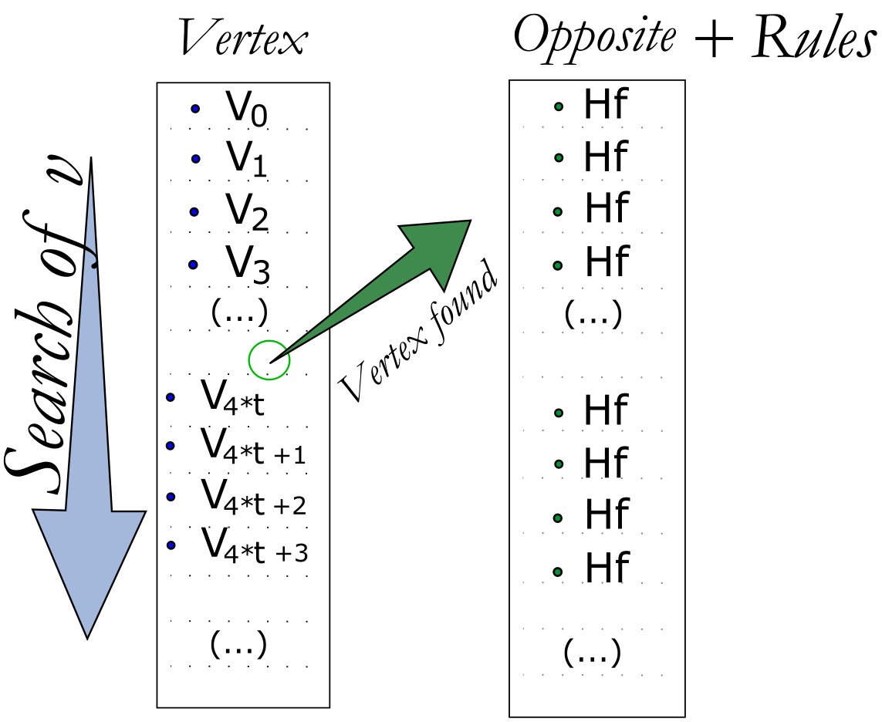
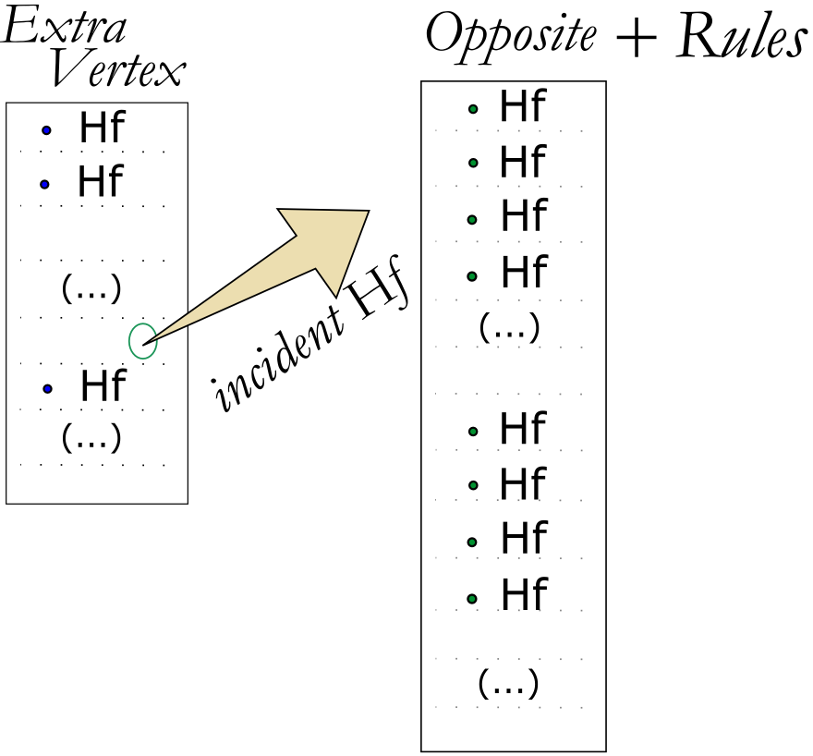
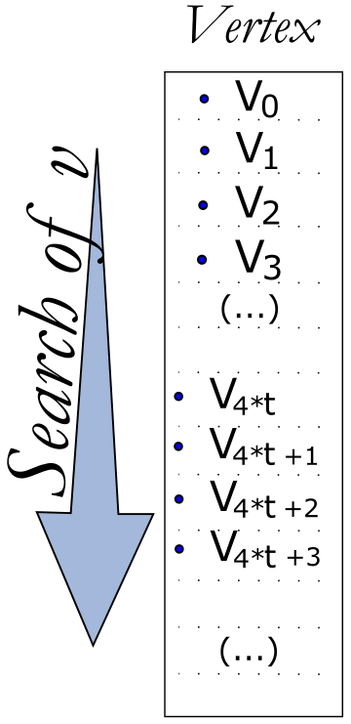
Operations – Vertex Star
Level 0
Level 1
Levels 2 & 3
O(4*n_{tetra})
O(2*n_{tetra})
Θ(d°(v))

Slide 18

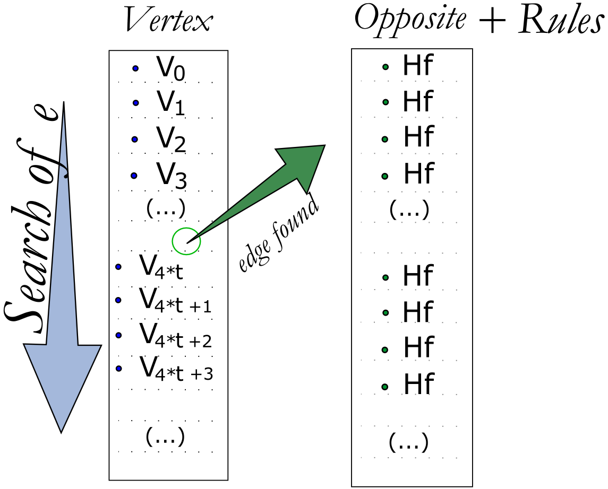
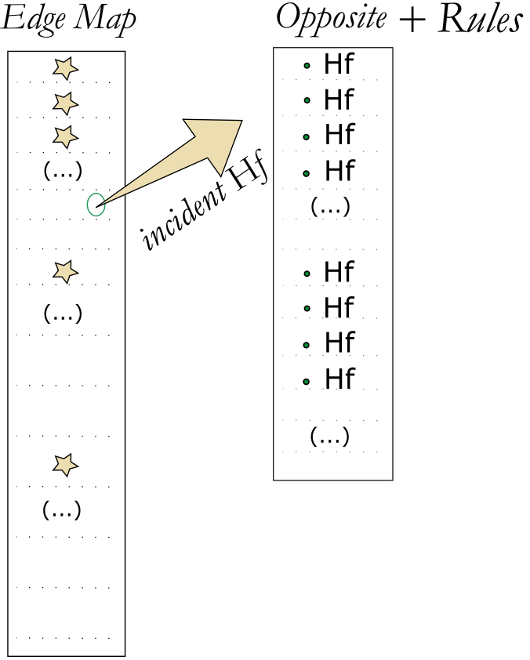
Operations – Edge Star
Level 0
Level 1
Levels 2 & 3
O(4*n_{tetra})
O(2*n_{tetra})
Θ(d°(e))

Slide 19
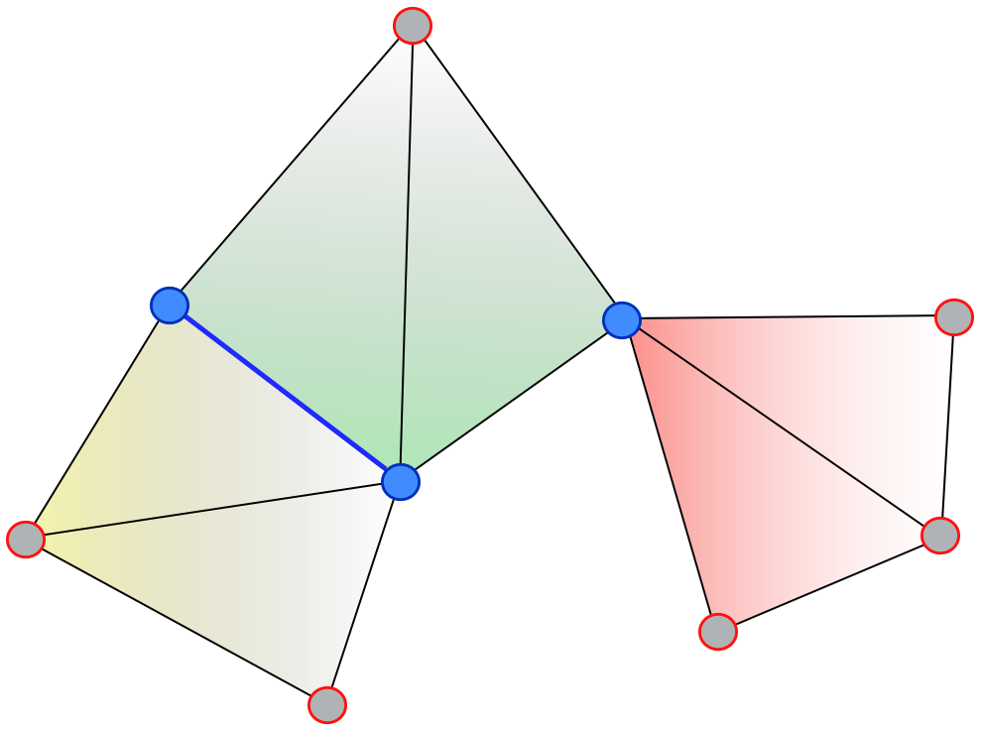
Future Works
Non-manifold meshes
  Vertex and
  edge singularities

Slide 20
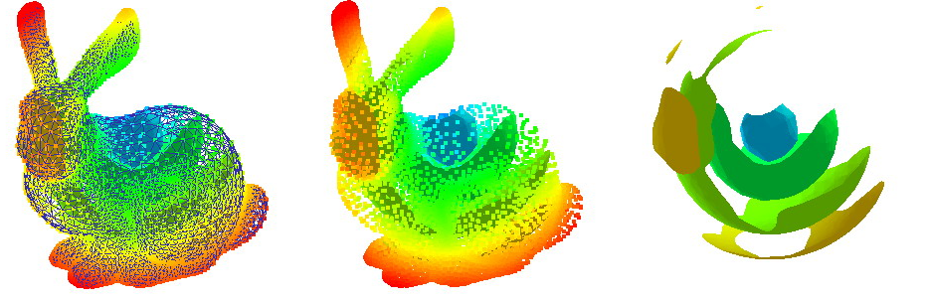
Thanks !!!

