Slide 1


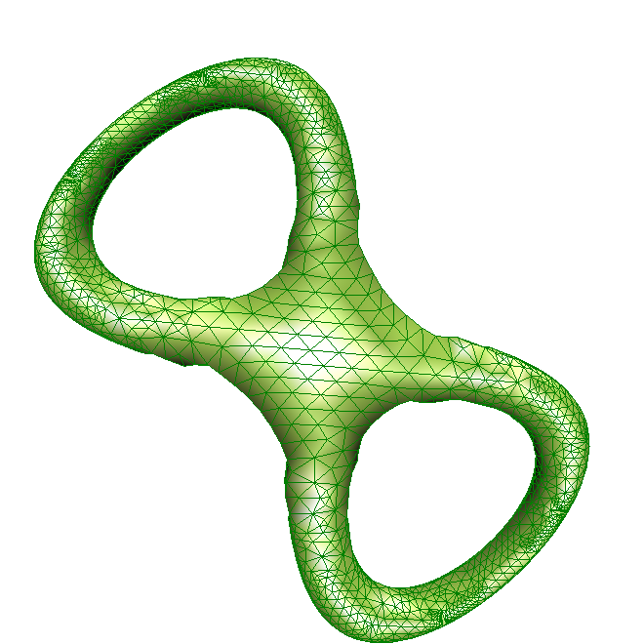
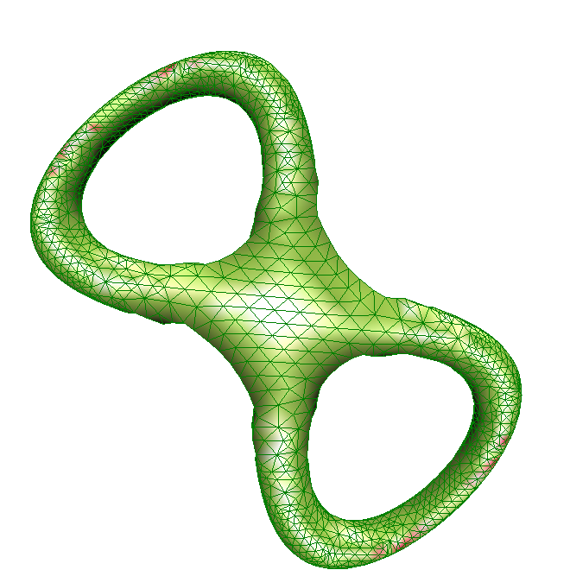
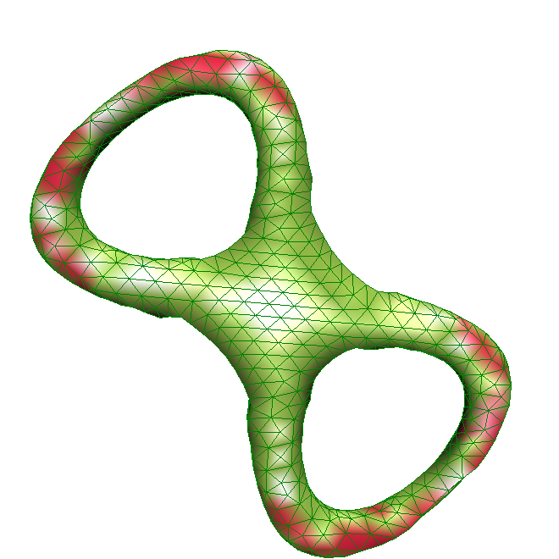
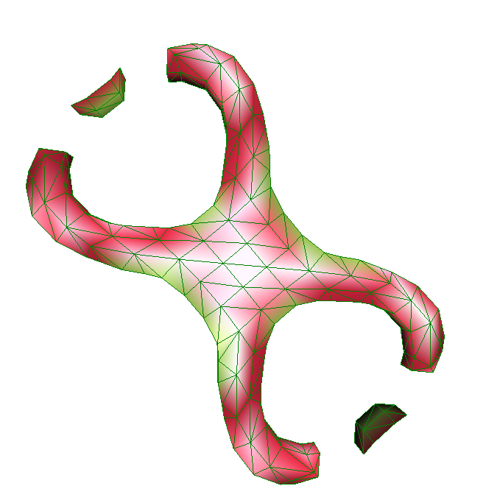



Robust Adaptive Meshes for Implicit Surfaces
Afonso Paiva Hélio Lopes Thomas Lewiner
Matmidia - Departament of Mathematics – PUC-Rio
Luiz Henrique de Figueiredo
Visgraf - IMPA

Slide 2
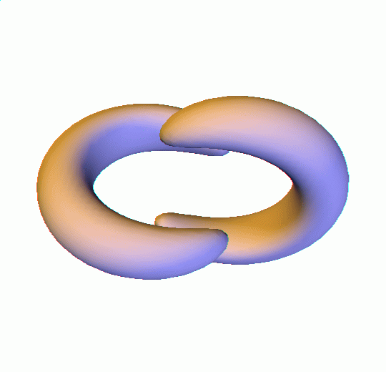
Motivation
Topological Guarantees?
– 3D extension of “Robust adaptive approximation of implicit curves” –
  Hélio Lopes, João Batista Oliveira and Luiz Henrique de Figueiredo, 2001

Slide 3
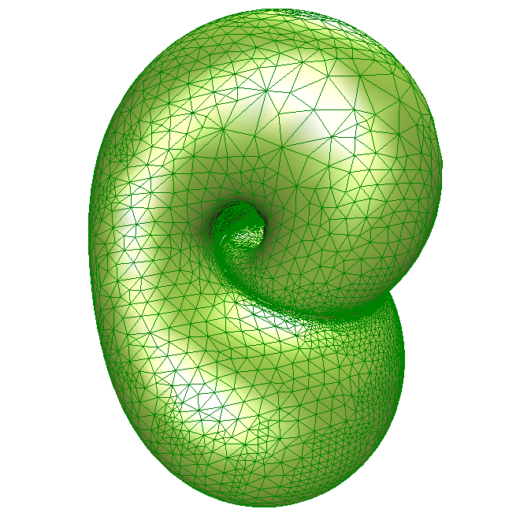

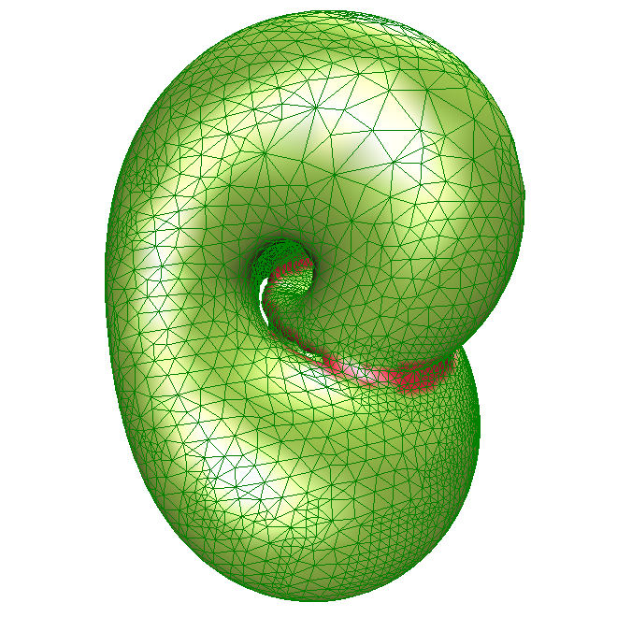
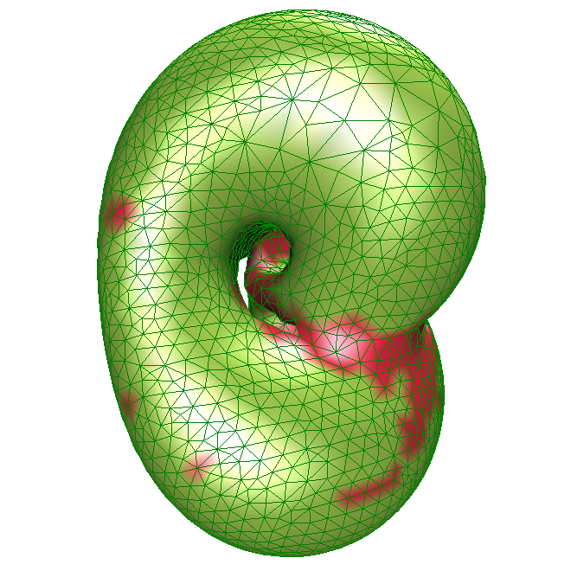
Challenges
Adaptive Mesh
Topological Robustness
Mesh Quality
Guaranteed
Not Guaranteed
Klein bottle 3D
  According to Ian Stewart
level 8
level 7
level 6
level 5

Slide 4
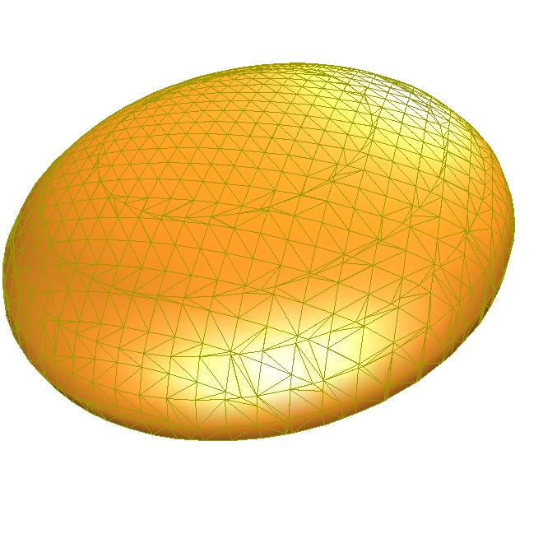
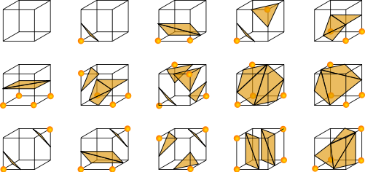
Isosurface Extration
Marching Cubes
  Lorensen and Cline, 1987
  Look-up table method
  Not adaptive
  Sliver triangles

Slide 5
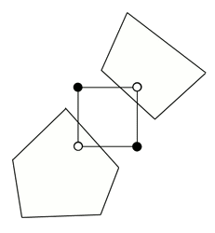
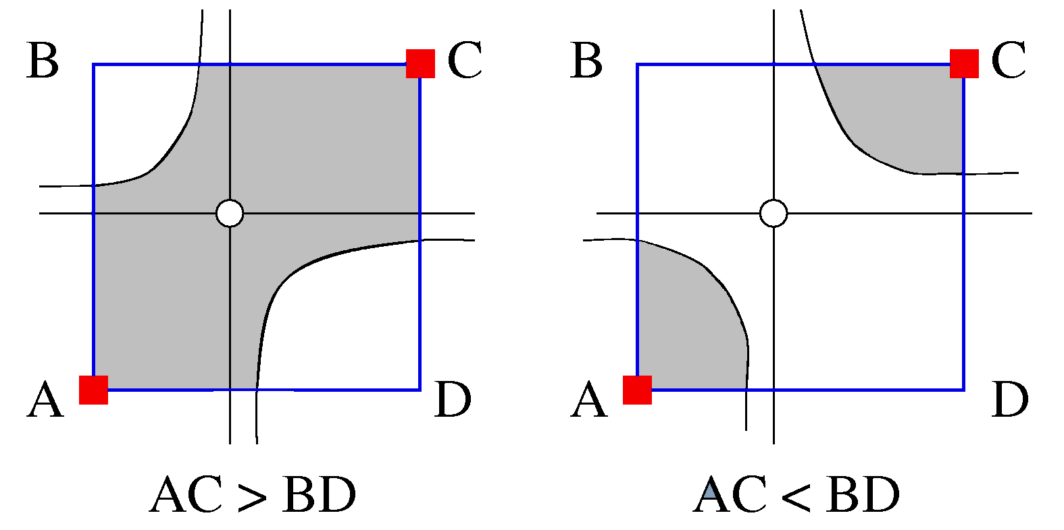
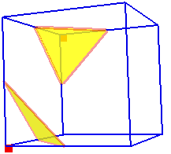
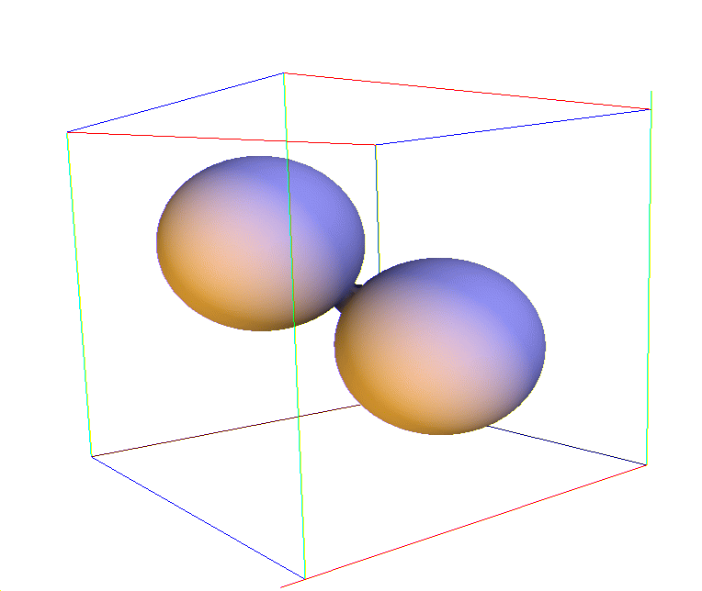

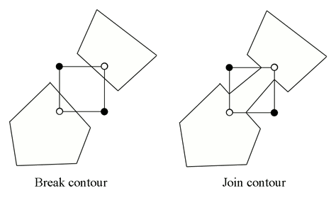
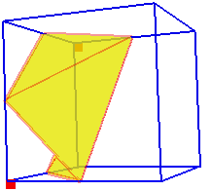
Isosurface Extration
Ambiguities of Marching Cubes :
tri-linear topology = original topology ?

Slide 6
Overview
Numerical tools
Build the octree
  Connected Component Criterion
  Topology Criterion
  Geometry Criterion
From octree to dual grid
Mesh generation
Mesh improvements
Future Work

Slide 7
Numerical Tools
Interval Arithmetic (IA)
  A set of operations on intervals
  Enclosure
F(B)
B
f(B)

Slide 8
Numerical Tools
Automatic Differentiation (AD)
  Speed of numerical differentiation
  Precision of symbolic differentiation
  Defining an arithmetic for tuples:
  Combining IA & AD: is a tuples of intervals!!

Slide 9
Build the Octree
Connected Components Criterion
f > 0
B₁
F
0
f < 0
F(B₁)
S
F
0
F(Ω)

Slide 10
Build the Octree
Topology Criterion
-n
0
n
B_{n}

Slide 11
Build the Octree
Geometry Criterion
n
high curvature
B_{n}

Slide 12
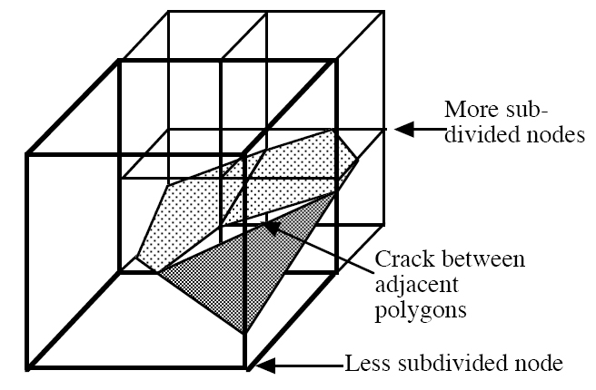
Adaptive Marching Cubes
Shu et al, 1995
Cracks & holes

Slide 13
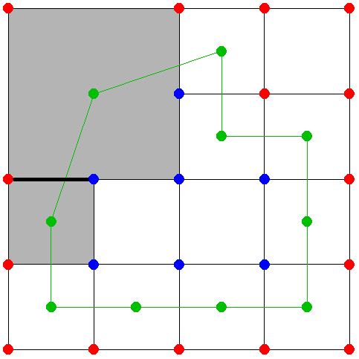
Dual Contouring
Ju et al., SIGGRAPH 2002
Subdivision controlled by QEFs
Well-shaped triangles and quads
Allows more freedom in positioning vertices
High vertex valence

Slide 14
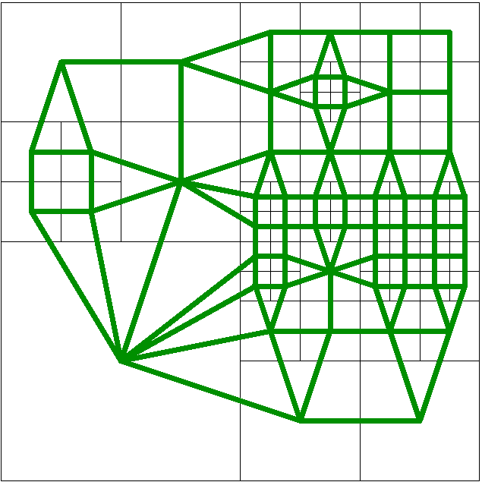
From Octree to Dual
“Dual marching cubes: primal countouring of dual grids” – S. Schaefer & J. Warren, PG, 2004.
Generates cells for poligonization using the dual of the octree
Creates adaptive, crack-free partitioning of space
Uses Marching Cubes on dual cells to construct triangles

Slide 15
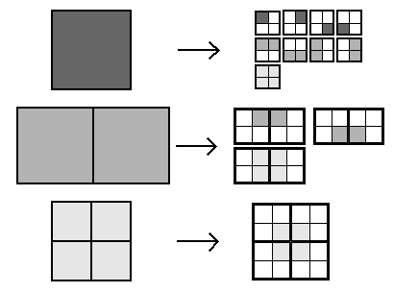
From Octree to Dual
Recursive procedures
  It does not require any explicit neighbour representation in octree data-structure
  Three types of procedures:
FaceProc
EdgeProc
VertProc

Slide 16
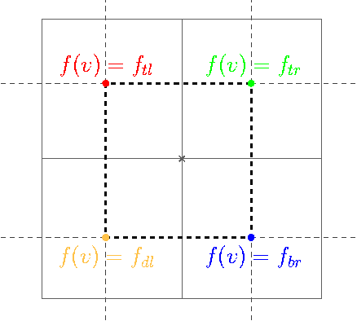
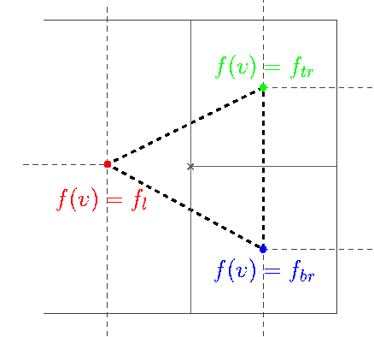
Mesh Generation
Cell key generation
The vertices of the triangles are computed using bisection method along the dual edge

Slide 17
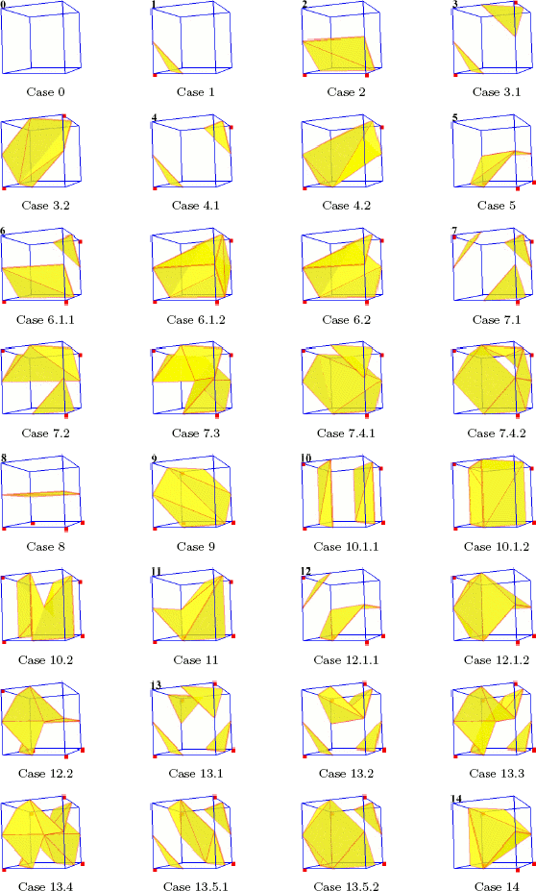
Mesh Generation
“Efficient implementation of Marching Cubes’ cases with topological guarantees”, T. Lewiner, H. Lopes, A. Vieira and G. Tavares, JGT, 2003.
Topological MC: 730 cases
Original MC: 256 cases

Slide 18
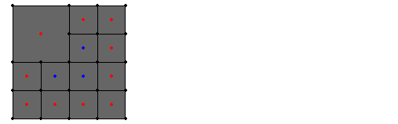
Mesh Generation

Slide 19
Mesh Improvements
Vertex smoothing
  Improves the aspect ratio of the triangles
  “A remeshing approach to multiresolution modeling”, M. Botsch and L. Kobbelt, SGP, 2004.
Project the vertices back to surface using bisection method

Slide 20
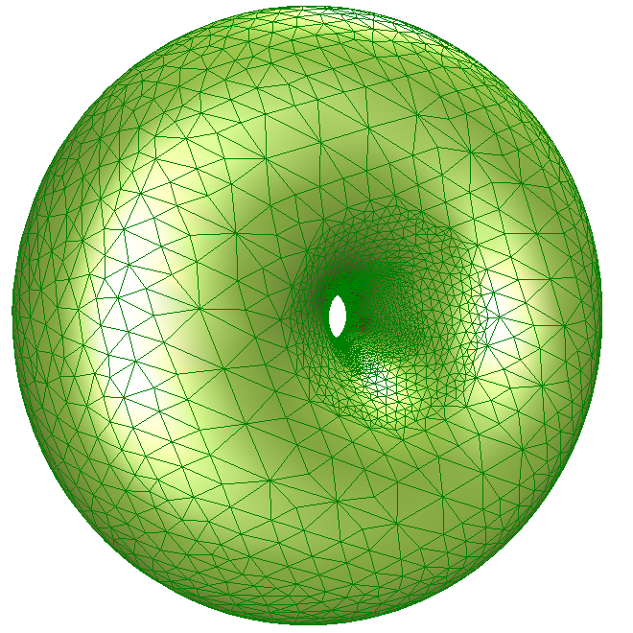
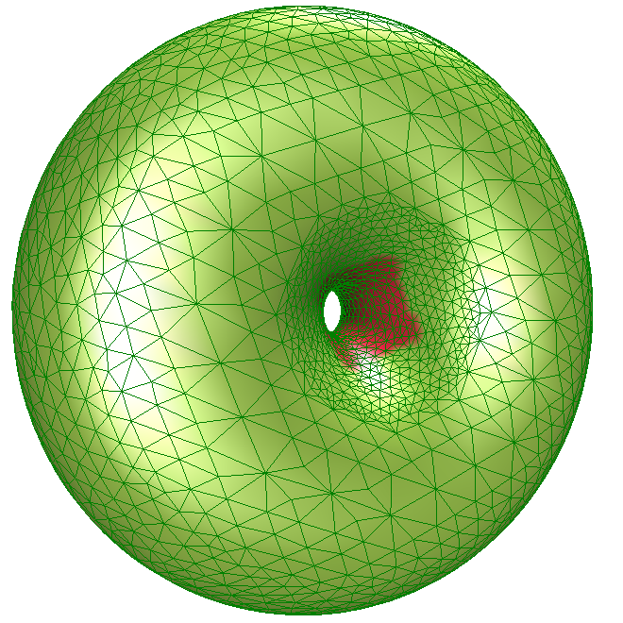
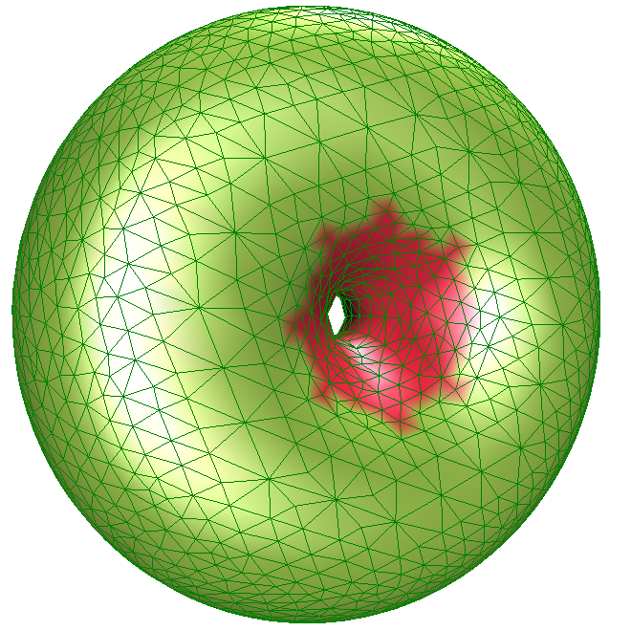
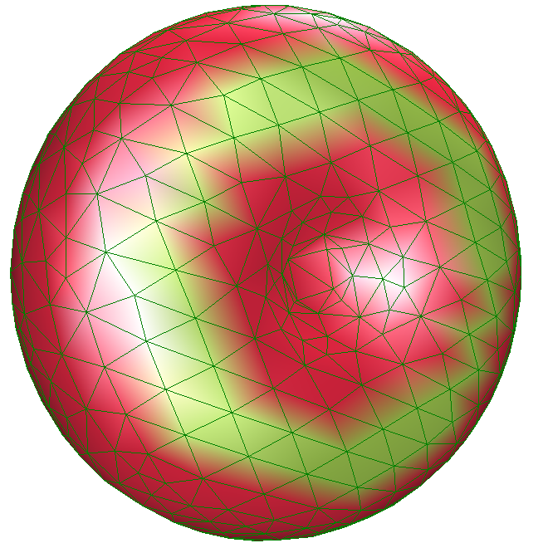
Results: robustness
Torus
Guaranteed
Not Guaranteed
level 7
level 6
level 5
level 4

Slide 21
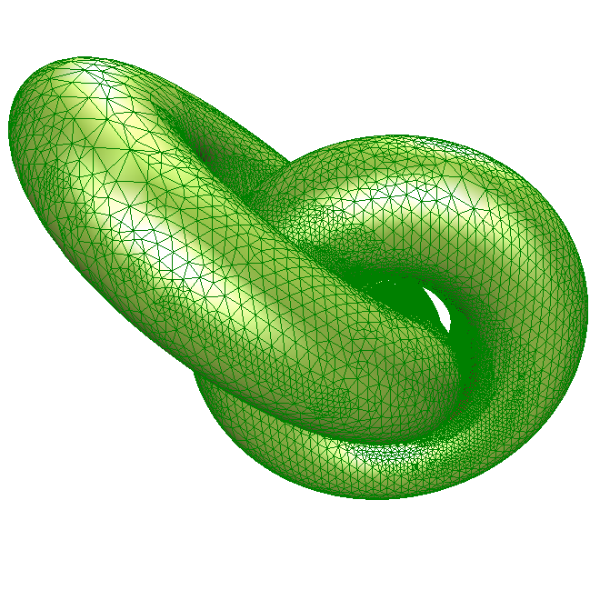
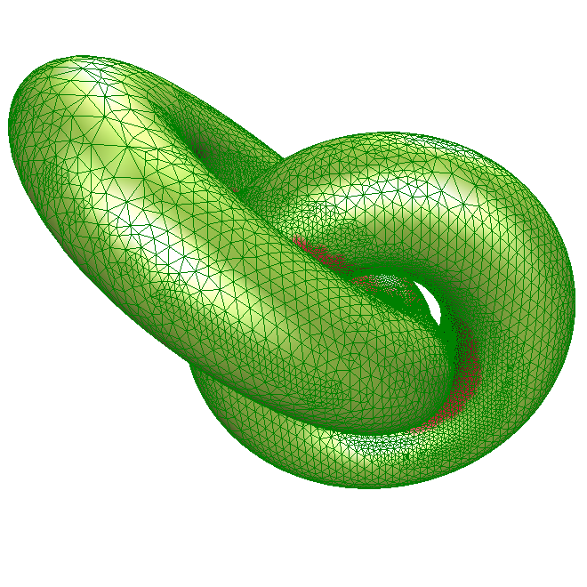
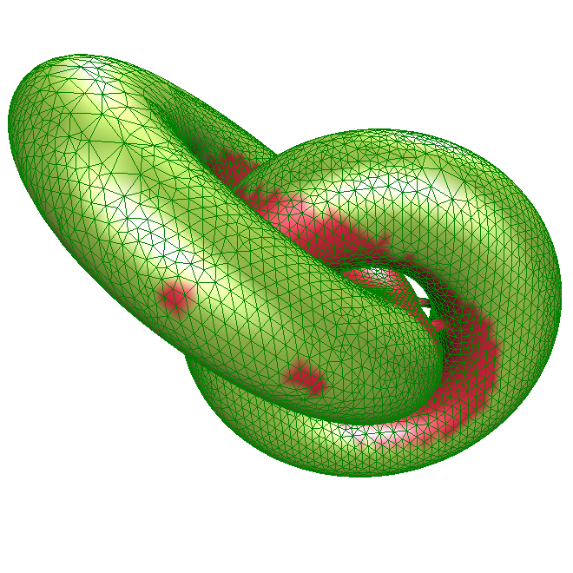
Results: topological guarantee
Complex models
  Two torus
Guaranteed
Not Guaranteed
level 8
level 7
level 6

Slide 22
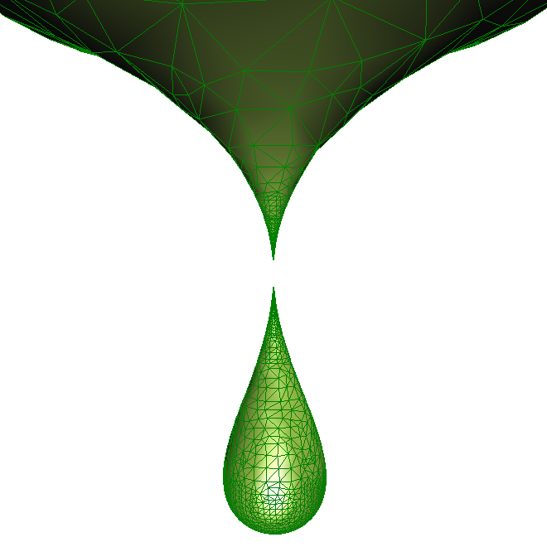
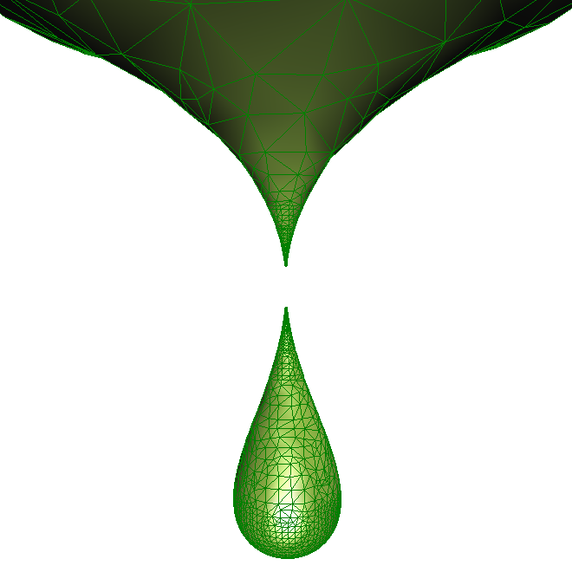
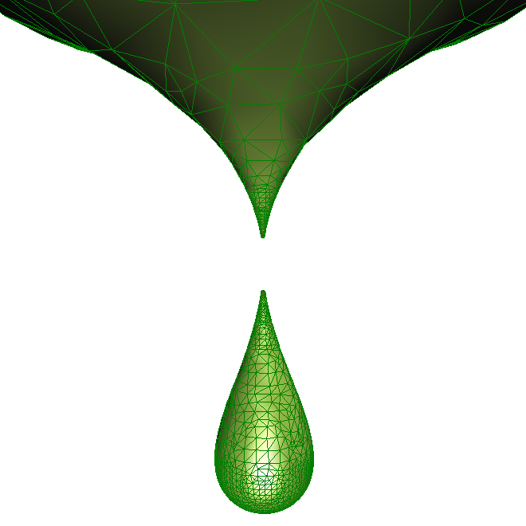

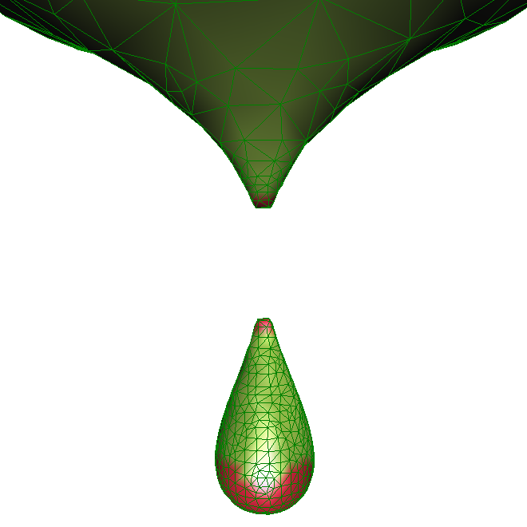
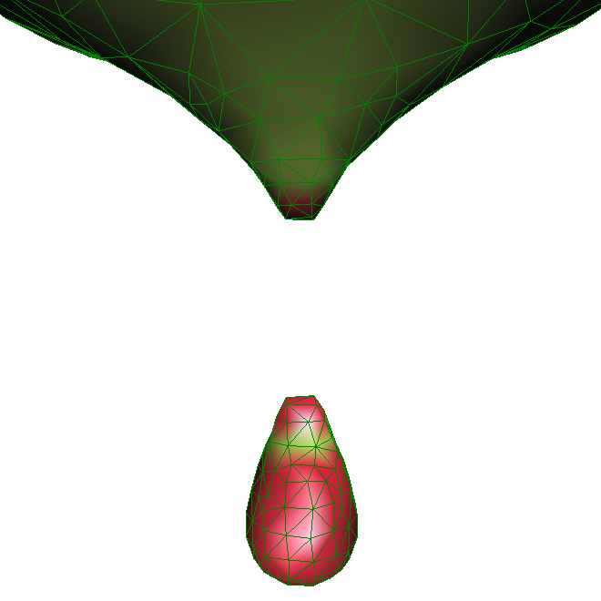
Results: robust to singularities
  Teardrop surface
Guaranteed
Not Guaranteed
level 5
level 10
level 9
level 8
level 7
level 6

Slide 23
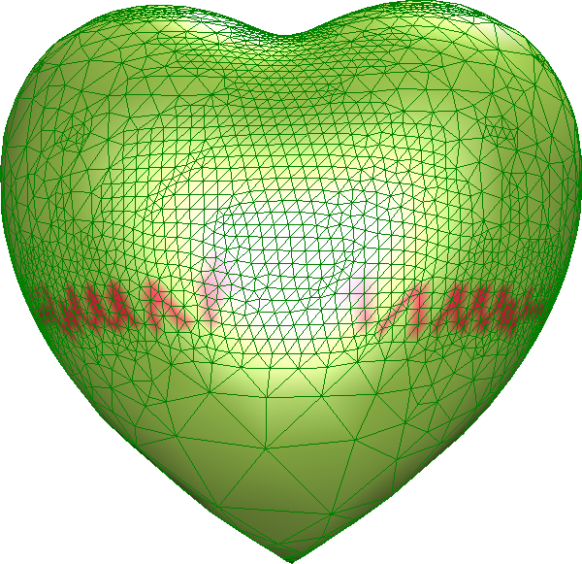
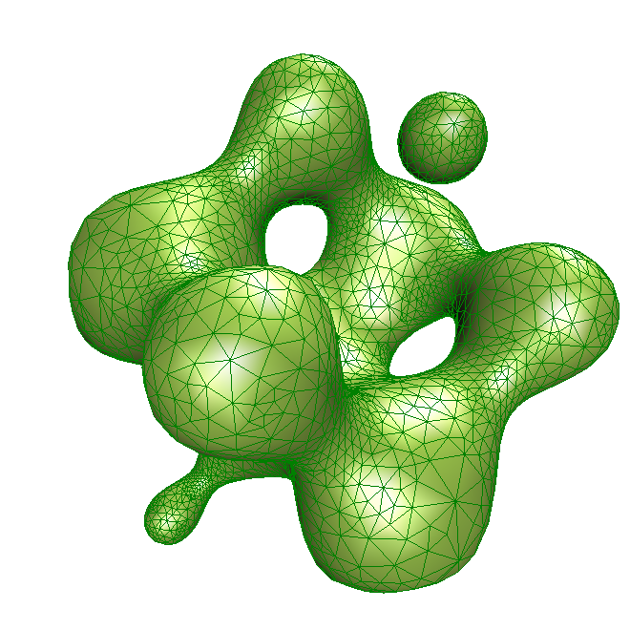
Results
Algebraic Surface
Non-Algebraic Surface

Slide 24
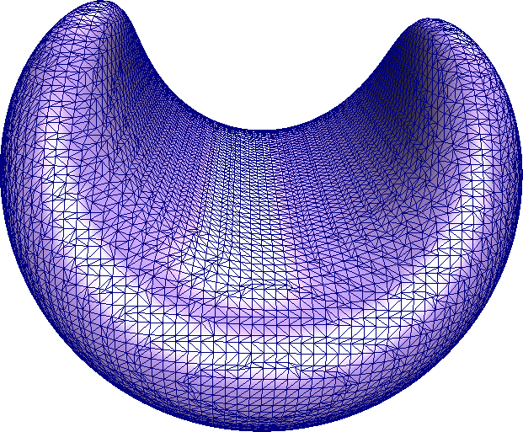
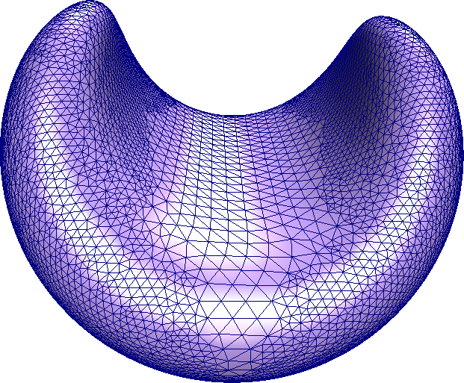
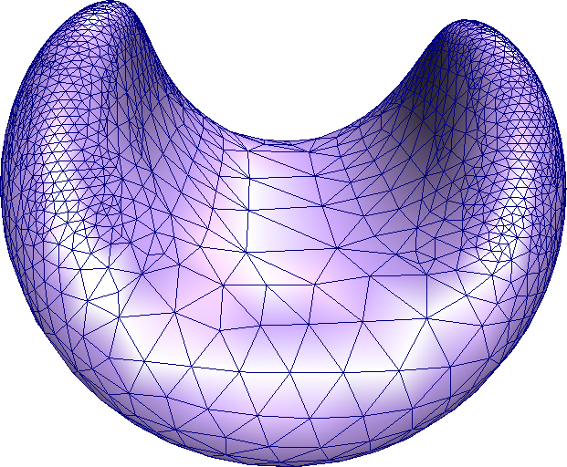
Results: adaptativity
The effect of geometry criterion
# triang = 25172
# triang = 22408
# triang = 4948

Slide 25
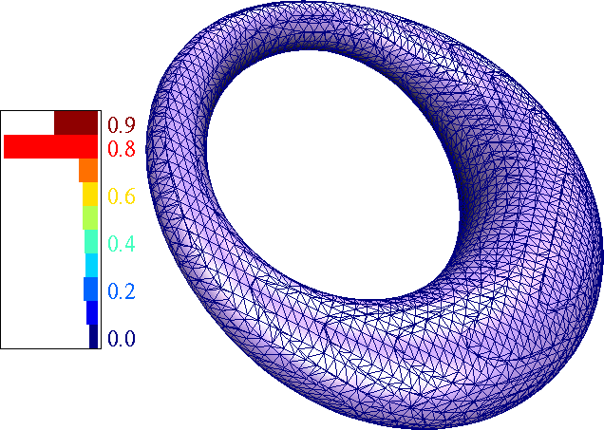
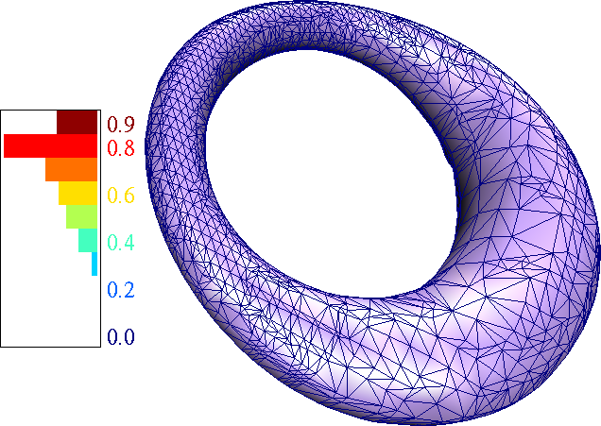
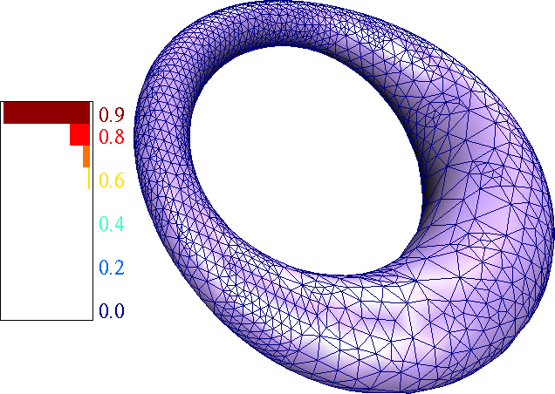
Results: mesh quality
Mesh processing
  Cyclide surface
  Aspect ratio histograms
Our method
without smooth
# triang = 5396
Our method
with smooth
# triang = 5396
Marching Cubes
# triang = 11664

Slide 26
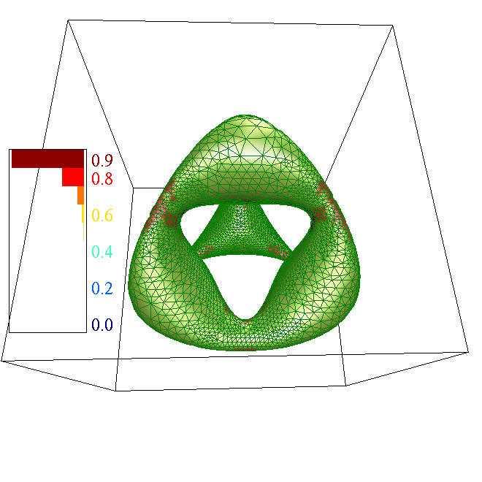
Results: no makeup!
Our algorithm does not suffer of symmetry artefacts
  Chair surface

Slide 27
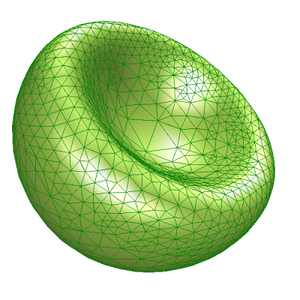
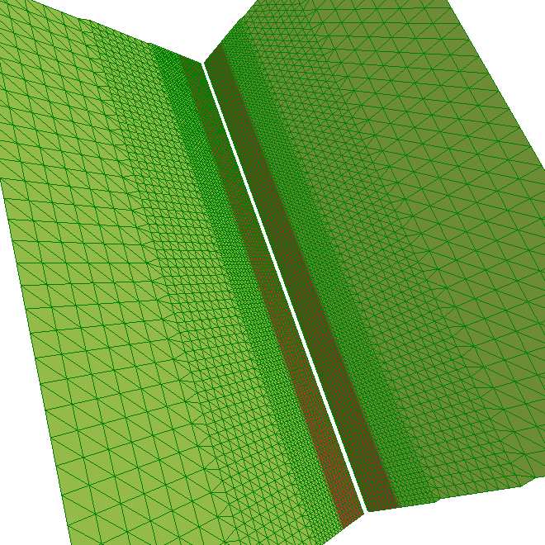
Results
Boolean operation
Non-manifold
xy = 0

Slide 28
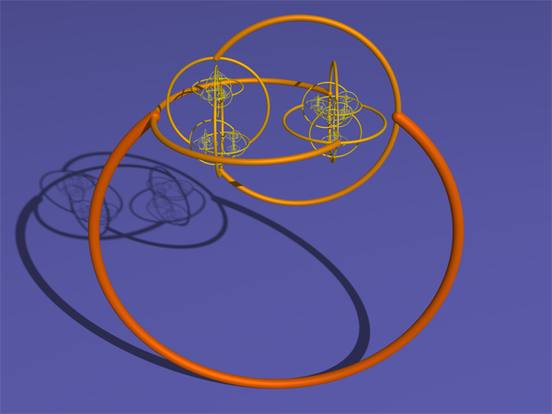
Limitations and Future Work
Tighter bounds for less subdivisions
  Replace Interval Arithmetics by Affine Arithmetics
Only implicit surfaces
  Implicit modeling such as MPU
Infinite subdivision:
  Horned sphere → no solution

Slide 29
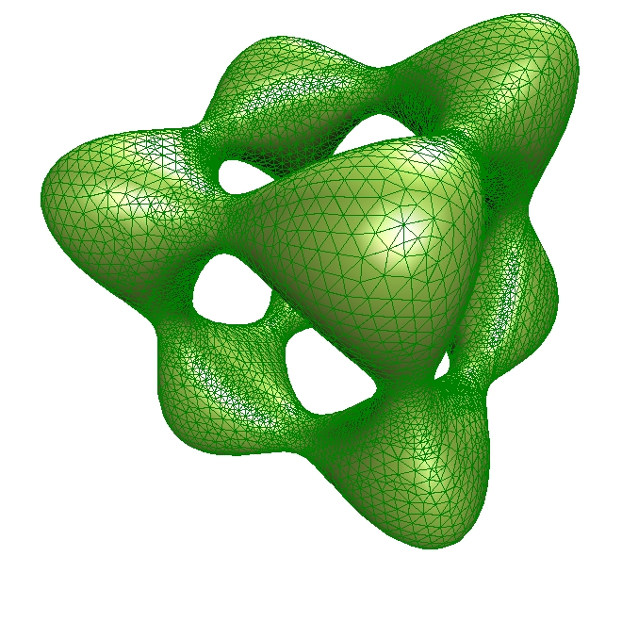
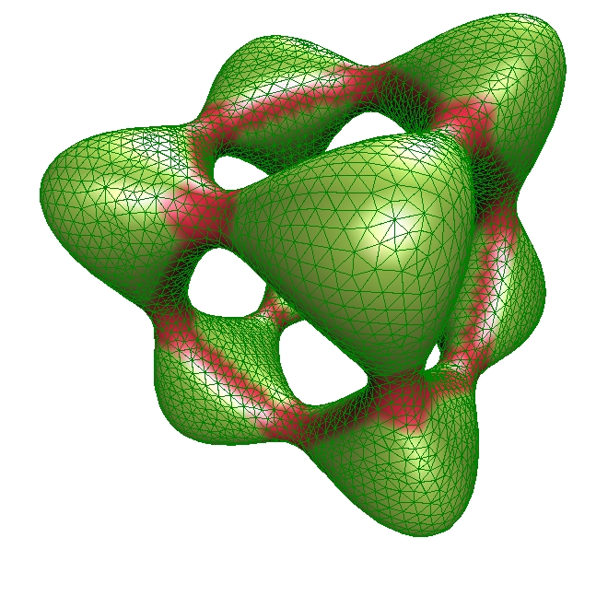

That’s all folks!!!!
http://www.mat.puc-rio.br/~apneto

