Slide 1
Approximations by Smooth Transitions in Binary Space Partitions
Marcos Lage, Alex Bordignon, Fabiano Petronetto, Álvaro Veiga, Geovan Tavares, Thomas Lewiner, Hélio Lopes
Matmidia Labs - PUC-Rio - Brazil

Slide 2
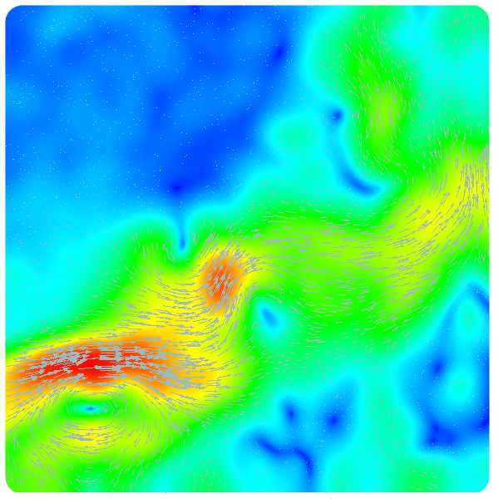
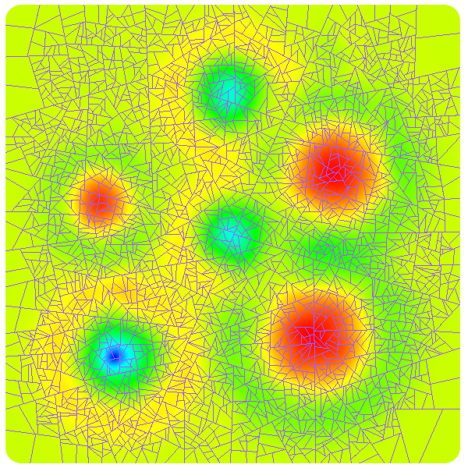
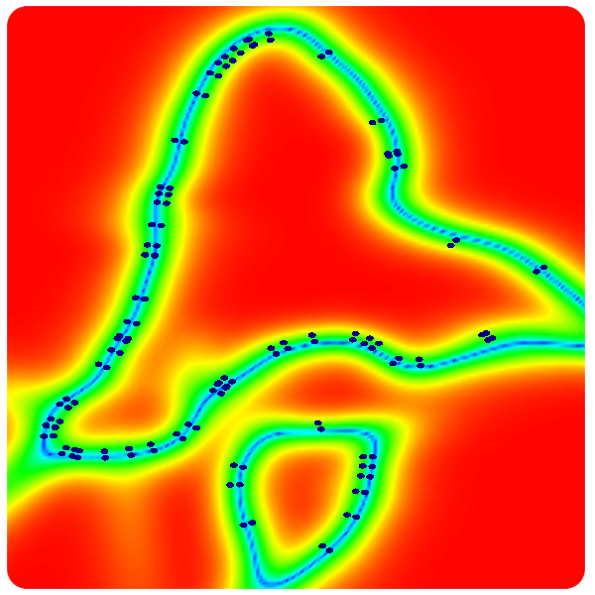
Motivation

Slide 3
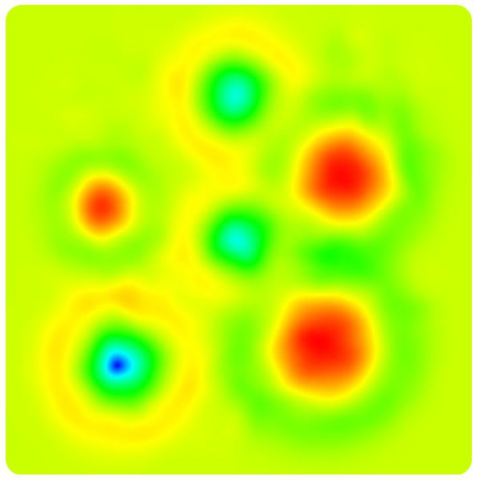
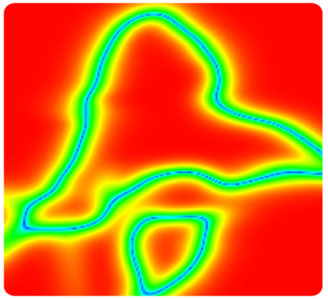
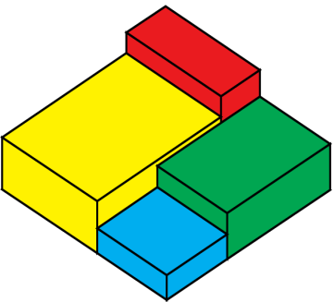
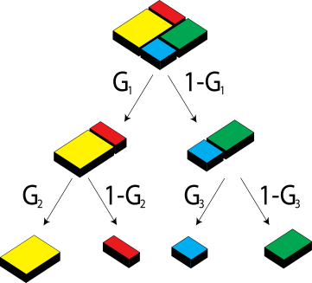
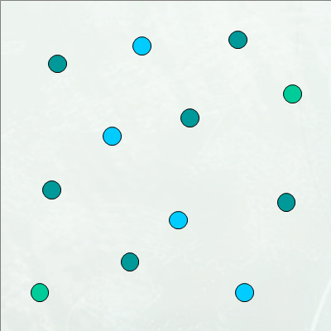
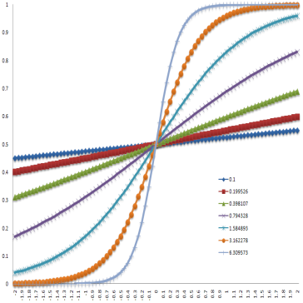
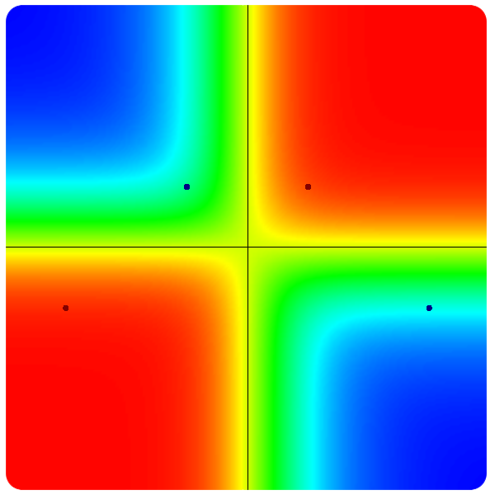
Outline
Motivation
Background Bsp CART STR-Trees
Smooth transition BSP approximation
Problem description Contributions Transition function Parameters
Results
Future works

Slide 4
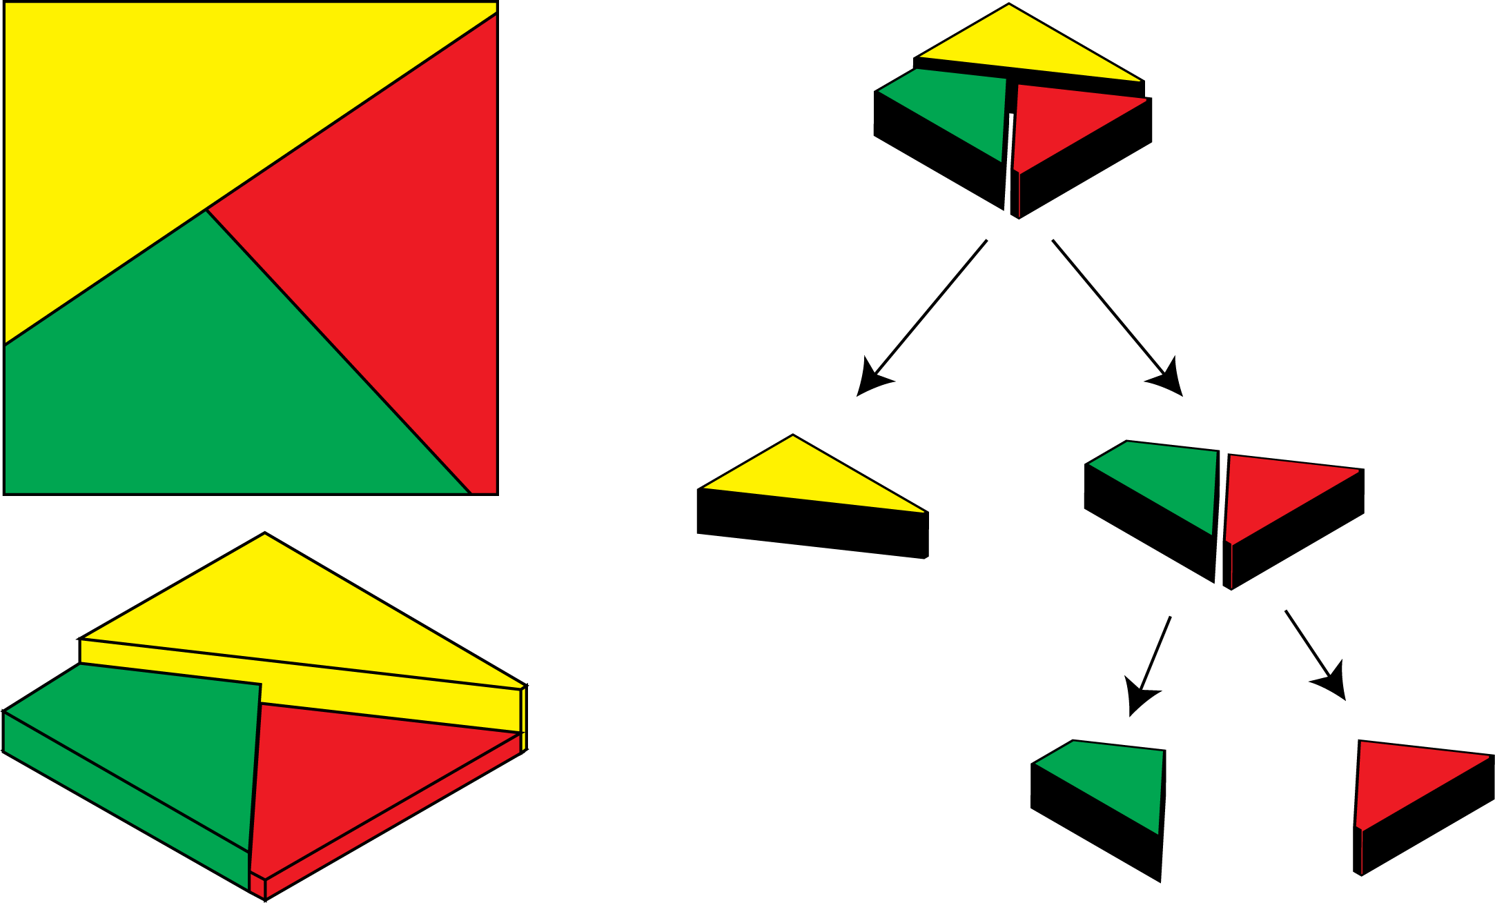
Background (Binary Space Partition trees - BSP)

Slide 5
Background (Classification and regression trees - CART)
Indicator function

Slide 6
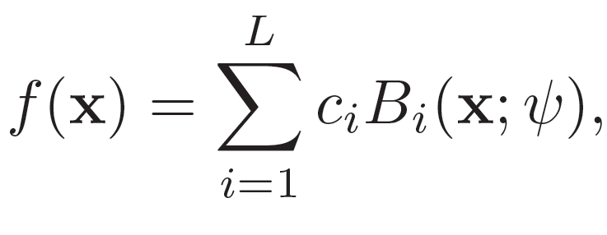
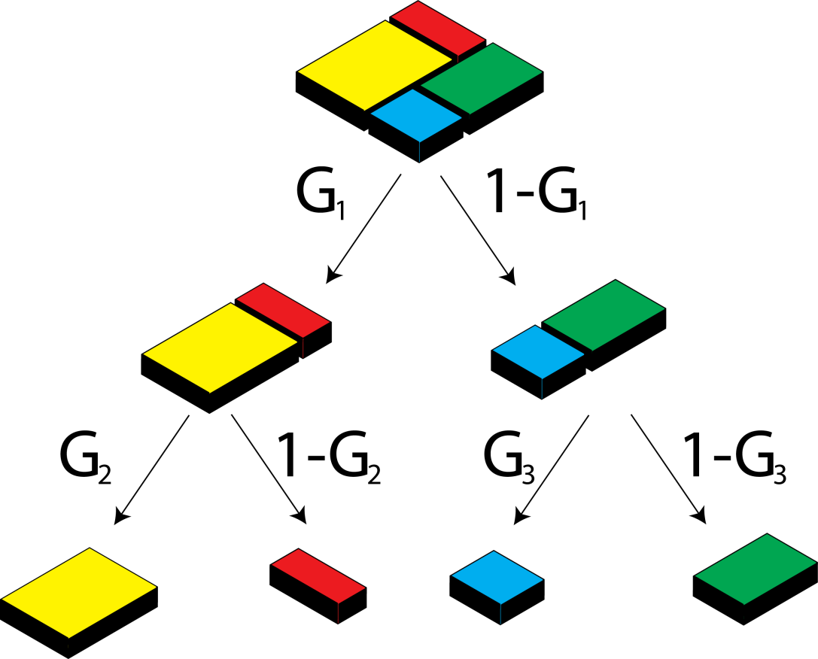
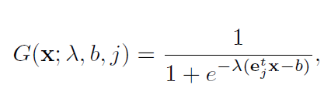
Background (Smooth transition regression trees – STR-Trees)
for example ...

Slide 7
Smooth transition BSP approximation (problem description)

Slide 8
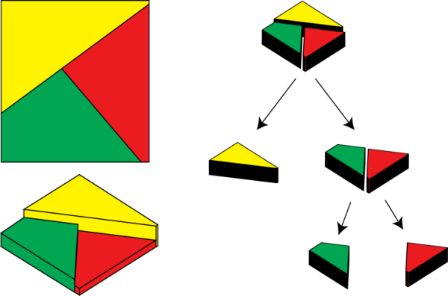
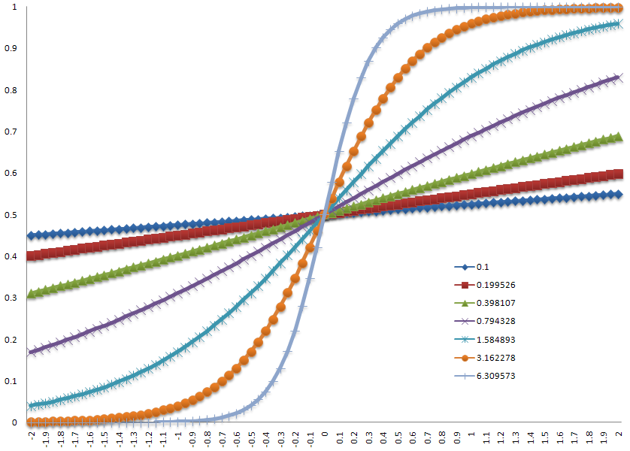
Contributions
Simple and fast approximation scheme
Hierarchical plane-basis
function modeling
Infinitely smooth and
analytical derivation

Slide 9
Smooth transition BSP approximation (Transition function)

Slide 10
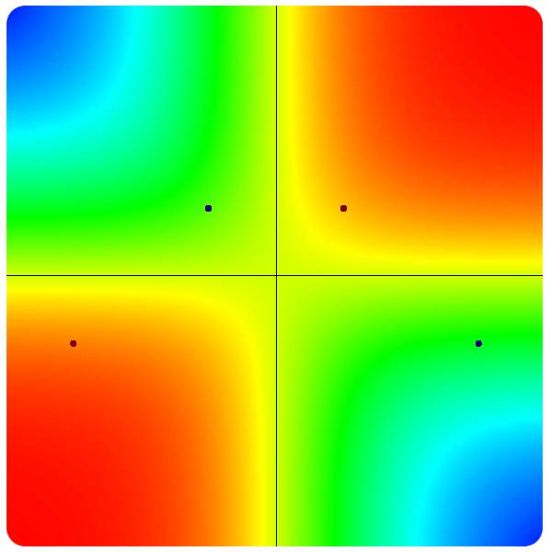
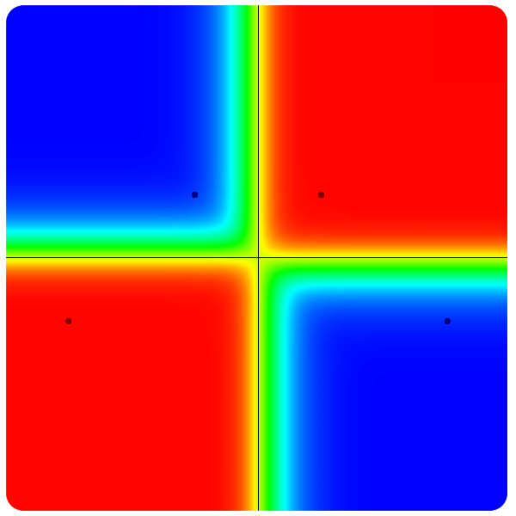
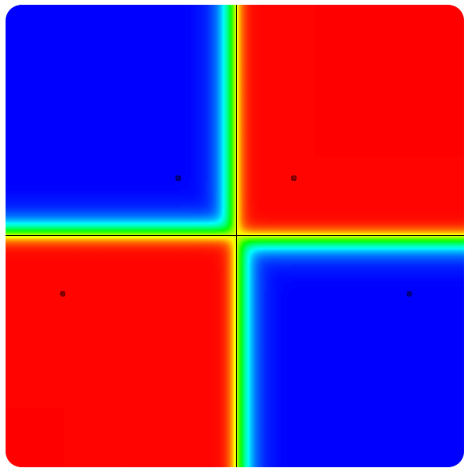
Smooth transition BSP approximation (Transition parameter)
Lambda = 5
Lambda = 10
Lambda = 25
Lambda = 50

Slide 11
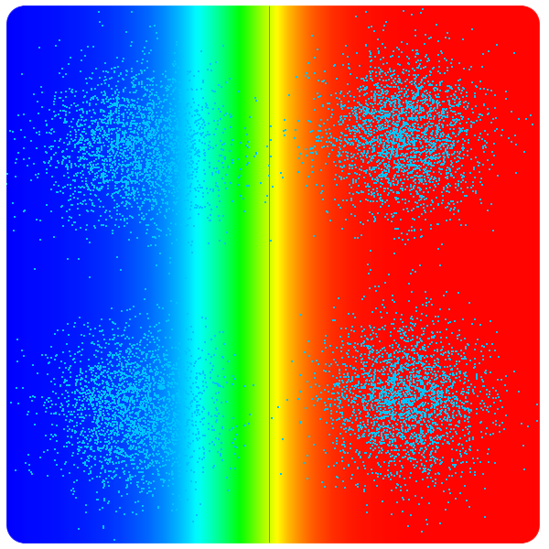
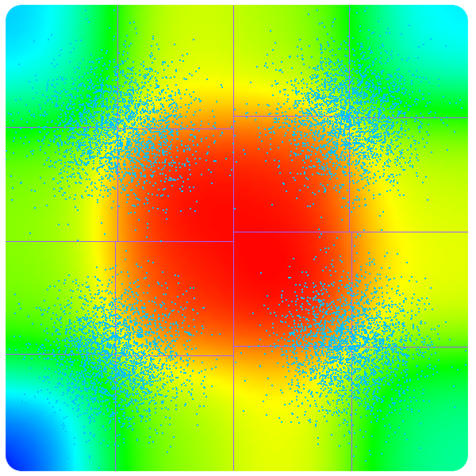
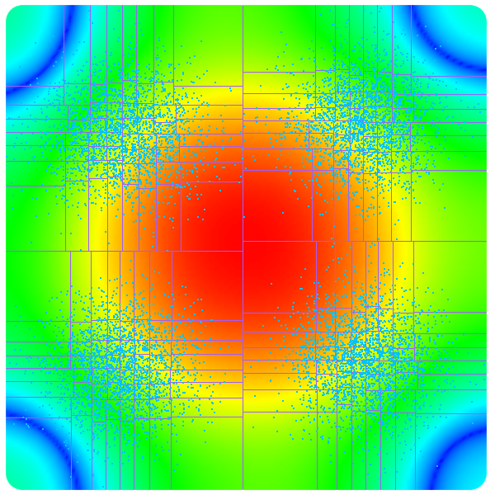
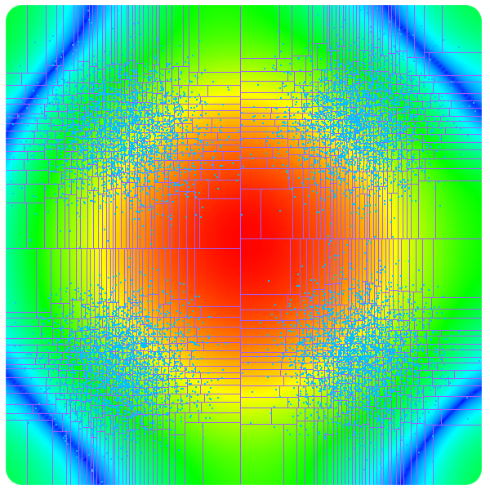
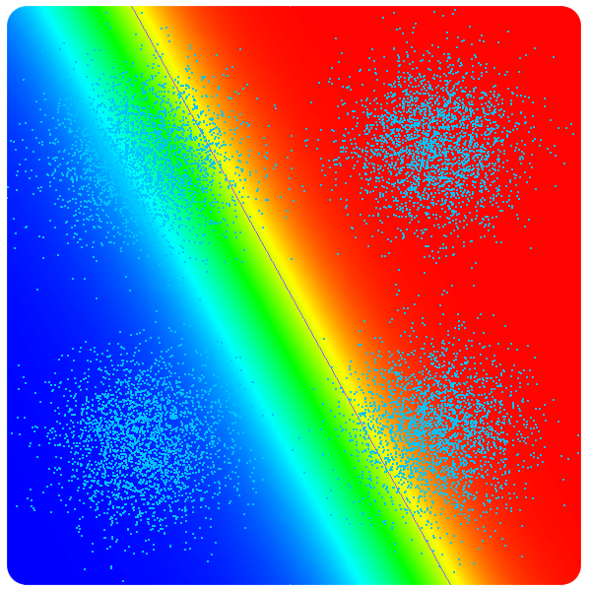
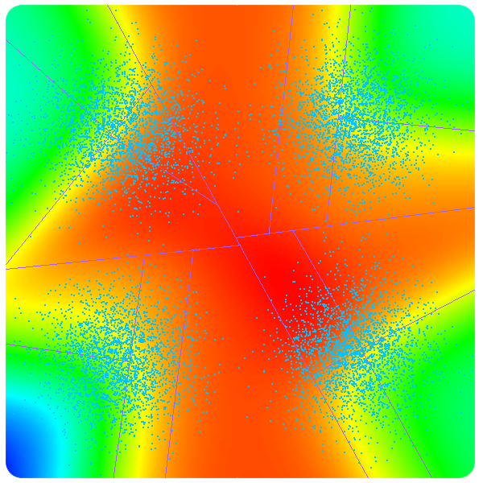
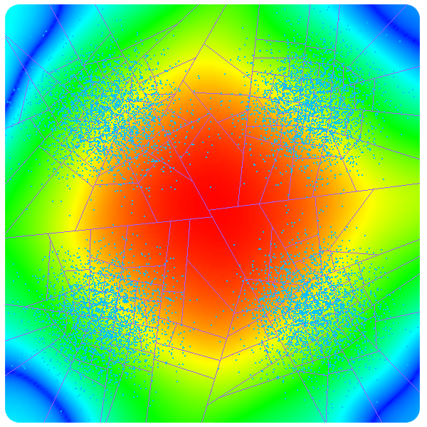
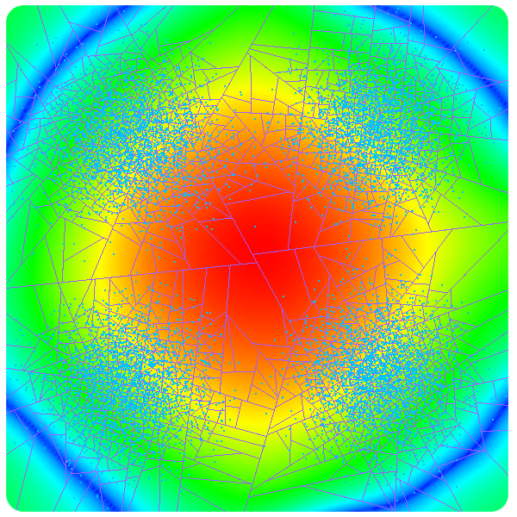
BSP refinement criteria (kd-tree versus bsp)

Slide 12
KD-tree versus BSP

Slide 13
Results and applications

Slide 14
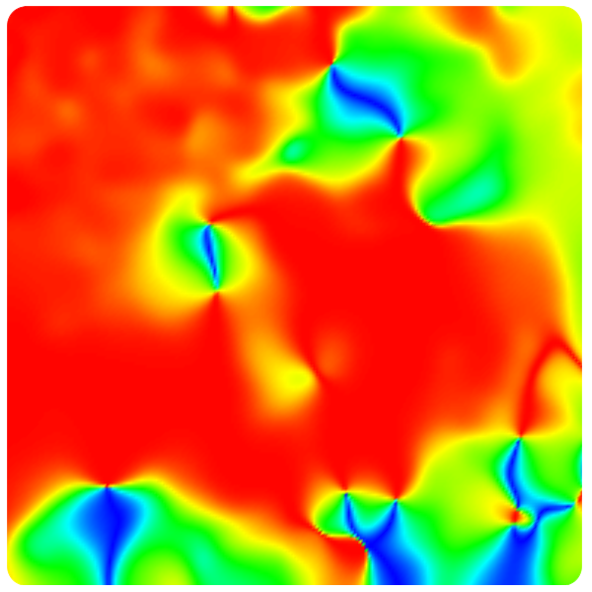
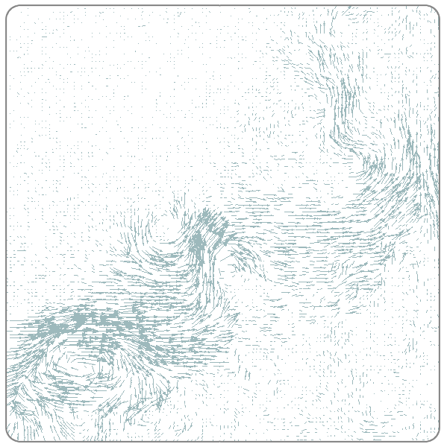
Results (vector-valued data)
Bsp level = 11
Lambda = 11

Slide 15
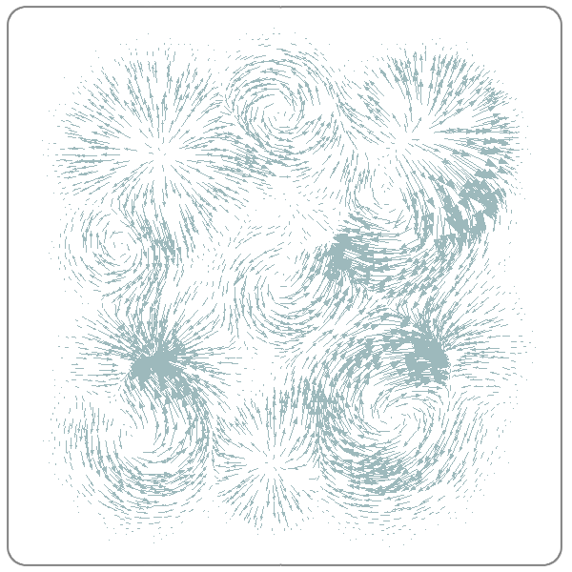
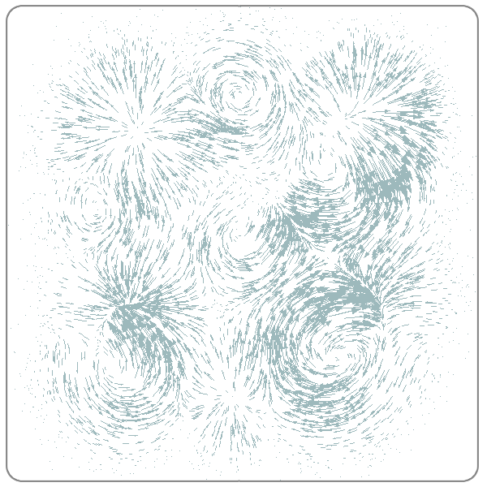
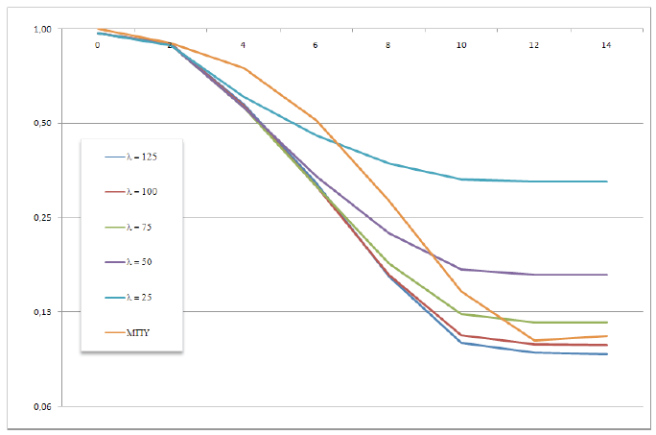
Results (analytic derivatives)
Bsp level = 11
Lambda = 5

Slide 16
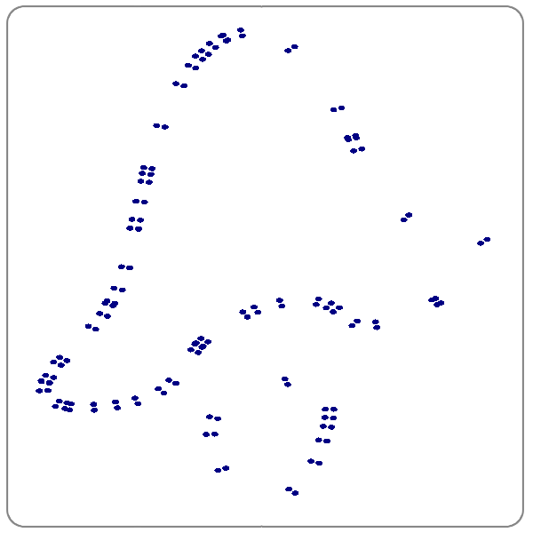
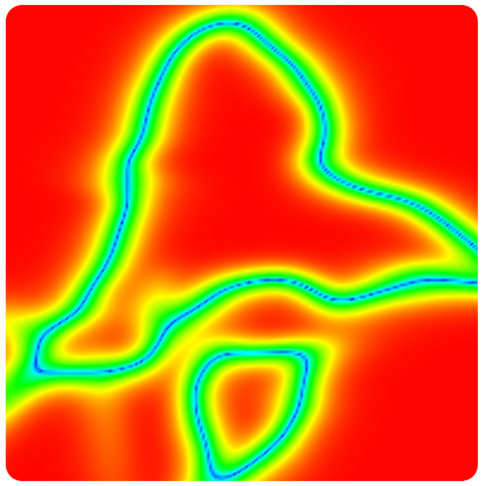
Results (scalar-valued data)
Bsp level = 11
Lambda = 10

Slide 17
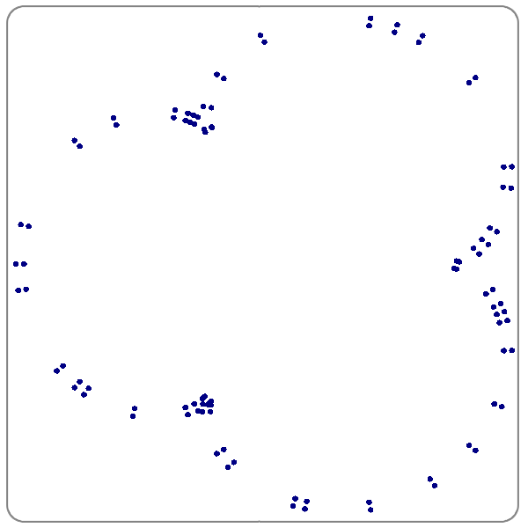
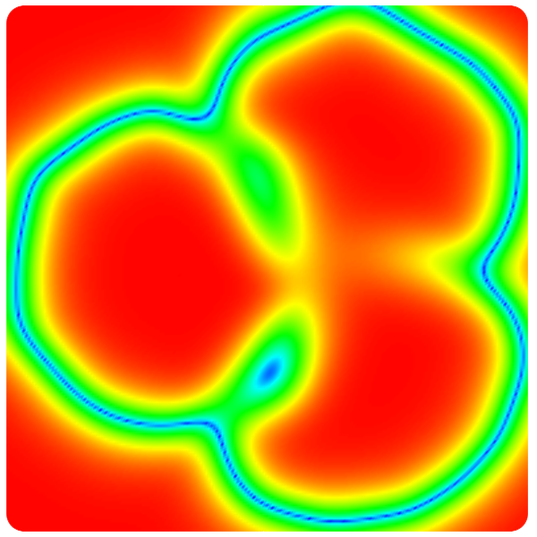
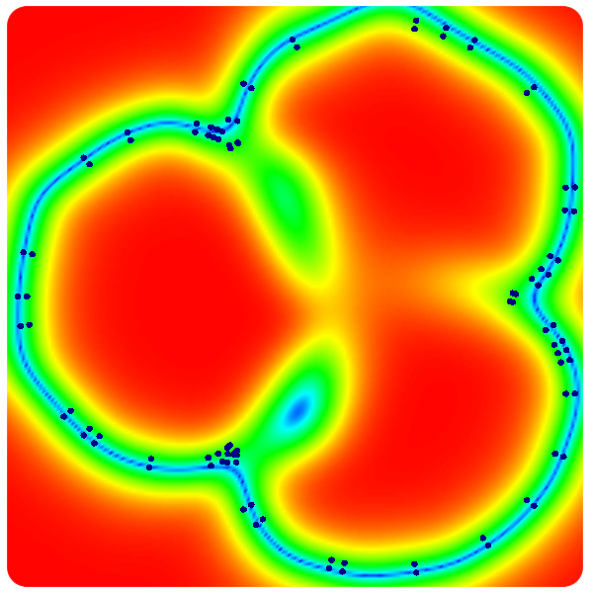
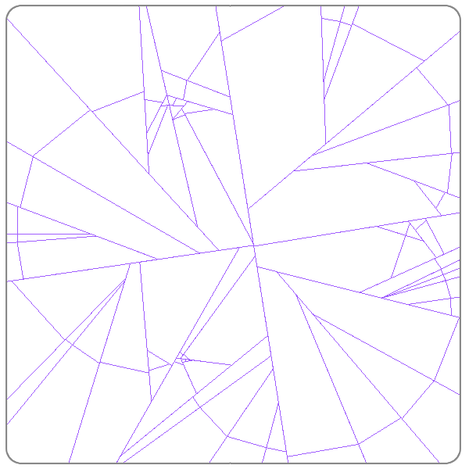
Results (curve reconstruction)
Bsp level = 11
Lambda = 2.85

Slide 18
Future works
Extension to higher dimensions
BSP refinement criterias
Adaptative transition parameter

Slide 19
Thanks !
www.matmidia.mat.puc-rio.br/~mlage mlage@mat.puc-rio.br

